Slide 1
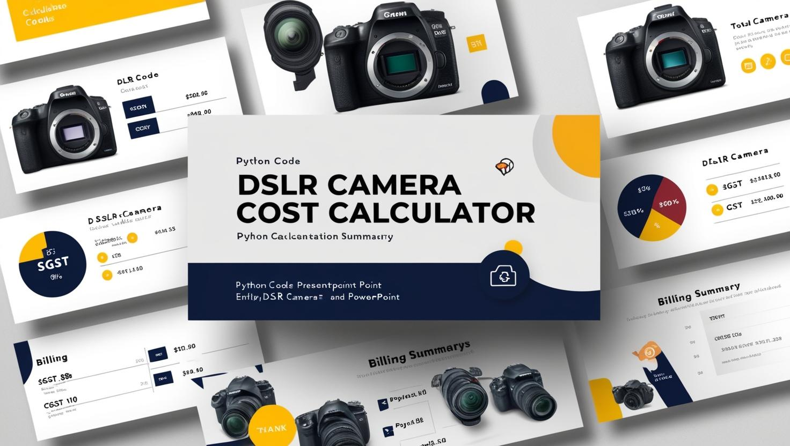
DSLR Camera Cost and Discount Calculation

Slide 2
TABLE OF CONTENTS:
1. Introduction to DSLR Camera Billing Code
2. Input and Discount Logic
3. Calculations of Cost Components
4. Final Total Payable Amount
Output and Billing Summary Display
Sample Output
7. Summary and Practical Applications

Slide 3

1. Introduction to DSLR Camera Billing Code :
Fixed Camera Cost and Tax Rates: Camera cost is set at 30,000 INR with SGST and CGST each fixed at 14%, ensuring consistent tax calculation.
User Input for Quantity: The code prompts users to enter the desired number of DSLR cameras, enabling dynamic cost computation based on quantity.
Output Structure: Billing summary clearly displays camera cost, individual tax components, applied discount, and final payable amount.

Slide 4
2. Input and Discount Logic :
User Quantity Input Mechanics: The user inputs the number of DSLR cameras required via a prompt, enabling dynamic quantity-based processing.
Tiered Discount Structure: Discounts utilize if-elif conditions mapping quantities to float percentages: 2-5 at 5%, 6-10 at 10%, 11-20 at 18%, 21-40 at 24%, 41+ at 33%, else 2% for one item.
Float Percentages Importance: Employing float discount rates enhances precision in discount calculations, ensuring accurate financial computation in variable quantity scenarios.

Slide 5
3. Calculations of Cost Components :
Total Camera Cost Computation: Multiply camera quantity by 30,000 INR to derive gross product cost before taxes or discounts.
Tax Calculations as Independent Entities: Calculate SGST and CGST each as 14% of total cost, isolating tax components for transparent accounting.
Discount Calculation and Billing Clarity: Determine discount as total cost times discount rate, clarifying deduction separate from tax computations.

Slide 6

4. Final Total Payable Amount :
Tax Computation on Gross Amount: Calculate SGST and CGST each as 14% on gross total cost before discount application, ensuring tax base consistency.
Discount Subtracted Post-Tax: Subtract discount from the sum of gross cost plus taxes to reflect final payable amount accurately after reductions.
Billing Summary Intermediate Values: Display total cost, individual taxes, discount, and final amount clearly to enhance transparency and verification.

Slide 7
5. Output and Billing Summary Display :
Formatted Output Labels: Labels such as Total Cost, SGST, CGST, Discount, and Final Amount aid user understanding clearly.
Clear User-Friendly Presentation: Formatted values with currency symbols and two decimals enhance readability and ensure billing transparency.
Thank You Message Importance: Including a polite thank you note at output fosters positive customer experience and professional communication.

Slide 8
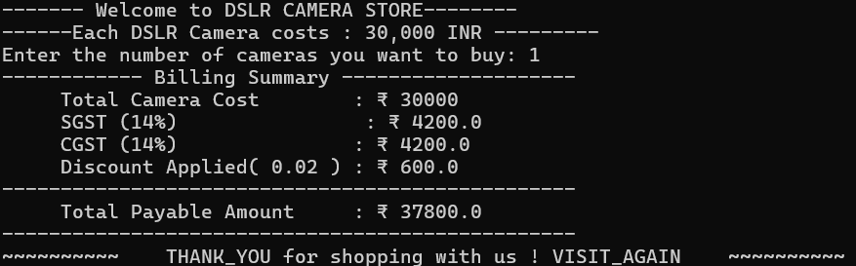
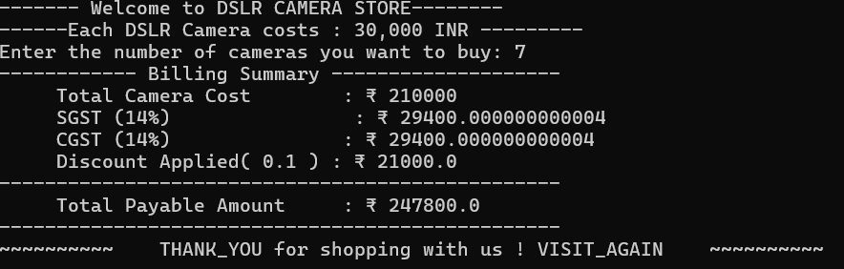
6. SAMPLE OUtPUt :

Slide 9
7. Summary and Practical Applications :
Comprehensive Billing Workflow: Workflow integrates quantity input, tiered discounts, dual tax applications, cumulative total, and detailed output display.
Retail Utility and Scalability: Applicable in retail environments requiring automated tiered discounting and tax computations for bulk electronics sales.
Enhancements for Robustness: Input validation ensures data integrity; GUI development improves user interaction and broadens accessibility.

Slide 10
THANK YOU

