Slide 1
EXECUTIVE SUMMARY
Faster credit decisions and earlier risk signals, with humans in control
34 → 13 d
origination-to-disbursement lead time
6% → 14%
process cycle efficiency
27.5 → 6.8 h
manual NVA touch per file
66 → 131
files / month at same FTEs
0
autonomous credit decisions
• Problem: 34.5-day lead time, only 6% of which is value-adding work; appraisal capacity (66 files/mo) is below demand (120), so backlog grows.
• Approach: Lean value stream map → Automation Priority Index → 7 agents placed where waste and bottlenecks are, not everywhere.
• Prototype (working): application → document ingestion → extraction with evidence → missing-info → RAG-cited policy checks → risk observations → recommendation → human approval → hash-chained decision summary.
• Control by design: agents recommend, humans decide; authority matrix enforced in code; deterministic financial maths; prompt-injection and PII guards.
• Ask: 8-week POC in one segment (SME/mid-corporate), shadow mode on live files, MRM-ready evidence pack.
Agentic Loan Lifecycle Management · FDE client challenge · synthetic data, mocked step times | 1
Notes:
All figures use mocked step times (stated) and synthetic data. KPIs are computed by shared/vsm.py.

Slide 2
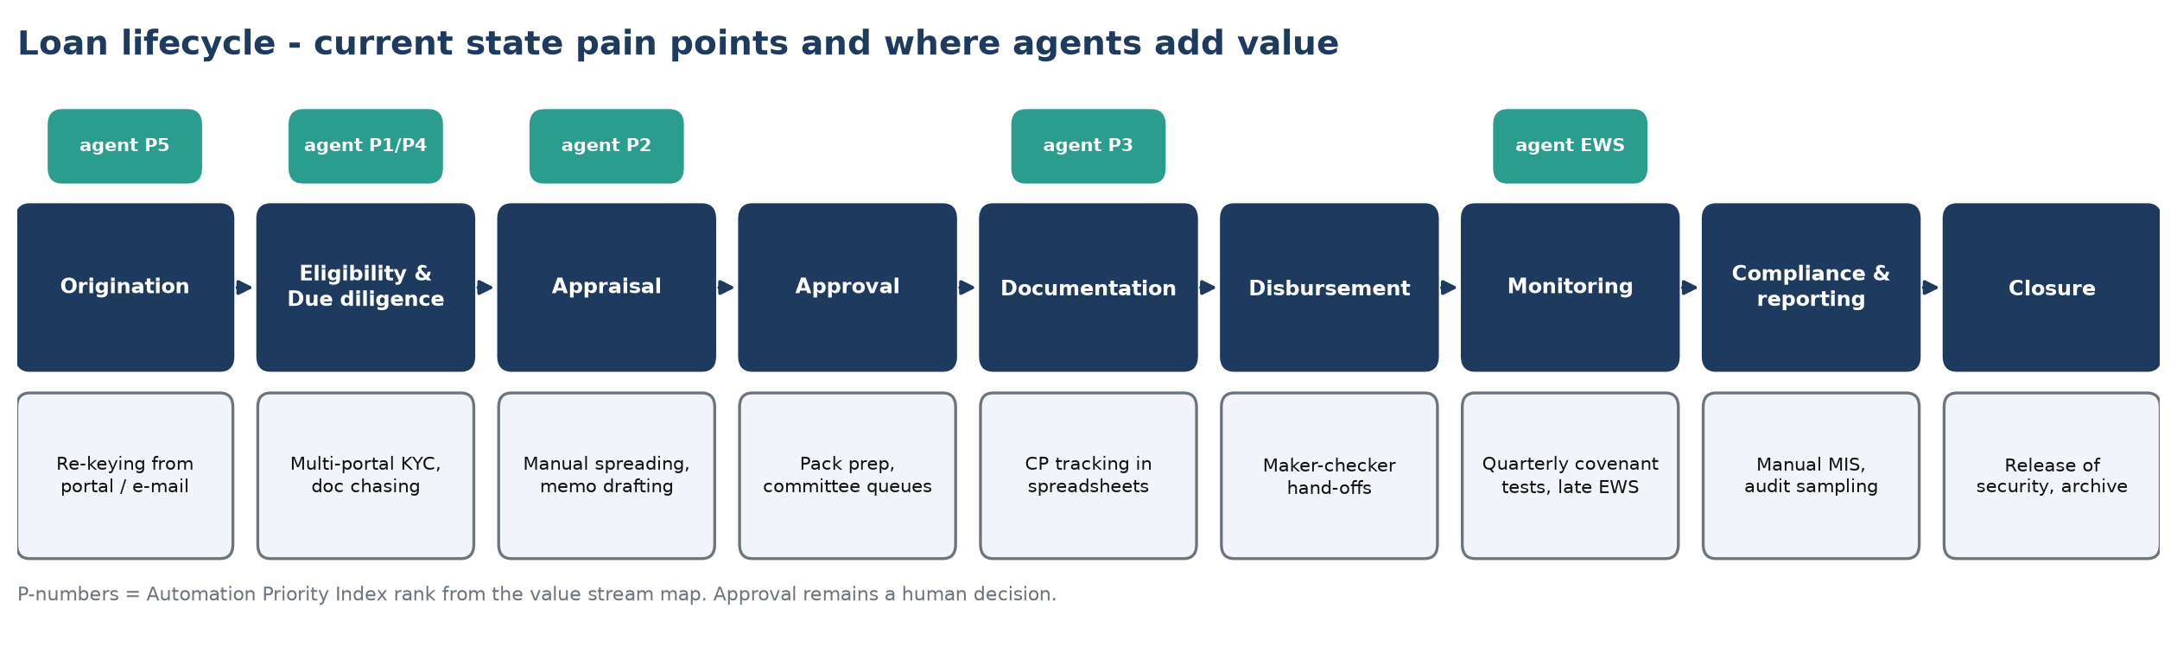
PROBLEM
Credit teams spend most of the lifecycle waiting, chasing and re-keying
Manual effort
Docs arrive by e-mail; data re-keyed into LOS and
spreadsheets; memos written from scratch.
Late risk visibility
Policy checks on checklists; covenant breaches
found at quarterly test; adverse media ad hoc.
Weak auditability
Rationale spread across e-mail and memos;
hard to evidence who decided what, on which data.
Agentic Loan Lifecycle Management · FDE client challenge · synthetic data, mocked step times | 2

Slide 3
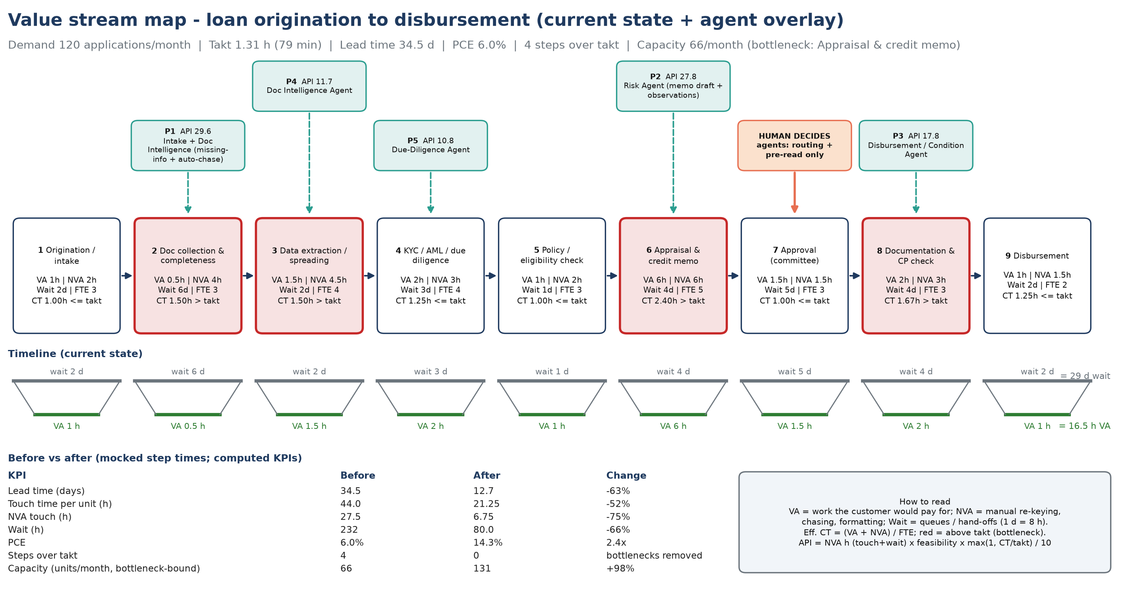
CURRENT PROCESS · LEAN VSM
Current process: value stream map shows 94% of elapsed time adds no value
Agentic Loan Lifecycle Management · FDE client challenge · synthetic data, mocked step times | 3
Notes:
Takt = 157.5 h / 120 applications = 1.31 h. PCE = VA / lead time. Step times mocked - validate in POC week 1 via time-and-motion + LOS timestamps.

Slide 4
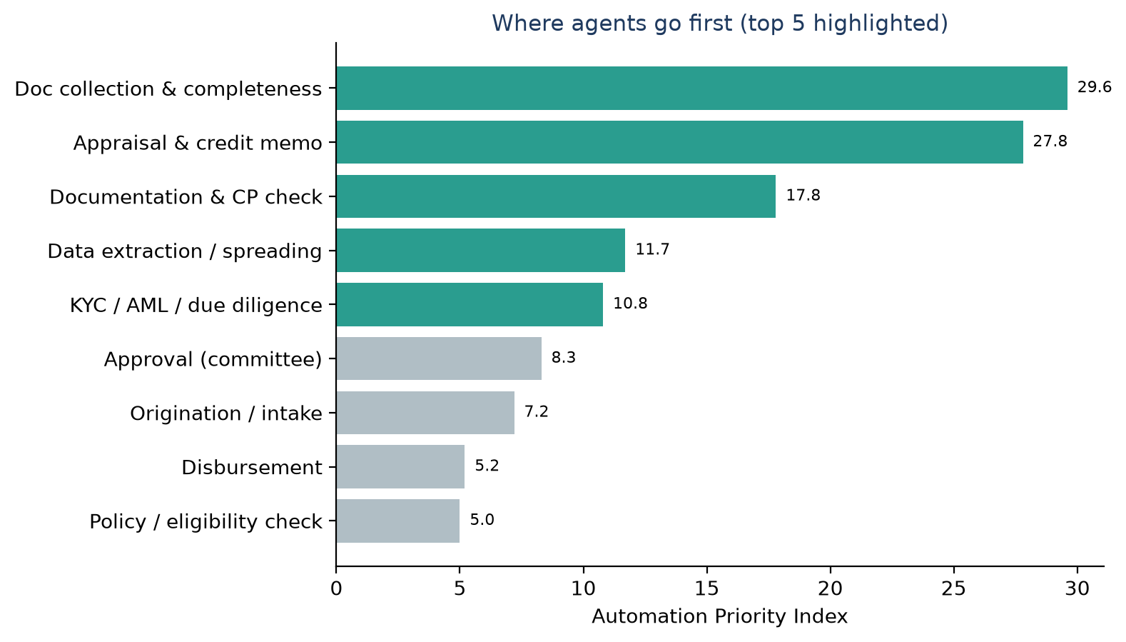
OPPORTUNITY · AUTOMATION PRIORITY INDEX
Opportunity: five areas where agents remove the most waste
# | Value area (VSM step) | Agent | API
1 | Doc collection & completeness | Intake + Doc Intelligence (missing-info + auto-chase) | 29.6
2 | Appraisal & credit memo | Risk Agent (memo draft + observations) | 27.8
3 | Documentation & CP check | Disbursement / Condition Agent | 17.8
4 | Data extraction / spreading | Doc Intelligence Agent | 11.7
5 | KYC / AML / due diligence | Due-Diligence Agent | 10.8
• Priority = waste hours × feasibility × bottleneck factor, so effort goes where it moves lead time and capacity.
• Approval ranks low on purpose: the decision stays human; agents only route and prepare the pack.
• Plus portfolio early-warning: continuous covenant/EWS monitoring instead of quarterly tests.
Agentic Loan Lifecycle Management · FDE client challenge · synthetic data, mocked step times | 4

Slide 5
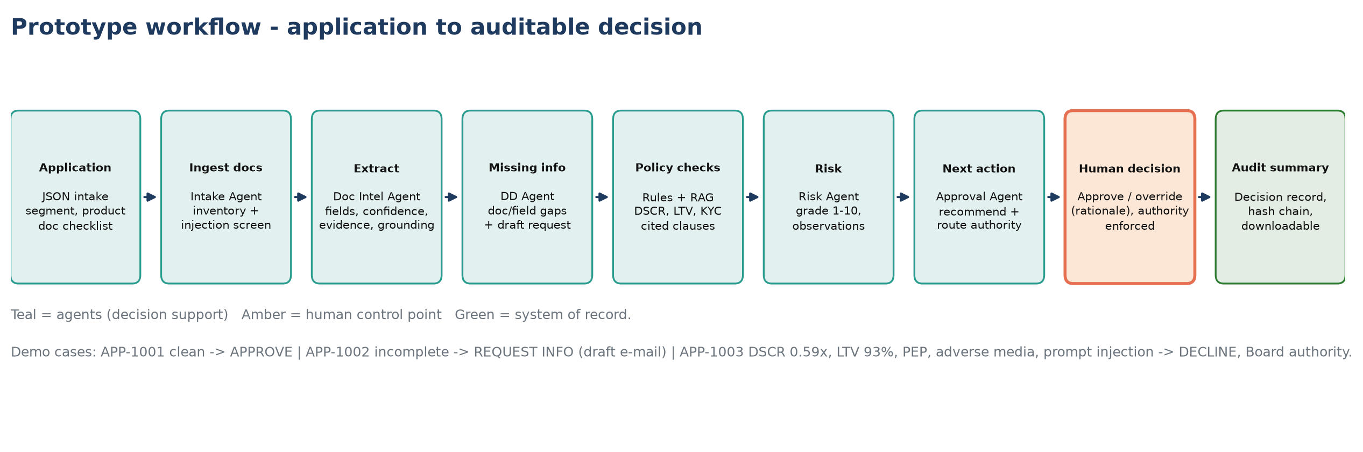
PROPOSED AI / AGENT SOLUTION
Agent ecosystem: seven specialist agents, one orchestrator, one human gate
Agent | Does | Never does
Intake | Normalises application, doc inventory, injection screen | Accept unscreened docs into prompts
Document Intelligence | Extracts fields with confidence + evidence; grounding check | Invent values not in source
Due-Diligence | Missing info + draft request; ratios; RAG-cited policy checks | Compute ratios with the LLM
Risk | Transparent scorecard grade, observations, mitigants | Use protected attributes
Approval / Workflow | Recommends next action, routes by authority, drafts memo | Approve or decline
Disbursement / CP | Tracks conditions precedent; blocks release until evidenced | Release funds
Portfolio Monitoring | Quarterly covenant + EWS scan, Red/Amber notes | Change limits or ratings
Agentic Loan Lifecycle Management · FDE client challenge · synthetic data, mocked step times | 5

Slide 6
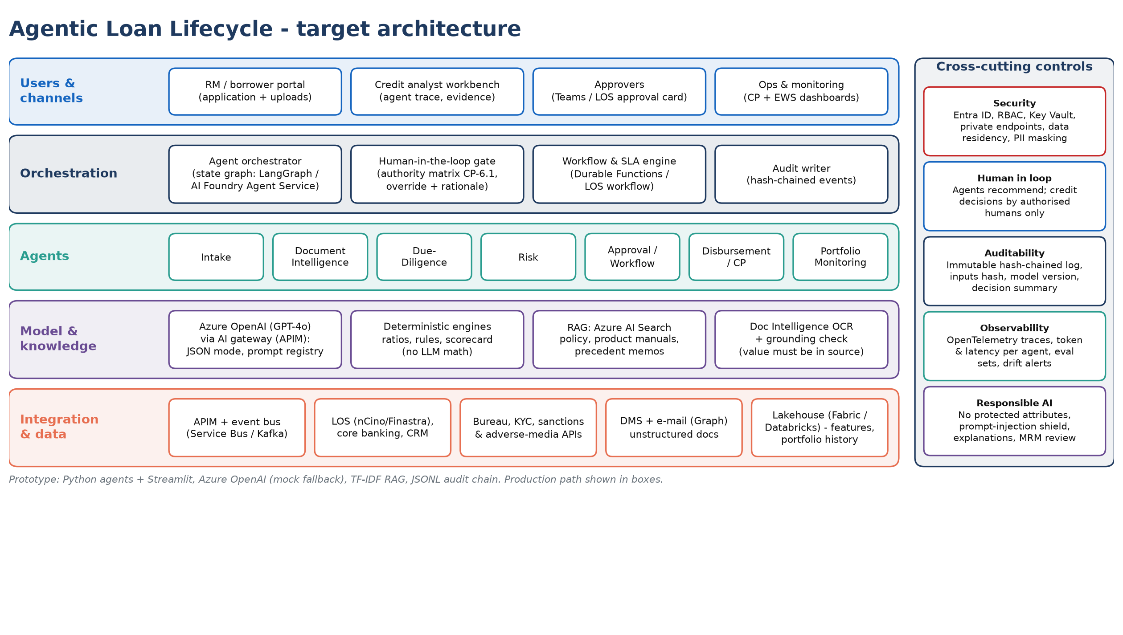
ARCHITECTURE
Architecture: enterprise-ready, model-agnostic, auditable
Agentic Loan Lifecycle Management · FDE client challenge · synthetic data, mocked step times | 6

Slide 7
WORKING PROTOTYPE · STREAMLIT RUN A1_LOAN_LIFECYCLE/APP.PY
Demo: three applications, three different outcomes
Case | Facility | Key agent findings | Recommendation | Routed to
APP-1001 Greenfield Logistics Pvt Ltd | $4.0M term loan | All checks pass | APPROVE | Senior Credit Officer
APP-1002 Sunrise Agro Foods Ltd | $1.5M working capital | CP-3.3 Audited financials Unaudited (audit in progress) | missing: Bank Statement, Stock Statement, Signed beneficial owner declaration | REQUEST INFO | Credit Manager
APP-1003 Meridian Infra Projects SPV Ltd | $28.0M project finance | CP-4.1 Pro-forma DSCR 0.59x; CP-4.2 Pro-forma Debt/EBITDA 10.24x; CP-4.3 Loan-to-Value 93% | warnings: CP-2.2, CP-2.3, CP-3.1, CP-3.3, CP-4.4, CP-5.1, CP-5.2 | prompt-injection text quarantined | DECLINE | Board Credit Committee
• Tabs: ⓪ value stream · ① origination → decision (agent trace, evidence, cited policy, memo, human gate) · ② disbursement CPs · ③ portfolio EWS · ④ audit chain + LLM telemetry.
• Controls you can try: approving above your authority is blocked; overriding the agent without rationale is blocked; every step lands in a hash-chained audit log.
• LLM: Azure OpenAI when credentials are set (.env), deterministic mock otherwise, so the demo always runs; PII masked before any model call.
Agentic Loan Lifecycle Management · FDE client challenge · synthetic data, mocked step times | 7

Slide 8
BUSINESS IMPACT
Business impact: before vs after (assumptions stated)
KPI | Before | After | Change
Lead time (days) | 34.5 | 12.7 | -63%
Touch time per unit (h) | 44.0 | 21.25 | -52%
NVA touch (h) | 27.5 | 6.75 | -75%
Wait (h) | 232 | 80.0 | -66%
PCE | 6.0% | 14.3% | 2.4x
Steps over takt | 4 | 0 | bottlenecks removed
Capacity (units/month, bottleneck-bound) | 66 | 131 | +98%
KPI | Before | After | Basis
Document review effort / file | 8.5 h | 1.0 h | VSM steps 2-3 NVA
Exception identification | sample-based | 100% of files | every policy check runs on every file
SLA adherence (21-day SLA) | ~30% | ~90% | assumed lead-time distribution
Analyst productivity | 1.0x | ~2.0x | touch time 44 → 21 h
Early warning lead | at quarterly test | +1 quarter | continuous EWS scan
• Value (illustrative): 1,440 files/yr × 22.75 h saved × $60/h loaded ≈ $2.0M/yr capacity; plus earlier interest accrual from a 22-day faster lead time.
• Assumptions: 120 applications/month, 21 days × 7.5 h, step times mocked (to be baselined in POC week 1); synthetic borrower data; 1 day = 8 h wait.
Agentic Loan Lifecycle Management · FDE client challenge · synthetic data, mocked step times | 8

Slide 9
POC APPROACH
POC: 8 weeks to prove value in shadow mode
Weeks | Milestone | Exit criteria
0-1 | Mobilise, data access, security review, VSM baseline (time-and-motion + LOS timestamps) | Baseline KPIs signed off
2-3 | Doc extraction + policy RAG on 200 historical files; evaluation harness | ≥95% field accuracy, ≥90% missing-info recall
4-5 | Agents + orchestrator in LOS sandbox; analyst workbench; HITL + audit | End-to-end on 50 files
6-7 | Shadow mode on live SME/mid-corp files alongside analysts | ≥95% policy-check agreement, −40% touch time
8 | Readout: KPI evidence, MRM/RAI pack, production plan | Go / no-go for MVP
Team
FDE lead · 2 AI engineers · data engineer · UX (0.5)
Client: product owner, credit SME, risk/compliance,
LOS integration engineer
Data required
200-500 historical files with decisions, credit policy,
LOS extracts, KYC/sanctions samples, covenant data
KPIs
Field accuracy · missing-info recall · policy agreement ·
touch time · lead time · override rate · zero autonomous decisions
Risks & mitigations
Data access delays → masked extracts / synthetic
Hallucination → grounding check + deterministic maths
MRM approval → early engagement, eval evidence
Adoption → analyst co-design, override with reason
Agentic Loan Lifecycle Management · FDE client challenge · synthetic data, mocked step times | 9

Slide 10
PRODUCTION ROADMAP
Production roadmap: from one segment to an enterprise agent platform
POC · wks 1-8
Shadow mode, SME/mid-corp
Evidence pack for MRM
Business case
MVP · months 3-6
Live in 1 segment, LOS integrated
Teams approval cards
SLA + override monitoring
Scale · months 6-12
Corporate & project finance
Disbursement CP + portfolio EWS live
Azure AI Search over memo history
Platform · 12-18 months
Reusable agent platform (gateway,
eval, audit, guardrails) for trade,
retail credit, collections
• Production hardening: Entra ID + RBAC, private endpoints, Key Vault, data residency; APIM AI gateway with quotas and content safety; OpenTelemetry tracing.
• Model risk management: model inventory, eval sets per agent, drift monitoring, challenger prompts, annual validation; documented human override.
• Next steps: confirm POC segment and sponsor · grant data access · nominate credit SME · schedule week-0 VSM workshop.
Assumptions & synthetic data
All borrowers, documents, policy (CP-x clauses), portfolio and step times are synthetic / mocked. Demand 120 apps/month; 21 days × 7.5 h; 1 wait-day = 8 h; $60/h loaded analyst cost. LLM runs in deterministic mock mode unless Azure OpenAI credentials are set. Ratios, rules and grades are deterministic code.
Agentic Loan Lifecycle Management · FDE client challenge · synthetic data, mocked step times | 10

