Slide 1
EXECUTIVE SUMMARY
From forecasts to actions: demand sensing with an agentic response loop
28 → 4 d
signal-to-action lead time
13.5% → 8.5%
4-wk WMAPE (synthetic backtest)
3.7% → 21%
process cycle efficiency
7
use cases mapped & prioritised
100%
ERP actions human-approved
• Problem: deviations from plan are found at the monthly S&OP, 3-4 weeks late; planners spend 70% of their time collecting and reconciling data.
• Opportunity map: 7 use cases scored on value × feasibility; demand sensing + agentic response leads wave 1 and is the data foundation for inventory optimisation and stockout prediction.
• Prototype (working): orders + inventory + capacity + PMI/Brent/construction → sensing model → Deviation → Impact → Constraint → Recommender agents → planner approval → SAP STO / planned order / IBP update (mocked).
• Ask: 8-week POC on one product family across two regions with real SAP/IBP extracts, run in shadow mode next to the S&OP process.
AI for Demand & Distribution · FDE client challenge · synthetic data, stated assumptions | 1
Notes:
TALK TRACK (30 sec) - Name the problem, not the technology.
"Demand changes faster than our planning cycle. We plan monthly; by the time we see a deviation it is ~4 weeks old. That gives us stockouts in one region, excess in another, and planners firefighting instead of planning. We looked at where AI and agents close that gap - and we recommend one place to start."
Preview the ask (last bullet): an 8-week POC in shadow mode.

Slide 2
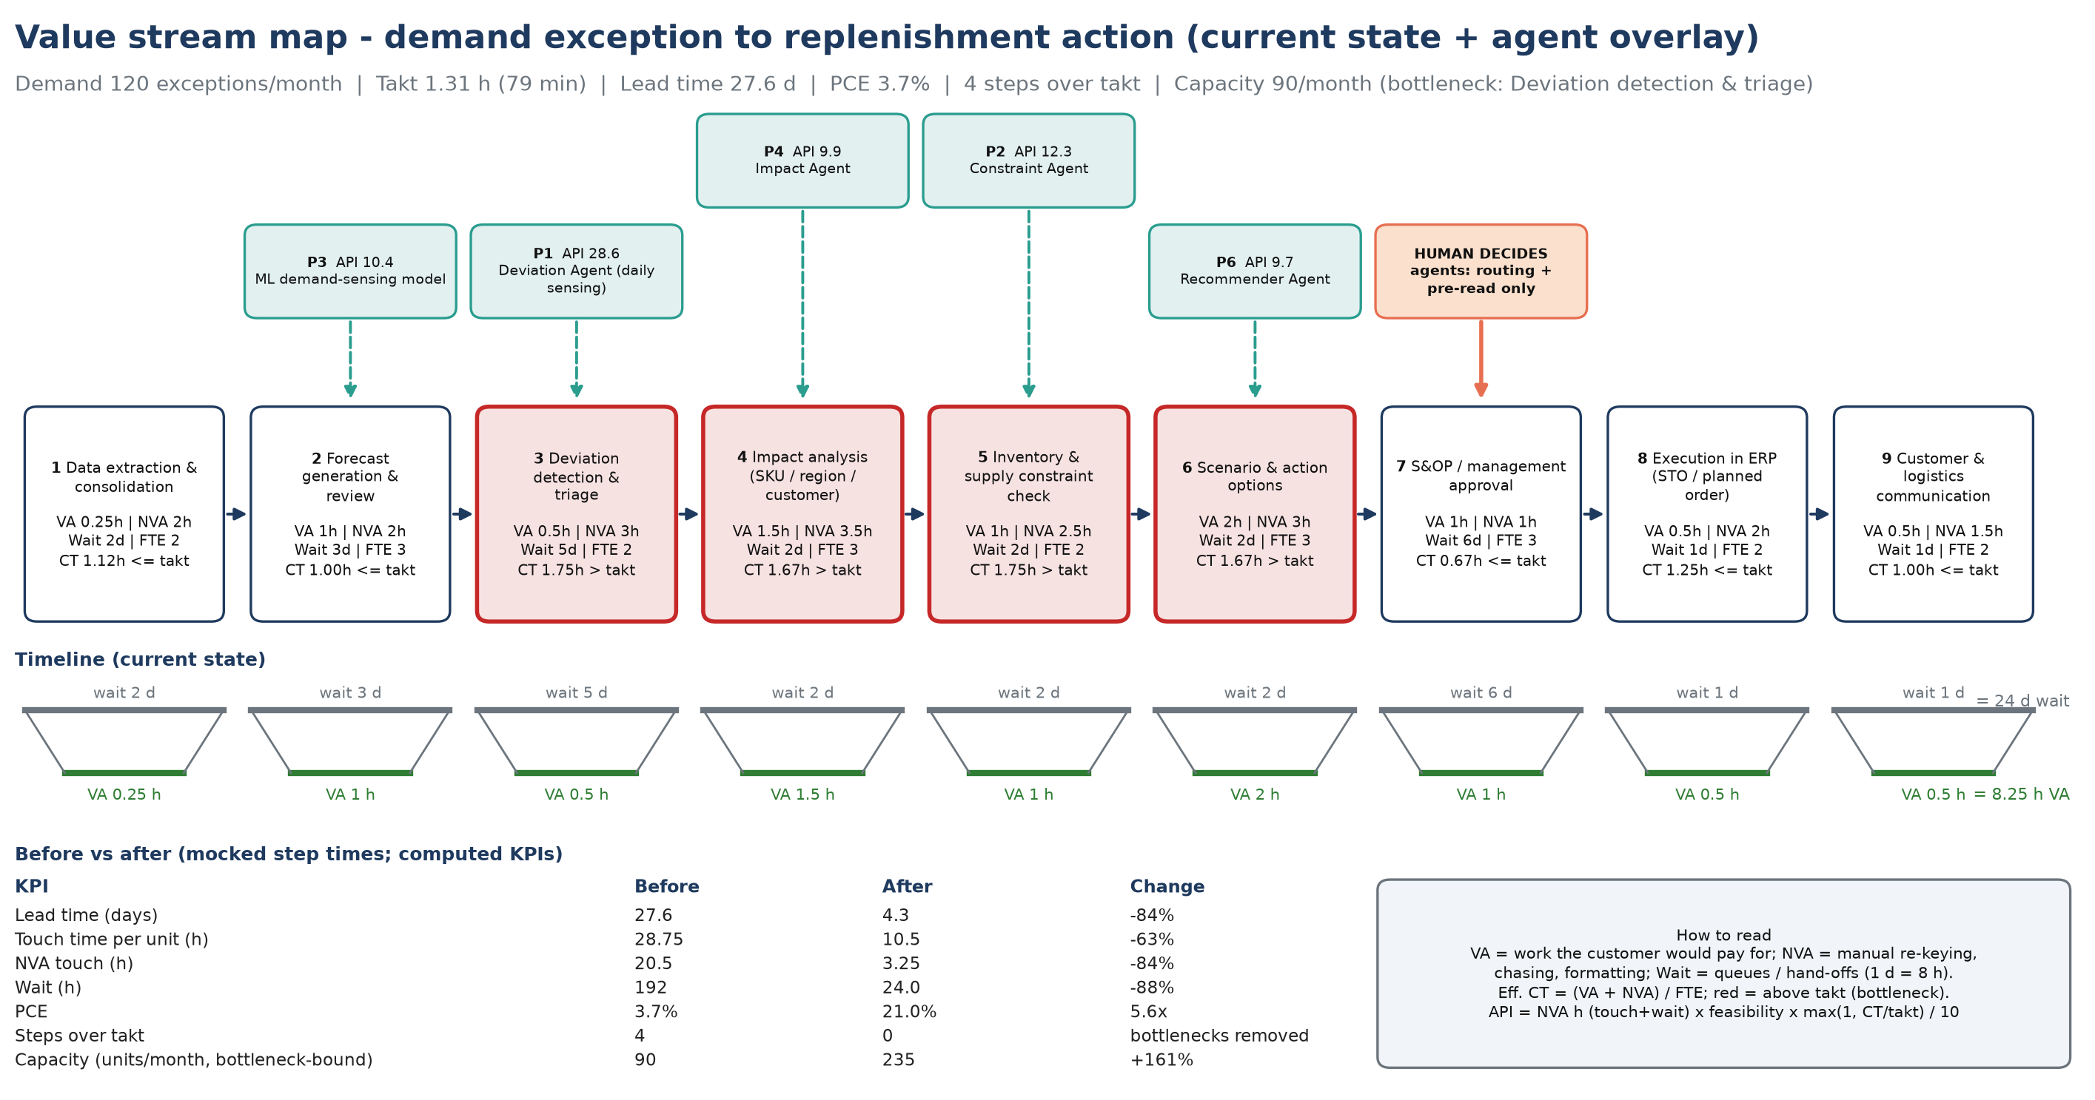
PROBLEM & CURRENT PROCESS · LEAN VSM
Current process: deviations wait for the monthly S&OP (PCE 3.7%)
AI for Demand & Distribution · FDE client challenge · synthetic data, stated assumptions | 2
Notes:
TALK TRACK (1 min) - Show the discipline before the answer.
"We mapped the process before choosing any AI. Signal-to-action takes 27.6 days and only 3.7% of that adds value - the rest is waiting, re-keying and email. 4 steps run slower than demand requires (takt 1.31 h); the bottleneck is deviation detection & triage."
Lead with these two numbers - they matter more to a CIO than any model detail. Step times are mocked; validated in POC week 1.

Slide 3
OPPORTUNITY MAP
Use-case opportunity map: 7 opportunities, each tied to a KPI and an owner
Use case | Business problem | AI / agent approach | Data required | Action → human involvement | KPI · expected benefit (assumption)
UC1 Demand sensing + agentic response (wave 1) | Monthly statistical forecast misses short-term shifts; deviations found weeks late causing stockouts in one region and excess in another | Gradient-boosted demand-sensing model with external signals + agents that detect deviations and size impact and propose production/distribution actions | Order history, open orders, shipments, inventory, capacity, customer promos, PMI, oil/feedstock price, weather | Recommend stock transfer / production reschedule / allocation and create SAP STO or planned order after approval → Planner approves or edits every action; S&OP lead approves above value threshold | Forecast MAPE, detection-to-action lead time, OTIF, expedite cost · MAPE 35%->22%; detection lag 27d->4d; ~$12-18M/yr margin protected (assumption)
UC2 Stockout / excess inventory prediction (wave 1) | Planners discover stockouts and slow-moving stock only after the fact | Classification model on projected inventory (forecast vs supply) per SKU-location with 4-8 week horizon + alert agent | Inventory positions, forecast, open POs/production orders, lead times, shelf life | Ranked risk list with recommended rebalancing / promotion of aged stock → Planner validates top risks weekly | Stockout incidents, excess & obsolete value, inventory turns · Stockouts -30%; E&O -15% (~$6-9M/yr, assumption)
UC3 Inventory optimization (multi-echelon safety stock) (wave 2) | Safety stocks set by rule of thumb; high working capital yet service gaps | Probabilistic multi-echelon optimisation using forecast error distributions; agent proposes parameter changes | Demand history & forecast error, lead-time variability, service targets, network structure, costs | Updates safety stock / reorder points in SAP (MRP parameters) after approval → Supply chain manager approves parameter changes per family | Inventory days, fill rate, working capital · Inventory -10-15% (~$40-60M one-off WC release; assumption)
UC4 Shipment exception management (wave 2) | Late / at-risk shipments found via customer complaints; manual carrier chasing | Agent monitors TMS / carrier events + ETA prediction; drafts recovery options and customer notices | TMS events, carrier tracking, orders, customer priority, weather/port data | Rebooks carrier / reroutes / notifies customer with revised ETA → CSR approves customer communication and premium freight above threshold | OTIF, premium freight cost, exception handling time · OTIF +5 pts; premium freight -20% (~$4-6M/yr, assumption)
UC7 Invoice / AP automation (3-way match) (wave 2) | High manual effort matching supplier invoices to POs and GRs; late-payment penalties | Document intelligence + LLM agent for extraction, matching and exception reasoning | Invoices (PDF/EDI), POs, goods receipts, vendor master, contracts | Auto-posts matched invoices; routes exceptions with suggested resolution → AP clerk resolves exceptions; approver signs payment runs | Touchless rate, cost per invoice, cycle time · Touchless 30%->75%; ~$2-3M/yr (assumption)
UC5 Distribution / lane optimization (wave 3) | Static DC assignments and lane choices; rising freight cost per tonne | Optimisation (MILP) of source-DC-customer assignment and mode/lane mix with agent explaining trade-offs | Shipments, freight rates, DC capacity, customer locations, service levels, hazmat constraints | Proposes revised sourcing rules and lane plan for next quarter → Logistics head approves network changes | Freight cost per tonne, cost-to-serve, service level · Freight -5-8% on ~$400M spend (~$20-30M/yr, assumption)
UC6 Supply / feedstock disruption prediction (wave 3) | Feedstock and supplier disruptions hit production with little warning | Risk-scoring model on supplier performance + news/geo-risk signals; agent proposes alternate sourcing | Supplier OTIF, POs, news/geo-risk feeds, weather, commodity prices, BOMs | Early warning + alternate supplier / safety stock pre-build recommendation → Procurement category manager decides | Disruption-days avoided, production loss, expedite cost · ~$5-10M/yr avoided losses (assumption; data dependent)
AI for Demand & Distribution · FDE client challenge · synthetic data, stated assumptions | 3
Notes:
TALK TRACK (2 min) - Do not read the table; point at the structure, then summarise by wave.
"Every use case has the same seven-part card: business problem, AI/agent approach, data required, action taken, human involvement, KPI and expected benefit. We scored them on value x feasibility into three waves."
Wave 1 (now): UC1 demand sensing + agentic response, UC2 stockout/excess - highest value, data already in ERP.
Wave 2 (next): UC3 inventory optimisation, UC4 shipment exceptions, UC7 invoice/AP (stand-alone quick win).
Wave 3 (later): UC5 lane optimisation, UC6 supply disruption - big value, needs external data and network change.
"Together roughly $50-75M a year run-rate plus a $40-60M one-off working-capital release - planning assumptions the POC will confirm or correct."
If asked about data readiness: point at the 'Data required' column. Source: a2_chem_demand/data/opportunities.csv.

Slide 4
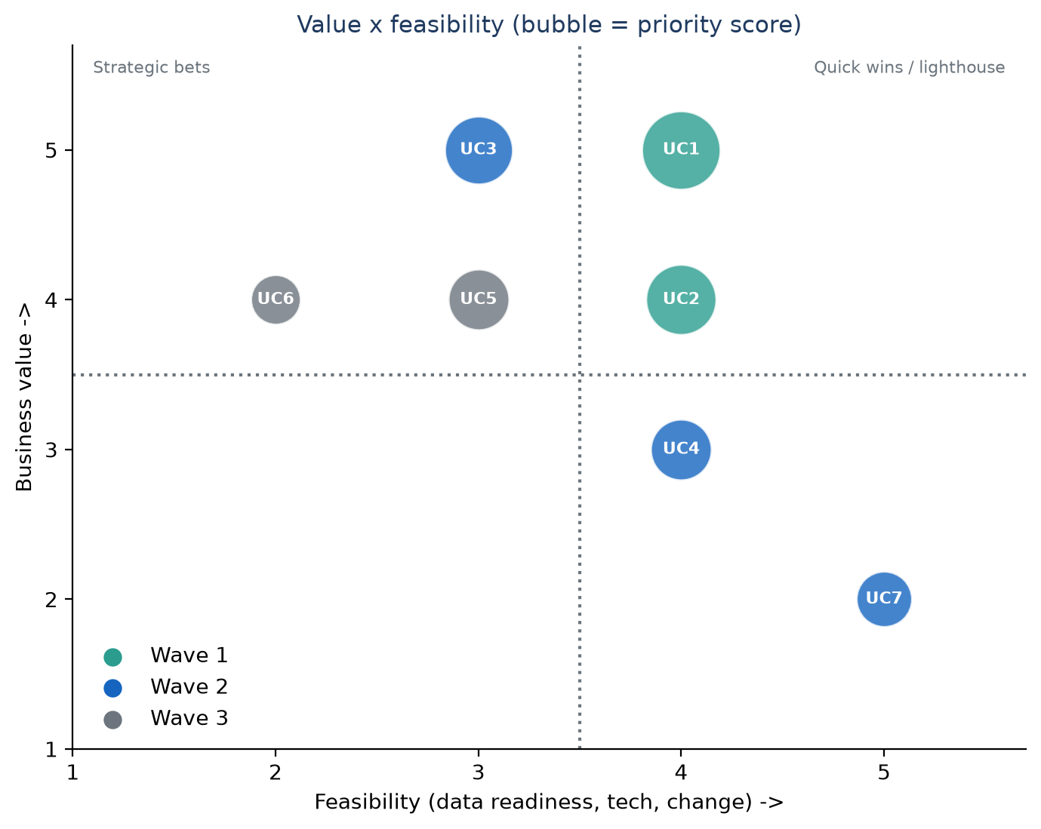
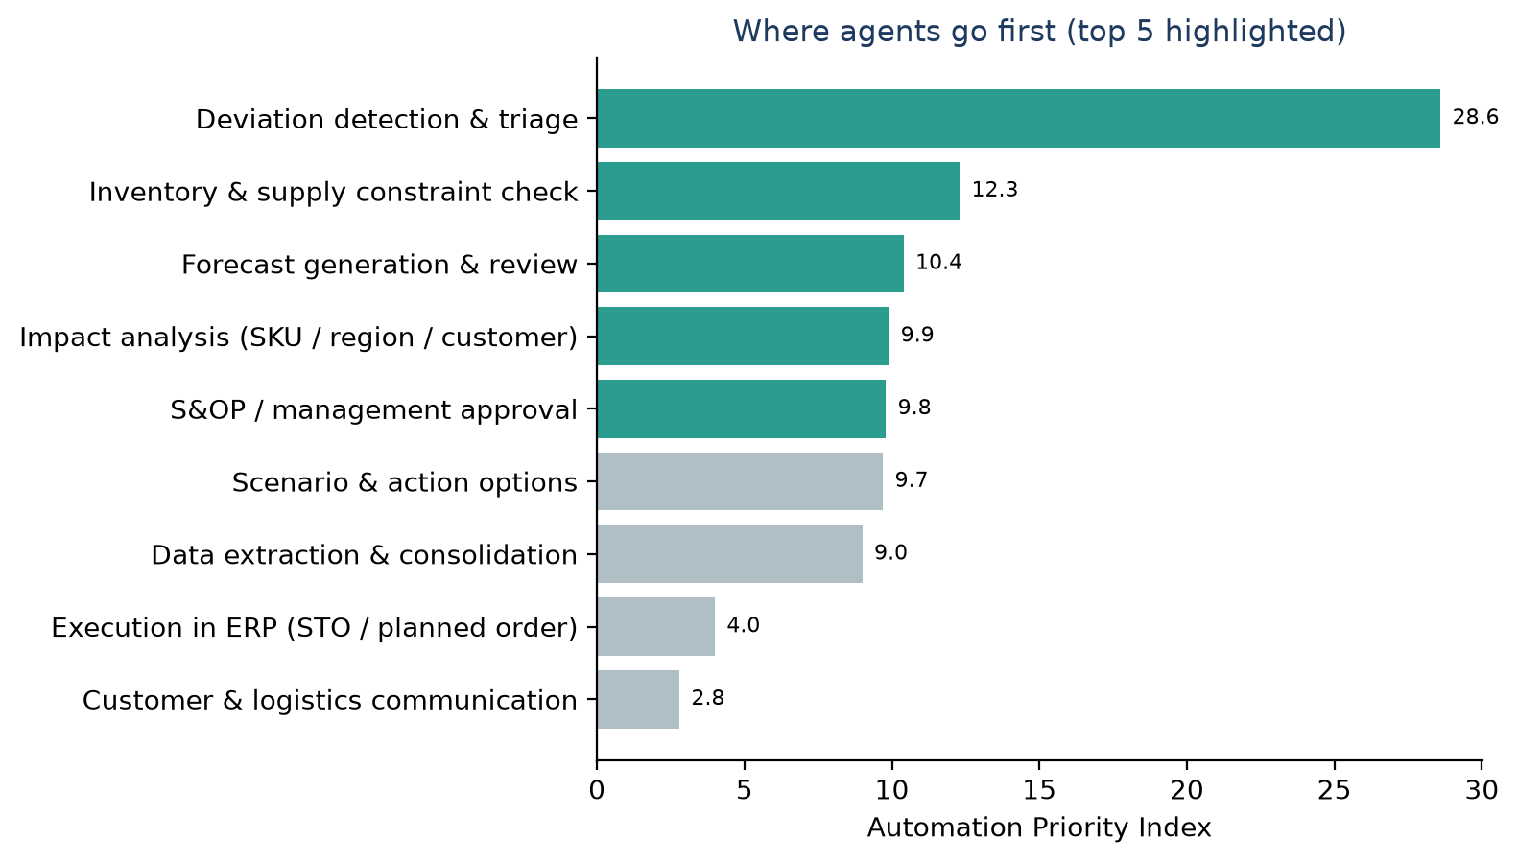
PRIORITISATION
Prioritisation: demand sensing first - fixes the #1 bottleneck
• Wave 1 (POC): UC1 demand sensing + agentic response, UC2 stockout/excess prediction (same data).
• Wave 2: UC3 inventory optimisation, UC4 shipment exceptions, UC7 invoice automation (quick win).
• Wave 3: UC5 network/lane optimisation, UC6 supply disruption prediction.
AI for Demand & Distribution · FDE client challenge · synthetic data, stated assumptions | 4
Notes:
TALK TRACK (1 min) - The decisive argument for UC1.
"Demand sensing is the foundation. Inventory optimisation, stockout prediction and distribution planning all need a better signal. Fix the signal first and every later use case becomes cheaper and more accurate. It also attacks the #1 bottleneck in our value stream (highest Automation Priority Index, right-hand chart)."

Slide 5
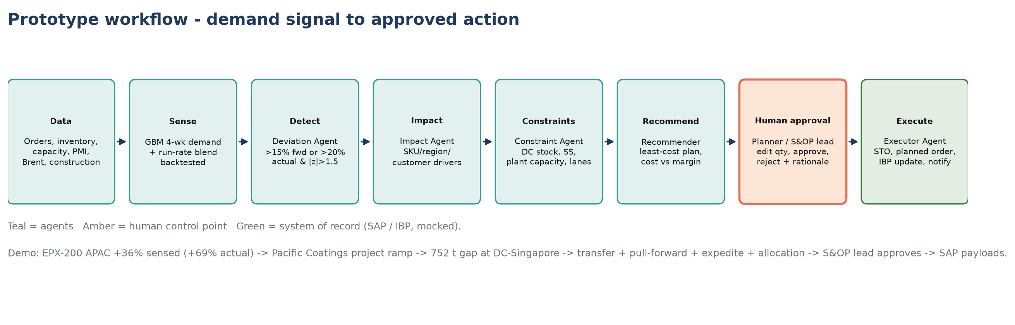
PROPOSED AI / AGENT SOLUTION
Solution: an agent loop that turns a demand signal into an approved action
Agent | Does | Guardrail
Deviation | Flags SKU×region where sensed demand vs plan > 15% (or actuals > 20%, |z| > 1.5); ranks by margin at stake | Thresholds configurable, logged
Impact | Drills to customers driving the change; flags anomalies (e.g. -86% outage) | Facts only; narrative from data
Constraint | DC stock, in-transit, safety stock, other DCs' surplus, plant free capacity, lanes | Deterministic maths
Recommender | Costs transfer / pull-forward / expedite / allocation; least-cost plan | LLM explains, never sets qty
Executor | STO, planned order, aATP allocation, IBP key figure, notifications | Only after approval
AI for Demand & Distribution · FDE client challenge · synthetic data, stated assumptions | 5
Notes:
TALK TRACK - It is an agentic response loop, not just a forecast.
"Signal -> forecast -> deviation -> impact -> constraint check -> recommendation -> human approval -> SAP action. Each agent has one job and a guardrail: deterministic code sets every quantity and cost, the LLM explains, and nothing is written to SAP before approval."

Slide 6
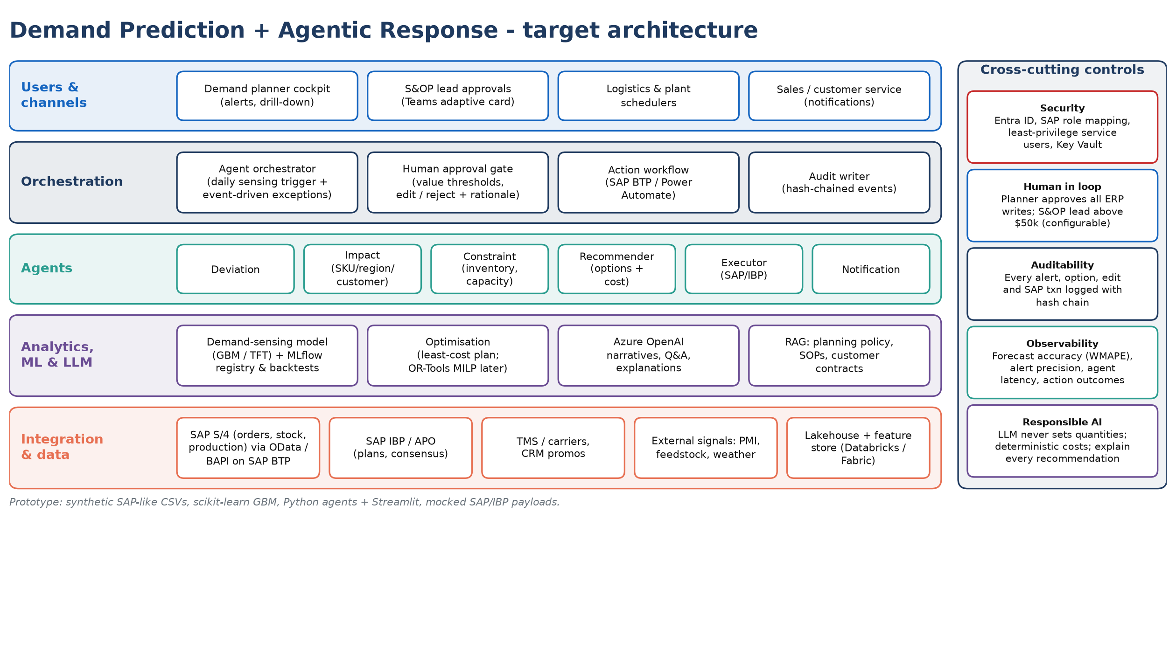
ARCHITECTURE
Architecture: SAP-integrated, ML + LLM, human-approved writes
AI for Demand & Distribution · FDE client challenge · synthetic data, stated assumptions | 6
Notes:
TALK TRACK (1 min) - Trust and control: what a CIO actually worries about.
"The AI never moves inventory on its own. Models do the maths, the LLM explains, a planner approves every action and larger ones escalate. Every decision is audit-logged. SAP is reached only through allow-listed tools; identity, observability and security are in from day one. It is model- and cloud-agnostic - AWS and Azure references are in the appendix."

Slide 7
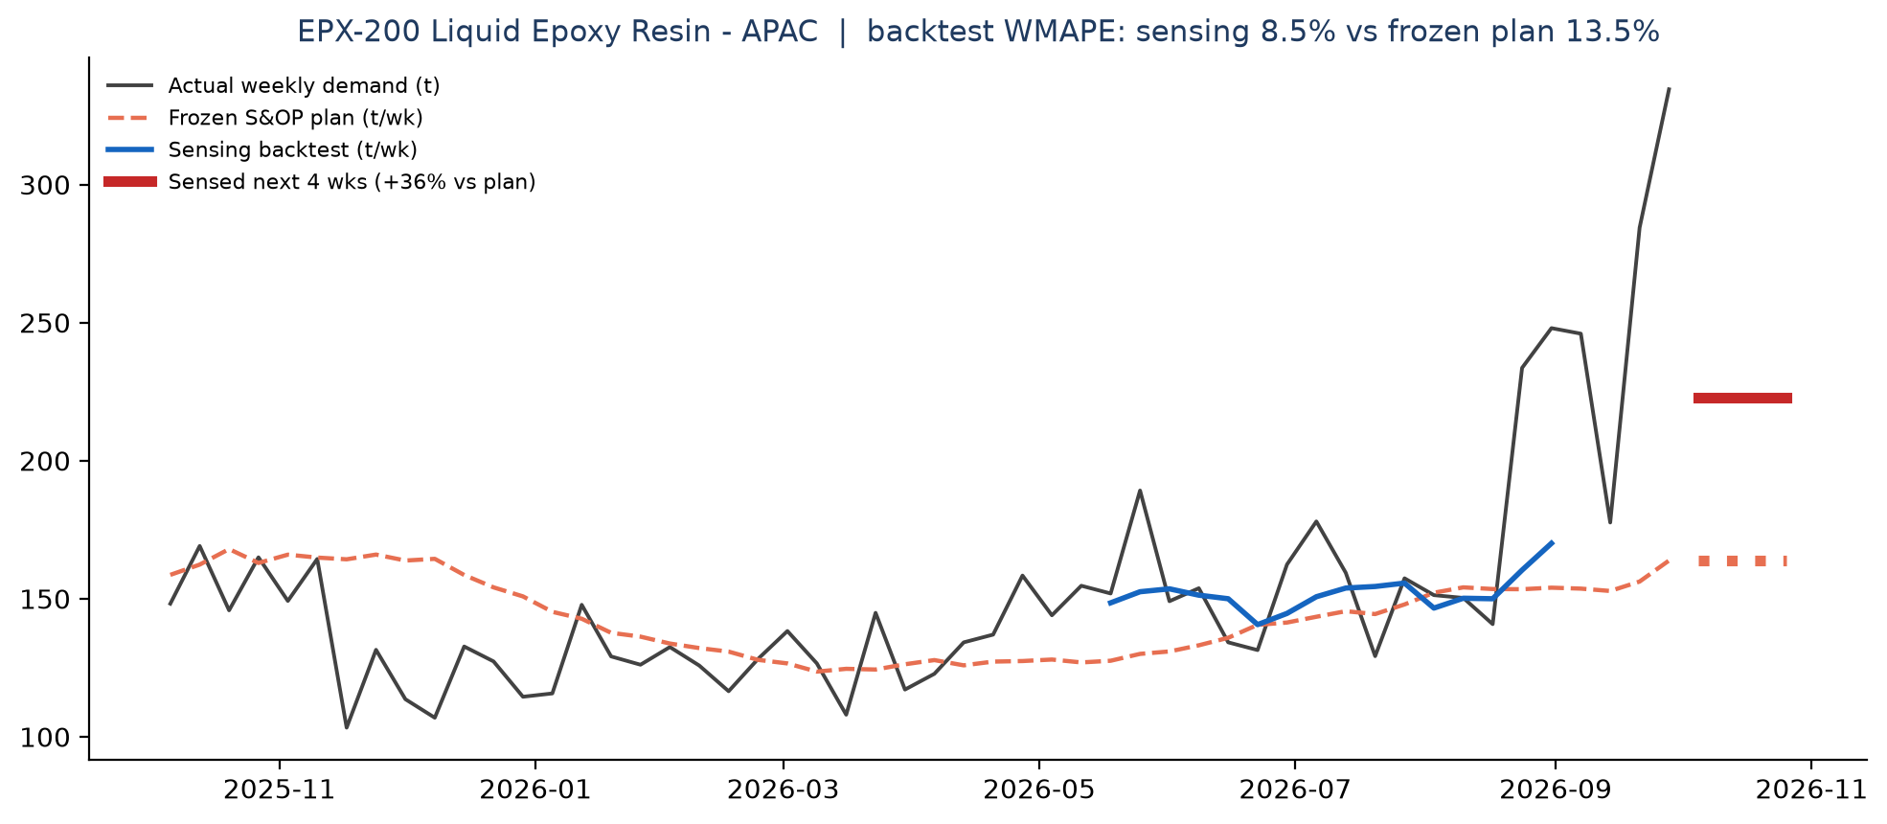
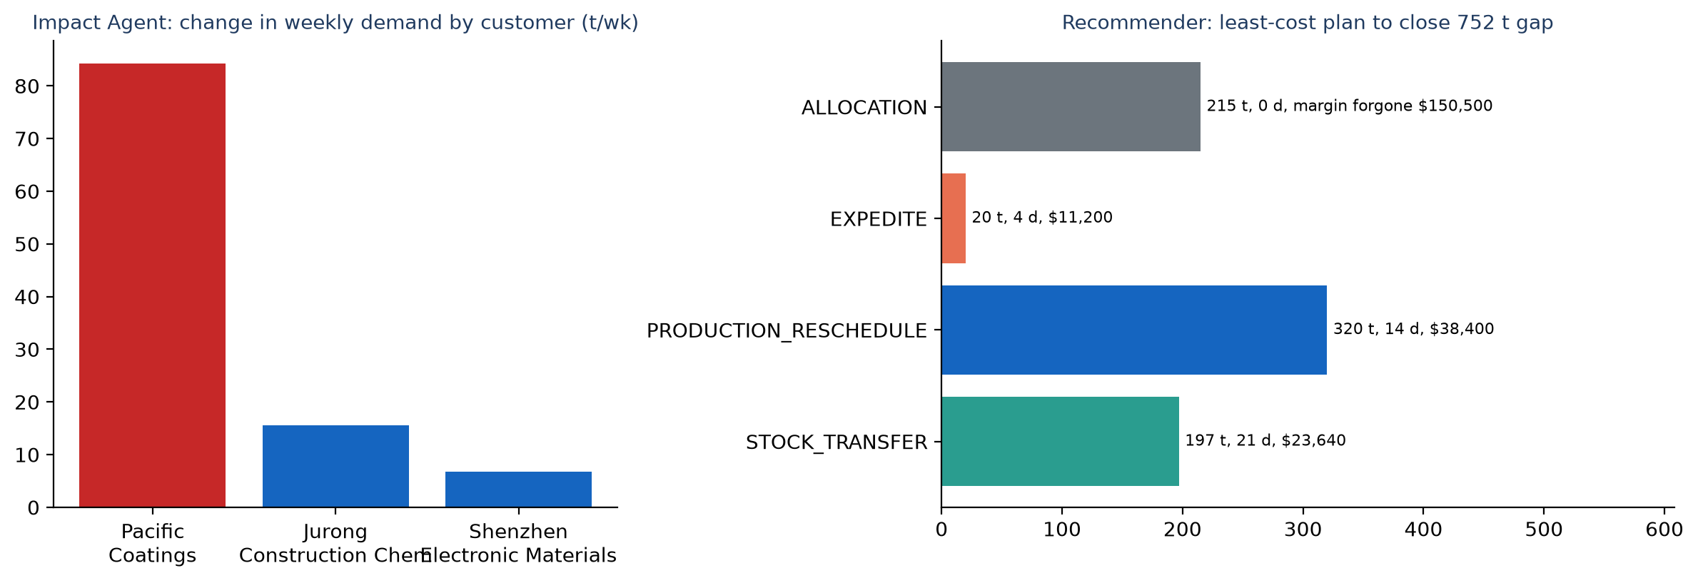
WORKING PROTOTYPE · STREAMLIT RUN A2_CHEM_DEMAND/APP.PY
Demo: EPX-200 epoxy resin in APAC, from signal to SAP in one flow
• Detect: sensed next-4-week demand +36% vs frozen plan; actuals last 4 weeks +69% (z=+3.5).
• Impact: Pacific Coatings drives 79% of the change; revenue exposure $755,914.
• Constraints: DC-Singapore covers 2.0 weeks; gap 752 t vs safety stock; Rotterdam has surplus, Jurong has free capacity.
• Recommend: transfer + pull-forward + expedite + allocation: cost $73,240 vs $375,900 margin protected.
• Approve & act: routed to S&OP Lead (> $50k); a planner without authority is blocked; approval creates SAP STO, planned order and IBP update (mocked) plus a notification.
AI for Demand & Distribution · FDE client challenge · synthetic data, stated assumptions | 7
Notes:
TALK TRACK (2 min) - Show it working; switch to the live app if possible (http://localhost:8502).
"In the backtest, forecast error drops from 13.5% (current plan) to 8.5% - about 37% better, in line with the 35% -> 22% industry assumption. For EPX-200 in APAC the agents find the spike, trace it to the customer driving it, check stock and capacity and propose a plan costing $73,240 that protects $375,900 - about $302,660 net. It is over $50k, so it routes to the S&OP Lead."
Demo tip: approve as a planner first to show the authority block, then as the S&OP Lead.

Slide 8
BUSINESS IMPACT
Business impact: before vs after (assumptions stated)
KPI | Before | After | Change
Lead time (days) | 27.6 | 4.3 | -84%
Touch time per unit (h) | 28.75 | 10.5 | -63%
NVA touch (h) | 20.5 | 3.25 | -84%
Wait (h) | 192 | 24.0 | -88%
PCE | 3.7% | 21.0% | 5.6x
Steps over takt | 4 | 0 | bottlenecks removed
Capacity (units/month, bottleneck-bound) | 90 | 235 | +161%
Lever | Impact (assumption) | Annual value
Forecast error (4-wk WMAPE) | 13.5% → 8.5% synthetic; 35% → 22% client assumption | enabler
Stockouts avoided | −30% lost-sales incidents | $6-9M
Excess & obsolete | −15% E&O | $3-5M
Expedite / premium freight | −20% | $4-6M
Planner productivity | NVA 20.5 → 3.3 h per exception | ~6 FTE redeployed
• Assumptions: $5B revenue manufacturer, ~120 significant demand exceptions/month, 12 SKUs × 4 regions in the prototype; step times mocked; benefits ranges to be validated with the client's SAP history in POC weeks 1-2.
• Measured in prototype: backtest WMAPE over 16 weekly origins on synthetic data (sensing vs frozen plan vs 13-week moving average).
AI for Demand & Distribution · FDE client challenge · synthetic data, stated assumptions | 8
Notes:
TALK TRACK - Lead time 27.6 -> 4.3 days; PCE 3.7% -> 21%.
Present every dollar figure as a planning assumption the POC validates against the client's own SAP history - that builds credibility. Forecast accuracy is the enabler; the money comes from fewer stockouts, less E&O and less premium freight, plus planner time redeployed.

Slide 9
POC APPROACH
POC: 8 weeks, one product family, two regions, shadow mode
Weeks | Milestone | Exit criteria
0-1 | Mobilise; SAP/IBP extracts (3 yrs orders, stock, capacity); VSM baseline with planners | Data contract + baseline KPIs
2-3 | Feature pipeline + external signals; sensing model + backtest vs current plan | ≥20% WMAPE improvement
4-5 | Agents + planner cockpit + Teams approval; SAP sandbox (STO / planned order) | End-to-end on 10 historical events
6-7 | Shadow mode next to weekly planning; capture accept/edit/reject | ≥60% recommendations accepted
8 | Readout: value case, scale plan to all families/regions | Go / no-go
Team
FDE lead · data scientist · 2 AI/data engineers ·
SAP integration (0.5) · client: demand planning lead,
S&OP owner, IT/SAP basis
Data required
Orders/shipments, inventory by DC, production plans &
capacity, lanes & freight rates, promos, PMI/feedstock
KPIs
WMAPE & bias · detection lag · alert precision ·
acceptance rate · OTIF · expedite cost · planner hours
Risks & mitigations
Data quality / master data → profiling in week 1
SAP access → sandbox + mocked APIs first
Planner trust → explain every alert, edit before approve
Scope creep → one family, two regions
AI for Demand & Distribution · FDE client challenge · synthetic data, stated assumptions | 9
Notes:
TALK TRACK (30 sec) - End with a decision.
"We are asking for an 8-week POC on one product family, in shadow mode next to S&OP, with real SAP/IBP data. Success means at least 20% better forecast error, detection-to-action under a week, and planners accepting at least 60% of recommendations. If it hits those, wave 1 scales and wave 2 starts."
Requests: business sponsor + demand-planning lead, SAP/IBP extracts, a sandbox, choice of LLM platform.

Slide 10
PRODUCTION ROADMAP
Production roadmap: from one loop to an autonomous-with-oversight supply chain
POC · wks 1-8
Epoxy family × APAC/EU
Shadow mode, value case
MVP · months 3-6
All families in 2 regions
Live SAP writes after approval
UC2 stockout/excess
Scale · months 6-12
Global; UC3 inventory optimisation
UC4 shipment exceptions
UC7 invoice automation
Transform · 12-24 months
UC5 network optimisation, UC6
supply risk; auto-approve low-value
actions within policy
• Platform: shared feature store + MLflow, agent orchestrator, approval and audit services reused by every use case.
• Governance: action-value thresholds by role, weekly model performance review, audit trail of every ERP write.
• Next steps: confirm POC scope and sponsor · SAP/IBP extract request · planner workshop for the VSM baseline.
Assumptions & synthetic data
104 weeks of synthetic orders (12 SKUs × 4 regions × 12 customers), PMI/Brent/construction signals, DC inventory, plant capacity and lanes, with two injected events (APAC epoxy project ramp; EU PVC outage). VSM step times mocked; financial benefits are ranges for a ~$5B manufacturer. SAP/IBP calls are mocked payloads.
AI for Demand & Distribution · FDE client challenge · synthetic data, stated assumptions | 10
Notes:
TALK TRACK - One loop today, a governed autonomous-with-oversight supply chain over 24 months.
Each wave reuses the same platform (feature store, orchestrator, approval and audit services), so cost per use case falls. Auto-approval of low-value actions comes only in the last phase, within policy.
Expected questions: data readiness (opportunity map 'Data required'); SAP integration (allow-listed MCP tools over SAP BTP); AI errors (recommends, never decides; edits and rejections tracked); benefits (validated in POC weeks 1-2).

Slide 11
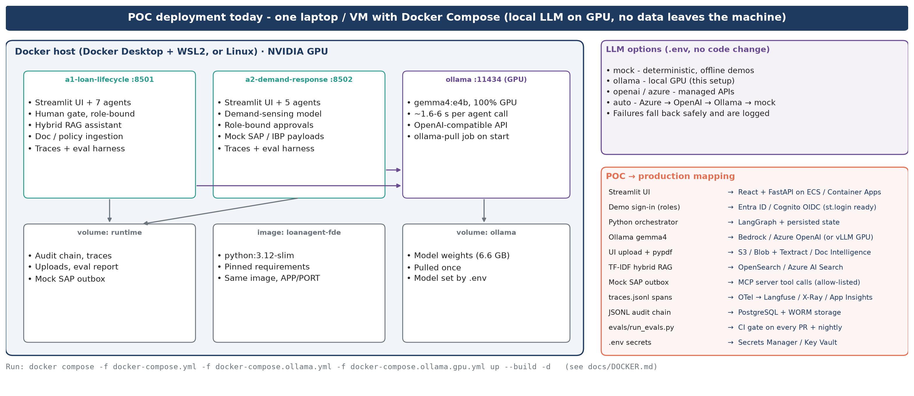
APPENDIX · DEPLOYMENT
Appendix A · POC deployment today: Docker Compose with a local GPU LLM
AI for Demand & Distribution · FDE client challenge · synthetic data, stated assumptions | 11
Notes:
What actually runs today. Same agents and code path as production; only the platform services change.

Slide 12
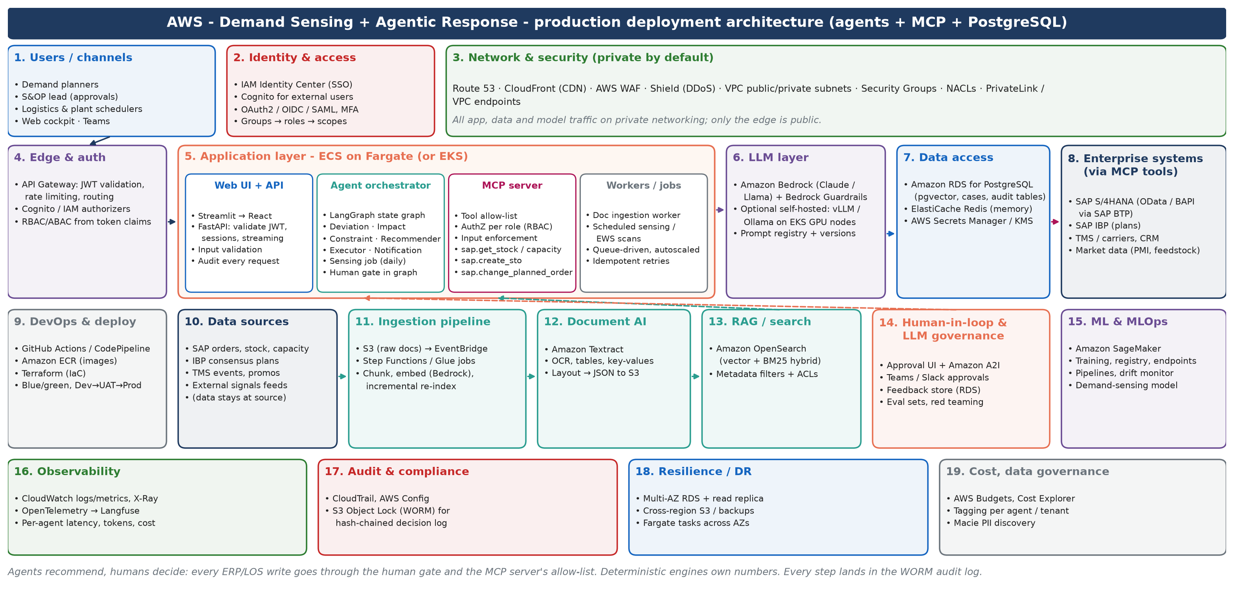
APPENDIX · DEPLOYMENT
Appendix B · AWS production deployment: agents, MCP server, PostgreSQL
AI for Demand & Distribution · FDE client challenge · synthetic data, stated assumptions | 12
Notes:
Target AWS deployment. Client-cloud agnostic: the same container images, agent graph and MCP tool contracts deploy to either cloud; only managed services differ.

Slide 13
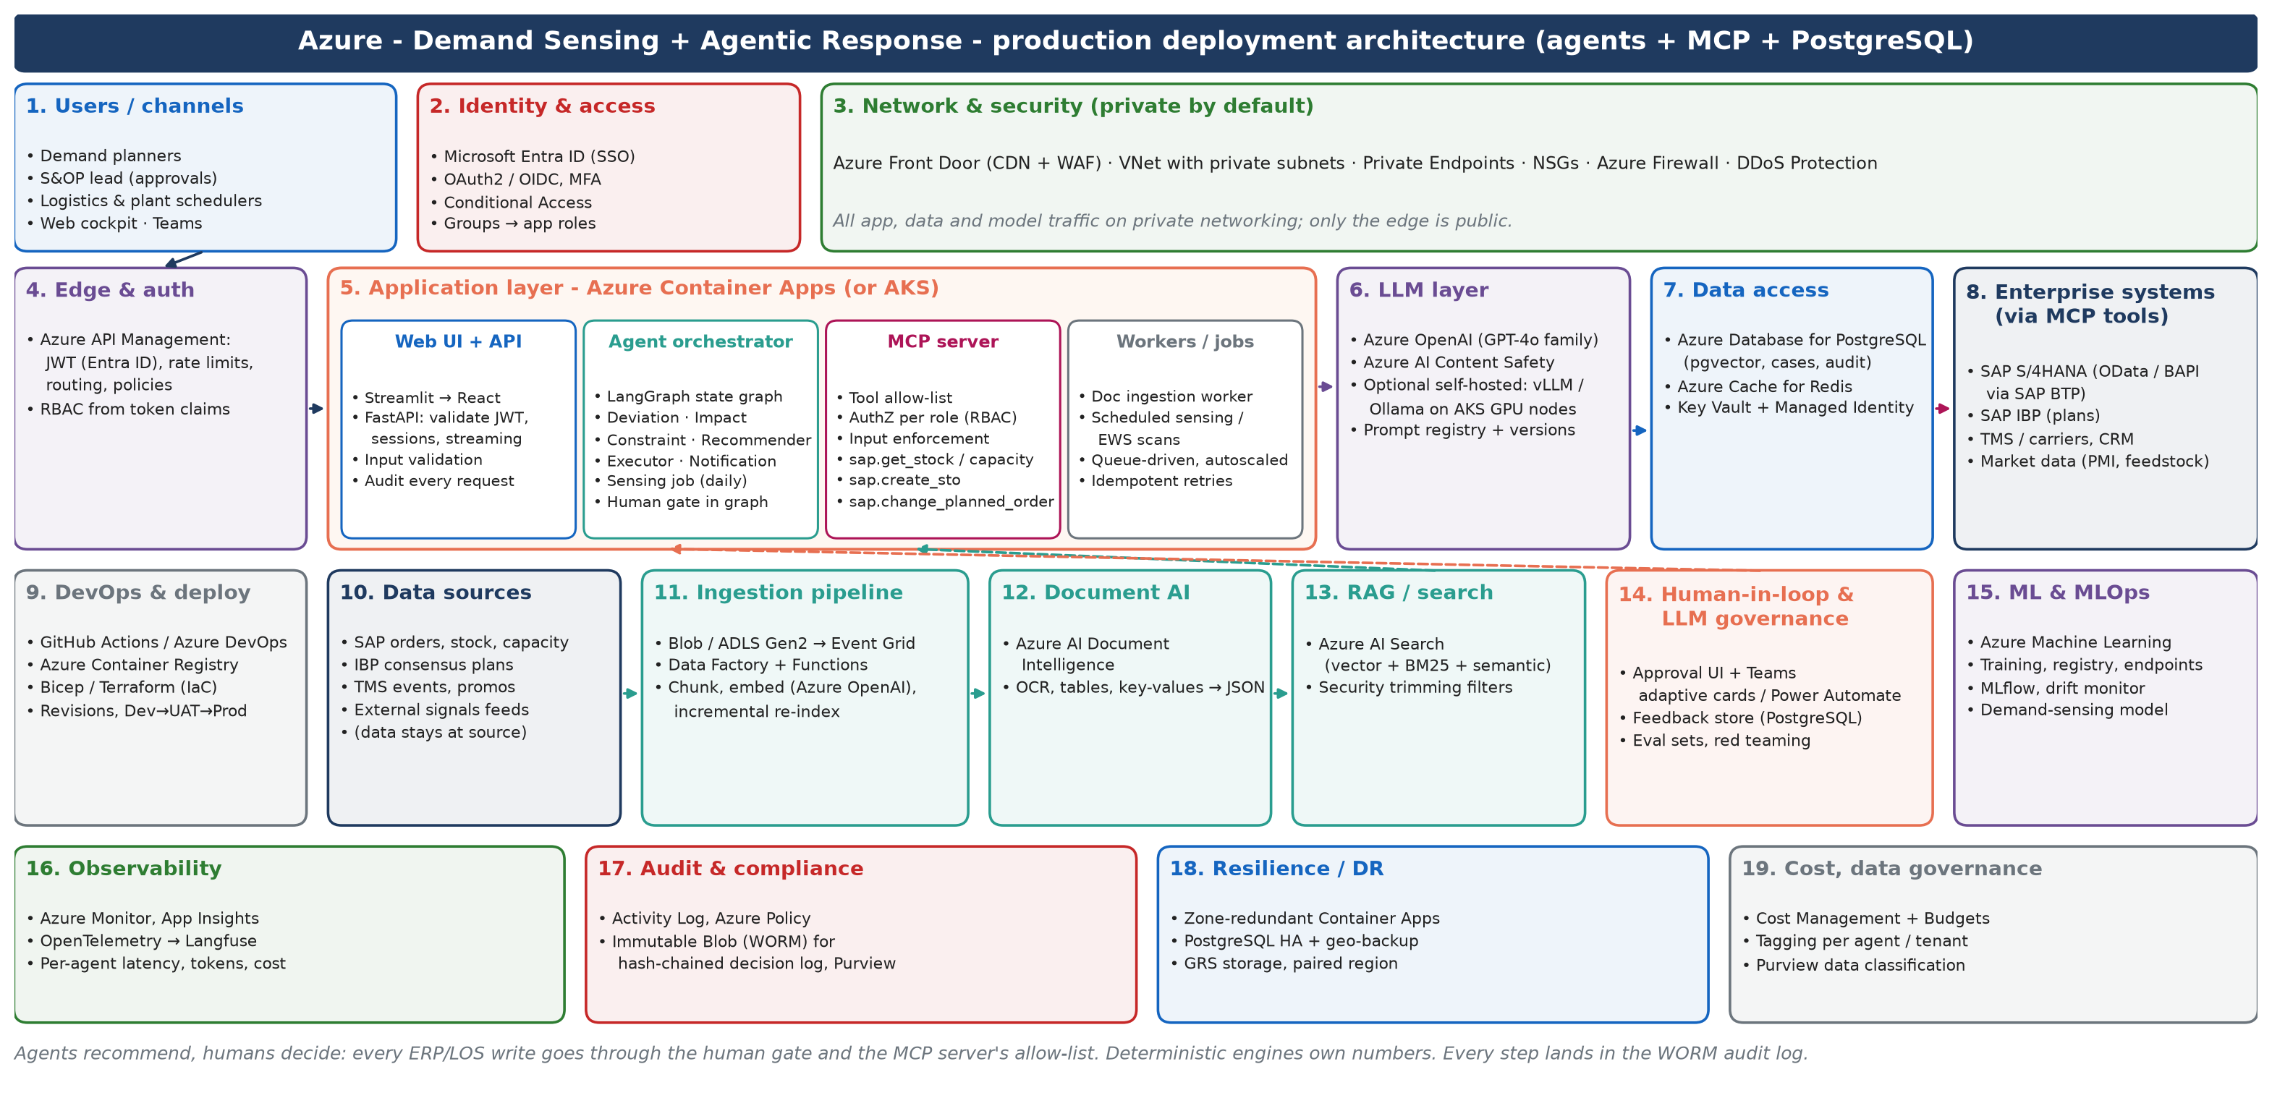
APPENDIX · DEPLOYMENT
Appendix C · Azure production deployment: agents, MCP server, PostgreSQL
AI for Demand & Distribution · FDE client challenge · synthetic data, stated assumptions | 13
Notes:
Target Azure deployment. Client-cloud agnostic: the same container images, agent graph and MCP tool contracts deploy to either cloud; only managed services differ.

Slide 14
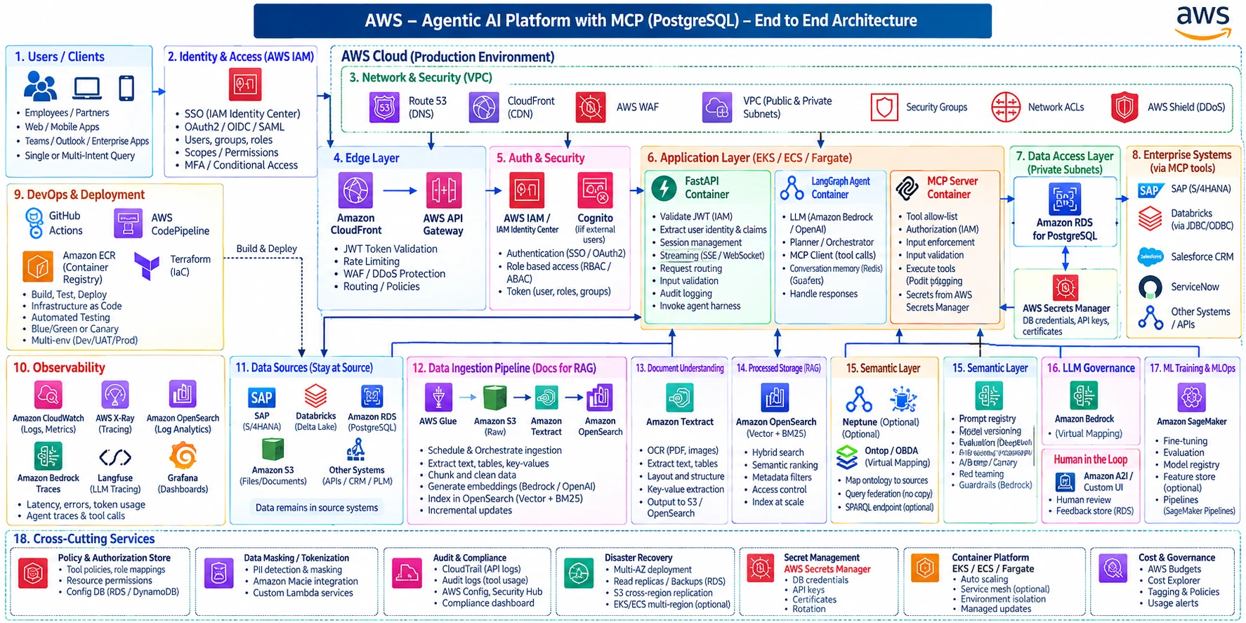
APPENDIX · REFERENCE ARCHITECTURE
Appendix D · Reference platform: AWS agentic AI with MCP
AI for Demand & Distribution · FDE client challenge · synthetic data, stated assumptions | 14
Notes:
Enterprise reference architecture for an agentic AI platform on AWS: users, identity, network, edge, auth, application layer (FastAPI, LangGraph agents, MCP server), data access (PostgreSQL + secrets), enterprise systems via MCP tools, ingestion/RAG, semantic layer, LLM governance, human-in-the-loop, MLOps, observability and cross-cutting services. Our agents slot into the LangGraph and MCP containers.

Slide 15
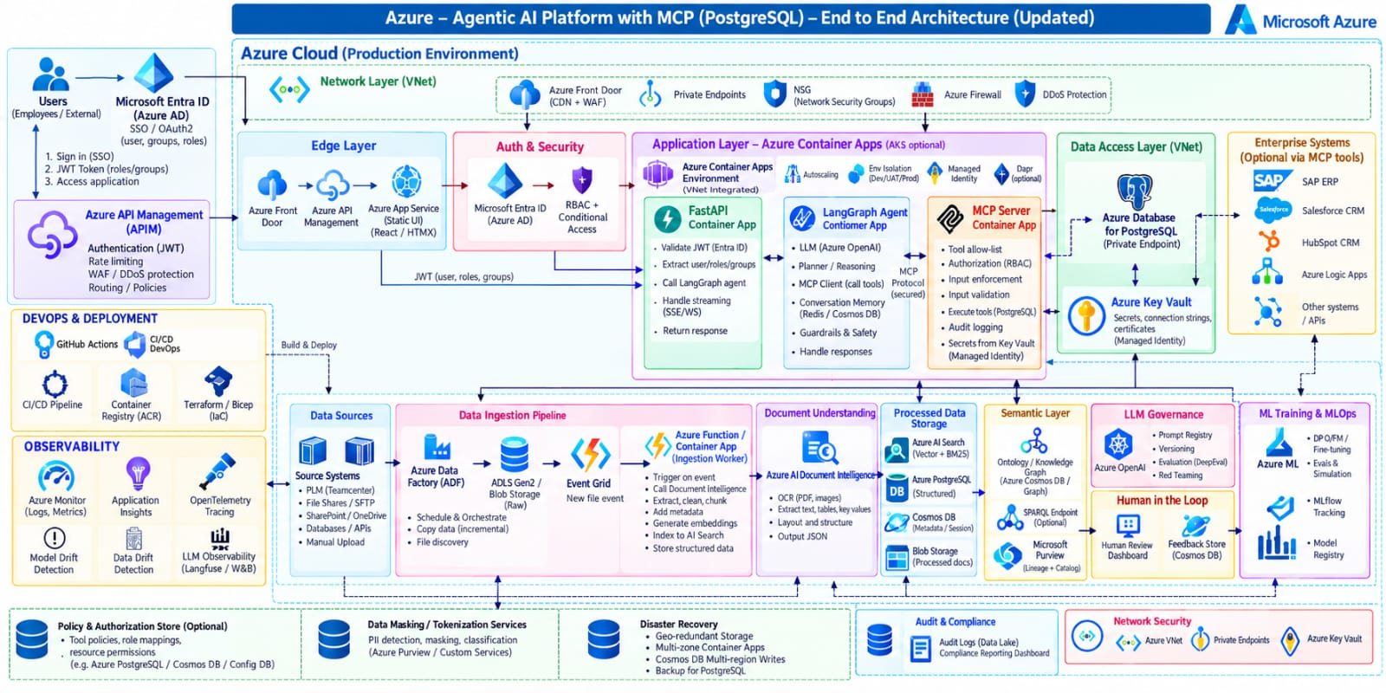
APPENDIX · REFERENCE ARCHITECTURE
Appendix E · Reference platform: Azure agentic AI with MCP
AI for Demand & Distribution · FDE client challenge · synthetic data, stated assumptions | 15
Notes:
Enterprise reference architecture for an agentic AI platform on Azure: users, identity, network, edge, auth, application layer (FastAPI, LangGraph agents, MCP server), data access (PostgreSQL + secrets), enterprise systems via MCP tools, ingestion/RAG, semantic layer, LLM governance, human-in-the-loop, MLOps, observability and cross-cutting services. Our agents slot into the LangGraph and MCP containers.

