Slide 1

Multi-Objective Transport System Based on Regression Analysis and Genetic Algorithm Using Transport Data
22 May 2019
Source: IEEE
Mahi Dedhia
1911025

Slide 2
Need for an optimized bus-schedule
Efficient and economical transportation is a must these days
In better interest of the passengers
To ensure that passengers don’t go unserved
To ensure minimal wastage of fuel and other resources
To maximize profit with the same available resources

Slide 3
Factors to be kept in mind to design an efficient and economic bus-system
Passenger count for a particular route
Bus capacity
Resource and trip management
Overall costs
Availability of buses

Slide 4
What’s new in this model in comparison to previous researches ?
Concepts for optimization of forecasting passengers and generation of optimized schedules to improve the transit network have been put forward. But their drawbacks which need to be addressed include:
Only identical buses considered
No vehicle capacity constraint
Same fare assumed for all routes (no cost benefit analysis)
Uniform passenger arrival at the stops considered
Company’s resources assumed to be unlimited

Slide 5
Forecasting of Passengers
No. of potential passengers on particular day of the week are predicted using Univariate Multiple regression performed on a dataset of a private bus company containing passenger data generated by 500 buses over a period of three years. While forecasting, the peak seasons, festivals and holidays are kept in mind.

Slide 6
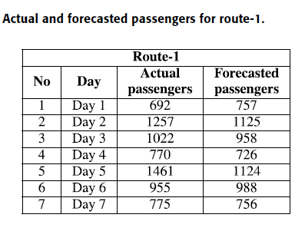


Forecasting of Passengers

Slide 7
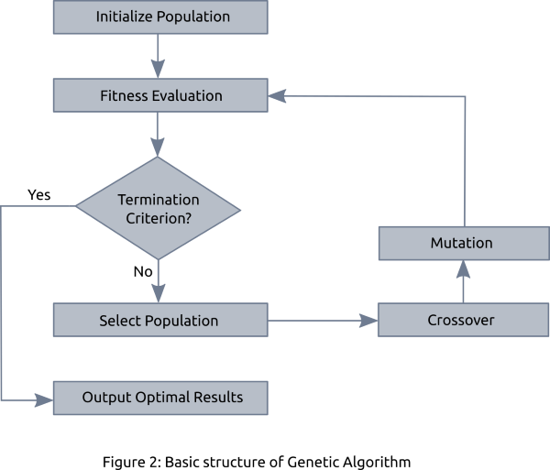
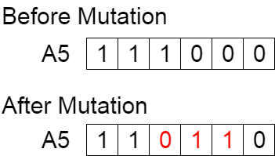
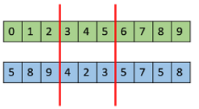
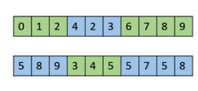
Optimized Bus-Schedule using Genetic Algorithm

Slide 8
Initial Input to the Genetic Algorithm
Three types of buses are owned by the company having 32, 39, and 44 seating capacity. To obtain the best possible combination of buses on different days of the week so that no or minimal empty seats are left, backtrack subset sum algorithm is used. This is then used as an input to the Genetic algorithm.
Cost benefit analysis is performed on the bus which may have empty seats left according to the prediction.
Cost of Bus < No. of Passengers * fare for each passenger

Slide 9
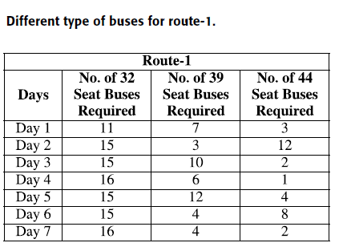
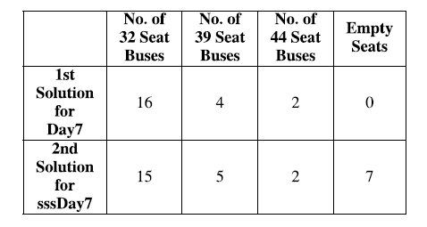
Minimum buses required on a particular day
Since the company owns 15 buses of each type

Slide 10
Objective function and Terminating Condition
The fitness value is obtained from the objective function.
The purpose is to minimize the expenses and the waiting time while meeting the passenger demand
f(x) = Cost of Bus + Minimum Buses required + waiting time
The GA terminates when the total number of optimized schedules is equal to the minimum number of buses which are required for that particular day.

Slide 11
Scheduling Departures : Selection, Crossover, Mutation
The buses are given a particular encoding so as to convert them into a binary string.
Selection operation: The most fit bus is selected using roulette wheel selection.
Crossover operation: One point crossover selected; frequency of crossover = 0.6
Mutation operation: The selected mutation rate in the proposed study is 0.01

Slide 12
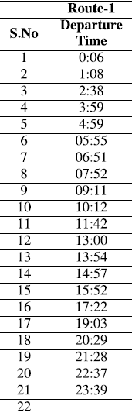
Results and Conclusion
The results show that the dependent variables chosen have a significant impact on the number of passengers.
Error calculation is performed using MAD (Mean Absolute Deviation) and MAPE (Mean Absolute Percentage Error). MAD obtained is 99.14 and MAPE obtained is 8.7%. Hence, we can say that the results are promising
Based on the required buses, optimized timetable for departures has been produced.

Slide 13
Future Work
The day can be divided into different groups to develop timetable by finding peak and off-times.

Slide 14
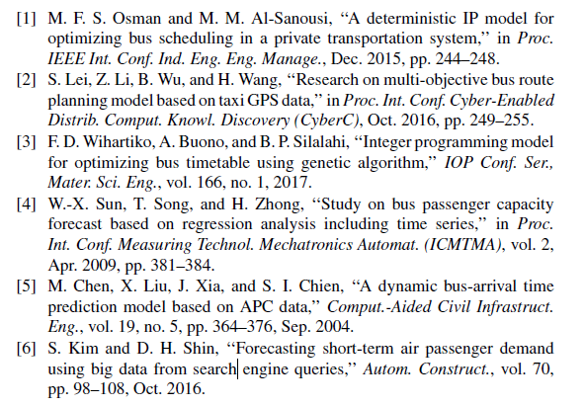
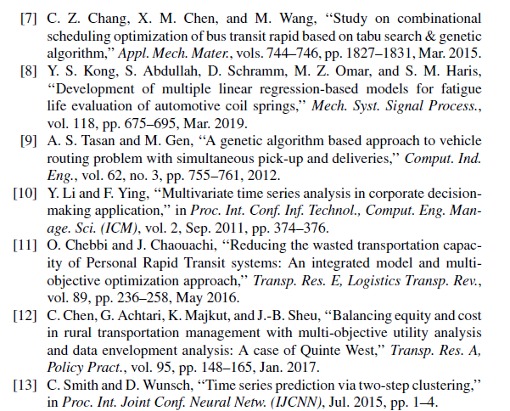
References

Slide 15
Implementation Strategy
Calculate/Predict the potential passengers by regression using a dataset from data.world
Use the predicted passengers to calculate the best possible combination of buses required using the backtrack subset sum algorithm.

Slide 16
THANKYOU!

