Slide 1
Metabolic Profiling
Validation and Clinical Application
Pathway Analysis:
Over-representation Analysis (ORA)
Quantitative Enrichment Analysis (QEA)
Bayesian?
Sample collection, treatment and processing
Data analysis:
Principal component analysis (PCA)
Partial Least-Squares-Discriminant Analysis (PLS-DA)
Orthogonal projections to latent structures-discriminant analysis (OPLS-DA)
Separation technique:
Gas Chromatography (GC)
High Performance Liquid Chromatography (HPLC)
Ultra Performance Liquid Chromatography (UPLC)
Capillary Electrophoresis (CE)
Detection technique:
Nuclear magnetic resonance (NMR) spectroscopy
Mass spectrometry (MS)
Ion-mobility spectrometry
Electrochemical detection

Slide 2
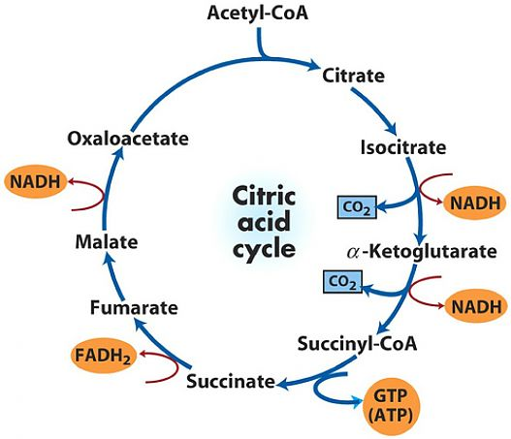
Citric Acid Cycle
Some TCA cycle defects are also implicated in cancer pathogenesis as accumulated TCA cycle intermediates act as oncometabolites such as Multiple cutaneous and uterine leiomyomas (MCUL) and Hereditary leiomyomatosis and renal cell cancer (HLRCC).
The citric acid cycle is the final common pathway for the oxidation of fuel molecules —amino acids, fatty acids, and carbohydrates.
Fumarase deficiency: global developmental delays, hypotonia, and seizures
Succinate dehydrogenase (SDH) deficiency: Encephalomyopathy, cardiomyopathy, optic atrophy

Slide 3
Over-Representation Analysis
(ORA)
Quantitative Enrichment Analysis (QEA)
Compound concentrations
Compound concentrations
Compound selection
Assess metabolite sets directly
Important compound list
Metabolite set libraries
Biological interpretation
(Xia and Wishart 2010)

