Slide 1

SIDDARTHA INSTITUTE OF SCIENCE AND TECHNOLOGY (AUTONOMOUS)
Department of Computer Science and Engineering
AI Driven Lora WAN Enabled Solar Powered Multi Sensor Framework for Proactive Flood Prediction and Early Warning
Presented by
G.V MAHIDHAR REDDY 224E1A4644
SYED MAHAMMAD SALEEM 224E1A4638
R .NIKHITHA SHARMA 224E1A4624
TALARI DHANUSH 234E5A4601
B.SUMANTH KUMAR 224E1A4635
Under the guidance of
Mrs. K.PURNIMA
M.Tech [ph.D], Dept of CSE

Slide 2
ABSTRACT
Floods cause serious damage to life and property every year. Early flood prediction can help reduce these losses. This project develops an AI-based, solar-powered flood prediction system for real-time monitoring and early warning.The system uses sensors to measure rainfall, water level, water flow, temperature, humidity, and air pressure. Sensor data is collected using an Arduino controller and transmitted over long distances using LoRaWAN technology. The data is sent to the cloud, where AI analyzes it to detect flood risk. When flood conditions are detected, warning alerts are sent using a GSM module, and local alerts are provided through a buzzer and LED. This system is low-cost, energy-efficient, and suitable for remote areas.

Slide 3
INTRODUCTION
Floods represent one of the most destructive natural disasters worldwide, leading to significant loss of life, property damage, and environmental degradation. Traditional flood monitoring systems are often manual or reactive, providing alerts only after water levels cross dangerous thresholds. Such systems lack predictive capabilities and real-time intelligence, resulting in delayed response and increased damage. With advancements in embedded systems, IoT, and artificial intelligence, it is now possible to develop smart systems that can predict floods in advance. This project introduces an AI-driven flood prediction system that continuously monitors critical environmental parameters, processes data intelligently, and provides timely alerts. The use of LoRaWAN ensures long-range communication even in remote locations, while solar power enables uninterrupted operation. The proposed system aims to enhance early warning mechanisms and strengthen disaster preparedness.

Slide 4
Domain Specification
Embedded Systems – Hardware and programming to collect sensor data
Internet of Things (IoT) – Long-range communication and cloud monitoring
Wireless Communication – Data transmission between devices
Renewable Energy Systems – Works during power failures using solar energy
Sensor Technology – Sensors monitor environmental conditions
AI & Machine Learning (Python) – Predicts floods using sensor data

Slide 5
Literature survey
S.No | Title of the Paper | Year | Author | Description
1 | IoT-Based Flood Monitoring and Early Warning System | 2019 | M. Pramudhita et al. | Used water level sensors and GSM alerts for real-time flood monitoring in flood-prone areas.
2 | A LoRaWAN-Based Remote Flood Level Monitoring System | 2020 | A. Rahman & R. Yusof | Implemented LoRaWAN for long-range, low-power flood data transmission in remote regions.
3 | Machine Learning Approaches for Flood Prediction Using Hydrological Data | 2021 | S. Kumar & P. Singh | Applied ML models like Random Forest and SVM for flood prediction using rainfall and river data.
4 | Design of Real-Time Water Level Monitoring System Using Ultrasonic Sensors | 2018 | R. Sharma & D. Patel | Used ultrasonic sensors for accurate and low-cost water level measurement.
5 | Multi-Sensor IoT System for Real-Time Environmental Monitoring | 2022 | Y. Zhang & L. Chen | Developed a multi-sensor system monitoring rainfall, humidity, temperature, and water level.

Slide 6
Literature survey
5 | Multi-Sensor IoT System for Real-Time Environmental Monitoring | 2022 | Y. Zhang & L. Chen | Developed a multi-sensor system monitoring rainfall, humidity, temperature, and water level.
6 | Smart Flood Monitoring System Using IoT | 2019 | P. Kumar et al. | Designed an IoT-based system for monitoring flood conditions and sending alerts to authorities.
7 | Flood Prediction Using Machine Learning Techniques | 2020 | A. Singh & R. Mehta | Used historical flood data and ML algorithms to forecast flood occurrences.
8 | LoRa-Based Environmental Monitoring System | 2021 | L. Gomez et al. | Demonstrated long-range, low-power environmental monitoring using LoRa communication.
9 | Solar-Powered IoT System for Disaster Monitoring | 2022 | N. Al-Hassan et al. | Proposed a solar-powered IoT system ensuring continuous operation during disasters.
10 | AI-Based Flood Forecasting and Warning System | 2023 | J. Lee & K. Park | Integrated AI models with real-time sensor data for early flood forecasting and alerts.

Slide 7
PROBLEM STATEMENT
Floods cause severe damage to life and property, destroying homes, infrastructure, and agricultural land. In remote and rural areas, proper monitoring systems are often unavailable, making it difficult to detect rising water levels in time. Traditional methods of flood detection usually provide warnings too late, and manual observation is unreliable, especially during extreme weather conditions. Additionally, power supply issues during floods can disrupt monitoring and warning systems. Currently, there is no intelligent system widely implemented to predict floods in advance and provide early warnings.

Slide 8
EXISTING SYSTEM
Short-range communication (GSM, Wi-Fi, wired). Poor performance in remote areas. High power consumption. Limited sensor usage (only 1–2 parameters). Manual monitoring causes delays. No AI-based flood prediction. Power supply dependency.

Slide 9
DISADVANTAGES OF EXISTING SYSTEM
Short-range and unreliable communication
GSM, Wi-Fi, and wired networks fail in remote areas
High power consumption and battery dependency
Limited sensor coverage
Poor performance during extreme weather
No long-range, low-power communication (LoRaWAN)
Low scalability for large flood-prone areas

Slide 10
PROPOSED SYSTEM
AI-driven flood prediction system. Uses LoRa WAN for long-range communication. Solar-powered for continuous operation. Multiple sensors monitor flood parameters. Arduino UNO collects sensor data. Data sent to cloud using NodeMCU.AI (Python) predicts flood risk. Alerts via buzzer, LED, LCD, GSM, and IoT

Slide 11
ADVANTAGES OF PROPOSED SYSTEM
Long-range communication using LoRa WAN
Solar-powered with battery backup
Multi-sensor based flood monitoring
AI-based early flood prediction
Real-time cloud monitoring
Multiple alert mechanisms
Reliable during harsh weather

Slide 12
SYSTEM REQUIREMENTS
Hardware Requirements
Arduino UNO
NodeMCU
LoRa SX1278 Module
Rain Drop Sensor
Ultrasonic Sensor
Pressure Sensor
Flow Sensor
DHT11 Sensor
GSM Module
Buzzer
Solar Panel (9V)
Power Supply

Slide 13
Hardware Requirements
Arduino UNO – Main controller for sensor data collection
NodeMCU (ESP8266) – Wi-Fi connectivity and cloud communication
LoRa SX1278 Module – Long-range, low-power data transmission
Rain Drop Sensor – Detects rainfall intensity
Ultrasonic Sensor – Measures water level
Pressure Sensor – Monitors water pressure
Flow Sensor – Measures water flow rate
DHT11 Sensor – Measures temperature and humidity
GSM Module – Sends SMS flood alerts
Buzzer – Local warning alarm
Solar Panel (9V) – Renewable power source
Power Supply – Provides regulated voltage

Slide 14
SOFTWARE REQUIREMENTS
Arduino IDE – Used to write, compile, and upload code to Arduino UNO and Node MCU
Embedded C – Programming language used to control sensors, communication modules, and alerts

Slide 15
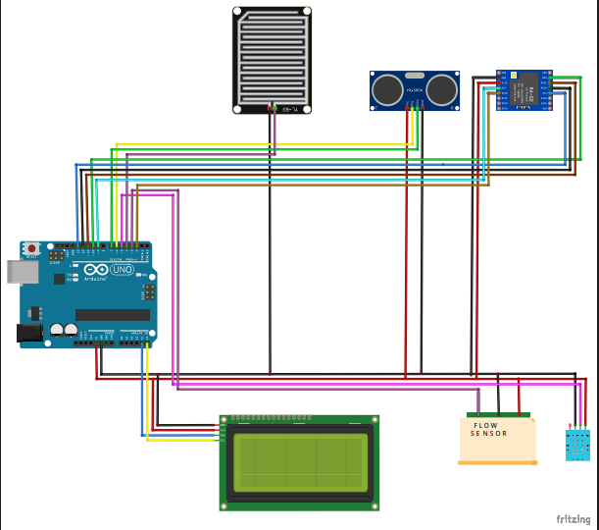
SYSTEM ARCHITECTURE -Transmitter

Slide 16
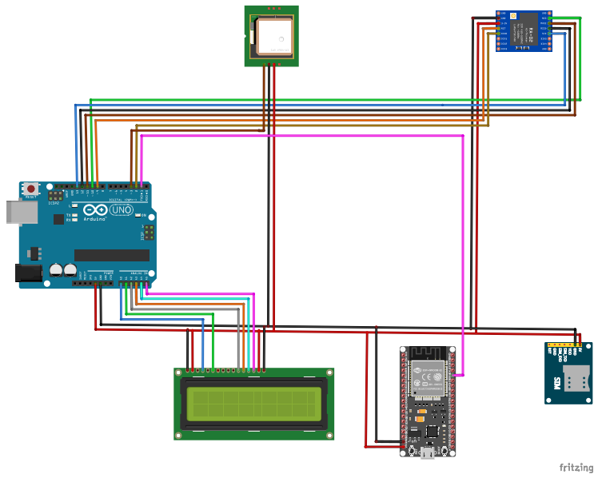
SYSTEM ARCHITECTURE -Receiver

Slide 17
MODULES
Sensor Data Module This module collects real-time data like water level, rainfall, pressure, humidity, temperature, and water flow.
Embedded Control Module This is the brain of the system. It reads the sensor data, filters it, and sends it for transmission. It also controls alarms like buzzers, LEDs, and LCDs, and connects with LoRa, GPS, and GSM.
LoRa WAN Communication Module This module sends data over long distances (2–10 km) using very little power. It works even in remote areas and does not need mobile network coverage.

Slide 18
MODULES
AI/ML Prediction Module This module uses historical and real-time sensor data to predict the chance of a flood before it happens. It can detect sudden changes like rapid water rise, heavy rainfall, or drops in pressure, and sends alerts with risk levels.
Central Monitoring Dashboard Module This module shows real-time graphs, sensor readings, predictions, GPS location, and alert history. It helps authorities make quick decisions and is useful for managing disasters and studying long-term flood patterns.

Slide 19
ALGORITHM
Initialize sensors , LoRa, GSM, GPS , and solar unit.
Acquire real-time environmental data.
Preprocess and normalize sensor readings.
Transmit data via LoRa to Node MCU.
Upload data to cloud IoT platform.
Apply python ML model for flood prediction.
Classify output into safe / Alert / Danger.
Trigger GSM , LED, buzzer , and cloud alerts.
Continuously repeat monitoring cycle.

Slide 20
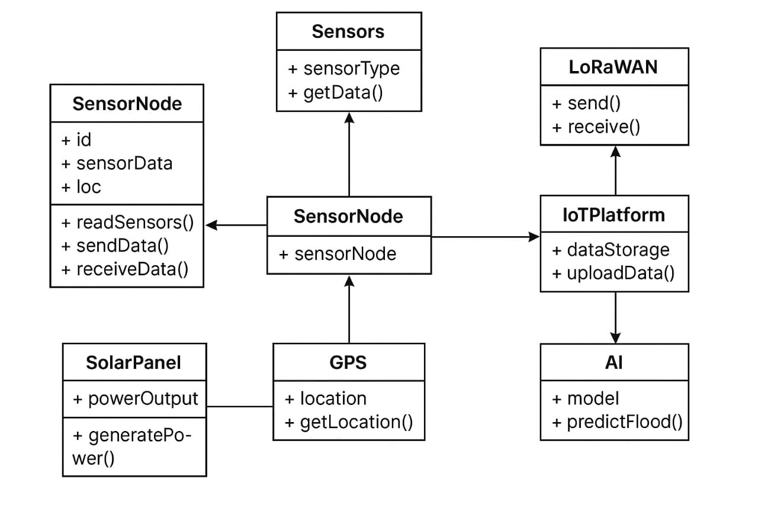
CLASS DIAGRAM
.

Slide 21
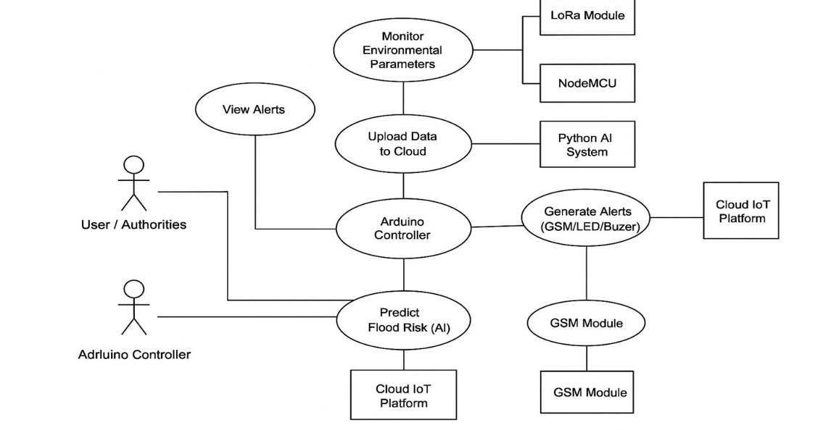
USE CASE DIAGRAM

Slide 22
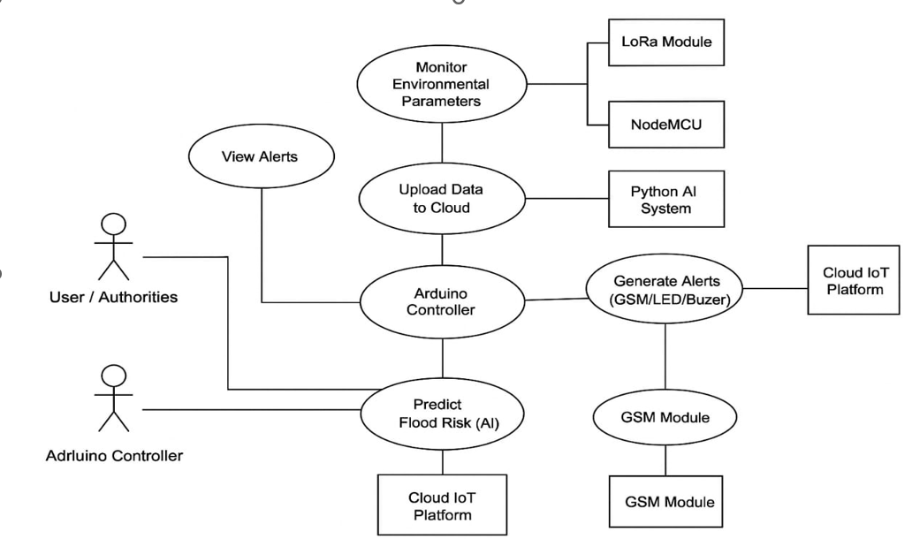
USE CASE DIAGRAM

Slide 23
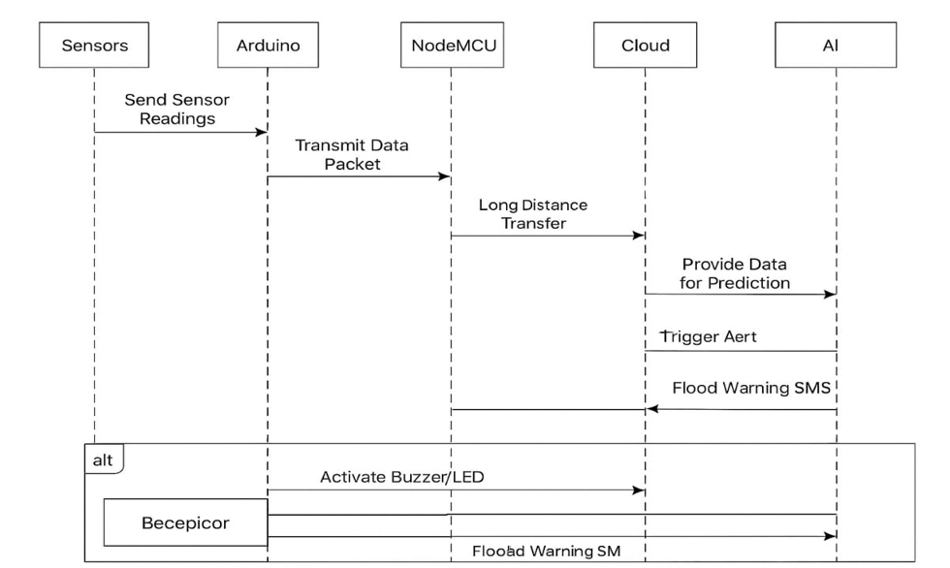
SEQUENCE DIAGRAM

Slide 24
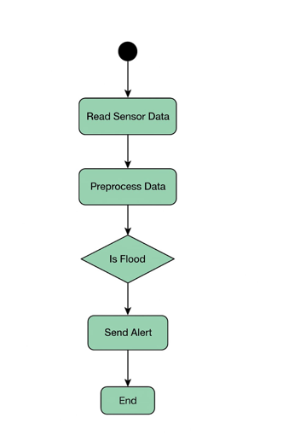
ACTIVITY DIAGRAM

Slide 25
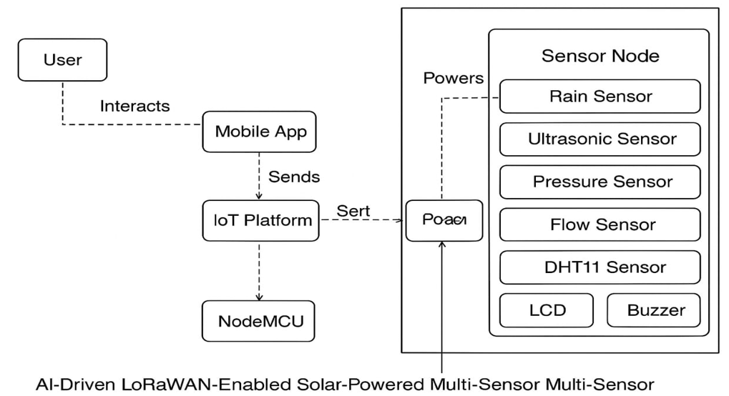
DEPLOYMENT DIAGRAM

Slide 26
RESULTS
Real-time monitoring of rainfall, water level, flow, temperature, and humidity. AI predicts possible flood events in advance. Alerts sent via: LCD display, SMS to authorities. Reliable operation during power failures (solar powered). Long-range communication ensures data from remote areas

Slide 27
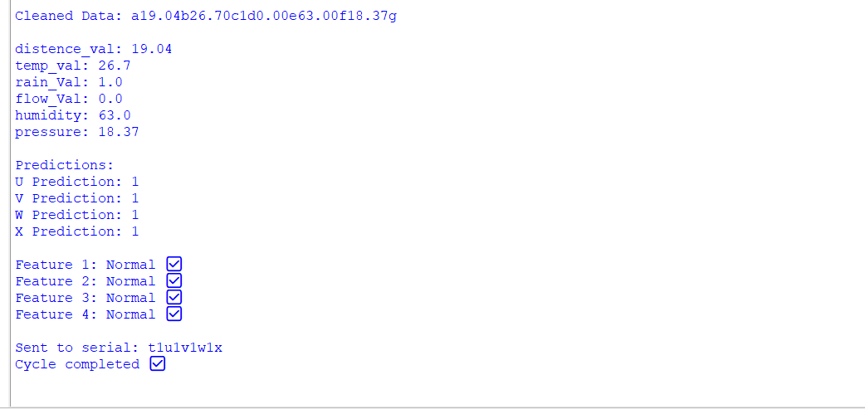
Output Screenshot

Slide 28
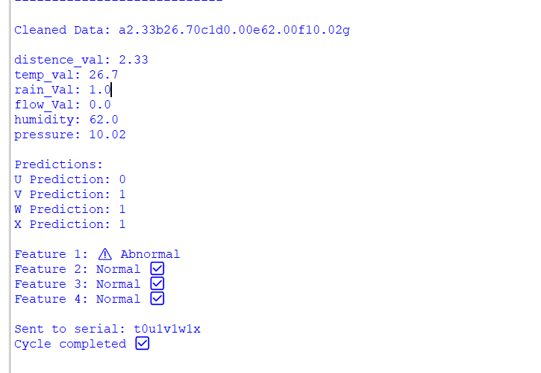
Output Screenshot

Slide 29
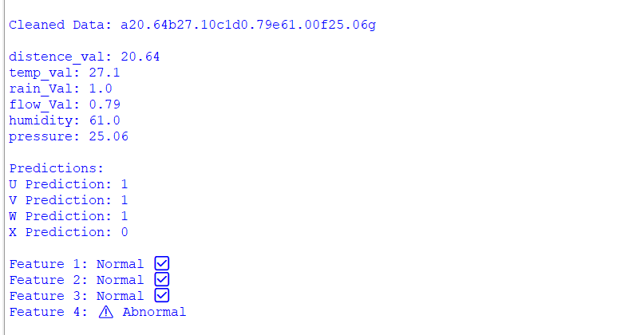
Output Screenshot

Slide 30
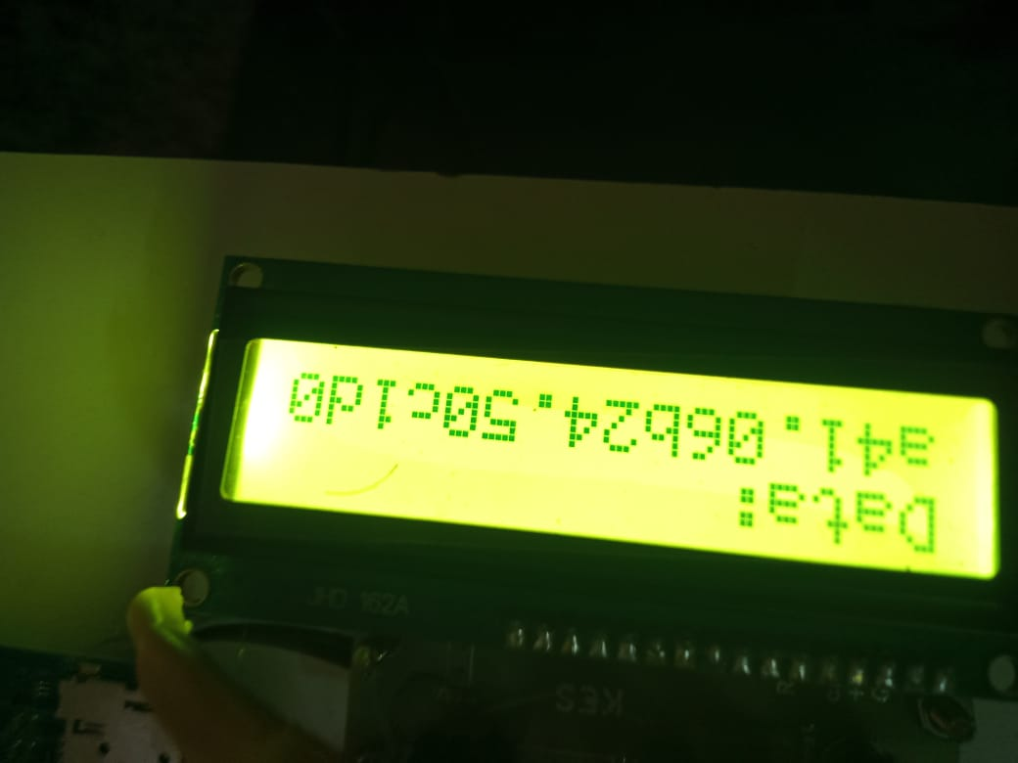
Output Screenshot

Slide 31
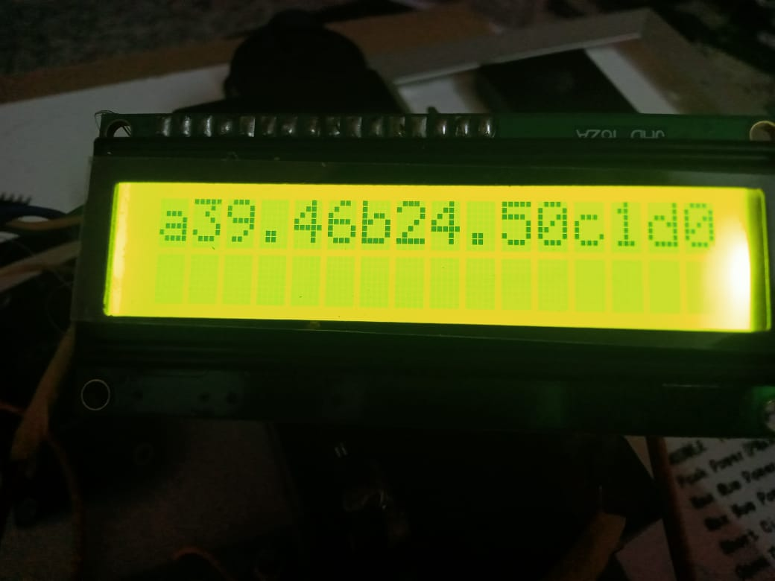
Output Screenshot

Slide 32
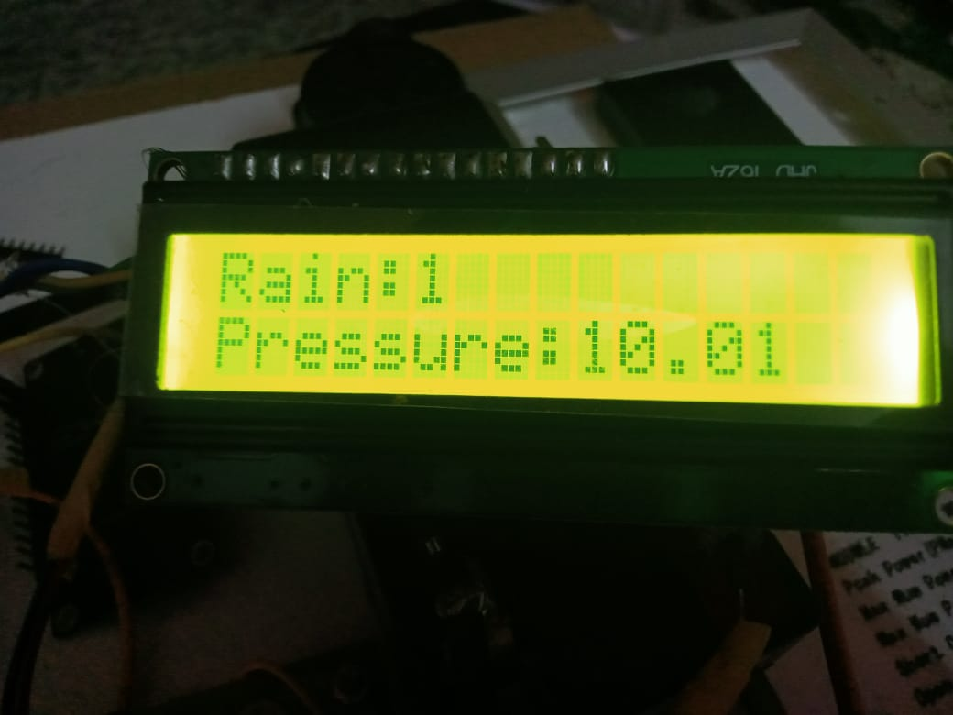
Output Screenshot

Slide 33
CONCLUSION
Smart and reliable flood prediction system
Uses AI, IoT, and multi-sensor data
Provides early warnings through multiple alerts
Solar-powered for continuous operation
Works in remote and power-deficient areas
Reduces flood damage and response time
Scalable and sustainable flood management solution

Slide 34
FUTURE ENHANCEMENT
Add more environmental sensors
Improve AI model accuracy
Integrate mobile app for alerts
Use satellite and weather data
Expand system to large river basins
Connect with government disaster systems

Slide 35
REFERENCES
[1] M. A. Kamal et al., “Requirements, deployments, and challenges of LoRa technology,” Comput. Intell. Neurosci., 2023.
[2] H. S. Munawar, “Flood disaster management: Risks, technologies, and future directions,” 2020.
[3] M. I. Zakaria et al., “LoRaWAN-based IoT flood monitoring and warning system,” Internet of Things Cyber-Physical Systems, 2023.
[4] S. Devalal and A. Karthikeyan, “LoRa technology—An overview,” IEEE ICECA, 2018.
[5] A. Augustin et al., “A study of LoRa: Long range & low power networks,” Sensors, 2016.
[6] N. Baccour et al., “Radio link quality estimation in low-power wireless networks,” ACM Trans. Sens. Netw., 2012.
[7] R. S. Sutton et al., “Machine learning applications for flood prediction,” IEEE Access, 2019.
[8] A. K. Mishra and V. P. Singh, “Flood forecasting using data-driven techniques,” Hydrol. Processes, 2011.
[9] P. P. Ray, “Internet of Things cloud-based smart flood monitoring system,” J. Ambient Intell. Humanized Comput., 2018.
[10] S. S. Sahoo et al., “AI-based flood prediction and early warning systems,” Int. J. Disaster Risk Reduction, 2021.

Slide 36
THANK YOU !!

