Slide 1
Implementation and Evaluation of Network
Anomaly Detection Algorithms

Slide 2
Modules

Slide 3
Control Unit
The Control Unit centrally manages communication between the rest of the modules.

Slide 4
Traffic Capture Module
The Traffic Capture Module captures traffic required for learning phase, and computes traffic statistics as required for the Learning Module.

Slide 5
Learning Module
The LM computes the model probabilities which is later used by the Detection Module (DM) for classification of normal traffic/anomalous traffic.

Slide 6
Detection Module
The Detection Module determines the state of the network (normal or abnormal) in real-time.

Slide 7
Mitigation Module
The Mitigation Module
  When attack flag is not set in any stream, it allows input traffic unaltered.
  When attack flag is set in one or more streams, it filters traffic for the stream(s) on the basis of a white list of source IP's corresponding to the stream.

Slide 8
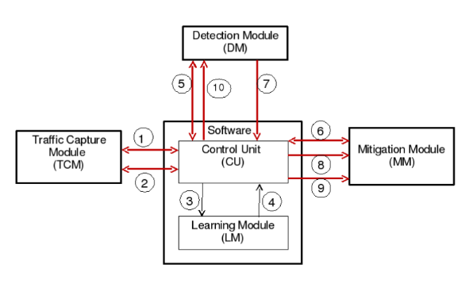
Modules

Slide 9
Algorithms

Slide 10
Deploy
This module tests the input traffic and computes if a window is an attack window or not.
Input: Stream S, filename, Abnormal Window Count (AWC)
Output: State of the system and the window counts

Slide 11
Train Phase Functionality
This procedure initiates training. It calls the training module that trains the NBC against the training dataset. It also calls the module that determines the threshold probability.
Input: Window size N, number of bands K, group count, error proportion t and the filename containing the dataset.
Output: Updated Stream S with learnt probabilities and threshold probability for stream.

Slide 12
Train
This procedure trains the Naive Bayes Classifier using the TCP flags retrieved from the dataset.
Input: Stream S, Flag Array TF, Window size for stream N , number of bands K.
Output: Updated Stream S with learnt probabilities.

Slide 13
Determine Optimal Bands
This procedure groups the events into bands. The band formation is based on the clustering algorithm.
Input: Event array A, window size for stream N, number of bands K.
Output: 2-dimensional array band, containing indices of per group elements in A.

Slide 14
Update Probabilities
This procedure computes and updates the probability based on the events.
Input: TCP Stream S, 2-D array band containing band indices of groups of A, number of bands K, Index of observable type L
Output: Probabilities of all events updated into corresponding probability array W index in stream S

Slide 15
Determine Threshold Probability
This module computes the threshold probability which will be used to classify if a particular window is either an attack window or not
Input: Stream S, Window size for stream N , group count , flag array
Output: Threshold probability Pt for S

Slide 16
Datasets used in the paper
Packet Numbers | Nature of Attack
1-1046 | SYN flooding
1047-2277 | FIN/ACK flooding
2278-2543 | SYN/ACK flooding
2544-2911 | PSH/ACK flooding
2912-3629 | SYN flooding
3630-4806 | RST flooding
4807-6077 | FIN/ACK flooding
6078-16115 | SYN flooding
16116-22934 | ACK flooding
22935-31864 | PSH/ACK flooding
31865-42349 | RST flooding
42350-97649 | FIN/ACK flooding
97650-192549 | SYN flooding
192550-545549 | ACK flooding
545550-1158549 | SYN flooding
DARPA
  Training data - 70,603 packets to port 23.
  Attack traffic ->

Slide 17
Our datasets
DARPA Train – 219600 packets = 1999 Week 1, Monday + Thursday (Dest-172.16.112.50:23)
DARPA 1
  No Attack – 61400 packets - 1999 Week 1, Wednesday (Dest-172.16.112.50:23)
  Attack – 74200 packets - 1999 Week 1, Tuesday + attacks (Dest-172.16.112.50:23)

Slide 18
Our Datasets (contd.)
DARPA 2
  No Attack – 126400 packets - 1999 Week 3, Tuesday + Wednesday (Dest-172.16.112.50:23)
  Attack – 1164 packets - 1999 Week 3, Friday + attacks (Dest-172.16.112.50:23)
DARPA 3
  Attack – 244107 packets (39303 NA / 204804A) - 1998 Week 3, Thursday (Dest-172.16.112.50 all ports)

Slide 19
Accuracy results (t = 0.08)
 |  | Actual |  | Detected |  | Accuracy %
 |  | Normal | Attack | Normal | Attack
DARPA 1 | No Attack file | 614 | 0 | 614 | 0 | 100.00
 | Attack File | 371 | 371 | 377 | 365 | 98.38
DARPA 2 | No Attack file | 1264 | 0 | 1241 | 23 | 98.18
 | Attack File | 582 | 582 | 556 | 608 | 95.53
DARPA 3 | Attack File | 393 | 2048 | 656 | 1785 | 87.16
Thesis | Attack File | 0 | 11594 | 6 | 11588 | 99.95

Slide 20
Accuracy results (t = 0.091)
 |  | Actual |  | Detected |  | Accuracy %
 |  | Normal | Attack | Normal | Attack
DARPA 1 | No Attack file | 614 | 0 | 607 | 7 | 98.86
 | Attack File | 371 | 371 | 371 | 371 | 100.00
DARPA 2 | No Attack file | 1264 | 0 | 1210 | 54 | 95.73
 | Attack File | 582 | 582 | 550 | 614 | 94.50
DARPA 3 | Attack File | 393 | 2048 | 347 | 2094 | 88.30
Thesis | Attack File | 0 | 11594 | 2 | 11592 | 99.98

Slide 21
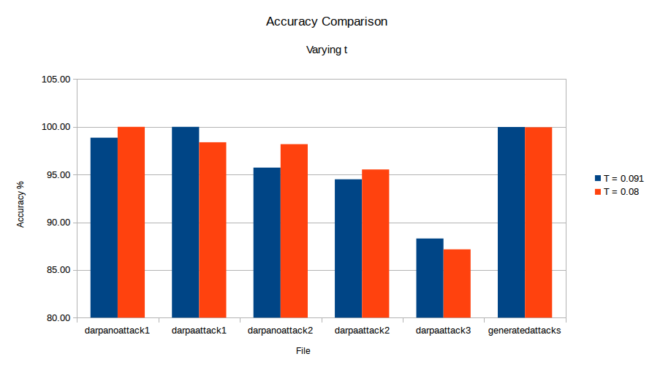
Accuracy Comparison

