Slide 1
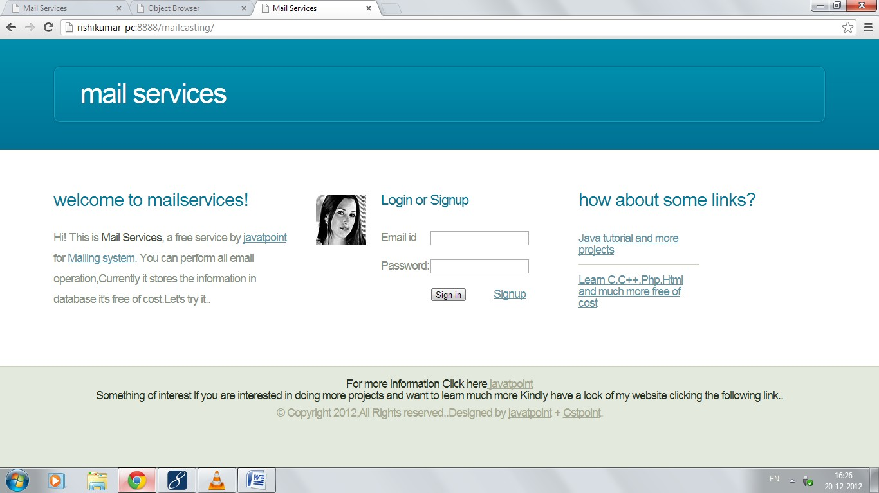
How Mail casting Project Works?
Welcome Page
Steps:
If you are a registered user kindly log in, if you aren’t please signup first.
Signup:

Slide 2
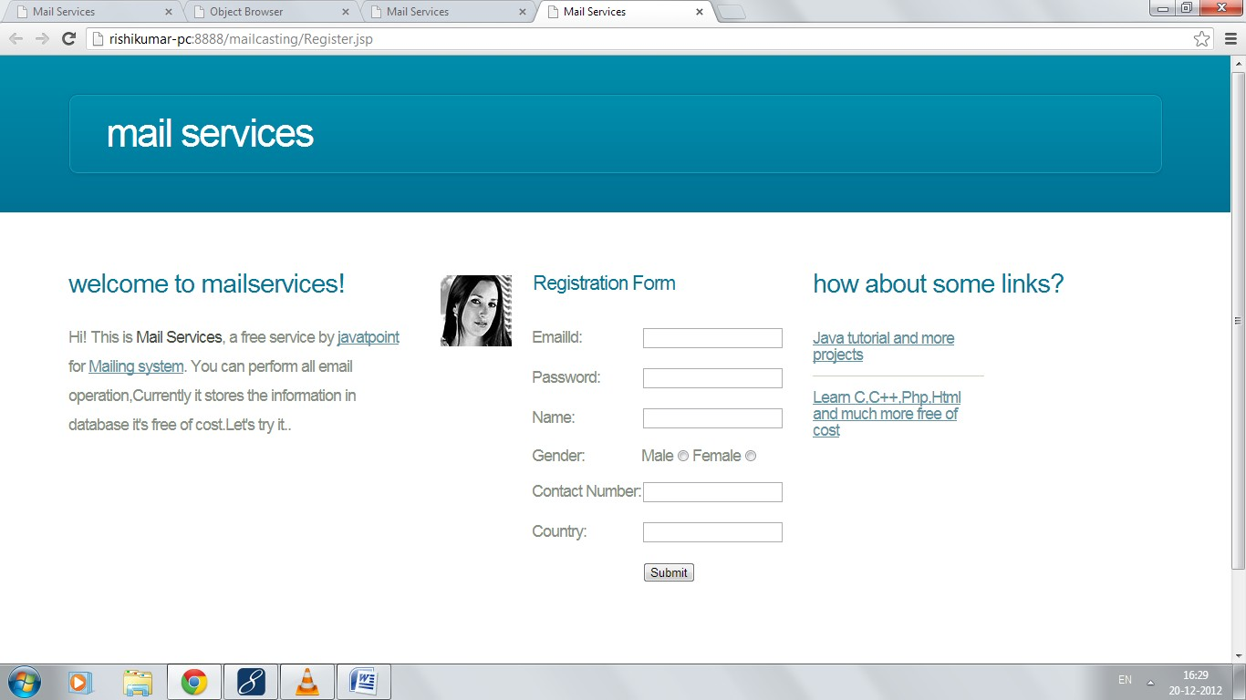
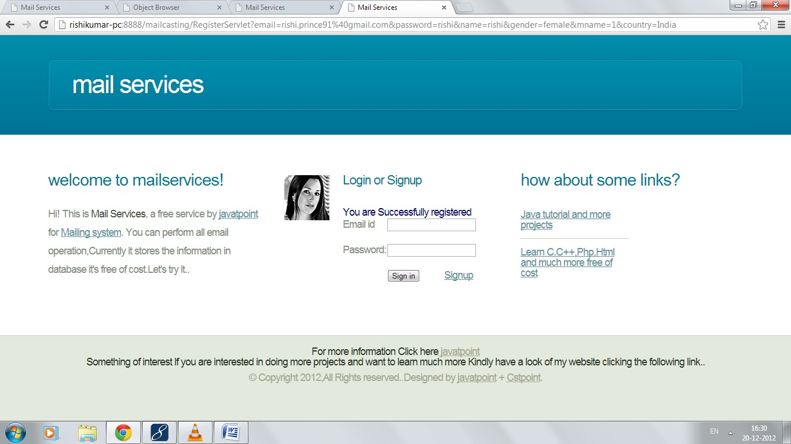
On successful registration:
3. Login:
Login through above page or welcome page.

Slide 3
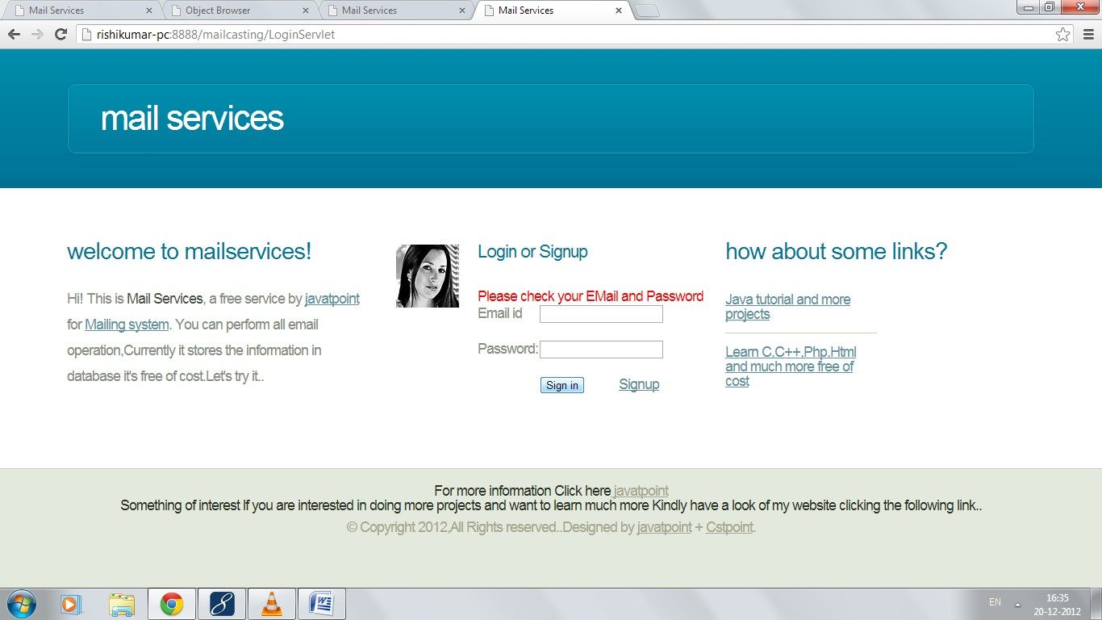
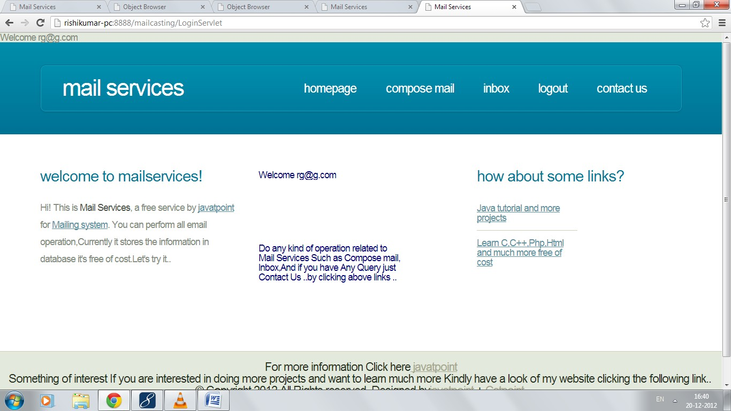
On filling Incorrect Detail:
On filling Correct Detail:

Slide 4
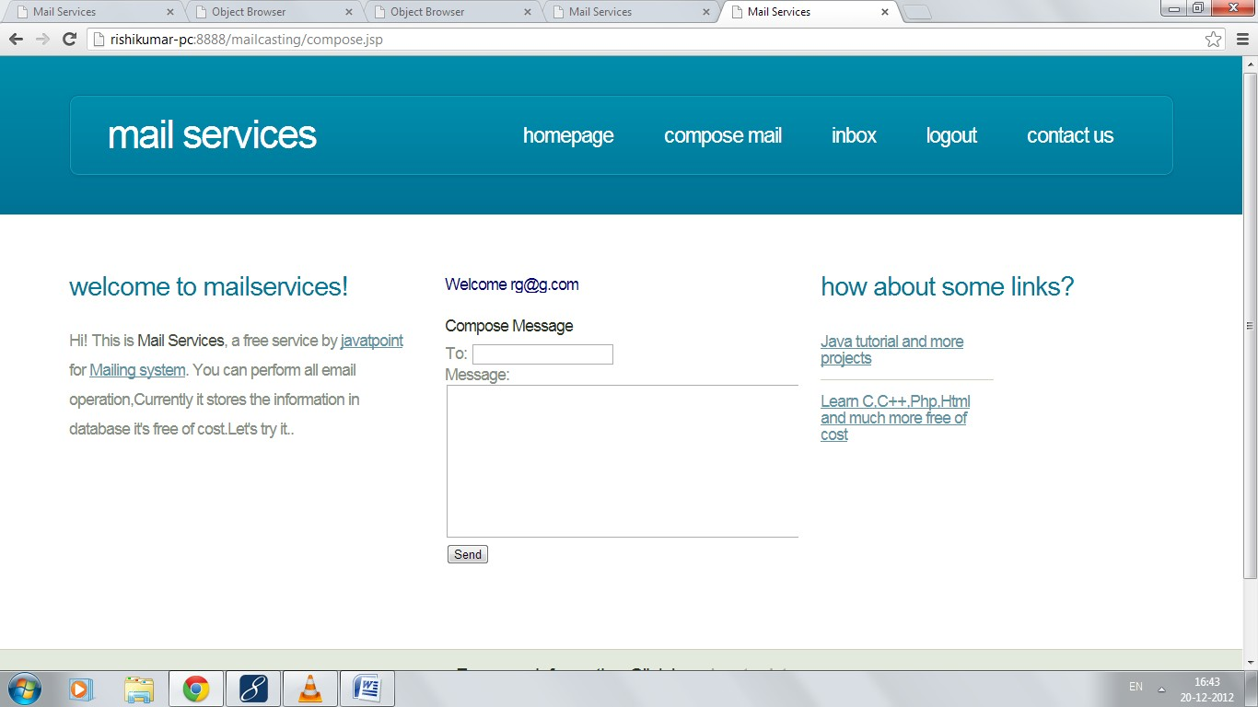
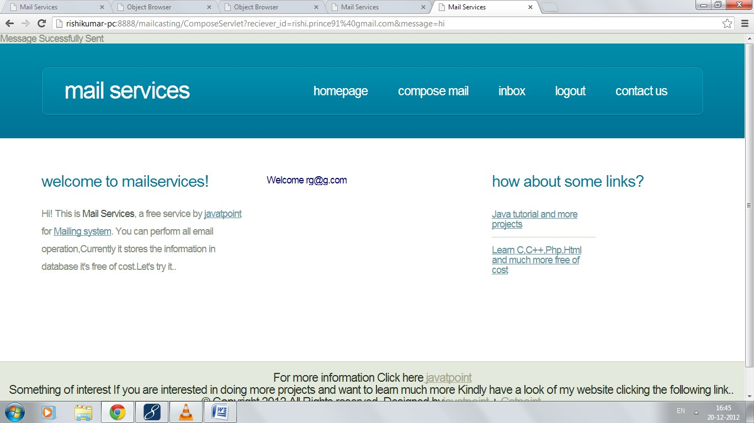
Authorized user can compose mail, can check received mail and can contact to us.
Composing mail:
After sending mail:

Slide 5
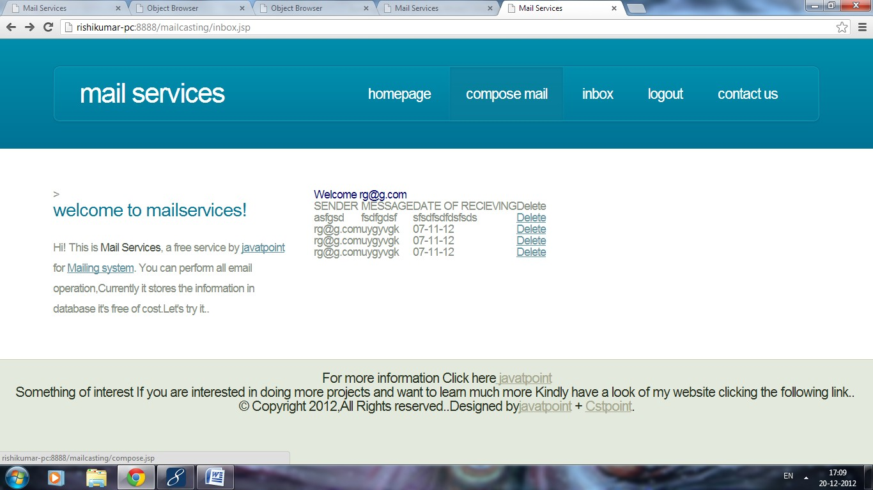
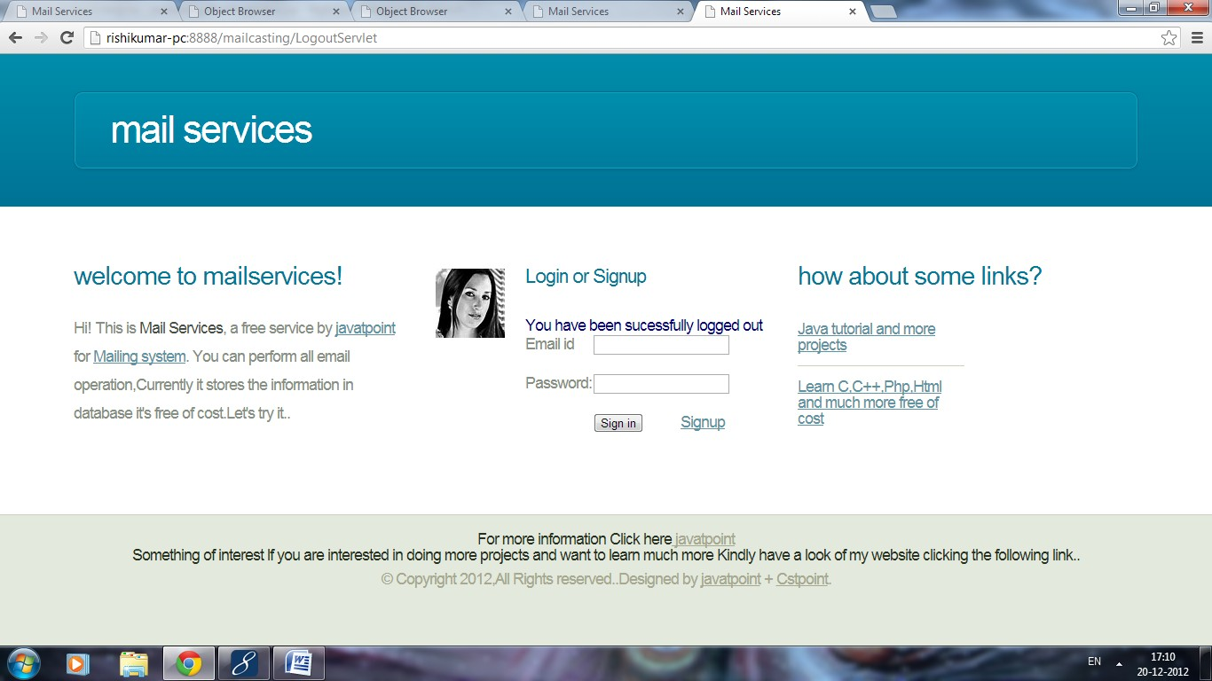
6. Inbox:
7. Logging out:

Slide 6
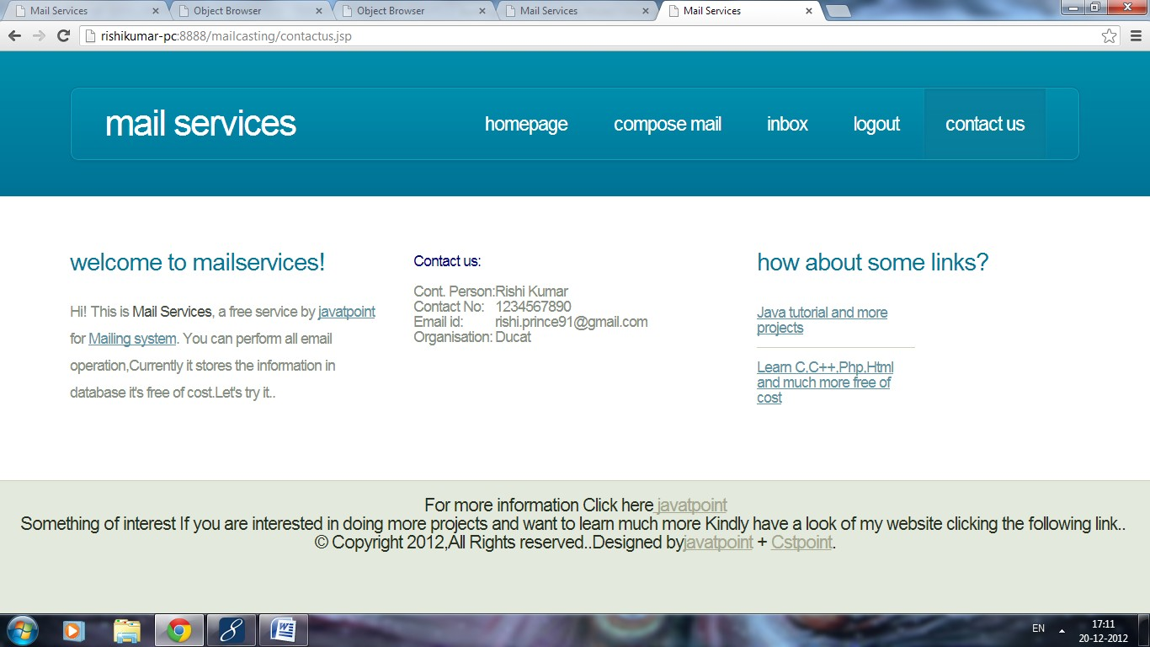
8. Contact us:
This is all about mail casting project……
Good Luck

