Slide 1

Lakshmi Narain College of Technology,Excellence (BHOPAL)
DEPARTMENT OF MECHANICALENGINEERING
Major Project On
Regenerative Braking System
Submitted By
Ankit Barange (0176ME161007)
Kuldeep Lodha (0176ME161017)
Rambabu Dangi (0176ME161033)
RanJeet Jaiswal (0176ME161034)
Submitted To :-
Dr. Shankar Kumar
(HOD Mechanical Department LNCTE
BHOPAL)
Guided by:
Prof. Sachin khare

Slide 2


CONTENTS
Introduction
History
Principle of Regenerative Braking Sys.
Need of Regenerative Braking Sys.
Working of Regenerative Braking Sys.
Types and Elements of Regen. Sys.
Advantages and Disadvantages of RBS
Conclusion and References.

Slide 3

INTRODUCTION
A Regenerative Brake, is an energy recovery mechanism which slows a vehicle or object down by converting its kinetic energy into another form, which can be either used immediately or stored until needed.
A Traditional Braking System, brake pads produce friction with the brake rotors to slow or stop the vehicle. Additional friction is produced between the slowed wheels and the surface of the road. This friction is what turns the car's kinetic energy into heat.

Slide 4

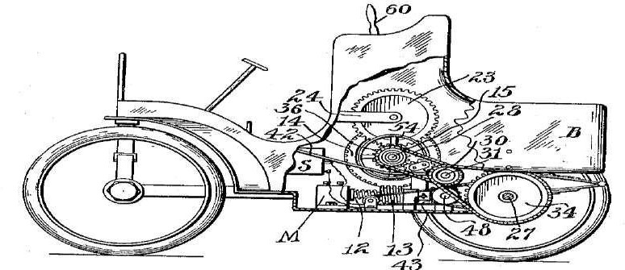
HISTORY
In 1908 C.J. Paulson Patented a smart car with Regenerative Braking System.

Slide 5
The “Energy Regeneration Brake” system was developed in 1967 by American Motors Corporation (AMC) in cooperation with Gulton Industries.
The Energy Regeneration from braking idea was later commercialized by the Japanese and both Ford & Chevrolet licensed it from Toyota for use in their domestic built hybrid Vehicles.
During the late 2000s, an electronic control unit used by BMW that engages the alternator during braking.

Slide 6

PRINCIPLES OF REGENERATIVE BRAKING
Law of Conservation of Energy states that the total energy of an isolated system cannot change it is said to be conserved over time. Energy can be neither created nor destroyed, but can change form, for instance chemical energy can be converted to kinetic energy in the explosion of a stick of dynamite.
The most common form of regenerative brake involves using an electric motor as an electric generator. the generated electricity is fed back into the supply system, whereas in battery electric and hybrid electric vehicles, the energy is stored chemically in a battery

Slide 7

NEED OF REGENERATIVE BRAKING
Regenerative braking have the potential to improve the fuel economy of vehicles.
The price increase of petroleum based fuel
also given rise to various research and
development efforts in energy conservation.
It reduces the emission of the vehicles.
It improved the fuel consumption by 33%.

Slide 8


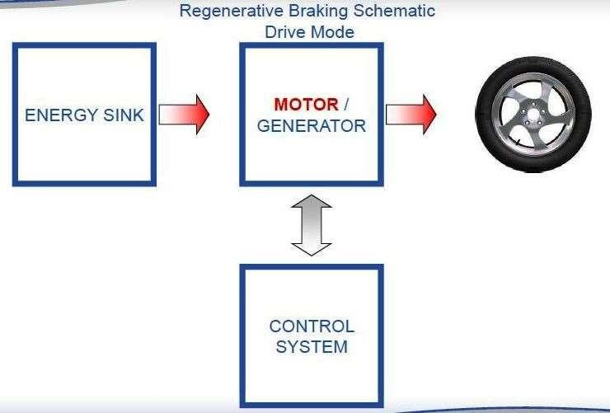
WORKING OF REGENERATIVE BRAKING SYS.

Slide 9
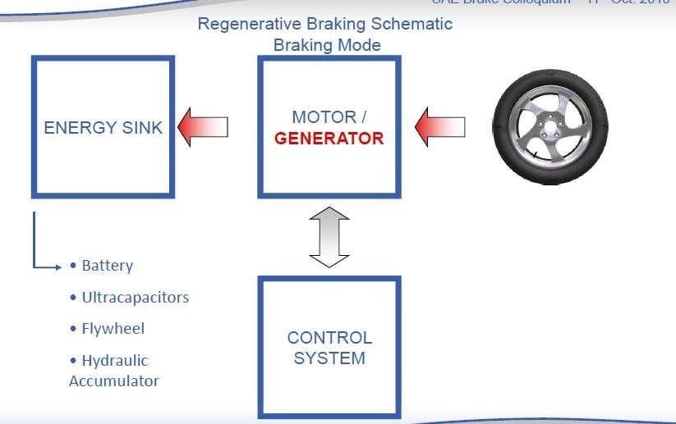

Slide 10



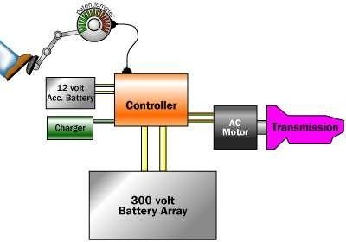
COMPONENT OF REGENERATIVE BRAKING SYSTEM IN EV’S
Fig.-1 Regenerative Braking circuit

Slide 11



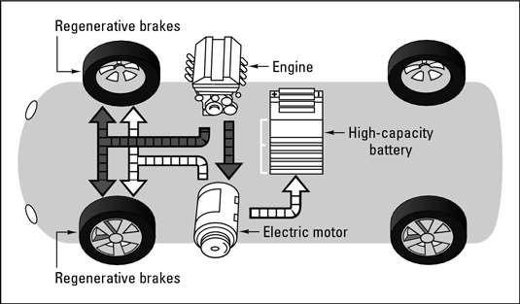
REGENERATIVE BRAKING SYSTEM IN HYBRID VEHICLES
A vehicle which contains two such sources of propulsion is known as hybrid system.
A hybrid vehicle consist a series and a parallel circuit of motor and the ICE.

Slide 12


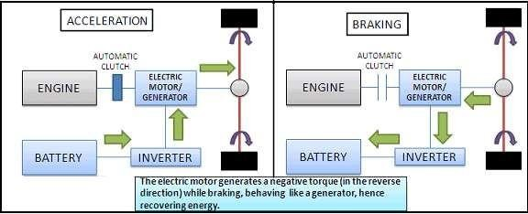
CIRCUIT DIG. OF REGENERATIVE BRAKING SYSTEM IN HYBRID CAR
Fig.-2 Circuit Dig. of Reg. Braking in Hybrid Car

Slide 13


WORKING OF REGENERATIVE BRAKING SYSTEM IN HYBRID & EV’S
Regenerative braking is used in vehicles that make use of electric motors, primarily fully electric vehicles and hybrid electric vehicles.
It's run in one direction, it converts electrical energy into mechanical energy.
When the motor is run in the opposite direction, a properly designed motor becomes an electric generator, converting mechanical energy into electrical energy.
This electrical energy can then be fed into a charging system for the car's batteries.

Slide 14


ELEMENTS OF REGENERATIVE BRAKING SYSTEM
Energy Storage Unit (ESU) :
The ESU performs two primary Functions:
To Recover & Store Braking Energy.
To absorb excess engine energy during light operation.
The Selection Criteria for an effective energy Storage
includes.
load
High specific energy storage density.
High energy transfer rate.
Small space requirement.
The Energy recaptured by regenerative braking might be stored in one of three devices , an Electrochemical battery, a Flywheel, & a Hydraulic Accumulator.

Slide 15

REGENERATIVE BRAKING WITH BATTERIES
Regenerative braking is used in vehicles that make use of electric motors, primarily fully electric vehicles and hybrid electric vehicles.
It's run in one direction, it converts electrical energy into mechanical energy.
When the motor is run in the opposite direction, a properly designed motor becomes an electric generator, converting mechanical energy into electrical energy.
This electrical energy can then be fed into a charging system for the car's batteries.

Slide 16

REGENERATIVE BRAKING WITH FLYWHEELS
In this system, the translational energy of the vehicle is transferred into rotational energy in the flywheel, which stores the energy until it is needed to accelerate the vehicle.
The benefit of using flywheel technology is that more of the forward inertial energy of the car can be engaged even during relatively short intervals of braking and acceleration. In the case of the batteries, they are not able to accept charge at these rapid intervals, and thus more energy is lost to friction.

Slide 17

CONTINUOUSLY VARIABLE TRANSMISSION
The Energy storage unit requires a transmission that can handle torque and speed demands in a steeples manner and smoothly control the energy flow to and from the vehicle wheels. For the flywheel the continuously variable transmission and vehicle because flywheel rotational speed increase when vehicle speed decrease and vice versa.
A continuously variable transmission is one of the most common forms of variator mechanism, which varies the speed.
The following types of CVT is used:
Hydrostatic CVT.
Electrical or Electromagnetic CVT.
Mechanical CVT.

Slide 18

CONTROL SYSTEM OF REGENERATIVE BRAKING
An ON-OFF engine control system is used. That means that the engine is ON until the energy storage unit has been reached desired charge capacity and then is decoupled and stopped until the energy storage unit charge fall below its minimum requirement.
Brake controllers are electronic device that can control brakes remotely, deciding when braking begins ends, and how quickly the brake need to be applied.
During the braking operation the brake controller directs the electricity produced by the motor into the batteries or capacitors.

Slide 19

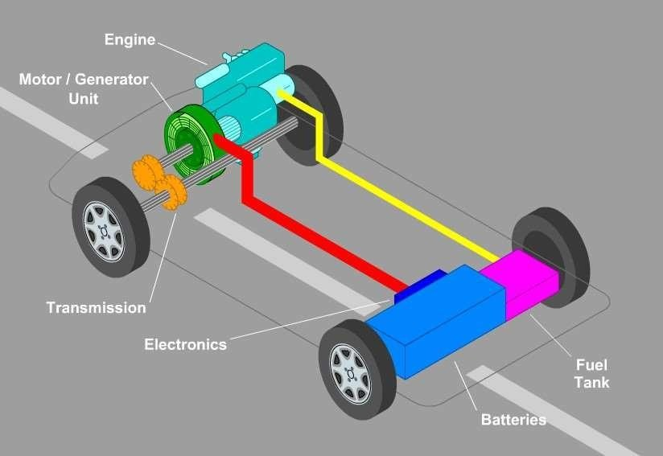
DIFFERENT TYPES OF REGENERATIVE BRAKING SYSTEM
Electric Regenerative Braking System.
In an Electric System which is driven only by means of electric motor the system consists of an electric motor which acts both as generator and motor.

Slide 20
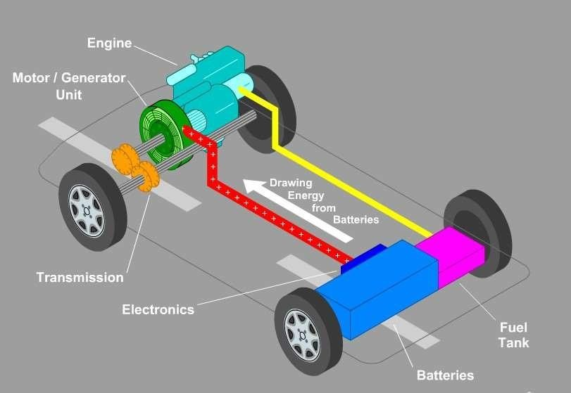
The Main Component of Electric Regenerative Braking System.
Engine
Motor/Generator
Batteries
Electronic Control System`

Slide 21
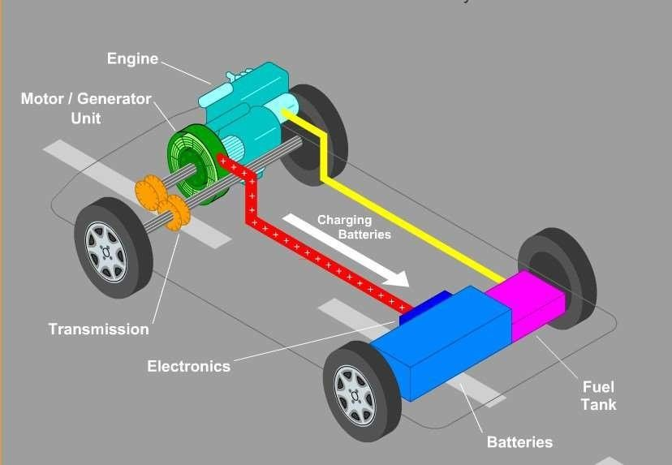
During acceleration, the motor/generator unit acts as electric motor drawing electrical energy from batteries to provide extra driving force to move the vehicle.
During braking electric supply from the battery is cut off by the electronic system.
Showing Charging of Battery when Brake Applied

Slide 22
Hydraulic Regenerative Braking System
To improve the vehicle fuel economy an alternative regenerative braking system is being developed by the Ford Motor Company and the Eaton Corporation. It is called Hydraulic Power Assist or HPA.
In this system when the driver steps on the brake, the vehicle’s Kinetic energy is used to power a Reversible pump.
This Reversible Pump sends hydraulic fluid from a low pressure accumulator inside the vehicle into a high pressure accumulator. This slow the vehicle and helps bring it to stop
The fluid remains under pressure in the accumulator, until the driver pushes the accelerator again.

Slide 23
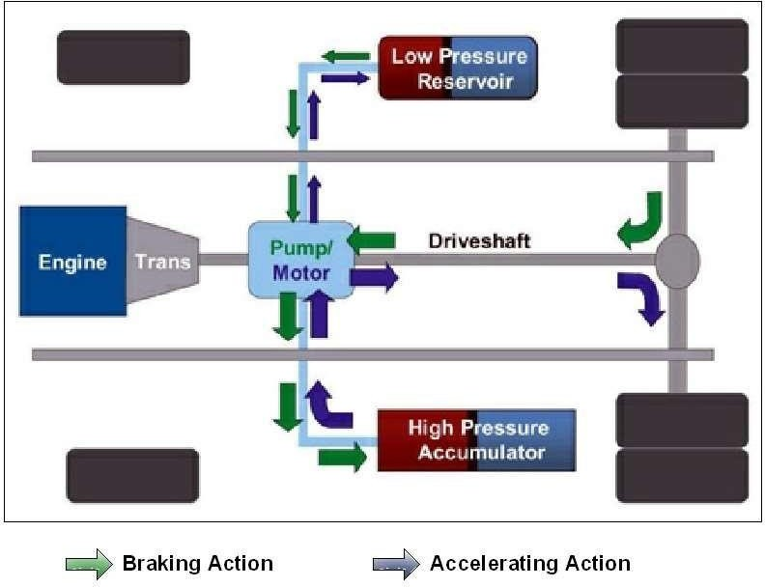
During braking, the vehicle’s Kinetic energy drives the pump transferring hydraulic fluid from the low pressure reservoir to the high pressure accumulator. The fluid compresses the nitrogen gas in the accumulator and pressurize the system.
During acceleration, fluid in high pressure accumulator is metered out to drive the pump as a motor. The system propels the vehicle by transmitting torque to the driveshaft.

Slide 24

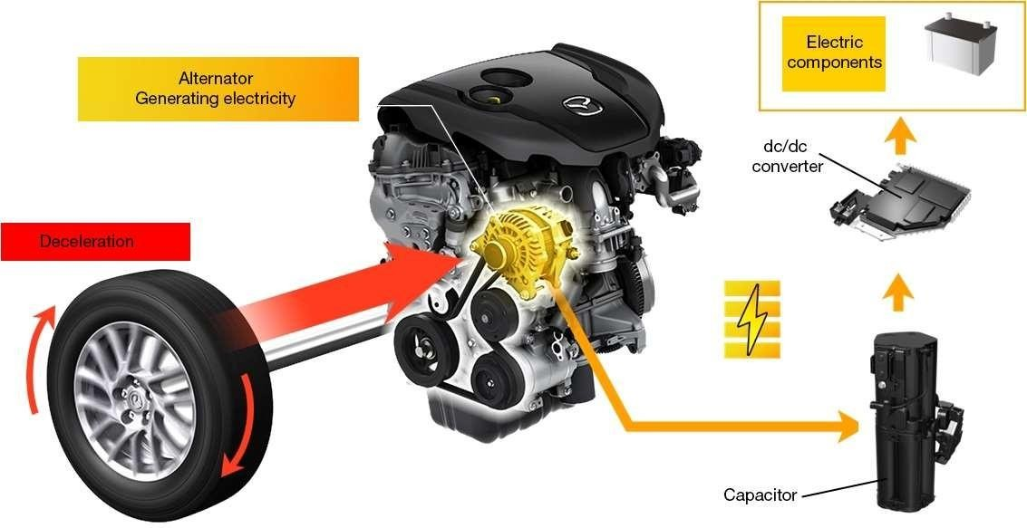
APPLICATION OF REGENERATIVE BRAKING SYSTEM
SUPER-CAPACITOR IN MAZDA A-6

Slide 25
Super capacitor accept and release charge much more quickly.
It can be discharged and recharged many more times and with far deterioration than a battery.
The Mazda Unit can accept a full charge in just 8- 10 seconds
The capacitor may take up to about 113s when the load is at minimum about 18A.

Slide 26

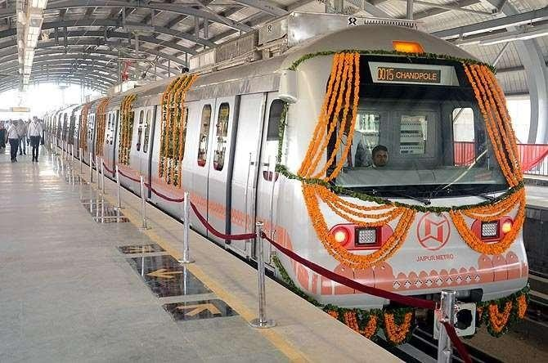
REGENERATIVE BRAKING SYSTEM IN LOCOMOTIVES
Jaipur Metro uses the Regenerative
Braking
System & saves 35% of Electricity.

Slide 27

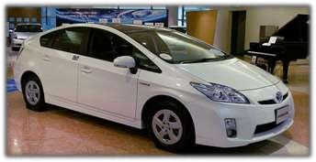

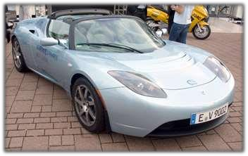

CAR WITH REGENERATIVE BRAKING SYSTEM
Toyota Prius
Honda Insight
Ford Escape Hybrid
Tesla Roadster
Chevy Volt
Fig.5-Toyota Prius
Fig.6-Tesla Roadster

Slide 28


ADVANTAGES OF REGENERATIVE BRAKING SYSTEM
Increase of overall energy efficiency of a vehicle.
Improved Performance.
Emission Reduction.
Reduction in Engine Wear.
Cuts down on pollution related to electricity generation.
Increases the lifespan of friction braking systems.
Smaller Accessories.
Less use of traditional mechanical brakes leads to less wear over time

Slide 29

DISADVANTAGES OF REGENERATIVE BRAKING SYSTEM
Added Weight-Extra components can increase weight.
Complexity-depends on control necessary for operation of regenerative braking system.
Cost of components, engineering, manufacturing and installation is high.
Friction brakes are still necessary.
Safety-Primary concern with any energy storage unit of high energy density.
Added maintenance requirements dependent on the complexity of design.

Slide 30
Conclusion
Regenerative braking is an effective method of improving vehicle efficiency and longevity
Is already in use in many EVs
The technology to do it exists and is often well worth it
Mostly dependent on the wider adoption of EVs or further development of hydraulic regeneration systems

Slide 31

REFERENCES
1Sergio Vazquez, Srdjan Lukic, Eduardo Galvan, Leopoldo G. Franquelo, Juan M. Carrasco and Jose I. Leon, “Recent Advances on Energy Storage Systems”, IEEE Transaction on Industrial Electronics, Dec 2010
2Kuruppu Sandun, “Implementaion and Performance Evauation of Regenerative Braking System Coupled Ultra capacitor for a Brushless DC Hub Motor Driven Electric Tricycle”, College of Technology Master Theses, Paper 3 (2010)
3Cibulka,J, “Kinetic Energy Recovery System by Means of Flywheel Energy Storage”, ISSN 1846-5900,3(2009)
4M.Rakesh, P.V.R.L. Narasimham, “Different Braking Techniques Employed to a Brushless DC Motor Drive Used in Locomotives”, International Electrical Engineering Journal (IEEJ) Vol.3 No.2, pp.784-790 ISSN 2078-2365 (2012)
5 Qingsheng Shi, Chenghui Zhang, and Naxin Cui, D. Jin and S. Lin, “An Improved Electrical Vehicle Regenerative Braking Strategy Research”, Advances in CSIE, Vol. 2, AISC 169,pp.637-642, 2012
6Zhongpeng Yu, Liang Chu, Kun Ma, Lipeng Ren, “Coordinated Control of Regenerative Braking System for a Hybrid Electric Bus”, 2nd International Conference on Electronic & Mechanical Engineering and Information Technology, EMEIT-2012

Slide 32
[7] Ying HUANG, Fuyuan YANG, Minggao OUYANG, Lin CHEN, Guojing GAO, Yongsheng He, “An Efficient Energy Regeneration System for Diesel Engine”, World Electric Vehicle Journal Vol. 4 –ISSN 2032-6653, Nov 5-9, 2010
8Junzhi Zhang, Xin Lu, Junliang Xue, and Bos Li, “Regenerative Braking System for Series Hybrid Electric City Bus”, The World Electric Vehicle Journal, Vol. 2 , Issue 4 0363-0369, ISSN 2032-6653, 2008
9Wim J.C. Melis, Owais Chishty, “Fully Regenerative Braking and Improved Acceleration for Electrical Vehicles”, International Journal of Sustainable Energy Development (IJSED), Volume 2, Issue 1and 2, March/June, 2013
10Jarrad Cody, Özdemir Göl, Zorica Nedic, Andrew Nafalski, Aaron Mohtar, “Regenerative Braking in Electric Vehicle”, University of South Australia,2009
11M. M. Tehrani, M. R. Hairi -Yazdi, B. Haghpanah-Jahromi, V. Esfahanian, M. Amiri and A. R. Jafari, “Design of Anti Lock Regenerative Braking System for a Series Hybrid Electric Vehicle”, International Journal of Automotive Engineering, Vol. 1 Number 2, June 2011

Slide 33
[12] S.J. Clegg, “A Review of Regenerative Braking Systems”, Institute of Transport Studies, University of Leeds, Working Paper 471, 1996
13ER. Amitesh Kumar, “Hydraulic Regenerative Braking System”, International Journal of Scientific & Engineering Research Volume 3 , Issue 4, ISSN 2229-5518, April – 2012
14Juan W. Dixon & Micah E. Ortuzar, “Ultra capacitor + DC-DC Convertors in Regenerative Braking System”, IEEE AESS System Magazine, August 2002
15 Radhika Kapoor, C. Mallika Parveen, Member, IAENG, “Comparative Study on Various KERS”, Proceeding of the World Congress of Engineering, Vol. 3, July 2013
16Christopher Dumm, Joseph Sadecky, “Continuously Variable Power Transmission and Regenerative Braking Increasing Automotive Mechanical Efficiency”, University of Pittsburgh Swanson School of Engineering, Session B4, April, 142012.
17Spencer Evans ,Matt Hilger , “Regenerative Braking: Stopping Doesn’t Have To Slow You Down”, University of Pittsburgh Swanson School of Engineering, Session B5, April, 14 2012.

Slide 34
THANK YOU…

