Slide 1



ONLINE VOTING SYSTEM
- ENHANCING DEMOCRACY THROUGH TECHNOLOGY

Slide 2
OUR TEAMMATES
MAHIJA.M
- who writes the code and code executer
K.NANDHINI M.USHA RANI
- Advicer of the project -PPT text designer
M.POOJITHA

Slide 3
Introduction
An online voting system is a digital platform that enables citizens to cast their votes securely via the internet.
This method aims to increase voter turnout, improve accessibility, and reduce costs associated with traditional voting.
This presentation covers its architecture, benefits, challenges, and real-life applications.

Slide 4

ONLINE VOTING SYSTEM
AIM:Write a C Program on online voting system
SOURCE CODE:CLICK HERE TO GET THE CODE

Slide 5
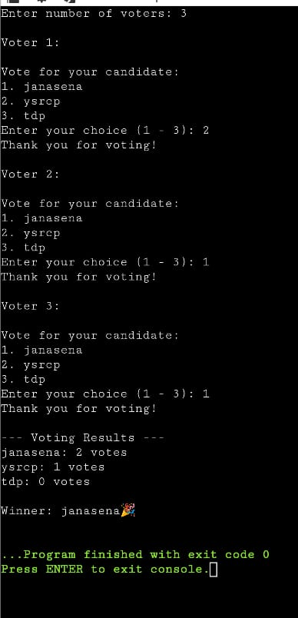
OUTPUT

Slide 6
Traditional vs Online Voting
Traditional Voting:
- Requires physical presence at polling stations
- Paper-based process prone to human error
Online Voting:
- Enables remote participation
- Reduces logistical issues
- Offers faster result compilation

Slide 7
Objectives of the Online Voting System
1. Improve voter accessibility, especially for people with disabilities and remote areas.
2. Ensure transparency and trust in the election process.
3. Maintain data security and voter privacy.
4. Increase efficiency in vote casting and counting.

Slide 8
System Architecture
Frontend:
- User interface for voters and administrators
Backend:
- Secure servers and encrypted databases
Admin Panel:
- Controls voter management, monitoring, and result processing

Slide 9
Workflow of the System
1. User Registration: Voter creates an account and submits identity documents.
2. Verification: System verifies authenticity of user credentials.
3. Voting: Authenticated users cast their votes.
4. Vote Storage: Votes are securely stored and counted.

Slide 10
Technologies Used
Frontend: HTML, CSS, JavaScript for user interface
Backend: PHP, Python, Node.js for server-side logic
Database: MySQL or MongoDB for storing voter data
Security: SSL, HTTPS, data encryption

Slide 11
Voter Registration Module
The module captures voter details such as name, ID proof, and contact info.
It includes a verification step using OTP/email confirmation to validate authenticity.
A unique voter ID is generated for secure access.

Slide 12
Voting Process Module
Users log in using secure credentials.
They are presented with the ballot interface.
Once a vote is cast, a confirmation is shown, and no further votes can be cast by the same ID.

Slide 13
Security Features
1. End-to-end encryption for vote transmission.
2. Multi-factor authentication for voter login.
3. Use of blockchain for tamper-proof vote storage.
4. Regular security audits and monitoring.

Slide 14
Advantages of Online Voting
1. Convenient for remote and disabled voters.
2. Faster and accurate vote counting.
3. Reduced costs for logistics and manpower.
4. Encourages higher voter turnout.

Slide 15
Challenges and Risks
1. Risk of cyberattacks like hacking or phishing.
2. Ensuring digital literacy among all voters.
3. Technical failures or outages.
4. Legal challenges in adapting existing electoral laws.

Slide 16
Case Studies / Real-Life Examples
Estonia:
- First country to implement nationwide online voting (i-Voting)
India:
- Conducted trials for remote voting for migrant workers
Other Examples:
- Switzerland, Canada, and pilot tests in the U.S.

Slide 17
Future Scope
1. Integration with biometric authentication and mobile apps.
2. AI for detecting and preventing fraud.
3. Wider adoption in developing countries.
4. Enhancements through blockchain and decentralized technologies.

Slide 18
Conclusion
Online voting is a promising innovation in democratic processes.
While it offers many advantages, addressing security and accessibility is crucial.
With technological advancement, it can become a reliable voting method worldwide.

Slide 19
THANK YOU

