Slide 1
DATA VISUALIZATION USING PYTHON
AirLens
A desktop dashboard for daily air quality in 12 Indian cities — CSV charts, a clickable map, and an honest live reading.
github.com/mahik504/AirLens

Slide 2
02 / 06
Dataset and stack
The CSV
12 cities · 2018–2020 · about 13,152 days
Ahmedabad, Amritsar, Bengaluru, Chennai, Delhi, Hyderabad, Jaipur, Kolkata, Lucknow, Mumbai, Patna, Visakhapatnam.
Columns used: City, Date, PM2.5, PM10, NO2, SO2, CO, O3, AQI, AQI_Bucket.
Blank AQI rows are dropped. Pollutant gaps use that city’s median.
Every chart number comes from this file. That is the assignment dataset.
How it runs
Python · FreeSimpleGUI · Pandas · NumPy
Matplotlib · Seaborn
Live air: Open-Meteo over urllib. No API key. No extra packages.
pip install -r requirements.txt
python app.py
Window opens maximised. Charts follow the window size.
python app.py · data/city_day.csv

Slide 3
03 / 06
Four screens, then the map
01
Overview
02
City explorer
National average AQI, most polluted and cleanest cities, category donut, AQI histogram. Sidebar Now is live Open-Meteo for Delhi.
Pick a city. The large number is the last day in the CSV (end of 2020 here), not the live API. Pollutant bars and monthly AQI sit beside it.
03
Comparison
04
Trends
Top 10 cities by average AQI. Heatmap is z-scored so CO is not crushed by PM10. Click a bar to jump to that city’s map.
Monthly AQI, a 3-month rolling average, and the worst month marked. The large number is that worst-month average.

Slide 4
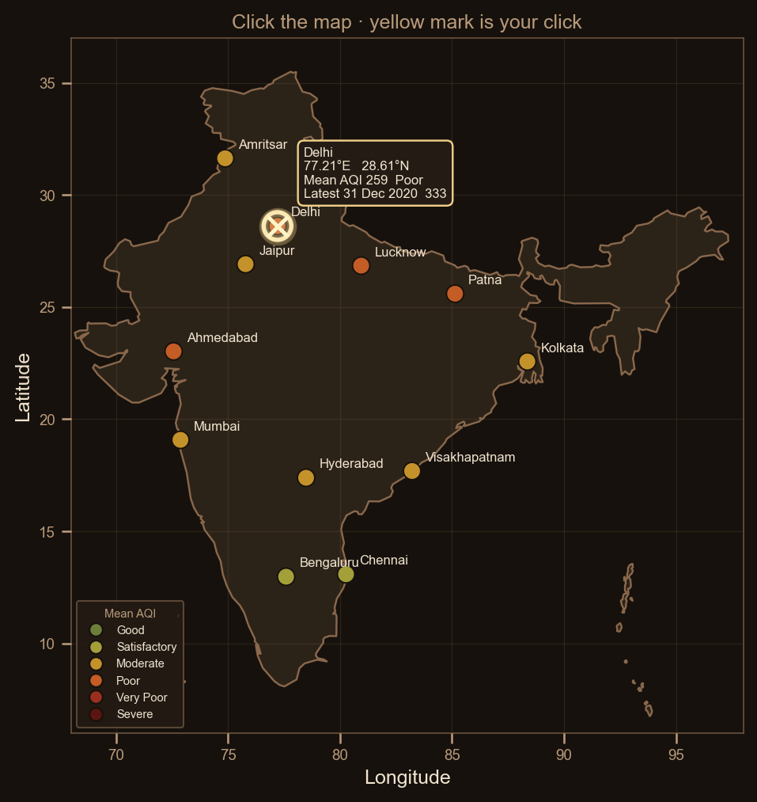
04 / 06
Map and live Open-Meteo
India outline under the cities
A local 2D country silhouette. CPCB-coloured dots, labels, selected-city ring, and the click mark sit on top.
Click anywhere: yellow glow + X at that lon/lat, a card with CSV AQI for the nearest city, a dotted line to it.
Live Now line is Open-Meteo EAQI. Charts stay on the 2018–2020 CSV.
EAQI is not CPCB AQI. Do not mix the two scales.

Slide 5
05 / 06
What we will say in the viva
CSV is history
The file ends 31 Dec 2020. It is not today’s CPCB bulletin.
Two AQI scales
Live EAQI is European. Chart colours follow CPCB bands on the CSV only.
Offline still works
If Open-Meteo is unreachable, the dashboard still runs. The Now line says so.
Visualisation, not a forecast
No machine learning, no login, no government product claim.

Slide 6
AIRLENS
Thank you
Team name
Add the group name and members before the viva
github.com/mahik504/AirLens

