Slide 1
July 26, 2021
Employee attrition analysis
Sta-380
Group 1:
Brent Hensley
Connor Gilmore
Christian Alfonso
Mahika Bansal
Rahul Singla
Neha Dipali

Slide 2
Presentation flow
Introduction and Exploratory Data Analysis
Modeling
KNN
Tree
Logistic Regression
Model Performance Evaluation
Insights and Recommendations

Slide 3

Introduction
Attrition:
Employees leaving their companies
44.3% turnover in 2019 (Bureau of Labor Statistics)
Costly and timely to replace

Slide 4
dataset
Introduction
Problem statement
Sourced from Kaggle
1,470 records with ~35 variables
19.2% Attrition Rate
Predicting Employee Churn
Identifying key variables contributing to Employee Churn
Notes:
-list some data points (attrition, age, pay, satisfaction, travel, department, time at the company, time since their last promotion)
-237 employees left
Goal of predicting whether an employee stays or goes

Slide 5
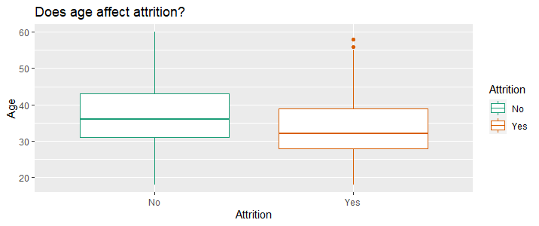
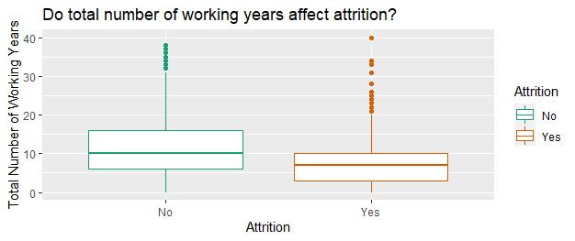
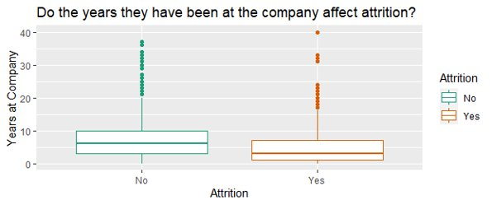
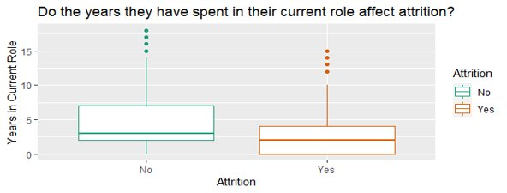
Preliminary Analysis and Data Preparation

Slide 6
Modeling – knn
Scaled Non-Categorical Data
Normal & Oversampled
Statistically significant variables – 1% level
Business Travel
Environment Satisfaction
Job Satisfaction
# Companies Worked At
Overtime
Marital Status

Slide 7
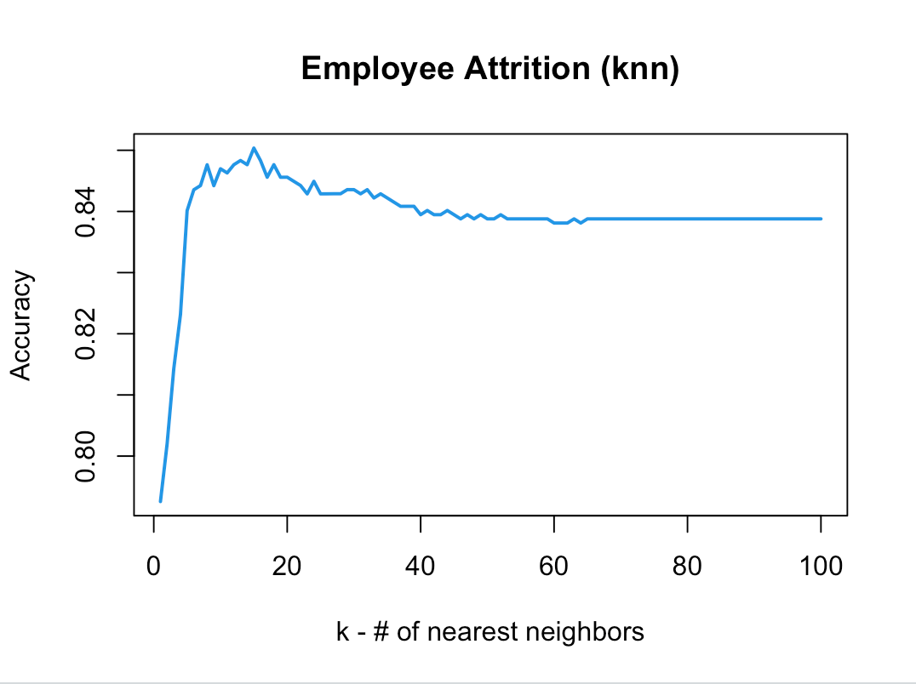
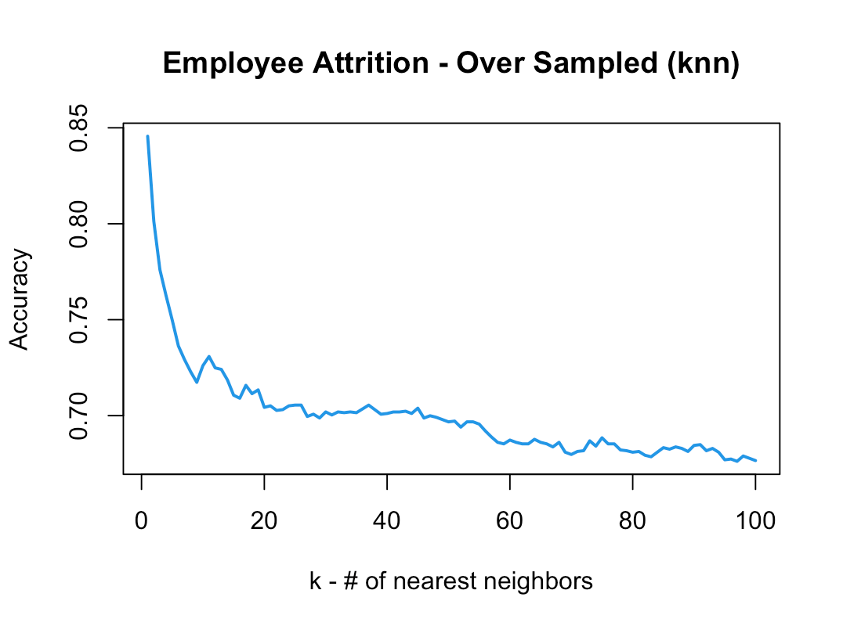
Modeling – knn
highlights

Slide 8
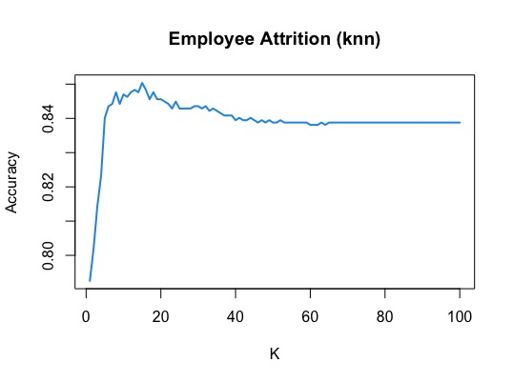
Modeling – knn
highlights
K = 15
Accuracy: 85.03%

Slide 9



Modelling - TREES & ENSEMBLE METHODS
BOOSTING PROVED TO BE THE MOST EFFICIENT ALGORITHM AMONG THE ENSEMBLE METHODS FOR ATTRITION FORECASTING
EDA, FEATURE ENGINEERING & SELECTION
Accuracy
Insights
Model with all variables: 75.51%
Model with subset: 75.17%
High variance, low accuracy
Ensemble models required
Decision Tree
Model with all variables and class wts(5:1): 87.76%
Model with subset and class wts(5:1): 86.05%
Improved accuracy
Class weights helped improve recall
Model with previously done feature subset selection didn’t work well
Random Forest
Model with all variables and further cross validation: 87.41%
Model with subset 87.07%
Similar accuracy with CV, better recall
Model with subset selection still didn’t perform well
Boosting

Slide 10
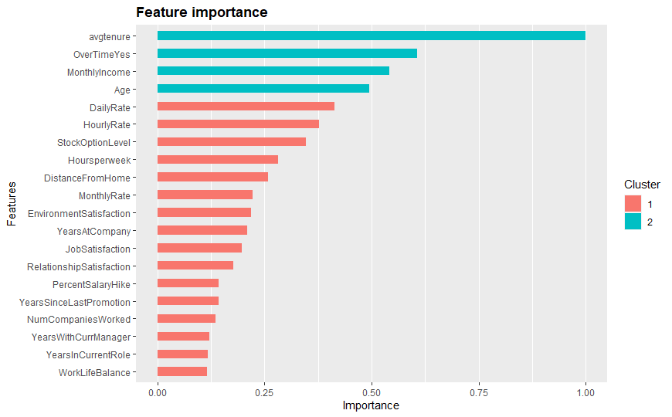
Modelling - TREES & ENSEMBLE METHODS
TIME SPENT, SALARY COMPONENTS AND SATISFACTION LEVELS ARE AMONG THE MAJOR FACTORS WHICH IMPACT ATTRITION
▲ Attrition:
Average tenure at previous companies, experience and age
Salary components as monthly income, hourly daily rates etc. , hikes, promotions and stock options
Satisfaction levels (environment/ job/ relationship)
▲ Attrition:
Work hours and overtime
Distance from home
TOP 20 PARAMETERS FOR FINAL BOOSTING MODEL

Slide 11
Modeling - Logistic regression
Model evaluation
Logistic Regression (LR) Baseline | LR with Updated Class Weights (3:1) | Backward Stepwise Regression | Lasso Regression
31 | 31 | 18 | 22
85.7% | 75% | 85% | 88.7%
69% | 79% | 60% | 62%
INSIGHTS
High Variance | High Variance | Low Variance | Low Variance
Probable Overfitting | Improved recall | High Accuracy | Highest Accuracy
Variable Count
Accuracy
Recall

Slide 12
Modeling - Logistic regression
Statistically significant variables – 0.1% level
Business Travel
Distance From Home
Job Level
Years Since Promotion
positive impact on attrition*
negative impact on attrition*
Job Involvement
Job Satisfaction
Monthly Income
* Attrition: Yes = 1; No = 0

Slide 13
Insights and recommendations
Model insights
Points to consider
Recommended
Areas of focus
Lasso Regression – Best accuracy with few variables
Non-parametric models perform decently as well
Compensation
Work-Life Balance
Years since Promotion
Cannot be generalized
Evolving industry and geographical trends
Cost vs Benefit Tradeoff

Slide 14
THANK YOU!

Slide 15
APPENDIX

Slide 16
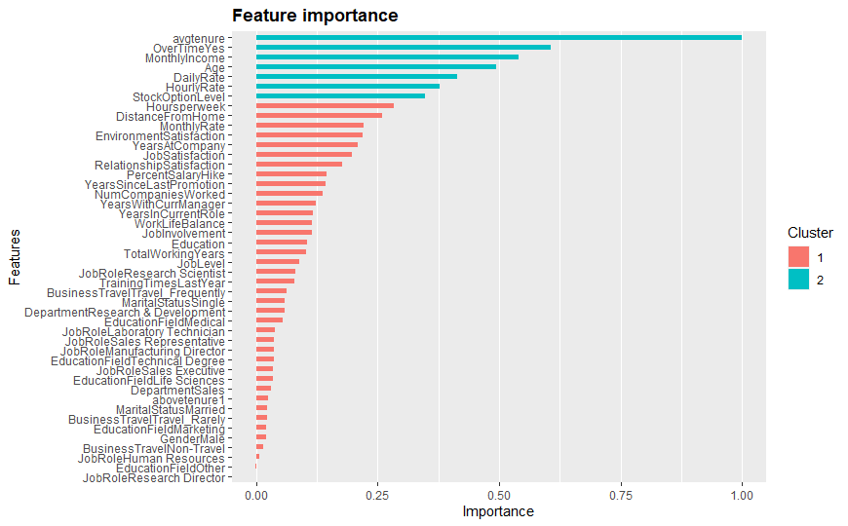
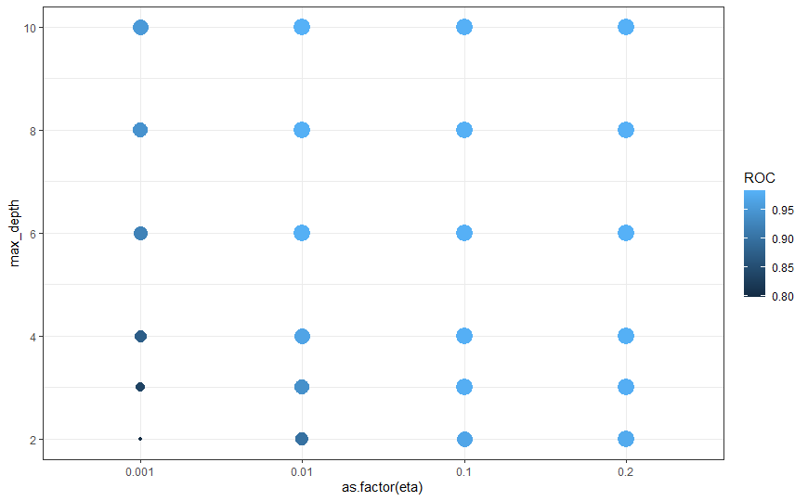
Boosting MODEL FINAL FEATURE IMPORTANCE (ALL VARIABLES & LEVELS)
ROC ESTIMATION FOR SELECTION OF HYPERPARAMETERS UNDER CROSS VALIDATION
* TEST AUC ~ 0.7

Slide 17
Boundary Decision
Assumptions
R&D Focussed Company
Let's assume that average employee makes $100K per year.
To retain someone who is going to attrite, it takes $60K to retain him (In form of promotions, hike benefits etc.)
Assuming average employee helps generate additional $200K revenue for the organization.
Understanding the assumptions, above we can calculate the losses associated with each of our predictions.
Thus, decision probability comes to 0.3, implying that if output > 0.3 model predicts that employee will attrite

Slide 18
Variables with +ve co-efficent (Inc in value of these variables is associated with INC in Attrition chances)
Business Travel
Distance From Home
Gender(Male)
Job Level
Marital Status (Single)
Number of companies worked in
Over Time
Years At Company
Years since promotion
Variables with -ve co-efficent (Inc in value of these variables is associated with DEC in Attrition chances)
Age
Environment Satisfaction
Job Involvement
Job Satisfaction
Monthly Income
Stock Level Option
Total Working Hours
Work Life Balance
Years In Current Role
The co-efficient sign was found similar across different models
Variables dropped from model found to have strong correlation with the included variables.
Ridge model provided best OOS accuracy and recall

Slide 19
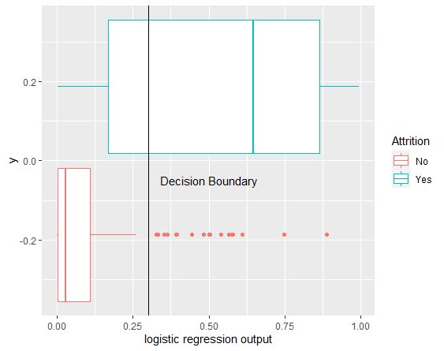
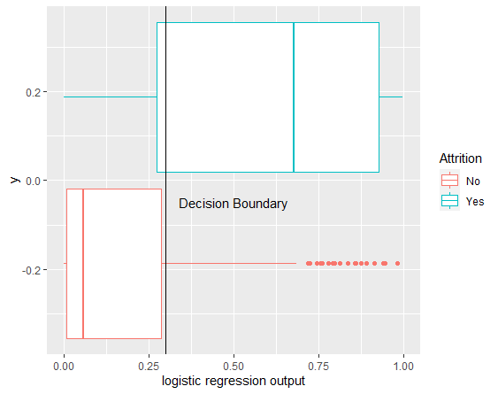
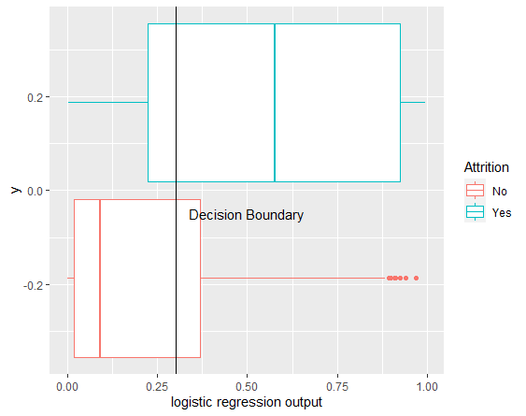
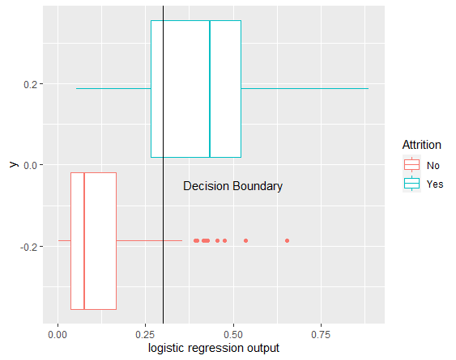
Model Progression
Logistic Regression Model with Updated Class weights - (3:1)
Model created with Stepwise Regression - backward
Lasso Regression
Baseline Logistic Regression Model
Num of variables - 31
Accuracy – 85.7%
Recall – 69%
Num of variables – 31
Accuracy – 75%
Recall – 79%
Num of variables – 18
Accuracy – 85%
Recall – 60%
Num of variables – 26
Accuracy – 89.7%
Recall – 60%
Model evaluation strategy - Validation Set was used to calculate performance metrics
Class weights – 3:1 for "Yes" : "No" attrition to account for undersampling of "yes" samples. The value was chosen based on cross-validation

