Slide 1
Alphashots.ai Buy and Sell decisions for EUR/INR With Moving Average , Bollinger Bands and CCI complete code - https://colab.research.google.com/drive/19bvwG_BKOStd9V4xM9b-uBPoK2I2Lod6?usp=sharing Mahikshith - 6303423352 - Github - Linkedin

Slide 2
Alphastots.ai
Introduction and Assumptions
Approach and Reasoning
Table for Buy and sell
Visual Graphs for Analysis

Slide 3
Introduction and Assumptions :
The Fundamental Idea of this Analysis is to help traders and Investors make better decision while buying and selling a stock using Technical Analysis with Moving Averages , Bollinger Bands and CCI
The data we considered is from January 1, 2023, to sept 30, 2024.
Took 20 day MA as standard because the frequency of data is daily
Moving Average period: 20 days and 50 days
Bollinger Bands: 20-day period with 2 standard deviations
CCI: 20-day period with standard thresholds of +100 and -100
BUY when price is above 20 MA > 50 MA , SELL when price is below 20 MA < 50 MA Else NEUTRAL
BUY when price touches lower Bollinger band vice versa for upper band else Neutral
BUY when CCI [Commodity Channel Index] < -100 (oversold) , SELL when CCI > 100 (overbought)
NEUTRAL when CCI is between -100 and 100
Remember most of the technical Indicators are Lagging Indicators

Slide 4
Approach and Reasoning :
Approach :
Import and pre-process the data
Calculate Moving Averages - Buy and sell triggers
Bollinger Bands with ± 2 standard deviation
CCI with ± 100 channels
Analyzing daily trends
Calculate metrics for day after sep-30 and week after sep-30
Graphs for visual aid for end users
Reasoning :
We have to consider the last week window period into the data while analyzing since we assumed using 20 moving average for daily analysis.
If we take the data for last week separately from Analysis then we would be getting NaN since we are using 20 MA i.e the first 20 data points for MA would be NaN.
All the metrics have been calculated based on their respective formulae

Slide 5
Table for Buy and sell : Analysis for Day after Sep-30 and week after Sep-30
Reiterating the fact that these decision triggers are based on 20 MA ; these decisions are influenced by time frame that we choose
Technical indicators + Funda mental Analysis combination should be considered for long term investing for stocks as they are affected by a lot of economic factors
(Ctrl + click) – for complete Analysis + code link →
Indicator | Day after Sep 30 | Week after Sep 30
Moving Average | Buy | Buy
Bollinger Bands | Neutral | Neutral
CCI | Neutral | Buy
https://colab.research.google.com/drive/19bvwG_BKOStd9V4xM9b-uBPoK2I2Lod6?usp=sharing

Slide 6
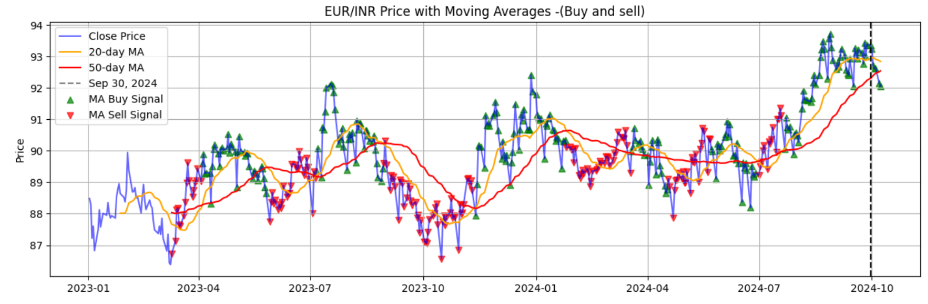
Visual Analysis :
Moving Average Analysis :
We took the closing price for calculating 20 MA & 50 MA . If the small MA [20 -yellow] crosses Big MA [50-red] in upward trend a buy signal has been triggered (shown with green marker) and vice versa for sell signal (red marker)
If 20 MA = 50 MA then neutral (No buy or sell has been triggered)
All the Analysis is based on the closing price.

Slide 7
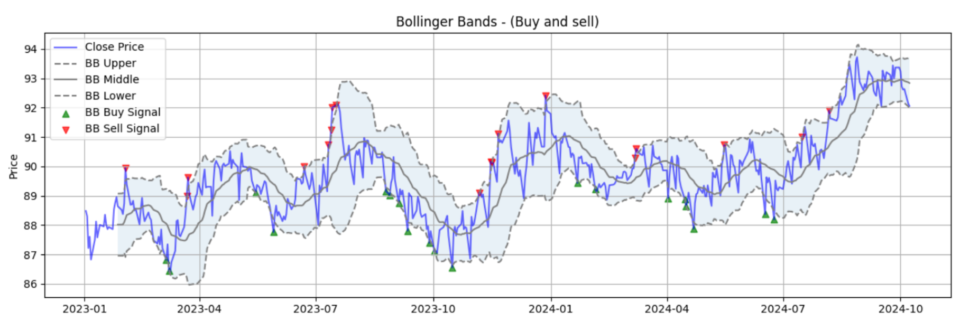
Bollinger bands :
When the closing price hits upper band (20 MA + 2 Std ) then a sell signal has been triggered where as the closing price is closer to lower band (20 MA – 2 Std) then a buy , if the market is sideways or fluctuating in the middle band then neutral.
The below Analysis for entire data , we can also the analysis for one day , one week after sep 30 in the table in the previous slide and graph for the same has been shown in the upcoming slides

Slide 8
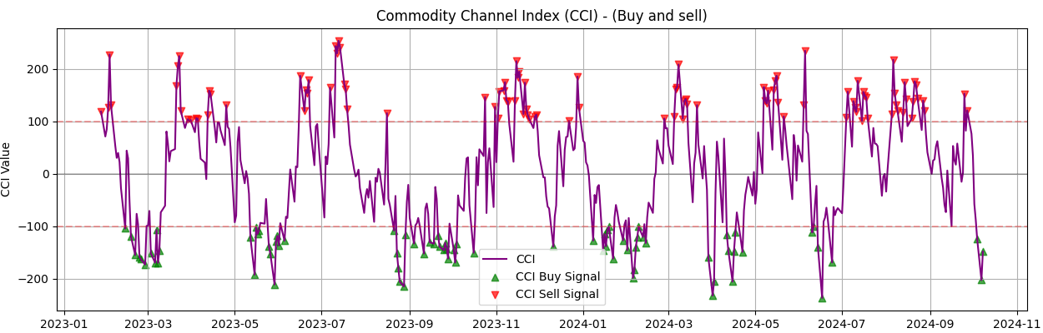
CCI (Commodity Channel Index) :
The CCI is a momentum-based oscillator used to identify overbought and oversold conditions in a market. It measures the current price level relative to an average price level over a given period. Average of the high, low, and closing prices for each period (typical price) and calculate the simple MA (20) for typical price , then we calculate mean absolute deviation for every datapoint.
CCI = (Typical Price - SMA of TP) / (0.015 * MAD)
BUY when CCI [Commodity Channel Index] < -100 (oversold) , SELL when CCI > 100 (overbought)
NEUTRAL when CCI is between -100 and 100.

Slide 9
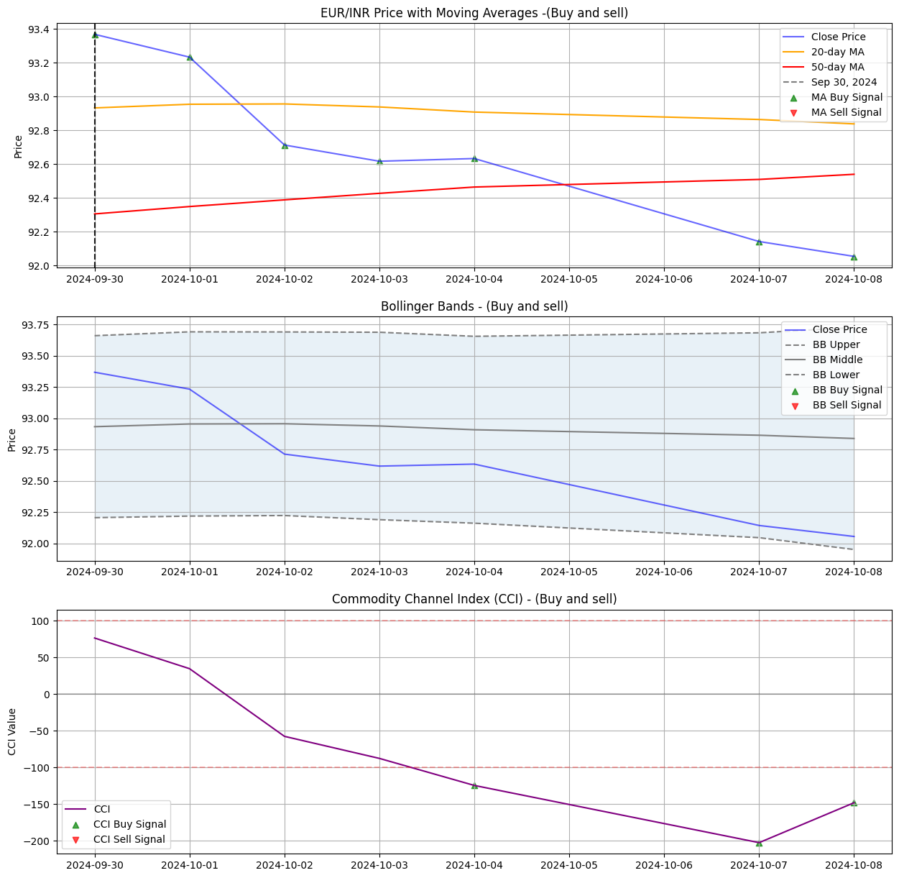
Graphs for Day & Week after Sep 30 :
Indicator | Day after Sep 30 | Week after Sep 30
Moving Average | Buy | Buy
Bollinger Bands | Neutral | Neutral
CCI | Neutral | Buy

Slide 10
Complete code : https://colab.research.google.com/drive/19bvwG_BKOStd9V4xM9b-uBPoK2I2Lod6?usp=sharing thank you
Mahikshith
6303423352
mahikshith97@gmail.com
Github
Linkedin

