Slide 1
Session 26 : Introduction to Hibernate Module 3.3 : Advanced Java

Slide 2
Learning Objectives
At the end of the session successful participants will be able to
Describe OR Mapping tools
Identify different ORM tools available in the market
Describe Hibernate as the best OR mapping tool
Understand the architecture of Hibernate
Use main classes and interfaces of org.hibernate package
Install and configure Hibernate in your system
Create first Hibernate application

Slide 3
Introduction to OR Mapping tool
To deal with data is critical part of the application
To solve these problems, multiple solutions exist. Their goal is to simplify the creation of data access layers, automate data access, or generate data access code.
The principle of object-relational mapping is to delegate to tools, the management of persistence, and work at code-level with objects representing a domain model, and not with data structures in the same format as the relational database.

Slide 4
DAO and ORM
A DAO can use an ORM framework for persistence tasks.
ORM framework is written to reduce the efforts done by DAO classes, such as database connectivity, constructing sql queries etc.
ORM also improves the performance of DAO layer by providing caching, query optimization etc.
Even ORM takes care of database independency which does not require the use of factory method and abstract factory pattern at DAO layer for achieving the same.
DAO was a second approach, ORM will be introduced as the third approach.

Slide 5
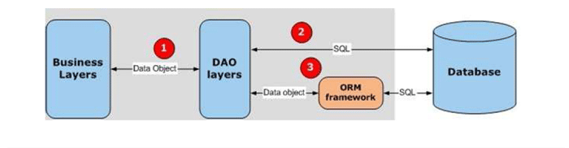
ORM Framework

Slide 6
HIBERNATE - Introduction
Powerful and high-performance object-relational mapping
Standards-driven, open source
Transparent Persistence
Flexible Object Relational Mapping
Native SQL or Object Oriented Query Language (HQL)
Ultra-high performance
Hibernate’s goal is to relieve the developer from 95 percent of common data persistence related programming tasks
Hibernate is a Free Software

Slide 7
HIBERNATE - Alternative
There are several persistent frameworks and ORM options in Java. Some of them are listed below:
Enterprise JavaBeans Entity Beans
Java Data Objects
Castor
TopLink
Spring DAO
Some alternatives are open source products while some are commercial
These alternatives are based on JDBC and SQL and typically use the Data Access Object design pattern.
Among all these alternative, Hibernate is considered highly portable, provides good mapping flexibility, and good performance.

Slide 8
Hibernate Architecture and API
Hibernate is built on top of many Java APIs and other Java open source frameworks/APIs.
The Hibernate architecture is layered so you do not have to know the underlying APIs.
Hibernate architecture has three main components
Connection Management
Transaction management
Object relational mapping
It is called "Lite" architecture when you use the Object relational mapping component only in Hibernate application.
It is called "Full Cream" architecture all the three components Object Relational mapping, Connection Management and Transaction Management are used in Hibernate application.

Slide 9
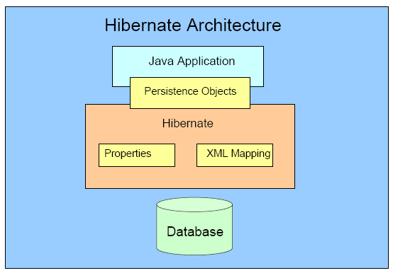
Architecture of Hibernate

Slide 10
Hibernate API
Hibernate is built on top of many Java APIs and other Java open source frameworks/APIs.
The architecture is layered so you do not have to know the underlying APIs.
You are required to know fewer than a dozen Hibernate classes to use Hibernate.

Slide 11
Hibernate API
The main interfaces and classes of the Hibernate API are given below:
org.hibernate.Hibernate
org.hibernate.Session
org.hibernate.SessionFactory
org.hibernate.Transaction
org.hibernate.Query
org.hibernate.Criteria
org.hibernate.ScrollableResults
org.hibernate.cfg.Configuration
org.hibernate.expression.Expression
org.hibernate.expression.Order

Slide 12
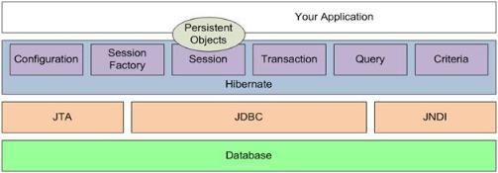
Main classes and interfaces of Hibernate API

Slide 13
org.hibernate.cfg.Configuration
The Configuration object is the Hibernate object that you have to create first in your Hibernate applications.
It represents a configuration or properties file for Hibernate.
The Configuration object reads and establishes the properties Hibernate uses to connect to a database and configure itself for work.
A Configuration object is used to create a SessionFactory and then is typically discarded.
/* Load the hibernate configuration file */
Configuration cfg = new Configuration();
cfg.configure(CONFIG_FILE_LOCATION);

Slide 14
org.hibernate.SessionFactory
The SessionFactory object, as its name implies is a factory for Session objects and is an expensive object to create.
It is usually created during application start up like the Configuration object. However, unlike the Configuration object, it should be created once and retained for later use.
It is a thread safe object.
/* Create the session factory */
SessionFactory sessionFactory = cfg.buildSessionFactory();

Slide 15
org.hibernate.Session
The Session object provides the main interface to accomplish work with the database.
Persistent objects are saved and retrieved through a Session object.
A Session object is lightweight and inexpensive to create.
A Session object establishes a physical connection to the database.
Session objects are not thread safe.
/* Retrieve the session */
Session session = sessionFactory.openSession();

Slide 16
org.hibernate.Transaction
A Transaction represents a unit of work with the database.
Transactions in Hibernate are handled by an underlying transaction manager and transaction from JDBC, JTA or CORBA.
The Hibernate Transaction object absolves the developer from having to deal with the underlying transaction manager/transaction.
This allows developers to use a Transaction Manager of their choice without having to code to a specific Transaction Manager.

Slide 17
A typical transaction code
Transaction tx;
try {
tx = sess.beginTransaction(); //do some work ... tx.commit();
} catch (Exception e)
{
if (tx!=null)
tx.rollback();
throw e;
}

Slide 18
Query and Criteria
Query and Criteria objects are used to retrieve (and recreate) persistent objects.
Query objects use SQL or Hibernate Query Language (HQL) string to retrieve data from the database and create objects.
Criteria uses an object/method based means of constructing and executing a request to retrieve objects.
/* create query */
Query query =
session.createQuery("QUERY HERE”);

Slide 19
Installing and Configuring Hibernate
Hibernate can be downloaded in a single all-inclusive distribution file from www.hibernate.org (Download version 3.3.1).
Unzip this distribution in C: drive of your system. (You can unzip it in any drive)
Set classpath for the hibernate3.jar.
Make sure that following jar files must be present in and available in classpath.
antlr-2.7.6.jar
commons-collections-3.1.jar
dom4j-1.6.1.jar
javassist-3.4.GA.
jta-1.1.jar
ojdbc14.jar(or classes12.jar)-JDBC Driver jar file
slf4j-api-1.5.2.jar
slf4j-simple-1.5.2.jar

Slide 20
Configuring Hibernate
The Hibernate configuration file holds various properties for databases in a standalone situation.
The following are examples of some of the properties and property values found in the file (Here we are using Oracle as database, so following properties contain value to interact with Oracle Database where service ID is 'orcl', user name is 'user' and password is 'pwd').
hibernate.dialect org.hibernate.dialect.OracleDialect hibernate.connection.driver_class oracle.jdbc.driver.OracleDriver
hibernate.connection.url jdbc:oracle:thin:@localhost:1521:orcl hibernate.connection.username user hibernate.connection.password pwd

Slide 21
Creating first Hibernate application
Step 1: Create a POJO with the name Product
Step 2: Create a table in Oracle database with the name PRODUCT
Step 3: Mapping the Product Object to the Database PRODUCT table
Step 4: Configuring Hibernate
Step 5: Developing Code to Test Hibernate example

Slide 22
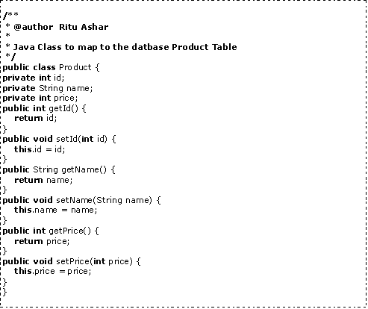
Step 1 Create a POJO with the name Product

Slide 23

Step 2 Create a table in Oracle database with the name PRODUCT

Slide 24
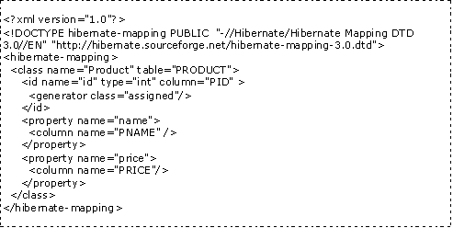
Step 3 Mapping the Product Object to the Database PRODUCT table

Slide 25
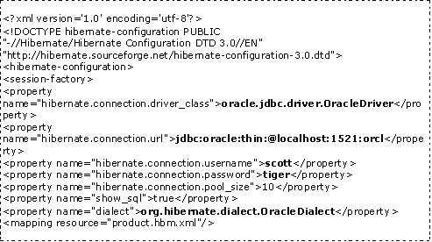
Step 4 Configuring Hibernate

Slide 26
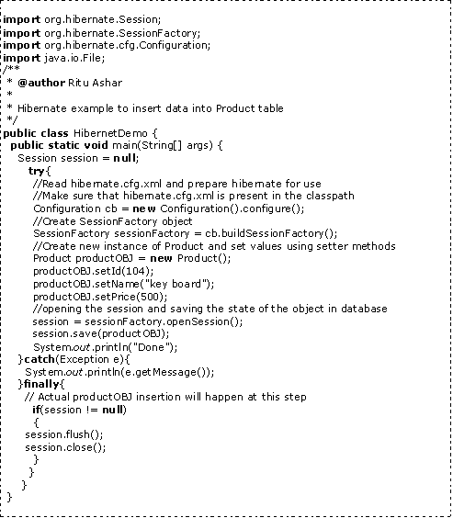
Step 5 Developing Code to Test Hibernate example

Slide 27
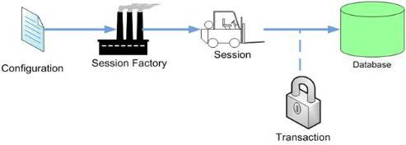
Flow of Hibernate application

Slide 28
Why is Hibernate better than JDBC?
Relational Persistence for JAVA
Transparent Persistence
Support for Query Language
Database Dependent Code
Maintenance Cost
Optimize Performance
Automatic Versioning and Time Stamping
Open-Source, Zero-Cost Product License
Enterprise-Class Reliability and Scalability

Slide 29
Summary
In this chapter, we have learned the following:
ORM framework improves the performance of DAO layer by providing caching, query optimization.
Hibernate is an open source OR tool for Java which relieves the developer from 95 percent of common data persistence related programming tasks.
Entity Beans, JDO, Castor, TopLink, Spring DAO are alternatives of Hibernate.
Hibernate is built on top of many Java APIs and other Java open source frameworks/APIs. The architecture is layered so you do not have to know the underlying APIs.

Slide 30
Summary
Configuration, SessionFactory, Session, Transaction, Query and Criteria are the main objects of Hibernate applications.
Hibernate maps Java object to the database table. The following files play an important role:
hibernate.cfg.xml - This file contains all database related information such as database type, driver info, user-password details, Dialect etc.
XXX.hbm.xml - This is the mapping file which contains code for mapping a Java class to the database table.
Relational Persistence for JAVA, Transparent Persistence, Support for Query Language, Open-Source, Zero-Cost Product License, Enterprise-Class Reliability and Scalability make Hibernate much better then JDBC.

