Slide 1
Session 27 : Configuring Hibernate Module 3.3 : Advanced Java

Slide 2
Learning Objectives
At the end of the session successful participants will be able to
Work with Session interface
Create an application to retrieve data from the database
Create an application to Update data from the database
Create an application to Delete data from the database

Slide 3
Working with Session Interface
Session interface is the main runtime interface between a Java application and Hibernate.
This is the central API class abstracting the notion of a persistence service.
The main function of the Session is to offer create, read, and delete operations for instances of mapped entity classes.
Transient instances may be made persistent by calling save(), persist() or saveOrUpdate().
Instances may exist in one of three states: transient: never persistent, not associated with any Session persistent: associated with a unique Session detached: previously persistent, not associated with any Session

Slide 4
Working with Session Interface
save() and persist() result in an SQL INSERT, delete() in an SQL DELETE and update() or merge() in an SQL UPDATE.
Changes to persistent instances are detected at flush time and also result in an SQL UPDATE.
saveOrUpdate() and replicate() result in either an INSERT or an UPDATE.

Slide 5
Working with Session Interface
Any instance returned by a get() or load() method is persistent.
Detached instances may be made persistent by calling update(), saveOrUpdate(), lock() or replicate().
The state of a transient or detached instance may also be made persistent as a new persistent instance by calling merge().
A Session instance is serializable if its persistent classes are serializable.

Slide 6
Working with Session Interface
A typical transaction should use the following idiom:
Session sess = factory.openSession();
Transaction tx;
try {
tx = sess.beginTransaction();//do some work...
tx.commit();
} catch (Exception e)
{
if (tx!=null) tx.rollback();
throw e;
} finally
{
sess.close();
}
If the Session throws an exception, the transaction must be rolled back and the session discarded. The internal state of the Session might not be consistent with the database after the exception occurs.

Slide 7
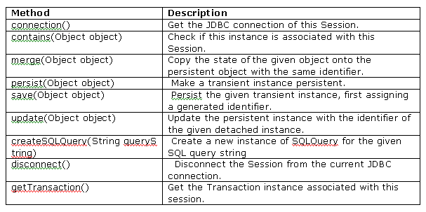
Some important methods of the Session interface

Slide 8
Create an application to retrieve data from the database
SelectDemo.java retrieves records from the product table.
Make sure that following files are available in the current directory
where this SelectDemo.class file is available.
Product.class
product.hbm.xml
hibernate.cfg.xml

Slide 9
Create an application to retrieve data from the database
//Create new instance of Query
Query query = session.createQuery("from Product"); query.setFirstResult(20);
query.setMaxResults(10);
List products = query.list();
System.out.println(products);

Slide 10
Create an application to update data from the database
Following program update a record in the product table.
Make sure that following files are available in the current directory where this UpdateDemo.class file is available.
Product.class
product.hbm.xml
hibernate.cfg.xml

Slide 11
Create an application to update data from the database
//Create new instance of Product and set values using setter methods
Product productOBJ = new Product();
productOBJ.setId(426);
productOBJ.setName("RAM");
productOBJ.setPrice(1800);
// update the state of the object in database you have 3 possible options
session.merge(productOBJ);// update will work or
//session.update(productOBJ);// update will also work or
//session.saveOrUpdate(productOBJ);//update or insert(if not there in database)

Slide 12
Create an application to delete data from the database
Following program deletes a record from the product table which product id is 427.
Make sure that following files are available in the current directory where this DeleteDemo.class file is available.
Product.class
product.hbm.xml
hibernate.cfg.xml

Slide 13
Create an application to delete data from the database
//Create new instance of Product and set value for PK using setter method
Product productOBJ = new Product();
productOBJ.setId(427);//Only PK is required for delete
//productOBJ.setName("RAM");
//productOBJ.setPrice(1800);
// delete the object from database
session.delete(productOBJ);// delete

Slide 14
Summary
In this session, you have learned the following:
Session interface is the main interface in Hibernate programming. This interface contains methods to interact with database as well as for the transaction management.
createQuery() method of Session interface is used to built HQL queries.
Delete() method of Session interface is used to delete records from the database.
Marge(), update(), saveOrUpdate() methods are used to update records in the database.

