Slide 1
Session 30 : Fundamentals of Object Relational Mapping Module 3.3 : Advanced Java

Slide 2
Learning Objectives
At the end of the session successful participants will be able to
Understand need of mapping
Implements one-to-one relationship
Implements one-to-many relationship
Implements many-to-many relationship
Apply mapping to associations
Develop association mapping in Product-Order Scenario

Slide 3
Introduction
Hibernate is to allow you to treat your database as if it stores Java objects.
However, databases in practice do not store objects—they store data in tables and columns.
Unfortunately, there is no simple way to correlate the data stored in a database with the data represented by Java objects.

Slide 4
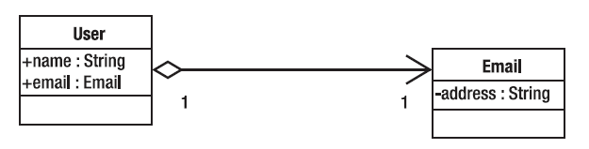
Object oriented association
The difference between an object-oriented association and a relational one is fundamental.
Consider a simple class to represent a user, and another to represent an e-mail address, as shown in this figure.
Figure 1: An object-oriented association

Slide 5
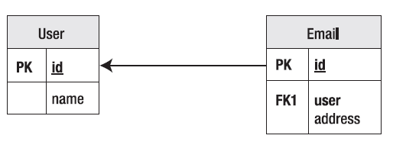
Relational association
User objects contain fields referring to Email objects.
The association has a direction given a User object; you can determine its associated Email object. For example:
User user = ...
Email email = user.email;
The reverse, however, is not true. The natural way to represent this relationship in the database, as illustrated in this figure, is superficially similar.
Figure 2: A relational association

Slide 6
Associations
Why the mapping process could not be automated?
Consider this example with two classes named Customer and Email
public class Customer {
int customerId;
int customerReference;
String name;
Email email;
}
public class Email {
String address;
}

Slide 7
Associations
Following five questions will help you to understand need of association:
Is a unique customer identified by their customer ID, or their customer reference?
Can a given e-mail address be used by more than one customer?
Should the relationship be represented in the Customer table?
Should the relationship be represented in the Email table?
Should the relationship be represented in some third (link) table?

Slide 8
Associations
The first question can be answered simply—it depends on what column you specify as the primary key.
The remaining four questions are related, and their answers depend upon the object relationships.
Furthermore, if your Customer class represents the relationship with the EmailAddress using a Collection class or an array, it would be possible for a user to have multiple e-mail addresses.
public class Customer {
int customerId;
int customerReference;
String name;
Set email;
}

Slide 9
Associations
So, you should add another question: can a customer have more than one e-mail address?
The set could contain a single entry, so you can’t automatically infer that this is the case. The key questions from the previous options are as follows:
Q1: Can an e-mail address belong to more than one user?
Q2: Can a customer have more than one e-mail address?
The answers to these questions can be formed into a truth table, as in following table.

Slide 10
The One-to-One Association
A one-to-one association between classes can be represented in a variety of ways.
At its simplest, the properties of both classes are maintained in the same table.
For example, a one-to-one association between a User and an Email class might be represented as a single table, as shown here:

Slide 11
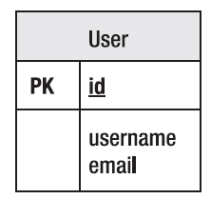
The One-to-One Association
The single database entity representing this combination of a User and an Email class is shown in figure here:

Slide 12
The One-to-One Association
Alternatively, the entities can be maintained in distinct tables with identical primary keys, or with a key maintained from one of the entities into the other, as in Tables here.
User Table
Email Table

Slide 13
The One-to-One Association
It is possible to create a mandatory foreign key relationship from one of the entities to the other, but this should not be applied in both directions because a circular dependency would be created.
It is also possible to omit the foreign key relationships entirely and rely upon Hibernate to manage the key selection and assignment.
Entities related by primary keys

Slide 14
The One-to-One Association
If it is not appropriate for the tables to share primary keys, then a foreign key relationship between the two tables can be maintained, with a “unique” constraint applied to the foreign key column.

Slide 15
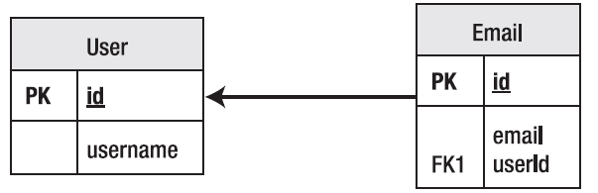
The One-to-One Association
This has the advantage that the association can easily be changed from one-to-one to many-to-one by removing the unique constraint.
Entities related by a foreign key relationship

Slide 16
The One-to-Many and Many-to-One Association
A one-to-many association (or from the perspective of the other class, a many-to-one association) can most simply be represented by the use of a foreign key, with no additional constraints.
The relationship can also be maintained by the use of a link table.
This will maintain a foreign key into each of the associated tables, which will itself form the primary key of the link table.

Slide 17
The One-to-Many and Many-to-One Association
Additional columns can be added to the link table to maintain information on the ordering of the entities in the association.
A unique constraint must be applied to the “one” side of the relationship; otherwise, the link table can represent the set of all possible relationships between User and Email entities—a many-to-many set association.

Slide 18
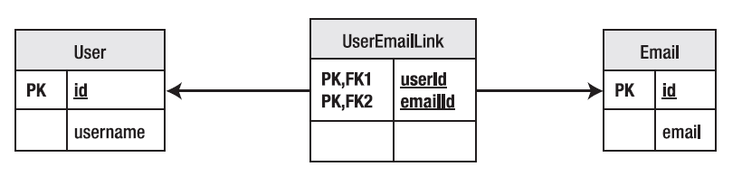
The One-to-Many and Many-to-One Association
A relationship represented by a link table (duplicates are not permitted because of the use of a compound primary key)

Slide 19
The Many-to-Many Association
If a unique constraint is not applied to the “one” end of the relationship when using a link table, it becomes a limited sort of many-to-many relationship.
All of the possible combinations of User and Email can be represented, but it is not possible for the same User to have the same e-mail address entity associated twice, because that would require the compound primary key to be duplicated.

Slide 20
The Many-to-Many Association
If instead of using the foreign keys together as a compound primary key, we give the link table its own primary key (usually a surrogate key), the association between the two entities can be transformed into a full many-to-many relationship, as shown in table here.
When the link table has its own independent primary key, thought should be given to the possibility that a new class should be created to represent the contents of the link table as an entity in its own right.
A Many-to-Many User/Email Link Table

Slide 21
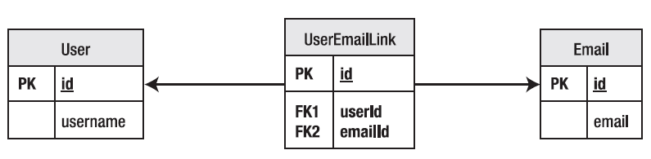
The Many-to-Many Association
A many-to-many relationship represented by a link table (duplicates are permitted because of the use of a surrogate key)

Slide 22
Applying Mappings to Associations
The mappings are applied to express the various different ways of forming associations in the underlying tables—there is no automatically correct way to represent them.
In addition to the basic choice of the approach to take, the mappings are used to specify the minutiae of the tables’ representations. While Hibernate tends to use sensible default values when possible, it is often desirable to override these.
For example, the foreign key names generated automatically by Hibernate will be effectively random—whereas an informed developer can apply a name (e.g., FK_USER_EMAIL_LINK) to aid in the debugging of constraint violations at run time.

Slide 23
Types of Mapping
At present, Hibernate supports two standard ways to express the mappings.
The technique that has been available the longest is the use of XML mapping files. As the most mature approach, this is currently the best way to control Hibernate, and gives the most sophisticated control over the Hibernate feature set.
Hibernate now also supports the Annotations feature introduced in Java 5. This permits the use of a special syntax to include metadata directly in the source code for the application. While this allows the core features of Hibernate to be controlled, many of the additional features cannot be specified in annotations

Slide 24
One-to-Many Association
In this kind of association one object of a class is in a relationship with many objects of another class.
The class that is having the single instance contains a collection of instances of the other class.
To specify this association the mapping file would have to be modified. The added code would be:
<one-to-many
name=”nameOfheVariable
column="NAME_OF_THE_COLUMN"
class="ClassName"
not-null="true"/>

Slide 25
One-to-Many Association
In the Persistent class the following change would be there:
class <className>
{
//other variable declarations
Set <className> =new HashSet();
//constructors and getter/setter code follows
:
}

Slide 26
Many-to-One Association
This is the opposite of the One-to-Many association.
In this case, the class that is having a Many-to-One association contains the object of the class.
For example, if class A has a Many-to-One association with class B, then each instance of B would have an instance of A.

Slide 27
Many-to-One Association
The change in the mapping would be:
<many-to-one
name=”nameOfheVariable
column="NAME_OF_THE_COLUMN"
class="ClassName"
not-null="true"/>
The attributes are the same as the case of One-to-Many. In the case of code it would be
class <className>
{
<classNameofAssociatedClass> o=new <classNameofAssociatedClass>
//construtors and getter/setter code follows
:
}

Slide 28
Associations in the Real World
Till now we have used User and Email table to explain relationship.
Now we will make things more interesting by using real time concepts like Product and Order scenario.
Each Order can have more than one Product.
Hence the relationship between Order and Product is One-to-Many.

Slide 29
Associations in the Real World
The schema of the Product table is:
CREATE TABLE PRODUCT(
ID VARCHAR NOT NULL PRIMARY KEY,
NAME VARCHAR NOT NULL,
PRICE DOUBLE NOT NULL,
AMOUNT INTEGER NOT NULL,
ORDER_ID VARCHAR NOT NULL)

Slide 30
Associations in the Real World
The persistent class for the Product table
package com.sqlstar.persist;
public class Product {
private String id;
private String name;
private double price;
private int amount;
private Order order;
public Product(String id, String name, double price, int amount, Order
order)
{
this.order=order;
//others not shown for brevity
}
public String getId() {
return id;
}
public void setId(String string) {
id = string;
}
// default constructor and other
// getters/setters not shown for brevity
// ...
}

Slide 31
Associations in the Real World
product.hbm.xml – Mapping file
<?xml version="1.0" encoding="UTF-8"?>
<!DOCTYPE hibernate-mapping
PUBLIC "-//Hibernate/Hibernate Mapping DTD//EN"
"http://hibernate.sourceforge.net/hibernate-mapping-2.0.dtd">
<hibernate-mapping>
<class name="test.hibernate.Product"
table="products">
<id name="id" type="string"
unsaved-value="null">
<column name="id" sql-type="char(32)"
not-null="true"/>
<generator class="assigned"/>
</id>
<property name="name">
<column name="name" sql-type="char(255)"
not-null="true"/>
</property>
<property name="price">
<column name="price" sql-type="double"
not-null="true"/>
</property>
<property name="amount">
<column name="amount" sql-type="integer"
not-null="true"/>
</property>
<property name="orderId">
<column name="ORDER_ID" sql-type="char(255)"
not-null="true"/>
<many-to-one
name="orderId"
column="ORDER_ID"
class="ORDER"
not-null="true"/>
</class>
</hibernate-mapping>

Slide 32
Associations in the Real World
The persistent class for the Order table
package com.sqlstar.persist;
import java.util.Date;
import java.util.HashSet;
import java.util.Set;
public class Order {
private String id;
private Date date;
private double priceTotal;
private Set products =new HashSet();
// Automatically set the creation time of
// this Order
public Order() {
this.date = new Date();
}
public Order(String id, Date date, private double priceTotal, Set
products){
this.products=products;
//others are not shown for brevity
}
public String getId() {
return id;
}
public void setProducts(Set products) {
this.products = products;
}
public Set getProducts () {
return products;
}
public void setId(String string) {
id = string;
}
// other getters/setters not shown for
// brevity
// ...
}

Slide 33
Associations in the Real World
order.hbm.xml – Mapping file
<?xml version='1.0' encoding='utf-8'?>
<!DOCTYPE hibernate-configuration PUBLIC
"-//Hibernate/Hibernate Configuration DTD 3.0//EN"
"http://hibernate.sourceforge.net/hibernate-configuration-3.0.dtd">
<hibernate-mapping default-cascade="none" default-access="property" auto-import="true">
<class name=" com.someorg.persist.Order" table="orders" mutable="true" select- before-update="false" optimistic-lock="version">
<id name="id" type="string" unsaved-value="null">
<column name="id" sql-type="char(32)" not-null="true" />
<generator class="assigned" />
</id>
<property name="date" not-null="false" >
<column name="order_date" sql-type="datetime" not-null="true" />
</property>
<property name="priceTotal" not-null="false" >
<column name="price_total" sql-type="double" not-null="true" />
</property>
<set name="products">
<key column="PRODUCT_ID"/>
<one-to-many class="Product"/>
</set>
</class>
</hibernate-mapping>

Slide 34
Associations in the Real World
The next step is to test this Product and Order table relationship
To test it we will be using the Criteria query.
In a QBC the joins are done using the setFetchMode method of the Criteria class.
The mode would be JOIN. You will learn more about Criteria query API in Chapter 5).

Slide 35
Associations in the Real World
The next step is to test this Product and Order table relationship
To test it we will be using the Criteria query.
In a QBC the joins are done using the setFetchMode method of the Criteria class.
The mode would be JOIN. You will learn more about Criteria query API in Chapter 5).

Slide 36
Associations in the Real World
import java.util.List;
//other imports
// use as java test. FindOrderById name
public class FindOrderById {
public static void main(String[] args) throws Exception {
// query to issue
String query = "select order from Order where order.id=:id";
// search for what?
String name = args[0];
// init
Configuration cfg = new Configuration()
.addClass(Order.class);
SessionFactory sf = cfg.buildSessionFactory();
// open session
Session sess = sf.openSession();
// search and return
Criteria criteria = session.createCriteria(Order.class);
criteria.add( Expression.eq("id", name) )
.setFetchMode(“products”,FetchMode.JOIN);
List result = criteria.list();
if (list.size() == 0) {
System.out.println("No Order having id "
+ name);
System.exit(0);
}
Order o = (Order) list.get(0);
sess.close();
System.out.println("Found Order: " + o);//this is just an example Here the o //
//object can be traversed to achieve anything
}
}

Slide 37
Summary
In this chapter, we learned:
There is no simple way to correlate the data stored in a database with the data represented by Java objects.
In One-to-Many kind of association one object of a class is in a relationship with many objects of another class.
A one-to-many association (or from the perspective of the other class, a many-to-one association) can most simply be represented by the use of a foreign key, with no additional constraints.
The mappings are applied to express the various different ways of forming associations in the underlying tables—there is no automatically correct way to represent them.
At present, Hibernate supports two standard ways to express the mappings, XML based and annotations based.

