Slide 1
Session 08: Inheritance and Polymorphism Module 3.2: Core Java

Slide 2
Learning Objectives
At the end of the session successful participants will be able to
Define inheritance
Explain the need for Inheritance
Types of Inheritance
Write Java code to create classes and subclasses in an inheritance hierarchy
Use “super” keyword
Implement constructor chaining in inheritance
Polymorphism and Overriding

Slide 3
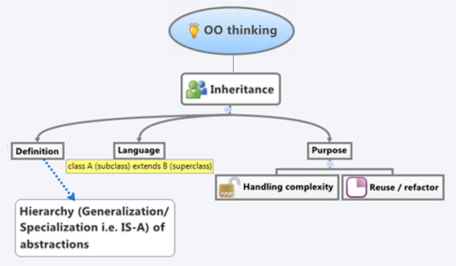
Inheritance
Inheritance is the concept of a child class (sub class) automatically inheriting the variables and methods defined in its parent class (super class).
Notes:
3

Slide 4
Inheritance
Inheritance
Inheritance:
Inheritance can be defined as the process where one object acquires the properties of another.
The keyword used for inheritance in Java is “extends”
The relationship between two classes participating in Inheritance is “is-a”
Example : class Mammal extends Animal
Notes:
4

Slide 5
Inheritance
Inheritance
Use of Inheritance:
Code Reusability
Change Management
Types of Inheritance
Single or Simple Inheritance
Multi-level Inheritance
Hierarchical Inheritance
Notes:
5

Slide 6
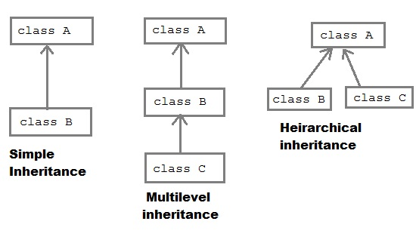
Inheritance
Inheritance
Notes:
6

Slide 7
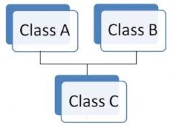
Inheritance
Inheritance
Multiple Inheritance:
Note: Java doesn't support Multiple Inheritance. In Java, a class cannot inherit more than one class.
Notes:
7

Slide 8
Deriving a Subclass
Inheritance
To derive a child class, we use the extends keyword.
Example: Suppose we have a parent class called Person. Then a subclass Student can be created as . . .
public class Person { protected String name; protected String address; /** * Default constructor */ public Person(){ System.out.println(“Inside Person:Constructor”); name = ""; address = ""; } . . . . } | public class Student extends Person { public Student(){ System.out.println(“Inside Student:Constructor”); } . . . . }
Notes:
8

Slide 9
What one can do in a Sub-class regarding Attributes?
The inherited attributes can be used directly, just like any other attributes.
You can declare new attributes in the subclass that are not in the super class.
You can declare an attribute in the subclass with the same name as the one in the super class, thus hiding it (not recommended).
A subclass does not inherit the private members of its parent class. However, if the super class has public or protected methods for accessing its private fields, these can also be applied by the subclass
Notes:
9

Slide 10
What one can do in a Sub-class regarding Methods?
The inherited methods can be used directly as they are.
You can declare new methods in the subclass that are not in the super class.
You can write a new instance method in the subclass that has the same signature as the one in the super class, thus overriding it.
Notes:
10

Slide 11
Need for “super”
Let us consider the following code snippet
class Person { String name; int age; public Person(String name,int age) { this.name = name; this.age = age; } } class Student extends Person { int rollNo; int rank; public Student(String name,int age,int rollNo, int rank) { this.name = name; this.age = age; this.rollNo = rollNo; this.rank = rank; } }
Class Student extends Person{
int rollNo;
int rank;
public Student(String name,int age,int rollNo, int rank)
{
super(name,age);
this.rollNo = rollNo;
this.rank = rank;
}
}
Calls the super class constructor
Can I avoid this repetition…??
Let me Try..!

Slide 12
What is “super” keyword?
A subclass can explicitly call a constructor of its super class using the super constructor call e.g.: super().
A super constructor call in the constructor of a subclass will result in the execution of relevant constructor from the super class, based on the arguments passed.
Ex : super(10,20);//it will invoke two-parameterized super class constructor

Slide 13
Inheritance
class Person{ String name; public Person(String name){ this.name=name; } } class Student extends Person{ int rollNo; public Student(int rollNo){ super(); this.rollNo = rollNo; } }
class Student extends Person{
int rollNo;
public Student(int rollNo){
super(“Grady Booch”);
this.rollNo = rollNo;
}
}
✓
class Test{
public static void
main(String args[]){
Student st;
st = new Student(131);
}
}
û
By default, the compiler will insert a super() call in the sub-class constructor which calls the default constructor of the super-class.
If the super-class doesn’t have default constructor, we have to explicitly write a super() call in sub-class which matches with the constructor in super-class.

Slide 14
Inheritance
Inheritance
Few things to remember when using the super constructor call:
The super() call must occur as the first statement in a constructor.
The super() call can only be used in a constructor (not in ordinary methods).
The Java compiler inserts super() call as the first statement of sub class constructor if we don’t provide it.
Another use of super is to refer to members of the super class (just like the keyword “this” ).

Slide 15
Inheritance
Inheritance
When does super class constructor gets called?
A subclass constructor invokes the constructor of the immediate superclass implicitly.
Ex:-In the below example the sub-class (Student) constuctor calls super-class (Person) constructor implictly.
class Student extends Person{
Student(){
super();
}
}
class Person{
Person(){
}
}

Slide 16
Constructor Chaining:
PostPaidMobile
Subscriber
MobileSubscriber
Subscriber
class PostPaidMobileSubscriber extends MobileSubsriber
class MobileSubscriber extends Subscriber
class Subscriber
If an object of PostPaidMobileSubscriber is created as:
PostPaidMobileSubscriber ppms = new PostPaidMobileSubscriber ();
Constructor of PostPaidMobileSubscriber
{
System.out.println(“ppmsub called");
}
Constructor of MobileSubscriber
{
System.out.println(“msub called");
}
Constructor of Subscriber
{
System.out.println(" sub called");
}

Slide 17
Constructor Chaining in inheritance
public class Subscriber { public Subscriber () { System.out.println (“Subscriber is called"); } }
public class MobileSubscriber extends Subscriber { public MobileSubscriber () { System.out.println (“ Mobile Subscriber is called"); } }
public class PostPaidMobileSubscriber extends MobileSubscriber { public PostPaidMobileSubscriber () { System.out.println (“Postpaid mobile Subscriber is called"); } }

Slide 18
Inheritance
public class RunProgram{ public static void main(String args[]) { PostPaidSubscriber ppsc = new PostPaidSubscriber(); } }
Output: Subscriber is called Mobile Subscriber is called Postpaid mobile Subscriber is called

Slide 19

Polymorphism
Exercise 1
Create the following Employee, Manager, Clerk, SalesPerson classes in java.
- Employee
Instance variables : name, salaryBasic, HRAPer, DAPer, PT.
Methods : computePayroll()
- Manager ( a sub class of Employee)
Instance variable : projectAllowance
Methods : computePayroll()
- Clerk ( a sub class of Employee)
Instance variable : int typingSpeed , int typingAccuracy
Methods : computePayroll()
- SalesPerson ( a sub class of Employee)
Instance variable : noOfTargetsCompleted, perkTarget
Methods : computePayroll()
Exercise 1
Create appropriate constructors for all the classes.
Create a class with main and add a displaySalary() method which takes one parameter of type employee and complete the application by using the computePayroll() method in displaySalary() method.

Slide 20
Polymorphism
Polymorphism
Polymorphism
Is a concept where a single name may denote objects of different classes that are related by some common base class. [Booch]
Is the ability to create an attribute, a method, or an object that has more than one form.
Notes:
Ask the students to modify their programs by using this Employee class instead of the previous class.

Slide 21
Polymorphism
Polymorphism
Polymorphism
A polymorphic reference variable can refer to different types of objects at different times.
In java every reference can be polymorphic except of references to base types and final classes.
It is the type of the object being referenced, not the reference type, that determines which method is invoked.
Polymorphic references are therefore resolved at run-time, not during compilation; this is called dynamic binding.
Careful use of polymorphic references can lead to elegant and robust software designs.
Notes:
Ask the students to modify their programs by using this Employee class instead of the previous class.

Slide 22
Polymorphism
Polymorphism
Example: Overriding Methods
class Employee {
int empId;
String name;
Employee(int id,String eName)
{
empId = id;
name = eName
}
void display() {
System.out.println("id and name: " + id + " " + name);}
}
class Manager extends Employee {
double projAllowance;
Manager(int id,String name double pAllowance) {
super(id, name);
projAllowance = pAllowance;
}
void display() {
System.out.println(" id,name and pAllowance:" +id+ " "+ name+" "+projAllowance);}
}
class MainClass{
public static void main(String args[]){
Employee e1 = new Employee(11,”scott”);
Manager m1 = new Manager(23,”roy”,300.00);
e1.display();
m1.display();
}
}
id and name: 11 scott
id , name and pAllowance: 23 roy 300.00

Slide 23
How does it work?
Polymorphism
What happened to the display() method of super class while calling m1.display().
Can we access the display() method of the super class Employee from sub class Manager?

Slide 24
Overriding
Program | s
class One{ int x1 = 10; public int m1(int x1){ return x1 * x1; } } class Two{ int x2=20; public int m2(){ return x2; } } class MainClass{ pubic static void main(String args[]){ One one = new One(); Two two = new Two(); } }
x1
10
one
m1(int)
x2
20
two
m2()

Slide 25
Overriding
Polymorphism
Program
class SuperClass{ int x1 = 10; public int m1(int value){ return value * value; } } class SubClass extends SuperClass{ int x2 = 20; public int m2(){ return x2;} } class MainClass{ pubic static void main(String args[]){ SuperClass one = new SuperClass(); SubClass two = new SubClass(); } }
x1
10
one
m1(int)
x1
10
two
m1(int)
x2
20
m2()

Slide 26
Overriding
Polymorphism
Polymorphism
Overridden
Program | JVM Memory
class SuperClass{ int x1 = 10; public int m1(){ return x1 * x1; } } class SubClass extends SuperClass{ int x1=20; public int m2(){ return x1; } } class MainClass{ pubic static void main(String args[]){ SubClass two = new SubClass(); System.out.println(two.x1); } }
x1
10
two
m1()
x1
20
m2()
Output:
20

Slide 27
Overriding
Polymorphism
Program | JVM Memory
class SuperClass{ int x1 = 10; public int m1(){ return x1 * x1; } } class SubClass extends SuperClass{ int x1 = 20; public int m1(){ return x1; } } class MainClass{ pubic static void main(String args[]){ SubClass two = new SubClass(); System.out.println(two.x1); System.out.println(two.m1()); } }
x1
10
two
m1()
x1
20
m1()
Output:
20
20

Slide 28
Overriding Methods
When a method of a sub-class has the same name and type as a method of the super-class, we say that this method is overridden.
Overriding method has the same name, number and type of parameters, and return type as the method it overrides.
Notes:
Ask the students to modify their programs by using this Employee class instead of the previous class.

Slide 29
Overriding
Polymorphism
Program | JVM Memory
class SuperClass{ int x1 = 10; public int m1(){ return x1 * x1; } } class SubClass extends SuperClass{ int x1 = 20; public int m1(){ return x1; } } class MainClass{ pubic static void main(String args[]){ SubClass two = new SubClass(); System.out.println(two.x1); System.out.println(two.m1()); } }
x1
10
two
m1()
x1
20
m1()
Output:
20
20

Slide 30
Dynamic method dispatch
Program | JVM Memory
class SuperClass{ int x1 = 10; public int m1(){ return x1; } } class SubClass extends SuperClass{ int x1=20; public int m1(){ return x1; } } class MainClass{ pubic static void main(String args[]){ SuperClass one = new SuperClass(); SubClass two = new SubClass(); System.out.println(one.m1()); System.out.println(two.m1()); one = two; System.out.println(one.m1());} }
x1
10
two
m1()
x1
20
m1()
x1
10
Output:
one
10
m1()
20
20

Slide 31
Introduction to Overloading
The ability to allow different methods or constructors of a class to share the same name
Always remember that overloaded methods have the following properties:
The same method name
type of parameters or number of parameters or order of parameters should be different.
Return types can be different or same
A method can be overloaded in the same class or in a subclass.
Access modifier CAN be different.
Notes:
Ask the students to modify their programs by using this Employee class instead of the previous class.

Slide 32
Overloading a method name
Overloading a method name
Same Method Name Means (does) different things in different circumstances
Notes:
Ask the students to modify their programs by using this Employee class instead of the previous class.

Slide 33
Method Overloading
class Example {
// same method name but 3 different methods
int area(double radius){
return 3.14 * radius * radius;
}
int area(int length, int breadth ) {
return length * breadth;
}
int area (int side){
side * side;
}
}
Notes:
Ask the students to modify their programs by using this Employee class instead of the previous class.

