Slide 1
Online Banking System
Group Members:
Ashish Ghadigaonkar(Team Leader) 10672278
Mahima Parmar 10672388
Vrushali Walavalkar 10672196
Rahul Prabhu 10672342
Aaron Goes 10672079

Slide 2
Problem Statement
The traditional way of maintaining details of a user in a bank was to enter the details and record them.
Every time the user needs to perform some transaction they have to go to bank and perform the necessary actions, which may not be so feasible all the time. Here, we provide an automation for banking system through Internet.
The aim is not only automation but also a better customer experience by providing a User Interface which is easily comprehendible by any person.

Slide 3

Introduction
Online banking, also known as internet banking or web banking, is an system that enables customers of a bank to conduct a range of financial transactions.
This system provides banking services offering features such as viewing account balances, obtaining statements, checking recent transactions, transferring money between accounts, and making payments.
The main aim of this system is not only to automate but also provide customer a better experience by providing a user-friendly interface.

Slide 4
Modules in Online Banking System
Modules in Internet Banking System are divided into two parts :
User Module:
Login
Register
Fund Transfer
Password change
Account unlocking
Forgot customer id/password

Slide 5
Modules in Online Banking System (Cont.)
Admin Module:
Login
Approve account creation

Slide 6
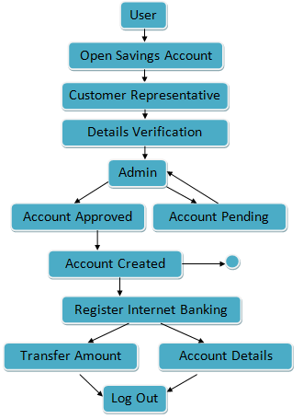
Project Flow

