Slide 1
CIS 5720 Project and Change Control Let’s get fit!
Presented by
MAHIMA SHUKLA
Guide:
Prof. Mark Dausch, ph.D

Slide 2
Opportunities
Any activity selection
Details of the requirements to do the activity
Workout events taking place in that location
Single user registration to tag with a team

Slide 3
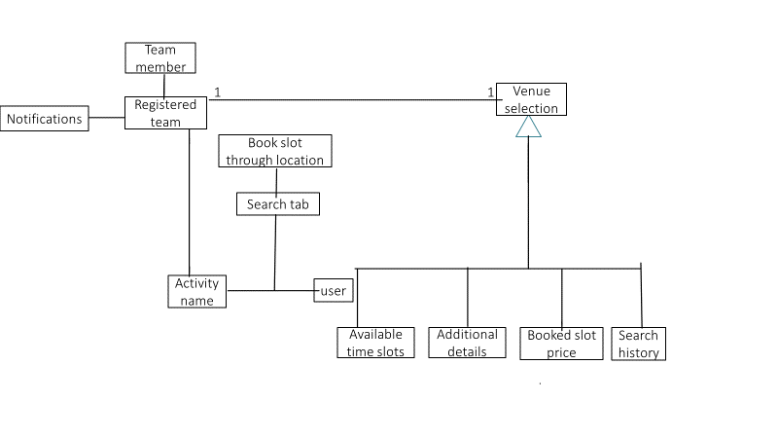

Slide 4
High level Features
Activity information
Suitable location for activity
Mandatory rules to follow to use the location
Events and team information at the location

Slide 5
Benefits
1.Easy to access and configure
2.Live event notifications
3.Time saving
4. Flexibility
5. Promotes healthy living

Slide 6
Thankyou ☺

