Slide 1
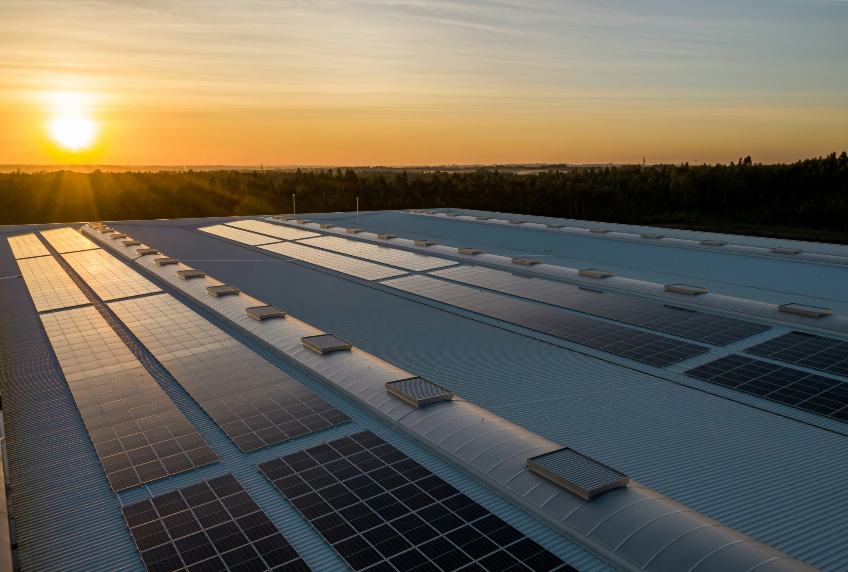
JAVA PROJECT • CO1–CO6
Rooftop Solar
Energy System
A Java-based model for solar generation, household demand and payback.
TEAM 13
Mahima • 2620040049
Rishita • 2620030420
15 OCTOBER 2026

Slide 2
INTRODUCTION
Project overview
Estimate what a rooftop solar installation can generate—and whether that generation can cover a household’s electricity use.
SYSTEM MODEL
SITE ASSUMPTIONS
WHAT IT REPORTS
12 panels × 450 W
Installed capacity: 5.4 kW
Hyderabad • 5.5 sunlight hours/day
Efficiency: 0.85
Energy generation, surplus/deficit, net-metering, savings and payback.
Project progression: expressions → control flow → methods & arrays → OOP → strings & files → collections & streams
ROOFTOP SOLAR ENERGY SYSTEM • TEAM 13
02

Slide 3
SYSTEM LOGIC
Understanding the problem
INPUTS
PROCESS
OUTPUTS
• 450 W panels; 12 panels
• Efficiency: 0.85
• Sunlight: 5.5 h/day
• Six bills: 300–360 units
• Tariff rates: ₹3.50 / ₹5.20 / ₹7.10
1. Calculate installed capacity
2. Estimate daily/monthly/yearly energy
3. Compare with average use
4. Apply tariff and estimate savings
• Generation and surplus/deficit
• Net-metering eligibility
• Battery requirement
• Monthly savings and payback
Validation rule: inputs must be valid; panel count, area and sunlight hours are positive, and efficiency is between 0 and 1.
Core formulas
Capacity (kW) = panel wattage × number of panels ÷ 1000 | Daily energy = capacity × sunlight hours × efficiency
ROOFTOP SOLAR ENERGY SYSTEM • TEAM 13
03

Slide 4
FOUNDATIONS • BTL3
CO1 — From problem to program
CONCEPTS USED
JAVA SNIPPET
double capacityKW =
(panelWattage * numPanels) / 1000;
double dailyEnergyKWh =
capacityKW * sunlightHours * efficiency;
boolean meetsDemand =
monthlyEnergyKWh >= avgConsumption;
System.out.printf("Daily: %.2f kWh%n",
dailyEnergyKWh);
• Algorithm and data types
• Expressions and console output
• String, int, double and boolean
• Arithmetic, logical and ternary operators
• Formatted reporting with printf
Program: RooftopSolarCalculator.java • Output: a formatted solar-generation report
ROOFTOP SOLAR ENERGY SYSTEM • TEAM 13
04

Slide 5
SELECTION • LOOPS • TERMINATION • BTL4
CO2 — Control flow
DECISION LOGIC
JAVA SNIPPET
if (avgUnits <= 100) {
slabCode = 1;
} else if (avgUnits <= 300) {
slabCode = 2;
} else {
slabCode = 3;
}
switch (slabCode) {
case 1: rate = slab1Rate; break;
case 2: rate = slab2Rate; break;
case 3: rate = slab3Rate; break;
default: rate = slab2Rate;
}
• if–else: surplus or deficit
• Eligibility for net metering
• Battery-backup decision
• else-if: tariff slab and payback rating
• switch–case: slab name and rate
• default branch handles unexpected codes
Reported example: Slab 3 at ₹7.10/unit • estimated savings ₹3,057.85/month • payback 17.4 years
ROOFTOP SOLAR ENERGY SYSTEM • TEAM 13
05

Slide 6
MODULAR DESIGN • BTL4
CO3 — Methods, recursion & arrays
DATA & METHODS
JAVA SNIPPET
int[] monthlyBillUnits =
{320, 300, 340, 310, 360, 330};
double[] tariffRates = {3.50, 5.20, 7.10};
static double calculateAverage(int[] units) {
double sum = 0;
for (int u : units) sum += u;
return sum / units.length;
}
• monthlyBillUnits[] stores six months
• tariffRates[] stores three tariff slabs
• Enhanced for-loop totals monthly units
• Methods separate calculation and reporting
• main() coordinates the method calls
Methods include calculateCapacityKW, calculateDailyEnergy, calculateAverage, calculateSavings and calculatePayback.
ROOFTOP SOLAR ENERGY SYSTEM • TEAM 13
06

Slide 7
OOP • ENCAPSULATION • EXCEPTIONS • BTL6
CO4 — Objects that fail safely
CLASS & OBJECT
ENCAPSULATION
SAFE FAILURE
RooftopSolarEnergy uses a parameterized constructor to initialize site and panel details.
Private fields include roofArea, panelEfficiency, numberOfPanels and sunlightHours, exposed through public getters.
Invalid efficiency raises IllegalArgumentException. try/catch handles errors; finally closes the Scanner.
JAVA SNIPPET
if (panelEfficiency <= 0 || panelEfficiency > 1)
throw new IllegalArgumentException("Panel efficiency must be between 0 and 1.");
ROOFTOP SOLAR ENERGY SYSTEM • TEAM 13
07

Slide 8
TEXT PROCESSING • BTL4
CO5 — Strings, library algorithms & files
STRING TOOLS
SEARCH & SORT
FILE I/O
toUpperCase(), toLowerCase(), length(), contains() and StringBuilder create and inspect the report.
Linear search checks panel names with equalsIgnoreCase(). Arrays.sort() sorts a clone of energyGenerated[].
FileWriter writes SolarEnergyReport.txt. BufferedReader reads the report back; IOException is handled.
JAVA SNIPPET
double[] sortedEnergy = energyGenerated.clone();
Arrays.sort(sortedEnergy);
ROOFTOP SOLAR ENERGY SYSTEM • TEAM 13
08

Slide 9
FUNCTIONAL PROCESSING • BTL6
CO6 — Collections & streams
COLLECTIONS
PREDICATE & FILTER
STREAM OPERATIONS
List<Double> / ArrayList stores panel wattages in a flexible collection.
wattage -> wattage >= 450 selects high-power panels using a Predicate and stream filter.
mapToDouble, sum, filter, sorted, average, count and collect process panel data.
JAVA SNIPPET
List<Double> highPowerPanels = panelWattages.stream()
.filter(wattage -> wattage >= 450)
.collect(Collectors.toList());
ROOFTOP SOLAR ENERGY SYSTEM • TEAM 13
09

Slide 10
OUTCOME
Conclusion & key results
5.4 kW
757.35
430.68
₹3,057.85
Installed capacity
kWh/month generation
kWh/month surplus
Monthly savings (est.)
PROJECT TAKEAWAY
ESTIMATED PAYBACK
The modeled 12-panel system generates more energy than the reported average monthly use of 326.67 kWh.
17.4 years using the stated tariff assumption. Surplus is modeled as eligible for net metering; no battery is needed in this scenario.
Future scope: city-specific user input, monthly sunlight data, subsidy calculation and a graphical interface.
ROOFTOP SOLAR ENERGY SYSTEM • TEAM 13
10

Slide 11
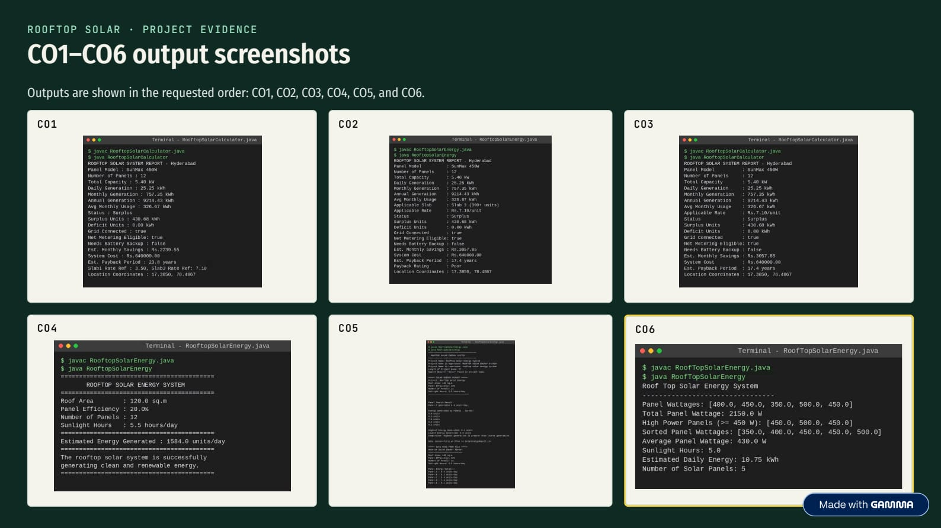
EVIDENCE
Program screenshots
ROOFTOP SOLAR ENERGY SYSTEM • TEAM 13
11

Slide 12
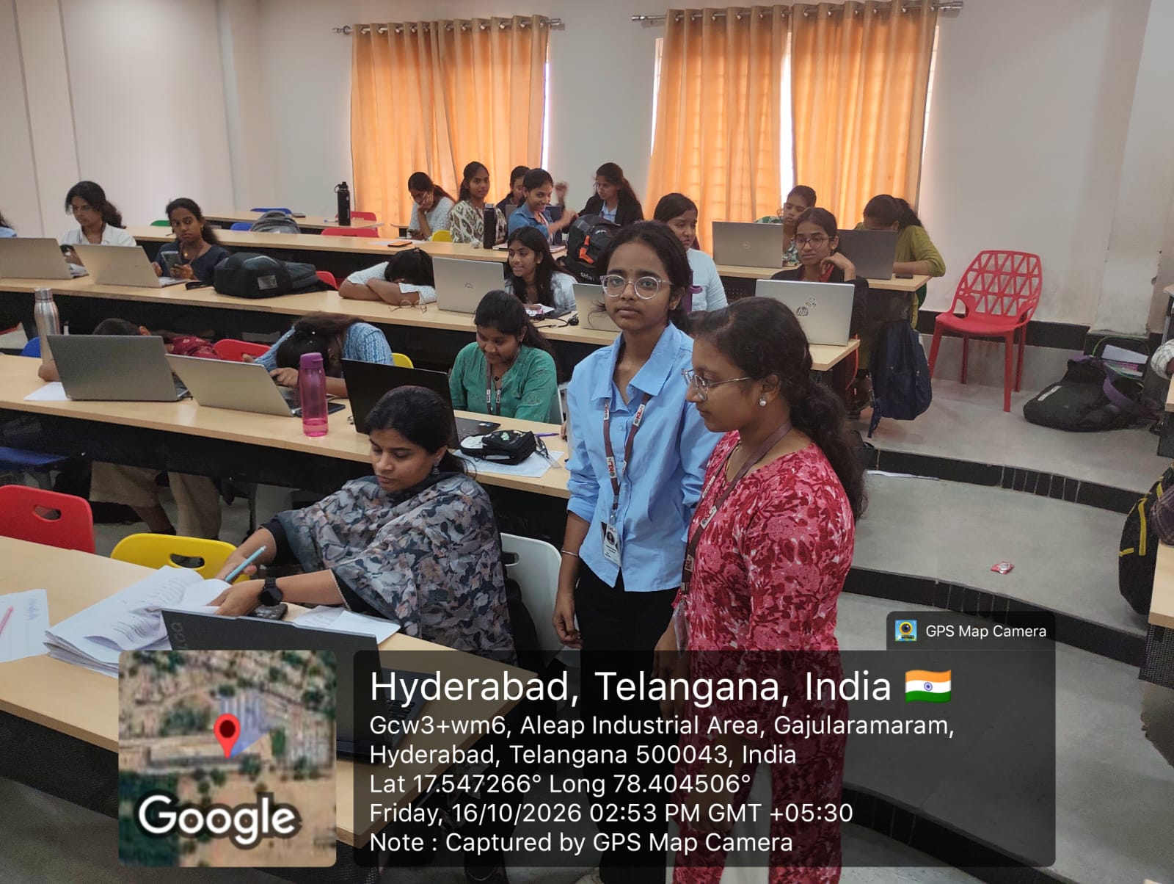
PROJECT EVIDENCE
Geo-tag photo & repository
GEO-TAG PHOTO
GITHUB REPOSITORY
GitHub Repository Links:
https://github.com/bhogadirishita-dot/PSPJ
https://github.com/mahima422/PSPJ
GEO-TAG PHOTO ADDED • Hyderabad, Telangana • 16 October 2026
ROOFTOP SOLAR ENERGY SYSTEM • TEAM 13
12

Slide 13
Thank You
Rooftop Solar Energy System • Team 13
PowerPoint template credit: SlideEgg

