Slide 1

School of Computer Science and Engineering
Department of Science and Application
CIA-3 PRESENTATION
Student Performance Prediction Using TensorFlow & Power BI
Subject : Capstone Project (CIA-3 Presentation)
Presented by: Ms. Mahima Chaudhari | PRN : 250105051019
Class: SY MCA
Under the Guidance of: Prof. Smita Dhawadekar
Academic Year 2026-2027

Slide 2
PROJECT OVERVIEW
Introduction
• Educational institutions generate large amounts of student usage and academic performance data.
• Machine Learning identifies complex patterns to estimate expected student performance.
• TensorFlow builds a deep neural network regression model to predict final scores.
• Power BI transforms raw predictions into interactive dashboards for academic monitoring.
• Demonstrates an end-to-end data pipeline from raw data to visualization.
System Flow
1. Student Data
2. Preprocessing
3. TensorFlow Model
4. Predicted Score
5. Power BI Dashboard

Slide 3
PROJECT OVERVIEW
Problem Statement
Traditional academic analysis depends on manual spreadsheet calculations and static reports, making it difficult to identify student performance trends early.
Challenge 1: Data Fragmentation
Academic and behavioral usage data are stored separately, making multi-variable analysis difficult.
Challenge 2: Lack of Early Indicators
Faculty require early predictive indicators rather than waiting for final semester examination marks.
Challenge 3: Static Reporting
Static tables fail to offer an interactive view of performance trends, adoption rates, and distributions.

Slide 4
SYSTEM DESIGN
Project Objectives
1. Collect and organize student academic performance and usage data.
2. Clean and preprocess numerical & categorical features for machine learning.
3. Train a TensorFlow neural network to predict continuous final performance.
4. Evaluate model precision using MAE and absolute error metrics.
5. Create an interactive Power BI dashboard for trend analysis and visual insights.

Slide 5
TECH STACK
Technologies Used
Python
Programming language for data preparation, model training, and evaluation.
TensorFlow / Keras
Deep learning framework used to build and train the neural network model.
Pandas & NumPy
Data manipulation, matrix operations, and numerical preprocessing.
Scikit-Learn
Feature scaling (StandardScaler) and dummy encoding (OneHotEncoder).
Microsoft Power BI
Interactive dashboards, KPI callout reporting, and dynamic filters.

Slide 6
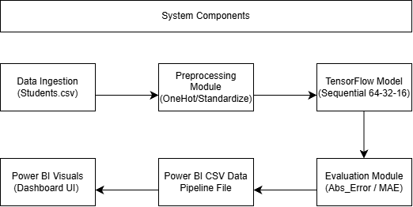
SYSTEM ARCHITECTURE
System Architecture
• Connects Machine Learning execution with Business Intelligence visualization.
• ML Pipeline: Data collection, cleaning, scaling, train/test split, and TensorFlow model training.
• BI Layer: Exports predicted dataset directly into Power BI Desktop.
• Output: Renders interactive dashboards and visual insights for academic decision-making.

Slide 7
DATA ENGINEERING
Data Preprocessing
1. Load & Clean Data
Ingests raw dataset and removes header whitespace or invalid entries.
2. Feature Scaling
StandardScaler normalizes numerical features so all variables contribute equally.
3. Categorical Encoding
OneHotEncoder transforms string categories into numerical dummy vectors.
4. Train / Test Split
Splits data into 80% training and 20% testing sets for model validation.

Slide 8
MODELING
TensorFlow Neural Network Model
Model Architecture
Python Code Implementation
• Model Type: Feed-forward Artificial Neural Network (ANN).
• Input Layer: Receives preprocessed academic and usage features.
• Hidden Layers: 3 Dense layers (64 -> 32 -> 16 nodes) using ReLU activation.
• Output Layer: 1 Dense neuron predicting continuous final score.
• Loss & Optimizer: Mean Squared Error (MSE) loss with Adam optimizer.
# Train/Test Split & Preprocessing
X_train, X_test, y_train, y_test = train_test_split(
X_processed, y, test_size=0.20, random_state=42)
# Model Building
model = tf.keras.Sequential([
tf.keras.layers.Input(shape=(X_train.shape[1],)),
tf.keras.layers.Dense(64, activation="relu"),
tf.keras.layers.Dense(32, activation="relu"),
tf.keras.layers.Dense(16, activation="relu"),
tf.keras.layers.Dense(1)
])
# Compilation & Fitting
model.compile(optimizer="adam", loss="mse", metrics=["mae"])
model.fit(X_train, y_train, epochs=25, batch_size=32)

Slide 9
RESULTS
Model Evaluation & Predictions
Mean Absolute Error (MAE)
1.25
Average difference between actual and predicted scores.
Average Actual Score
0.00
Observed baseline average across student records.
Average Predicted Score
0.10
TensorFlow Neural Network aggregate prediction.
Sample Student Predictions
Student Name | Stream | Actual Score | Predicted Score | Absolute Error
Aarav | Engineering | 2.0 | 2.28 | 0.28
Vivaan | Commerce | -3.0 | -1.28 | 1.72
Aditya | Science | 0.0 | -1.54 | 1.54
Vihaan | Arts | 2.0 | 2.22 | 0.22

Slide 10
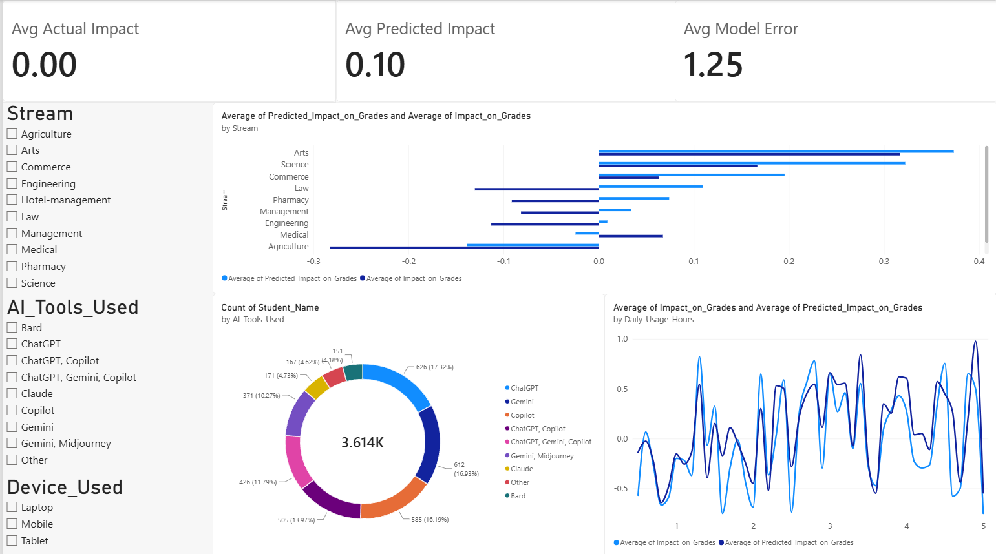
POWER BI DASHBOARD
Power BI Dashboard
• Interactive dashboard for monitoring student performance.
• KPI Cards: Total students, average actual score, and predicted average.
• Actual vs Predicted Chart: Compares predicted outputs with observed performance.
• Distribution Charts: Displays tool usage and performance trends.
• Slicers: Filter by student stream, usage hours, and performance categories.

Slide 11
IMPACT
Advantages & Applications
Key Advantages
Applications
✔ ML + BI Integration: Combines neural network prediction with interactive visualization.
✔ Repeatable Workflow: Automated pipeline from raw CSV data to predictions and dashboards.
✔ Reduces Manual Effort: Minimizes manual spreadsheet calculations across student indicators.
✔ Scalable Design: Architecture easily extends to larger multi-semester datasets.
➜ Academic Monitoring: Track performance trends and identify records needing review.
➜ Faculty Analytics: Provide consolidated reports for classes, subjects, and streams.
➜ Student Support: Use performance indicators to prioritize mentoring and guidance.
➜ Institutional Reporting: Create interactive dashboards for internal academic reporting.

Slide 12
Future Scope
Conclusion
➜ Use larger multi-semester datasets.
➜ Compare TensorFlow with Random Forest and XGBoost models.
➜ Automate model retraining pipelines.
➜ Publish dashboards to cloud with role-based access.
✔ Shows how TensorFlow can be used for academic score prediction.
✔ Power BI transforms model outputs into interactive analytics.
✔ Demonstrates a practical ML + BI project workflow.
✔ Data -> AI Prediction -> Visualization -> Insights

Slide 13

Thank You!
Questions & Answers
Ms. Mahima Chaudhari | SY MCA | Sandip University, Nashik

