Slide 1
GROUP PROJECT · LL(1) SYNTAX ANALYZER
Parse Bench
A grammar-aware syntax analyzer built on LL(1) recursive-descent parsing with dual-tier error recovery.
Manav Pareek
Vishavjeet Sharma
Sanyam Vekariya
S Mahimaa Priyadharshini
Visweswar Sarma Kota
24BCB0004
24BCE0077
24BCE0357
24BCE0411
24BCE0265
Presented to Vishnu Priya
github.com/mahimaapriyadharshinis/Parse_Bench
School of Computer Science and Engineering, VIT
parse-bench.build 01 / 28

Slide 2
PROJECT OBJECTIVES
What this project set out to prove
Six concrete, individually verifiable goals — each one maps directly to a slide later in this deck.
01
02
03
Formalize the language
Prove LL(1) compliance
Implement recursive descent
Define a restricted, C-like grammar in pure BNF covering declarations, assignment, IF/ELSE, WHILE, PRINT and precedence-correct expressions.
Compute FIRST/FOLLOW sets and the parsing table algorithmically, and verify zero FIRST/FIRST or FIRST/FOLLOW conflicts — not assert it, prove it.
One parsing function per grammar rule, mirroring the BNF directly in code, building a full parse tree as it goes.
04
05
06
Engineer dual-tier recovery
Visualize the algorithm
Validate rigorously
Handle both a missing expected token and a token that can't start any construct, so one pass reports every error, not just the first.
Give every internal decision — a match, a rule chosen, an error raised, a recovery taken — a real-time, steppable, on-screen trace.
Back every claim with automated tests spanning valid programs, malformed input, and edge cases.
School of Computer Science and Engineering, VIT
objectives.md 02 / 28

Slide 3
PROBLEM STATEMENT
A parser's decisions are usually invisible
Most beginner tools reduce parsing to one final label — VALID / INVALID — which hides which rule matched, where the tree came from, and how parsing continued after an error.
Current challenges
What Parse Bench makes observable
› Opaque debugging traditional tools obscure state-machine transitions, making error tracing difficult.
› Catastrophic crashes standard parsers halt outright or stall on the first unexpected token.
› Lost context a fail-fast parser discards every token after the first fault, so only one error is ever reported.
› Learn connect grammar rules to an actual run, token by token.
› Debug locate the exact token and expectation that failed.
› Explain present every parse as a live trace and a parse tree, not just a verdict.
School of Computer Science and Engineering, VIT
problem.md 03 / 28

Slide 4
EXECUTIVE SUMMARY
Advancing syntax validation through deterministic LL(1) analysis
Strategic goal
Scope of this build
Bridge theoretical compiler-design concepts with practical, visual analysis — both an educational platform and a robust syntax-validation engine.
No lexer by design: the analyzer's input is a token stream, not source text. It builds an LL(1) table and recursive-descent parser directly from a formal grammar.
The proposed solution — Parse Bench
A deterministic LL(1) parser with a genuinely proven, conflict-free grammar (FIRST/FOLLOW sets and the parsing table are computed by generic fixed-point algorithms, not hand-filled). Two error-recovery strategies work together so one run reports every mistake instead of stopping at the first.
School of Computer Science and Engineering, VIT
solution.md 04 / 28

Slide 5
PROJECT SCOPE
Six deliverables cover the full syntax-analyzer lifecycle
Task allocation ensures every layer of the system — from formal grammar to live demonstration — is documented and presented.
Presentation
System architecture
Grammar & algorithms
Slide deck summarizing goals, design and results.
Detailed flowcharts and pipeline logic.
Pure BNF grammar and LL(1) table specification.
Parse-tree visuals
Interface screenshots
Live demonstration
Structural AST visualizations for valid and error runs.
Real captures of the live web app in action.
Real-time web-app walkthrough of both scenarios.
School of Computer Science and Engineering, VIT
scope.md 05 / 28

Slide 6
TECH STACK
Built as a real, tested engineering project
Not a single script: a Python core with two independent, interchangeable frontends and an automated test suite.
Core algorithm
PYTHON 3.9+
tokens.py, grammar.py, parser.py, parse_tree.py — the FIRST/FOLLOW/LL(1)/recursive-descent logic lives here.
Primary frontend
REACT + VITE
frontend/react-app/ — the interactive stepper, tree visualizer, and tabs shown throughout this deck.
Zero-install demo
HTML / CSS / JS
frontend/parse_bench.html — the same algorithm ported 1:1, no build step, opens directly in a browser.
Testing
PYTEST
21 automated tests: valid programs, syntax errors, edge cases, and a genuine LL(1)-compliance check.
Optional tree export
GRAPHVIZ
Parse trees can be exported from the Python source as .dot diagrams.
School of Computer Science and Engineering, VIT
stack.md 06 / 28

Slide 7
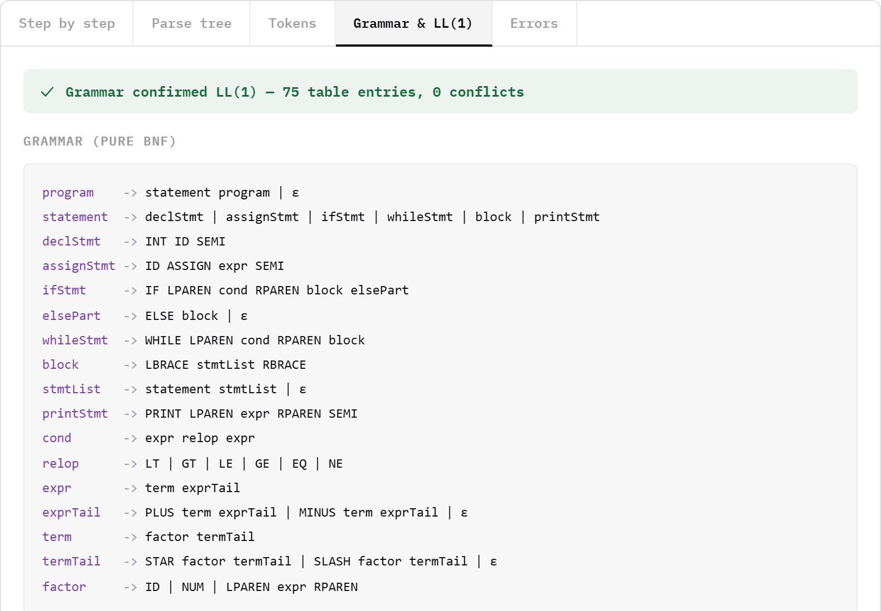
LANGUAGE SPECIFICATION
A context-free grammar in pure Backus–Naur Form
Captured live from the app's own “Grammar & LL(1)” tab — nothing here is hand-typed.
Declarations
INT ID SEMI — a single production defines variable creation.
Assignments
ID ASSIGN expr SEMI binds an identifier to an evaluated expression.
Control flow
IF / ELSE and WHILE both gate a nested block.
Expressions
Hierarchical precedence via term and factor — no ambiguity, no rewrites.
School of Computer Science and Engineering, VIT
grammar.bnf 07 / 28

Slide 8
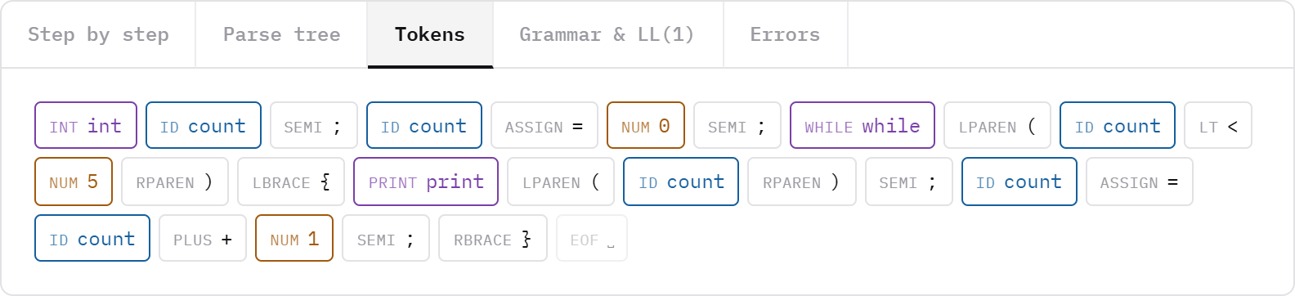
INPUT FORMAT
The input names tokens instead of raw characters
STREAM.TOK — the “Valid program” preset
Why this format
Separates lexical input from syntax analysis, so grammar tests stay short and repeatable.
Colour = category
Keyword / identifier / number / EOF — the only decorative colour in the whole UI, and it's functional.
INT ID(x) SEMI ID(x) ASSIGN NUM(1) PLUS NUM(2) SEMI
One or more tokens per line. Each token is TYPE or TYPE(lexeme) — a lexeme is required for ID/NUM, optional elsewhere. # starts a comment; no lexer is included by design.
School of Computer Science and Engineering, VIT
tokens.stream 08 / 28

Slide 9
ALLOWED INPUT
The accepted language, at a glance
Everything the grammar accepts, shown as source — and just as importantly, what it deliberately leaves out.
Every construct the grammar accepts
Deliberately not in this grammar
int x; // declaration
x = 1 + 2 * 3; // assignment + precedence
if (x < 10) { ... } else { ... }
while (x >= 0) { ... }
print(x);
(x + 1) * (x - 1) // parenthesized exprs
x == 10 x != 0 x <= 5 x >= 5 // relops
› Functions no user-defined procedures or calls.
› Arrays & strings int is the only data type.
› Floats NUM is integer-only.
› && || ! no boolean/logical operators.
› ++ -- no increment/decrement.
› for, do-while, switch one loop form (while) is enough to prove the technique.
Allowed token vocabulary
Keywords: int, if, else, while, print · Operators: = + - * / < > <= >= == != · Punctuation: ( ) { } ; · Literals: identifiers, integers.
School of Computer Science and Engineering, VIT
allowed.grammar 09 / 28

Slide 10
SYSTEM DESIGN
A modular five-stage pipeline
Raw ingestion flows through to interactive visualization; each stage has one responsibility.
1
2
3
4
5
Ingestion
→
Tokens
→
LL(1) parser
→
Recovery
→
Visualizer
Raw token stream arrives from the UI textarea.
tokens.py parses the text format into Token objects.
parser.py — recursive descent validated against grammar.py.
Phrase-level (soft expect) or panic-mode (synchronize).
parse_tree.py → an interactive React canvas.
School of Computer Science and Engineering, VIT
architecture.md 10 / 28

Slide 11
HOW IT WORKS
One input drives five connected views
A token stream enters the parser once; every panel in the interface is generated from that same run.
1
2
3
4
5
Token stream
LL(1) parser
Parse tree
Live trace
Result
Read token type and optional value.
Choose a rule using one lookahead.
Create nodes as rules match.
Show consumes, matches, recovery.
Report validity, metrics, errors.
Because every view shares one parser state, a highlighted token, a trace entry and a tree node all describe the same moment.
School of Computer Science and Engineering, VIT
dataflow.md 11 / 28

Slide 12
CORE ALGORITHM & TECHNIQUE
LL(1) keeps every parsing decision deterministic
L
Left to right
parser.py — Parser.parse_statement()
Input is scanned strictly left to right, one token at a time.
# parser.py — statement() dispatch, verbatim
dispatch = {
TokenType.INT: self.parse_decl_stmt,
TokenType.ID: self.parse_assign_stmt,
TokenType.IF: self.parse_if_stmt,
TokenType.WHILE: self.parse_while_stmt,
TokenType.PRINT: self.parse_print_stmt,
}
handler = dispatch.get(self.current().type)
L
Leftmost derivation
The parser constructs a leftmost derivation of the input program.
1
One-token lookahead
Exactly one lookahead token selects the production — never more.
One dedicated function per non-terminal — the runtime call stack literally mirrors the AST being built.
School of Computer Science and Engineering, VIT
algorithm.ll1 12 / 28

Slide 13
PREDICTIVE PARSING LOGIC
Deterministic execution, zero backtracking
1
2
3
4
Ingestion
→
Evaluation
→
Execution
→
Error dispatch
Initialize the token pointer.
Consult FIRST / FOLLOW sets.
Invoke the chosen production path.
Handle an invalid lookahead.
Match
Recurse
Epsilon
expect() / advance() — consume the current token, move the pointer forward.
Invoke the dedicated function for the chosen non-terminal.
Resolve valid ε-productions (e.g. elsePart) without consuming input.
School of Computer Science and Engineering, VIT
flowchart.md 13 / 28

Slide 14
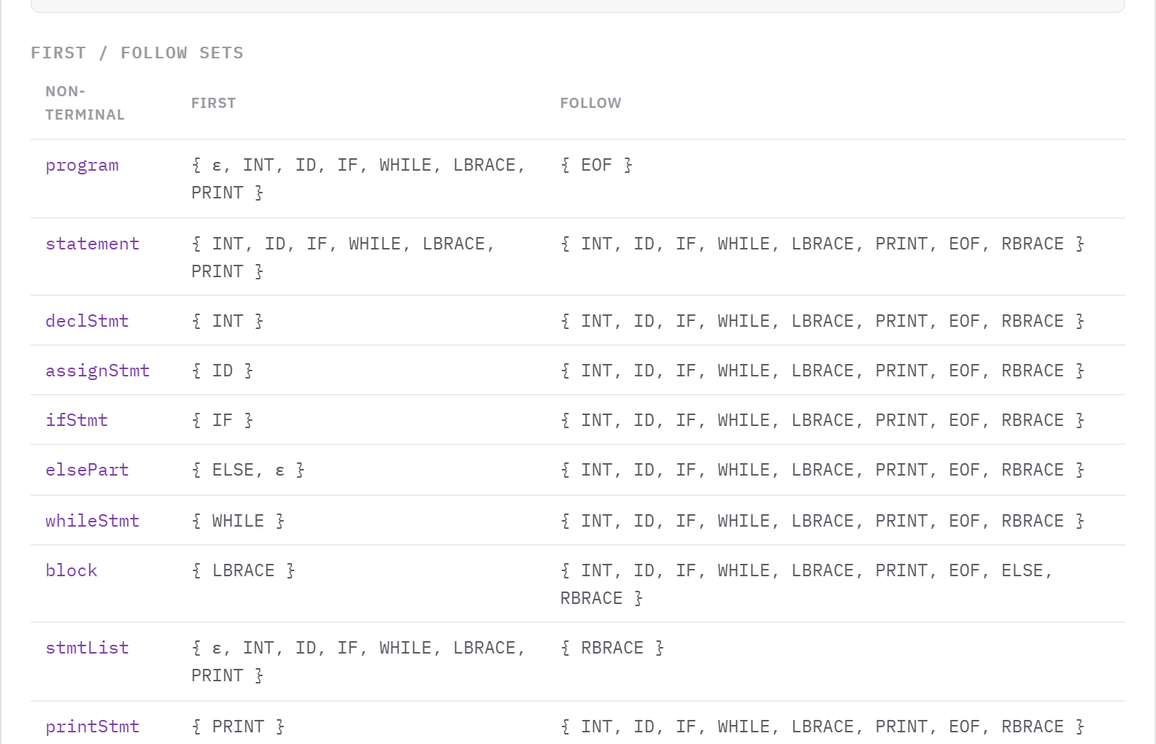
CORRECTNESS FOUNDATION
FIRST and FOLLOW sets are the routing logic
Computed by generic fixed-point algorithms in grammar.py — captured live, not hand-filled.
Set categorization
Program & statement sets fix valid starting tokens (INT, ID, IF, WHILE, PRINT, {); every statement's FOLLOW set spans the same set plus EOF and RBRACE.
Epsilon handling
If ε is valid in a FIRST set, the parser consults FOLLOW to safely bypass the production without a false syntax error.
School of Computer Science and Engineering, VIT
sets.first_follow 14 / 28

Slide 15
CORRECTNESS OF APPROACH
The parsing table is verified conflict-free
75
0
LL(1)
PARSING TABLE ENTRIES
GRAMMAR CONFLICTS
STRICT COMPLIANCE
The grammar exhibits no FIRST/FIRST or FIRST/FOLLOW overlap anywhere in its production set, so every cell of the table names exactly one production — table construction raises immediately on conflict, which is how the grammar is proven LL(1), not just asserted.
Testing
This claim is backed by an automated pytest check (test_grammar.py-style assertion) plus 21 tests covering valid programs, syntax errors, and edge cases — all passing.
School of Computer Science and Engineering, VIT
table.verify 15 / 28

Slide 16
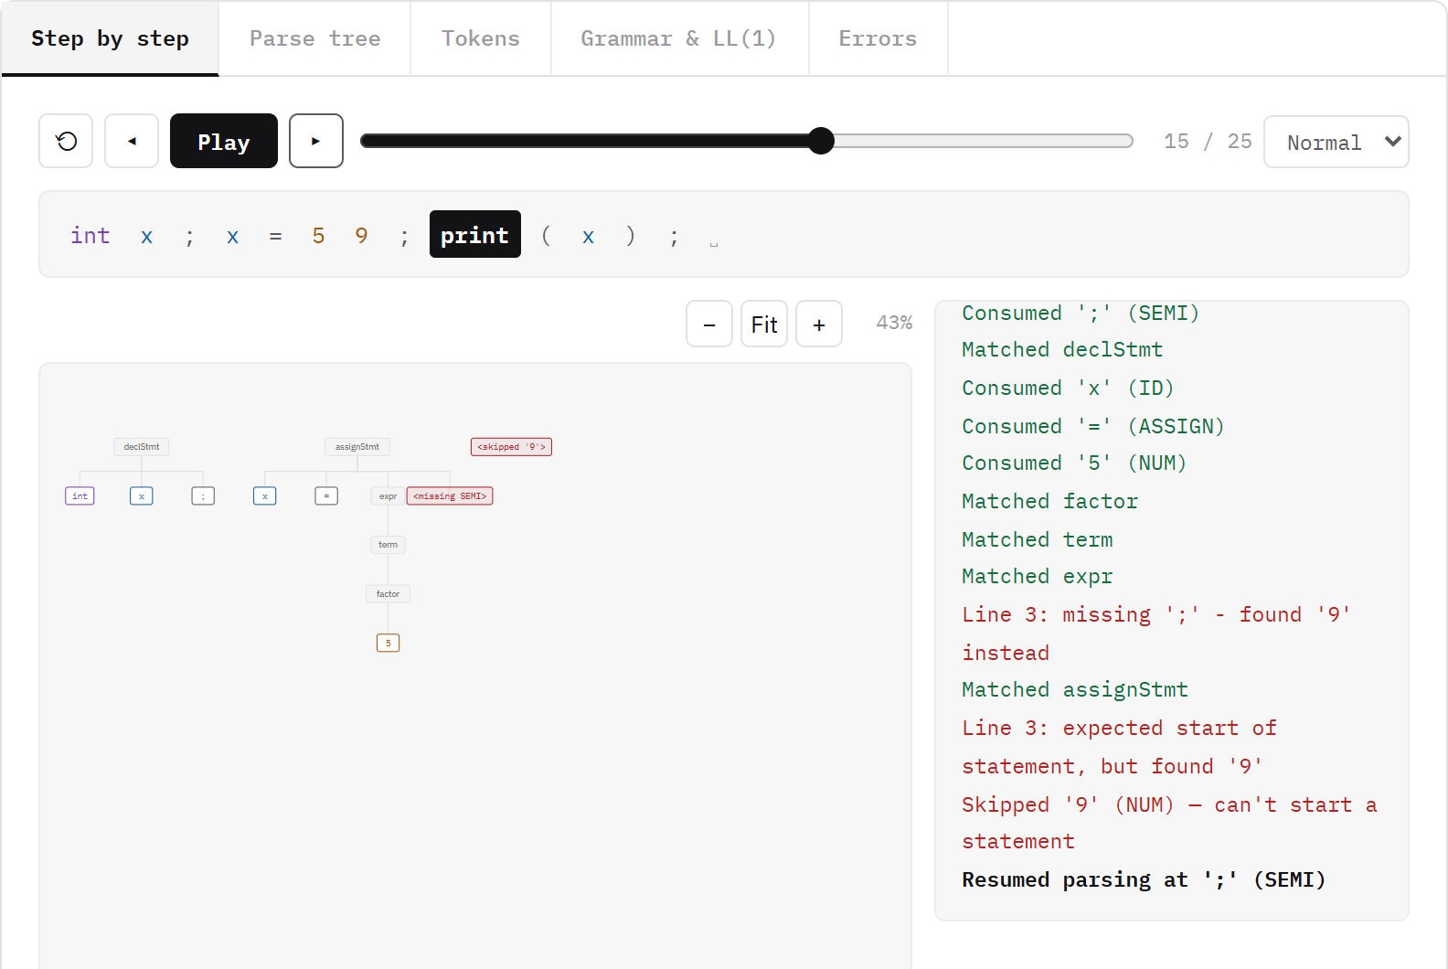
IMPLEMENTATION
Two recovery primitives implement the whole strategy
parser.py — the two recovery primitives
def expect(self, ttype):
if self.check(ttype):
return self.leaf(self.advance())
self.report(ParseError(...)) # phrase-level
return ParseTreeNode(f"<missing {ttype}>")
def synchronize(self, terminator): # panic-mode
while not self.check(EOF):
if self.check(SEMI): advance(); return
if token in FIRST_STATEMENT: return
self.advance() # skip garbage
Real trace: both primitives firing on one input
School of Computer Science and Engineering, VIT
primitives.py 16 / 28

Slide 17
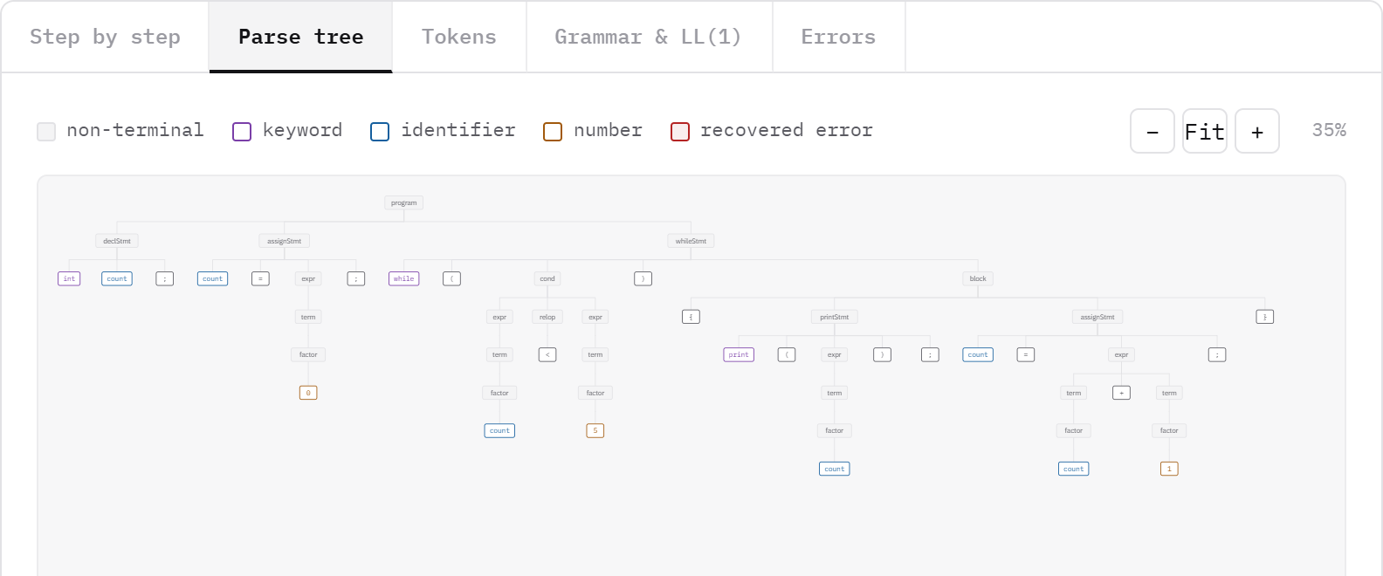
CORRECTNESS IN PRACTICE
The parse tree reveals precedence and nesting
The real “Parse tree” tab for the built-in valid-program example — count from 0 to 5, printing each step.
STAR/PLUS group inside term/expr before the outer statement combines them — precedence falls directly out of the grammar's shape, with no separate precedence table required.
52 nodes · depth 7
FULL VALID-RUN DERIVATION
School of Computer Science and Engineering, VIT
tree.precedence 17 / 28

Slide 18
ERROR RECOVERY THEORY
Four classical strategies — Parse Bench implements two, deliberately
The standard compiler-theory taxonomy of syntax error recovery, and why two of the four are the right fit for an LL(1) recursive-descent parser.
Panic-mode recovery
IN USE
Phrase-level recovery
IN USE
Discard input symbols one at a time until a designated set of “synchronizing” tokens is found (e.g. ';' or a statement-starting keyword). Simple, and guaranteed to terminate.
On detecting a local error, perform a local correction on the remaining input — e.g. treat a missing ';' as if it were there and continue parsing.
Implemented as synchronize() — the parser's Tier 2.
Implemented as the “soft” expect() — the parser's Tier 1.
Error productions
NOT USED
Global correction
NOT USED
Anticipate common mistakes and add explicit rules for them directly into the grammar, so the parser handles an error like any other construct.
Given an incorrect input and a grammar, compute the closest correct program — the minimum sequence of insert/delete/change edits — typically over the whole input.
Would pollute the formally clean BNF the LL(1) proof depends on.
Computationally expensive; rarely used outside theory.
School of Computer Science and Engineering, VIT
recovery.theory 18 / 28

Slide 19
ERROR RECOVERY
A dual-tier architecture, not a fail-fast one
Standard parsers halt on the first fault, losing every token of context after it. Parse Bench keeps internal state to surface multiple errors in one pass.
Tier 1 · Phrase-level (“soft expect”)
Tier 2 · Panic-mode (hard dispatch failure)
› Used for an expected-but-missing closing/terminating token (e.g. a missing ';' or ')').
› Reports the error but does NOT raise — pretends the token was there and keeps parsing.
› Injects a <missing X> node so the AST stays structurally complete.
› Used when the current token can't start ANY valid construct.
› Abandons the current statement; synchronize() skips tokens until one in FIRST(statement) or a matching '}'.
› A stray '}' with nothing open to close is skipped as garbage, not treated as safe — fixed after a real infinite-loop bug.
Both mechanisms are exercised together in the walkthrough that follows — on one real input, not two separate toy examples.
School of Computer Science and Engineering, VIT
recovery.md 19 / 28

Slide 20
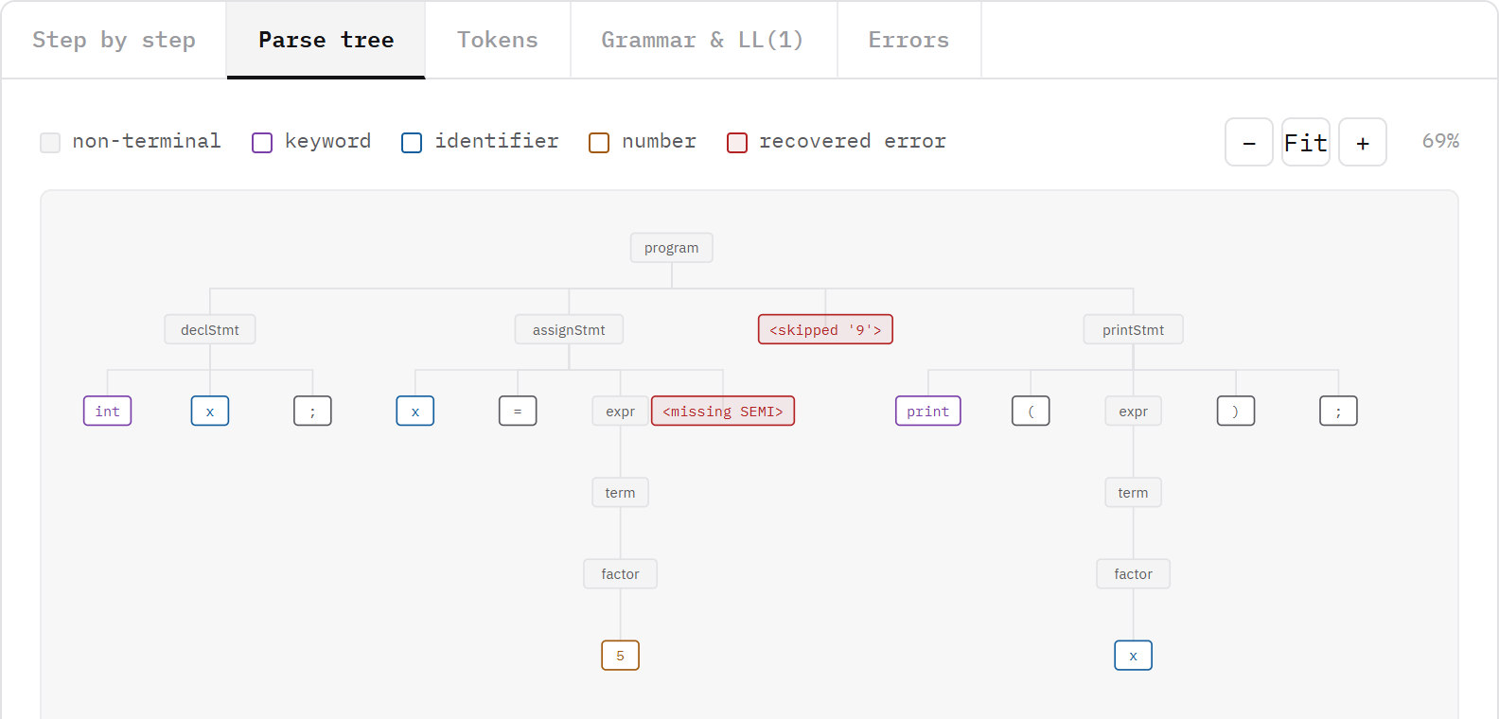
PHRASE-LEVEL RECOVERY, LIVE
A real run: “x = 5” with no semicolon
The exact input typed into the app
STREAM.TOK
INT ID(x) SEMI
ID(x) ASSIGN NUM(5) # no SEMI here
NUM(9) SEMI
PRINT LPAREN ID(x) RPAREN SEMI
> Line 3: missing ';' - found '9' instead
What happens
Real tree: <missing SEMI> node, highlighted red
expect(SEMI) sees '9' instead of ';'. It reports the error, does NOT consume '9', and returns a <missing SEMI> placeholder so assignStmt still completes.
School of Computer Science and Engineering, VIT
tier1.recovery 20 / 28

Slide 21
PANIC-MODE RECOVERY, LIVE
The same run: the stray '9' can't start a statement
PARSE_BENCH — real trace log
> Line 3: expected start of statement, but found '9'
> Skipped '9' (NUM) — can't start a statement
> Resumed parsing at ';' (SEMI)
What happens
'9' (NUM) isn't in FIRST(statement), so parse_statement() raises. parse_stmt_sequence catches it, records an <skipped '9'> node, and calls synchronize() — which discards '9' and consumes the very next SEMI to resume cleanly.
Real tree: <skipped '9'> node beside the recovered assignStmt
School of Computer Science and Engineering, VIT
tier2.recovery 21 / 28

Slide 22
RECOVERY PIPELINE
One real trace shows all four stages back to back
Detect → Report → Synchronize → Continue — captured from the app's own step-by-step log, not staged.
1 Detect
current token fails expect() or matches no dispatch entry
2 Report
exact message appended to parser.errors, with line number
3 Synchronize
insert a placeholder node, or skip to FIRST(statement)/';'
4 Continue
parsing resumes; later statements parse normally
School of Computer Science and Engineering, VIT
recovery.flow 22 / 28

Slide 23
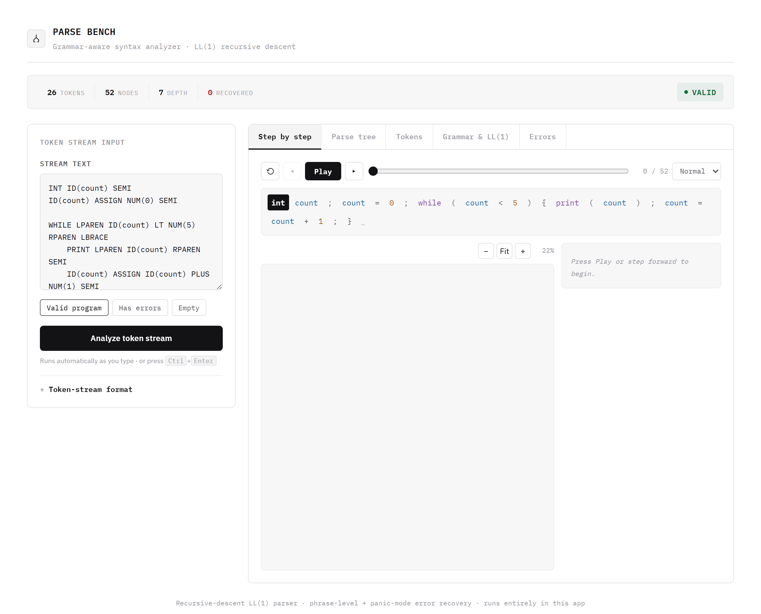
WEB INTERFACE OVERVIEW
The actual live app — React + Vite, running locally
Step by step
Replays the parser's own trace: Play/Pause/step/scrub.
Parse tree
Zoomable, syntax-highlighted by token category.
Tokens
Colour-coded token stream, category by category.
Grammar & LL(1)
Live FIRST/FOLLOW sets and table-entry count.
Errors
Every recovered error, with its line number.
School of Computer Science and Engineering, VIT
interface.ui 23 / 28

Slide 24
DEMO 1 · VALID PROGRAM
The built-in “Valid program” preset parses without recovery
26
52
7
0
VALID
TOKENS
NODES
DEPTH
RECOVERED
School of Computer Science and Engineering, VIT
demo.valid 24 / 28

Slide 25
DEMO 2 · DUAL-TIER RECOVERY IN ONE RUN
A custom input triggers both phrase-level and panic-mode recovery
13
23
5
2
2 ERRORS
TOKENS
NODES
DEPTH
RECOVERED
School of Computer Science and Engineering, VIT
demo.dualtier 25 / 28

Slide 26
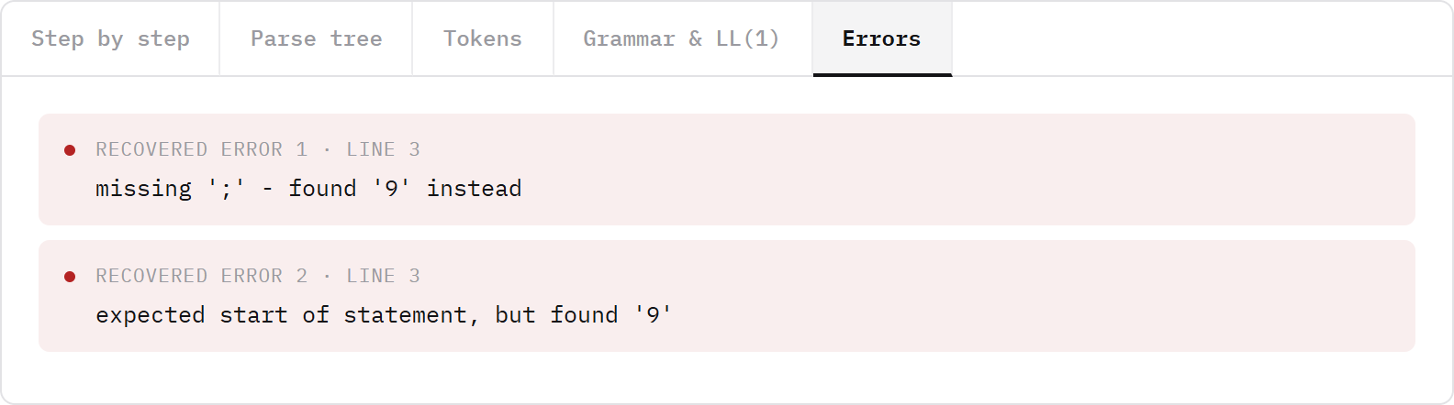
ERROR DIAGNOSTICS
Human-readable messages, not stack traces
The real “Errors” tab for the dual-tier example: two distinct causes, both on line 3, both correctly attributed.
Both messages are produced by the same friendly-error machinery: token types are spelled out (“';'”, “an identifier”) instead of raw enum names.
School of Computer Science and Engineering, VIT
errors.ui 26 / 28

Slide 27
LIMITS & EXTENSIONS
Focused today, with a clear path forward
Current boundaries
Practical next steps
› No lexer by design — input is a token stream, not raw source text.
› Checks syntax only — no type system, scope, or runtime semantics.
› Covers a deliberately restricted, C-like statement/expression subset.
› A wide tree can need the zoom/fit controls on very large programs.
› Add a lexer so users can paste raw source code directly.
› Add symbol-table and type checks after parsing.
› Search, collapse and export large parse trees.
› Grammar editing with automated LL(1) conflict tests.
The current scope keeps the core parser understandable; every extension builds on the same trace-and-tree foundation.
School of Computer Science and Engineering, VIT
roadmap.md 27 / 28

Slide 28
CONCLUSION
Parse Bench makes syntax analysis explainable
It connects three layers that are usually taught separately.
01
02
03
Grammar
Execution
Evidence
LL(1) rules and FIRST/FOLLOW decisions, computed live.
A token-by-token recursive-descent trace, replayable.
Parse trees, metrics, and recoverable errors, on screen.
A parser becomes easier to trust when its decisions can be inspected.
GitHub repository
Live web app
Grammar specs
github.com/mahimaapriyadharshinis/Parse_Bench — full source, both frontends, 21 tests.
frontend/react-app (npm run dev) or the zero-install frontend/parse_bench.html.
GRAMMAR.md — EBNF, pure-BNF, and every computed FIRST/FOLLOW set.
School of Computer Science and Engineering, VIT
Questions? 28 / 28

