Slide 1


U.S. Sales Overview Tableau Dashboard Project

Slide 2
INTRODUCTION
OBJECTIVE
The primary objective of the Sales Overview Tableau Dashboard Project is to create an interactive and user-friendly dashboard that provides a comprehensive view of the company’s sales performance. This dashboard aims to:
Visualize Key Sales Metrices: Present critical sales metrices such as total revenue, sales growth rate, and average deal size in an easy-to-understand format.
Identify Sales Trends And Patterns: Enable users to identify trends over time, including seasonal variations and long-term growth patterns.
Analyse Sales By Dimensions: Offer insights into sales performance across different dimensions, such as regions, product categories, sales channels, and customer segments.
Enhance Decision-Making: Provide actionable insights to support data-driven decision-making for sales strategy, resource allocation, and market expansion.
Improve Sales Performance Monitoring: Facilitate real-time monitoring of sales targets versus actuals, helping to identify areas of improvement and drive performance.
By achieving these objectives, the dashboard will serve as a powerful tool for sales managers, executives, and other stakeholders to make informed decisions, optimize sales strategies, and ultimately drive revenue growth.

Slide 3
SCOPE
The scope of the Sales Overview Tableau Dashboard Project encompasses the following key areas:
Data Coverage: The dashboard consolidates sales data from various sources, including CRM systems, ERP databases, and Excel files, covering multiple dimensions such as country/regions, product categories and sales channels.
Time Period Analysis: The dashboard provides insights into sales performance over different time periods-daily, weekly, monthly, quarterly, and yearly – allowing users to track trends and compare performance across timeframes.
Product and Category Insights: Analysis sales data across different products categories to identify top performers and underperforming segments, aiding in product portfolio optimization.
Sales Channel Performance: Evaluates the effectiveness of various sales channels(e.g., online, retail, wholesale) to help refine channel strategies and optimize resource allocation.
Interactive Features: The dashboard incorporates interactive elements such as filters, drill-down capabilities, and dynamic charts to provide a tailored analysis experience for different stakeholders.
Performance Monitoring: The scope also includes the ability to monitor key performance indicators (KPIs) such as sales targets, conversion rates, and customer acquisition costs to ensure alignment with business goals.

Slide 4
DATA SOURCES
This project provide a comprehensive view of sales performance. The key data sources used in project include:
Customer Relationship Management (CRM) Systems:
Source: Salesforce, HubSpot, or similar CRM platforms.
Data Extracted: Customer details, sales pipeline information, deal stage, lead conversion rates, sales rep performance.
Point Of Sale (POS) Systems:
Source: Retail POS systems (e.g., Square, Shopify POS).
Data Extracted: In- store sales data, customer purchase history, transaction details, and payment methods.
External Data Sources:
Source: Third-party market data providers.
Data Extracted: Market trends, competitor sales data, and industry benchmarks.
Excel And CSV Files:
Source: Internal sales reports, forecasts, and ad-hoc analysis files.
Data Extracted: Historical sales data, manual forecasts, custom calculations, and customer segmentation info.

Slide 5
KEY METRICES & KPIs
The Sales Overview Tableau Dashboard tracks several key metrices and Key Performance Indicators (KPIs) to provide a comprehensive analysis of sales performance. The following are the primary metrices and KPIs included here:
TOTAL SALES REVENUE:
Measures the total income generated from sales over a specific period. It provides an overall indication of the company’s revenue performance and is fundamental for assessing growth.
SALES GROWTH RATE:
Represents the percentage increase or decrease in sales over time (e.g., month-over-month, year over year). This KPI helps track the business’s expansion and identify trends.
SALES BY REGION:
Provides a geographical analysis of sales performance, highlighting regions with the highest and lowest sales, which supports targeted marketing and sales efforts.
TOTAL PROFITS:
The percentage of profit relative to total sales, providing insight into the profitability of sales activities and operational efficiency.
TOP PERFORMING SALES REPRESENTATIVES:
Analyses sales performance at the individual level, identifying top performers based on revenue generated, number of deals closed, or new customers acquired. This helps in rewarding high-performing sales reps.

Slide 6
DASHBOARD FUNCTIONALITIES FOR METRICES AND KPIs
Interactive Elements:
The dashboard includes filters for time, country, region, product category, profits, quantity and sales channel, allowing users to drill down into specific metrices.
Dynamic Visualizations:
Key metrices and KPIs are displayed using various visualizations such as bar charts, line graphs, hex map, and pie charts to facilitate easy analysis and interpretation.
Real-Time Data:
The dashboard is designed to pull real-time data, ensuring the latest information is available for decision-making.
By focusing on these metrices and KPIs the Sales Overview Tableau Dashboard provides actionable insights that help drive sales strategy, improve performance, and achieve business objectives.

Slide 7
FUTURE ENHANCEMENT
These enhancements aim to provide deeper insights, enhance user experience, and support more strategic decision make:
Integration Of Advanced Analytics: To forecast future sales trends, identify potential high-growth regions, and anticipate changes in customer demands. Utilize machine learning algorithms to analyse customer behaviour and sales patterns, enabling more accurate segmentation, targeted marketing and personalized sales strategies.
Enhanced Data Sources: Expand the data sources to include social media analytics, customer feedback, and competitive intelligence. Link sales data with marketing campaign data to measure the direct impact of marketing efforts on sales performance and optimize marketing strategies for better ROI.
Geospatial Analysis: Introduce more advanced geospatial analysis features, such as heatmaps, geographical clustering, and route optimization, to better understand sales distribution and logistics efficiency across different regions in U.S.
Improved User Experience: Allow users to customize the dashboard layout, choose preferred visualizations, and set personalized alerts and notifications. This will enhance user engagement and make the dashboard more versatile for different stakeholders. Further optimize the dashboard for mobile devices to ensure a seamless experience for users accessing the dashboard on the go.
Security And Data Governance: Implement role-based access controls and data encryption to ensure the security of sensitive sales data. This enhancement will also help in compliance with data governance policies.
By implementing these future enhancements, this dashboard will become a more powerful tool for analysing sales data, driving strategic decisions, and supporting overall business policies.

Slide 8
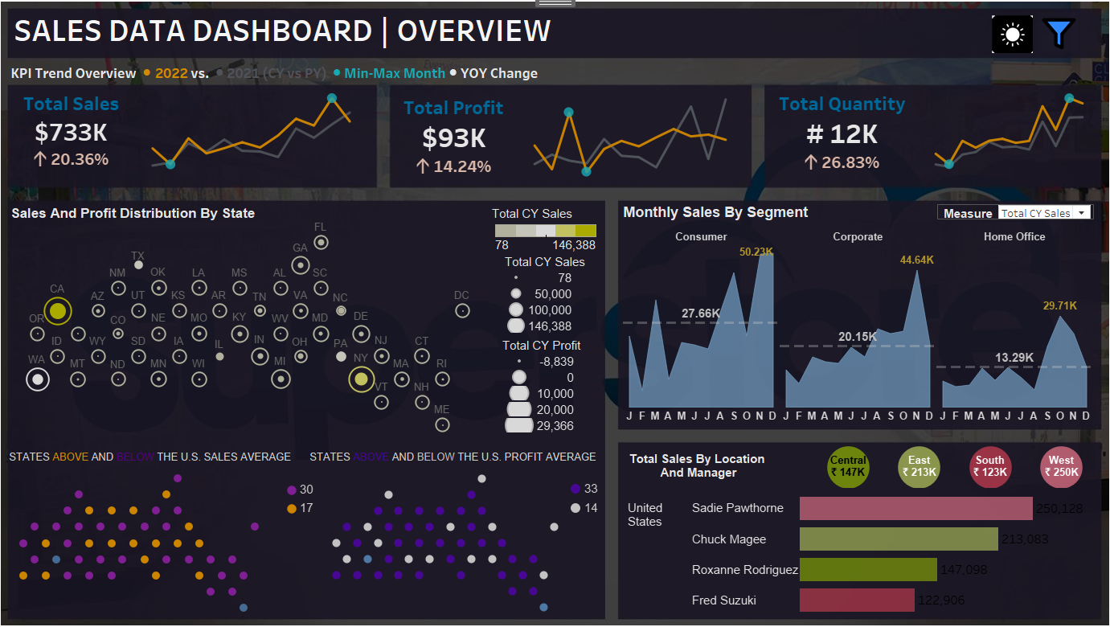

Slide 9
CONCLUSION
The U.S. Sales Overview Tableau Dashboard Project has successfully achieved its objective of providing a comprehensive, interactive, and user-friendly platform for analysing sales data across the U.S. market. The dashboard offers key insights into sales performance, customer behaviour, and market trends, allowing stakeholders to make data-driven decisions and develop effective sales strategies.
KEY OUTCOMES OF THE PROJECT:
Enhanced Sales Visibility: The dashboard consolidates sales data from various sources into a single view, offering a clear and concise overview of overall sales performance, regional trends, and product category dynamics.
Improved Decision-Making: By providing real-time insights and detailed breakdowns of key sales metrices and KPIs, the dashboard enables sales leaders and managers to make informed decisions quickly and effectively, optimizing sales strategies and resource allocation.
Strategic Insights For Growth: The dashboard has identified high-performing regions, top-selling products, and successful sales channels, offering valuable insights that can be leveraged to focus on areas of growth and improve underperforming segments.
Foundation For Future Enhancements: The project has laid a strong foundation for future enhancements, including advanced analytics integration, expanded data sources, and improved user customization, ensuring the dashboard remains a powerful tool for ongoing sales analysis and strategy development.

Slide 10
Next Steps:
Implementing the identified future enhancements to further improve the dashboard’s functionality and user experience.
Continuously updating the dashboard with the latest data and insights to maintain its relevance and value for stakeholders.
Leveraging the insights gained from the dashboard to refine sales strategies, enhance customer engagement, and drive revenue growth.
In conclusion, the U.S. Sales Overview Tableau Dashboard has proven to be an invaluable asset for understanding sales performance and driving strategic business decisions. By continuing to evolve and expand its capabilities, the dashboard will support the company’s long-term sales objectives and contribute to sustained market success.

