Slide 1
PHP (Hypertext Preprocessor)
Presented by: Mahima Koirala
Dikshya Shrestha

Slide 2
PHP
•PHP is a general purpose programming language originally designed for web development.
•It originally stood for Personal Home Page but now it stand for the recursive acronym PHP i.e. Hypertext Preprocessor.
•PHP is a server side scripting language because it runs on the web server.
•It is cross platform.
•It is open source

Slide 3
PHP Syntax and Structure
PHP code is written within tags, which tell the server to execute the code.
1
Semicolons
2
Case Sensitivity
3
Comments
Statements are terminated with semicolons.
PHP is case-insensitive for keywords, but case-sensitive for variables and function names.
Comments are used to explain code and are
ignored by the interpreter.
Syntax
<?php
//statement
?>

Slide 4
Variables
•Variables hold the data that your program manipulates while it runs.
•Denoted by $(dollar sign) followed by variables name.
•Example:
<?php>
$name;
$roll;
?>

Slide 5
PHP Data Types
PHP supports various data types, including integers, floats, strings, booleans, and arrays.
Data Type
Description
Integer
Whole numbers
Float
Decimal numbers
String
Textual data
Boolean
True or false
Array
Collection of data

Slide 6
PHP Control Structures
Control structures allow you to control the flow of your program, determining which code blocks are executed based on specific conditions.
1
if
Executes if condition is true.
2
if-else
Executed whether the condition is true or false.
3
Switch
used to execute one statement from multiple conditions.
4
Loops
Repeat a block of code multiple times, such as for, while, and do-while loops.

Slide 7
PHP Functions
Functions are reusable blocks of code that perform specific tasks, improving code organization and reducing redundancy.
creating a function
syntax: function function_name() {
// executable code ;
}
calling a function
functions can be defined before or after they are called. The PHP engine reads the entire program files and takes care of all the function definitions before it runs any of the commands in file.
passing argument to a function
syntax: function function_name ($first_parameter, $second_parameter) {
executable code;
}

Slide 8

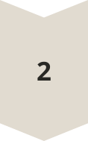
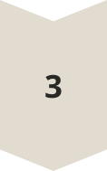
PHP Arrays
Arrays are data structures that store collections of values, providing a way to organize and access related data efficiently.
creating an array
syntax : <?php fruit_name = array("Hello", "Namaste"); ?>
<?php fruit_name = ["hello", "namaste"];
Indexed Arrays
Elements are accessed using numeric indices, starting from 0.
Associative Arrays
Elements are accessed using keys, which can be strings or integers.
Multidimensional Arrays
Arrays can contain other arrays, allowing for hierarchical data structures.

Slide 9
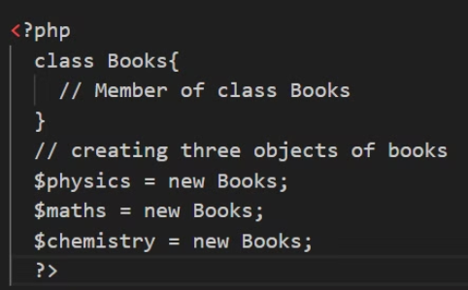
Creating class and objects in PHP
Like C++ and Java, PHP also supports OOP.
Classes are the blueprints of the objects. They are the collection of objects.
Object is an individual instance of the data structure defined by a class. We define a class once and then make many objects that belong to it.
Example:

Slide 10
PHP forms
Forms are how users communicate with your server. So, it is an essential component of almost any web application.
Form validation:
client-side validaion: validation is present on the client machine web browsers.
server-side validation: after submited by the data, the data has to be sent to a server and perform validation checks in the server machine.

Slide 11
Thank you!
Any questions???

