Slide 1
GENERAL PURPOSE SIMULATION SYSTEM
PRESENTED BY:
DIKSHYA SHRESTHA
MAHIMA KOIRALA
SUDIKSHA GHIMIRE
ABHINANDAN MALLA

Slide 2
Introduction to GPSS
GPSS is a general-purpose simulation language used for modeling and analyzing complex systems. It's widely used in various industries for improving efficiency, optimizing processes, and predicting system behavior.
GPSS (General Purpose Simulation System) is a simulation language that was developed in the 1960s for simulating complex systems.
It is no more as widely used as before.

Slide 3
Key features of GPSS include:
Process-Oriented Simulation: GPSS allows users to define simulation models in terms of entities (such as customers, parts, or transactions) and processes (such as queues, servers, or delays).
Block Structured Language: It uses a block-structured syntax to define simulation models, making it easier to organize and understand complex simulations.
Event Scheduling: GPSS employs event scheduling techniques where events (such as arrivals or departures) are scheduled to occur at specific times during the simulation.
Statistical Analysis: It includes built-in statistical functions and capabilities to collect and analyze simulation results, helping users understand system behavior and performance.
Variants and Versions: Over the years, several variants and versions of GPSS have been developed, each adding enhancements and improvements to the language and its capabilities.

Slide 4
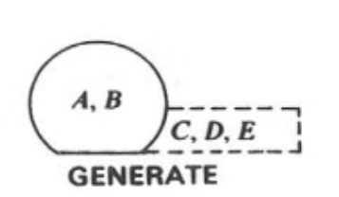
Generate Block
Function
Parameters
Example
Creates transactions at specified intervals, representing the arrival of entities into the system.
The block's parameters include the time interval between transaction creations and the transaction type.
A Generate block with an interval of 10 time units will create a new transaction every 10 time units.

Slide 5
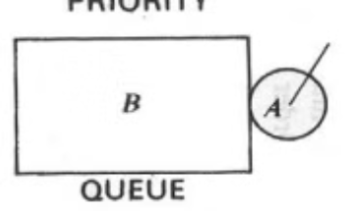
QUEUE Block
Function
Parameters
Example
Represents a waiting line where transactions are held until a resource becomes available.
The block's parameters define the queue's capacity and the priority rules for transactions.
A Queue block with a capacity of 5 will hold a maximum of 5 transactions before blocking further arrivals.

Slide 6
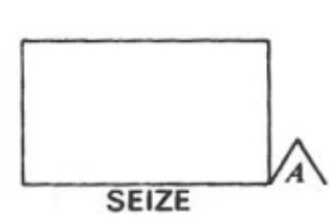
SEIZE Block
Function
Parameters
Example
Acquires a resource for a transaction, making the resource unavailable for other transactions.
The block's parameters define the resource that is being seized.
A Seize block connected to a resource called "Server" will acquire that server for a transaction, making it unavailable for other transactions.

Slide 7
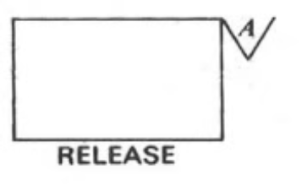
RELEASE Block
Function
Parameters
Example
Releases a resource that was previously seized by a transaction, making it available for other transactions.
The block's parameters specify the resource that is being released.
A Release block connected to a resource called "Server" will release that server, making it available for other transactions.

Slide 8
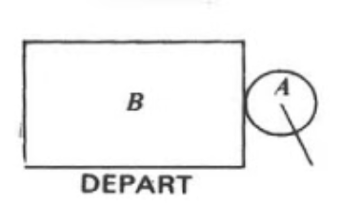
Depart Block
Function
Parameters
Example
Removes transactions from a queue when they have finished receiving service or accessing a resource.
The block's parameters specify the queue from which transactions are removed.
A Depart block connected to a Queue block will remove transactions from that queue when they have finished processing.

Slide 9
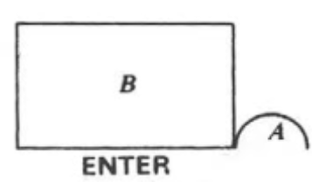
Enter Block
Function
Parameters
Example
Increases the count of a resource by one, representing the arrival of a new unit of that resource.
The block's parameters define the resource whose count is being increased.
An Enter block connected to a resource called "Machine" will increase the count of available machines by one.

Slide 10
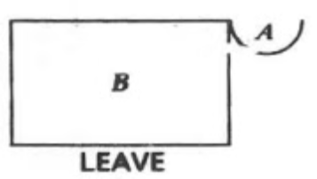
LEAVE Block
Function
Parameters
Example
Decreases the count of a resource by one, representing the departure of a unit of that resource.
The block's parameters define the resource whose count is being decreased.
A Leave block connected to a resource called "Machine" will decrease the count of available machines by one.

Slide 11
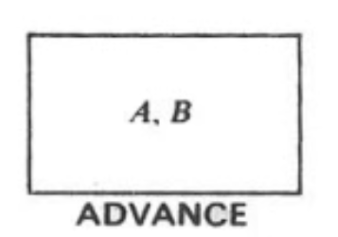
ADVANCE Block
Function
Parameters
Example
Delays a transaction for a specified amount of time, representing the time taken for a process or operation.
The block's parameters define the duration of the delay.
An Advance block with a delay of 5 time units will hold a transaction for 5 time units before allowing it to proceed.

Slide 12
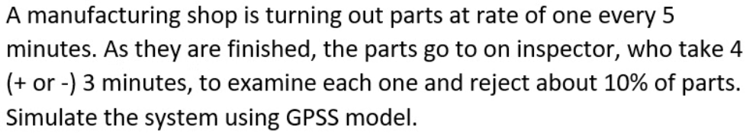
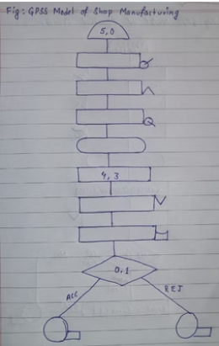
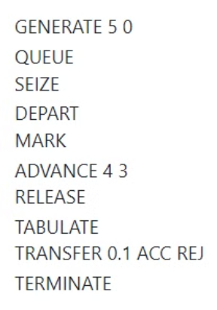
Example :
Solution,

Slide 13

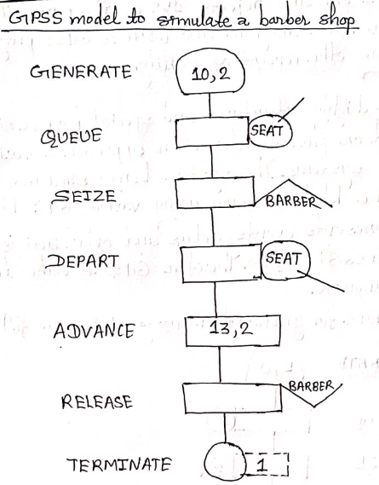
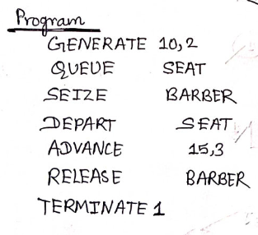
Example :
Solution,

Slide 14
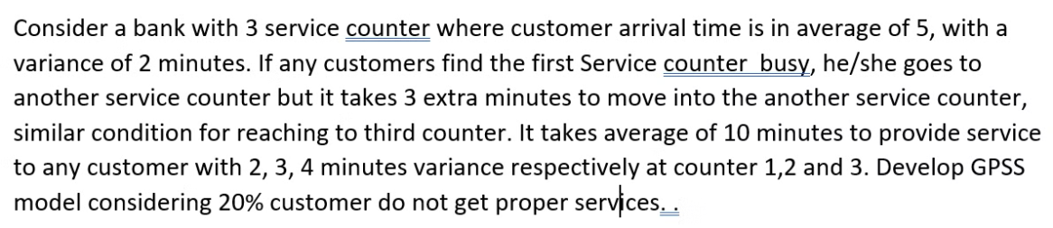
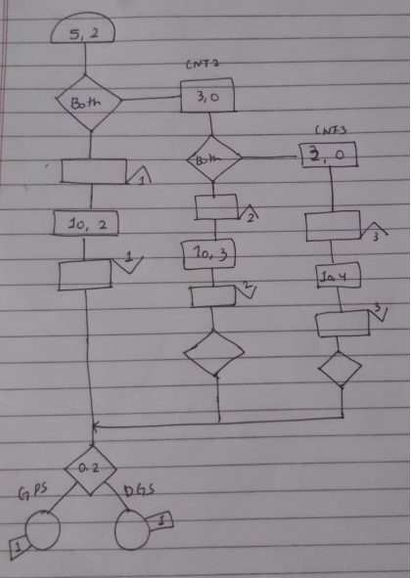
Example:

Slide 15
Conclusion
GPSS (General Purpose Simulation System) is a high-level simulation language developed for modeling discrete systems. GPSS has influenced the development of other simulation languages and tools, and although it may not be as widely used today as newer simulation languages, it still serves as an important historical reference in the field of simulation and modeling.

Slide 16
Thank you:)
Any questions?

