Slide 1
FEBRUARY 22-23, 2025
CIVIC HACKS
ReformAI
Rebuild lives.
Teammates
Mahima Lolla
Siddharth Shukla Sahil Satramani Ujjwal Pandit Suresh Palaparthi

Slide 2

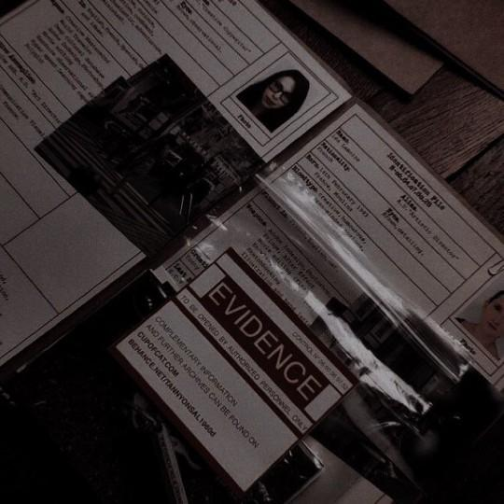
Problem Statement
Many released offenders return to crime due to a lack of structured rehabilitation, employment opportunities, and community support.
Additionally, there is no real-time, data-driven system to assess public safety levels in different areas.

Slide 3

Our Solution - ReformAI
1️ Predicts recidivism risk using offender history, employment, and crime severity. 2️ Recommends rehabilitation programs (job training, therapy, or supervision). 3️ Analyzes crime trends to develop a Safety by Area Index.
Key Features:
Machine Learning for risk prediction (Random Forest/XGBoost).
Data-driven safety index (real-time crime mapping).
Android app integration for easy access by law enforcement & NGOs.

Slide 4
