Slide 1
Amyotrophic Lateral Sclerosis
We are in the fight against ALS..Stay Strong..!!

Slide 2
Project Title
Prediction of genes causing ALS disease using Machine Learning.
Kumaresh C
Mahima M
Sanjay C R
Shivaani S
Sowmiya B
Team Members

Slide 3
Table of contents
01
02
03
04
Introduction
Model Development
Prediction
Patient Learning

Slide 4
Introduction
01
Amyotrophic lateral sclerosis (ALS), is a progressive neuro-muscular disease that affects nerve cells in the brain and spinal cord, causing loss of muscle control.

Slide 5
About the disease
What is the reason?
ALS affects the motor neurons controlling the voluntary muscle movements.
It causes the neurons to gradually deteriorate and eventually cause mortality.
When these neurons are damaged they stop sending signals to the muscles thereby reducing their function.

Slide 6
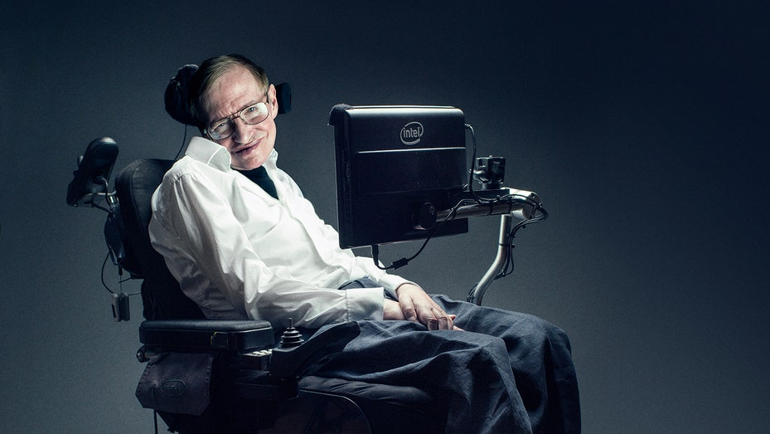
Lou Gehrig’s Disease
ALS is a genetic disease which is inherited in 5 – 10% of the people.
Genetic Disease

Slide 7
Model Development
02
Dataset was taken from Kaggle, Biogrid and ALSod databases. Using the clustering and association algorithms, we had classified the genes responsible for ALS.

Slide 8
Major Requirements
Algorithms
Clustering
Regression
Association
Prediction
Random Forest Classifier
Genome Wide Association Study
Analysis
Gene responsible for ALS

Slide 9
Prediction
03
We aim to develop a machine learning model to predict the genes responsible for ALS disease which is the most important factor in determining the disease.

Slide 10
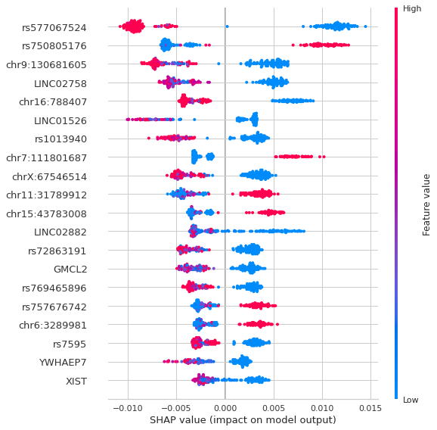
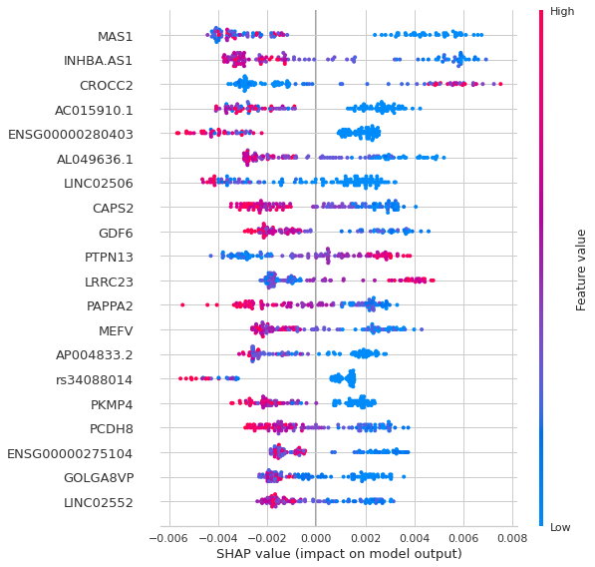
03
Shap plot for Random Forest Classifier
Shap plot for GWAS

Slide 11
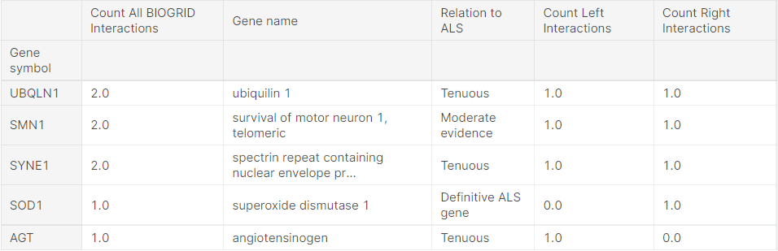
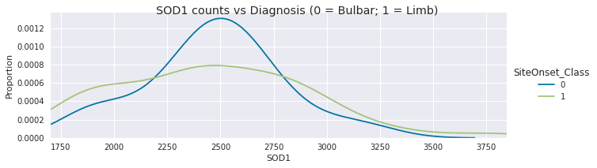
03
The major gene responsible for ALS

Slide 12
Patient Learning
04
We propose a web application to interact with the machine learning model to assist the patients.

Slide 13
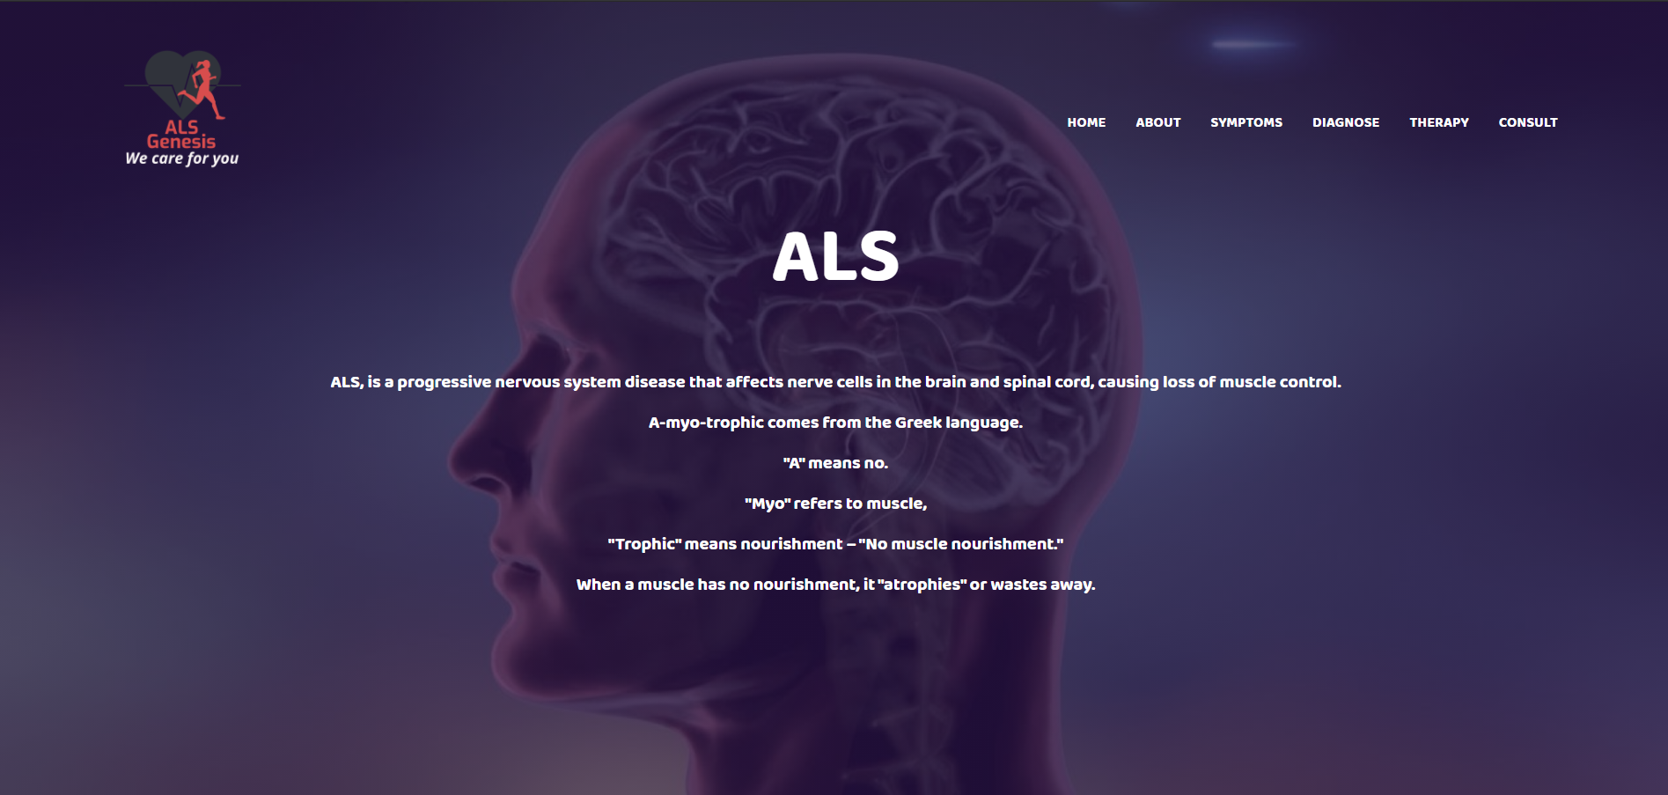
We Care For You

Slide 14

Thank you..!!

