Slide 1
WAREHOUSEIFY
Team Lead: Shivaani S
Team Members: Mahima M
College: Bannari Amman Institute of Technology,
Sathyamangalam, Tamil Nadu

Slide 2
PROJECT TITLE
WAREHOUSE MANAGEMENT
Optimized warehouse management of perishable goods for a food delivery company.

Slide 3
INTRODUCTION
A warehouse is place used by manufactures, importers, exporters, transport businesses, wholesalers, etc. for storing goods. With the recent developments in the technology, warehouse management is adopting to software application for efficient management of system.

Slide 4
OBJECTIVE
To predict the demand of items for the next few weeks.
To develop machine learning model for demand forecasting
To develop a web application to interact with ML model.

Slide 5
EXISTING PROBLEM
A food delivery company has to deal with a lot of perishable goods, which indicates that predicting the daily and weekly demand plays a important role in its sales.
Too much of goods can lead to wastage whereas not enough can lead a loss of the company.
Since the raw materials are perishable, planning on their demand for weekly basis is of utmost importance.

Slide 6
PROPOSED SOLUTION
Overloaded inventory and a customer leaving the store disappointed due to no stock of goods are some of the major problems in warehouse management.
The inventory capacity must be aligned with the demand of customers in a given time frame.
Hence, we propose the solution of developing a web application to interact with the machine learning model to predict the demand for goods based on the fluctuating customer needs and supply situations.

Slide 7
MAJOR REQUIREMENTS
ALGORITHMS
PREDICTION
ANALYSIS
Association
Clustering
Decision Tree Regressor
Demand for next few weeks

Slide 8
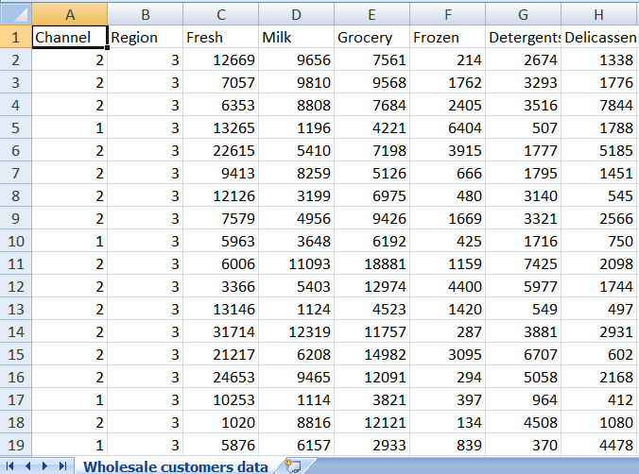
OUR DATASET

Slide 9
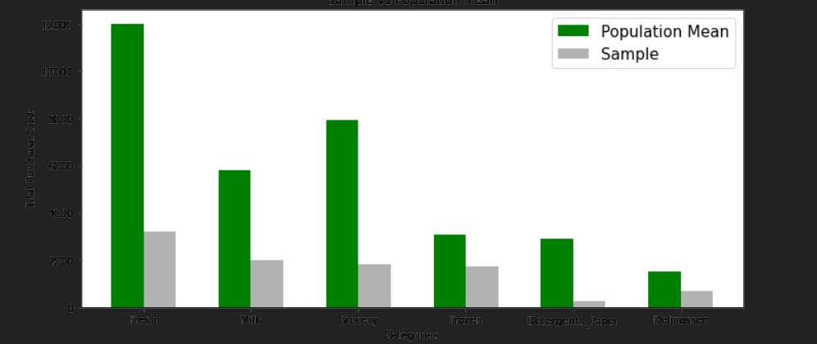
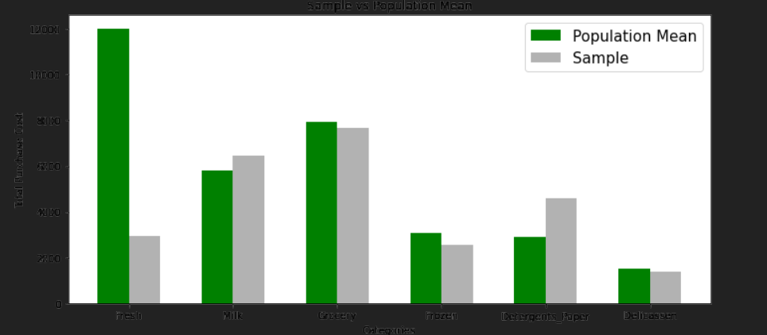
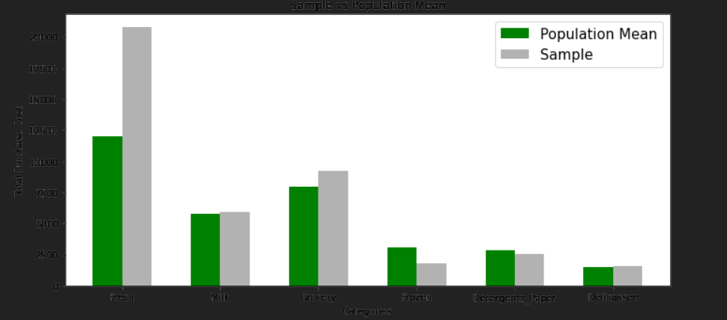
DATA EXPLORATION

Slide 10
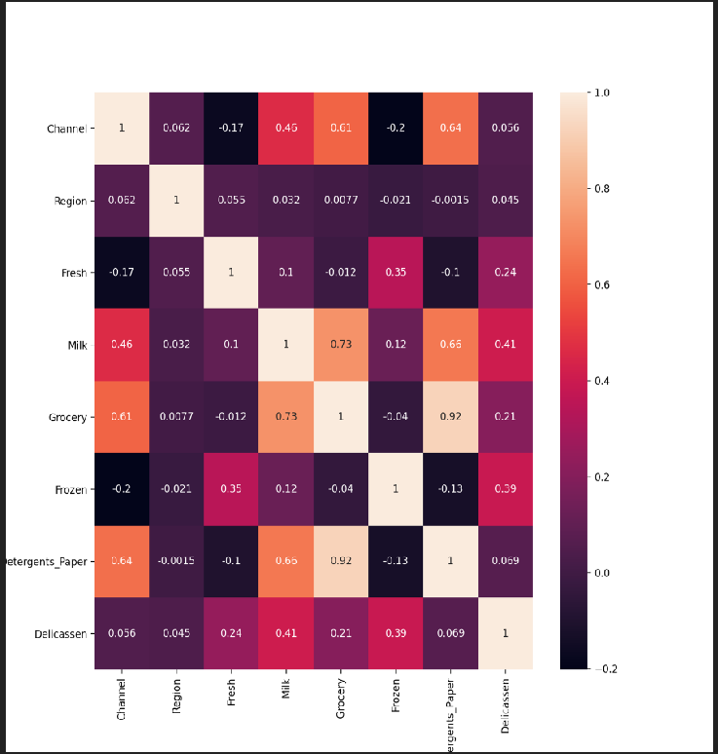
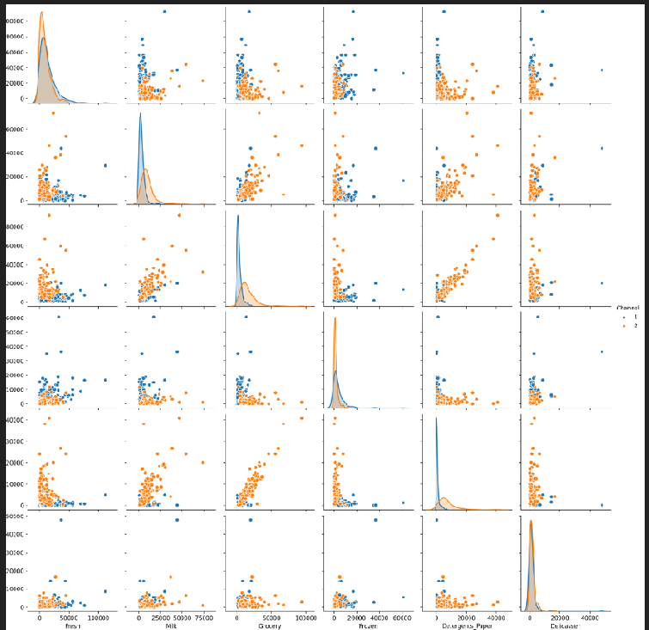
DATA EXPLORATION

Slide 11
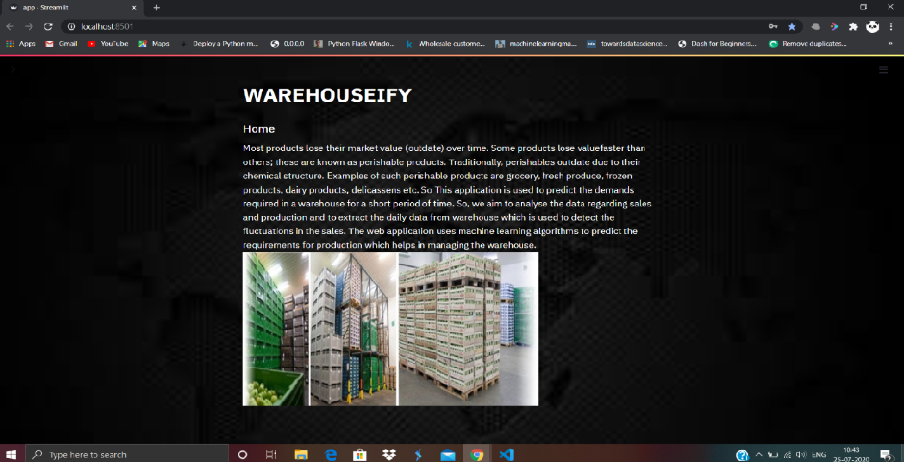
AN OUTLOOK OF OUR WEB APPLICATION

Slide 12
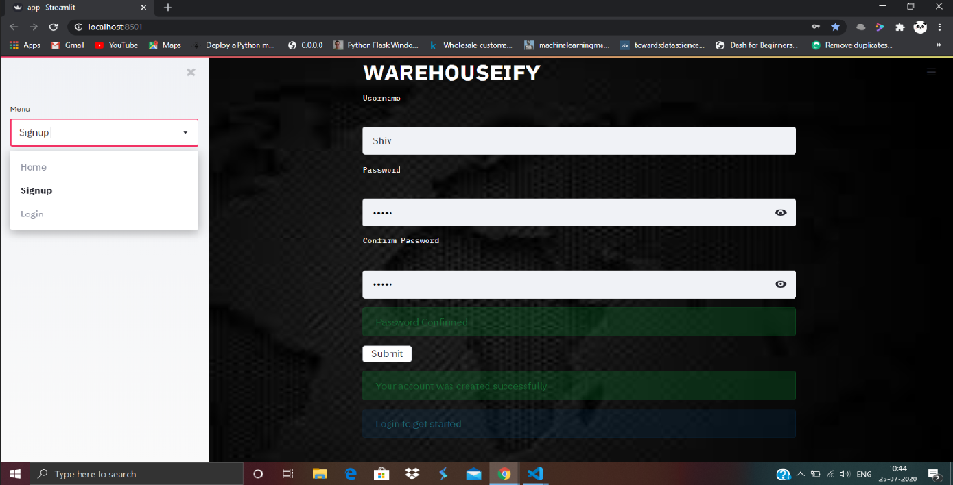
SIGNUP PAGE

Slide 13
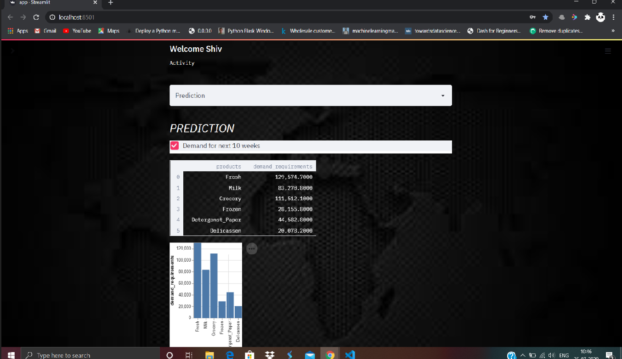
PREDICTION SITE

Slide 14
DEMO FOR WAREHOUSE ML MODEL..
http://192.168.43.26:850 http://localhost:8501/

Slide 15
FUTURE SCOPE
Wastage of goods can be prevented.
Demand for goods can be predicted which in turn helps in the efficient management of the warehouse

Slide 16
THANK YOU

