Slide 1
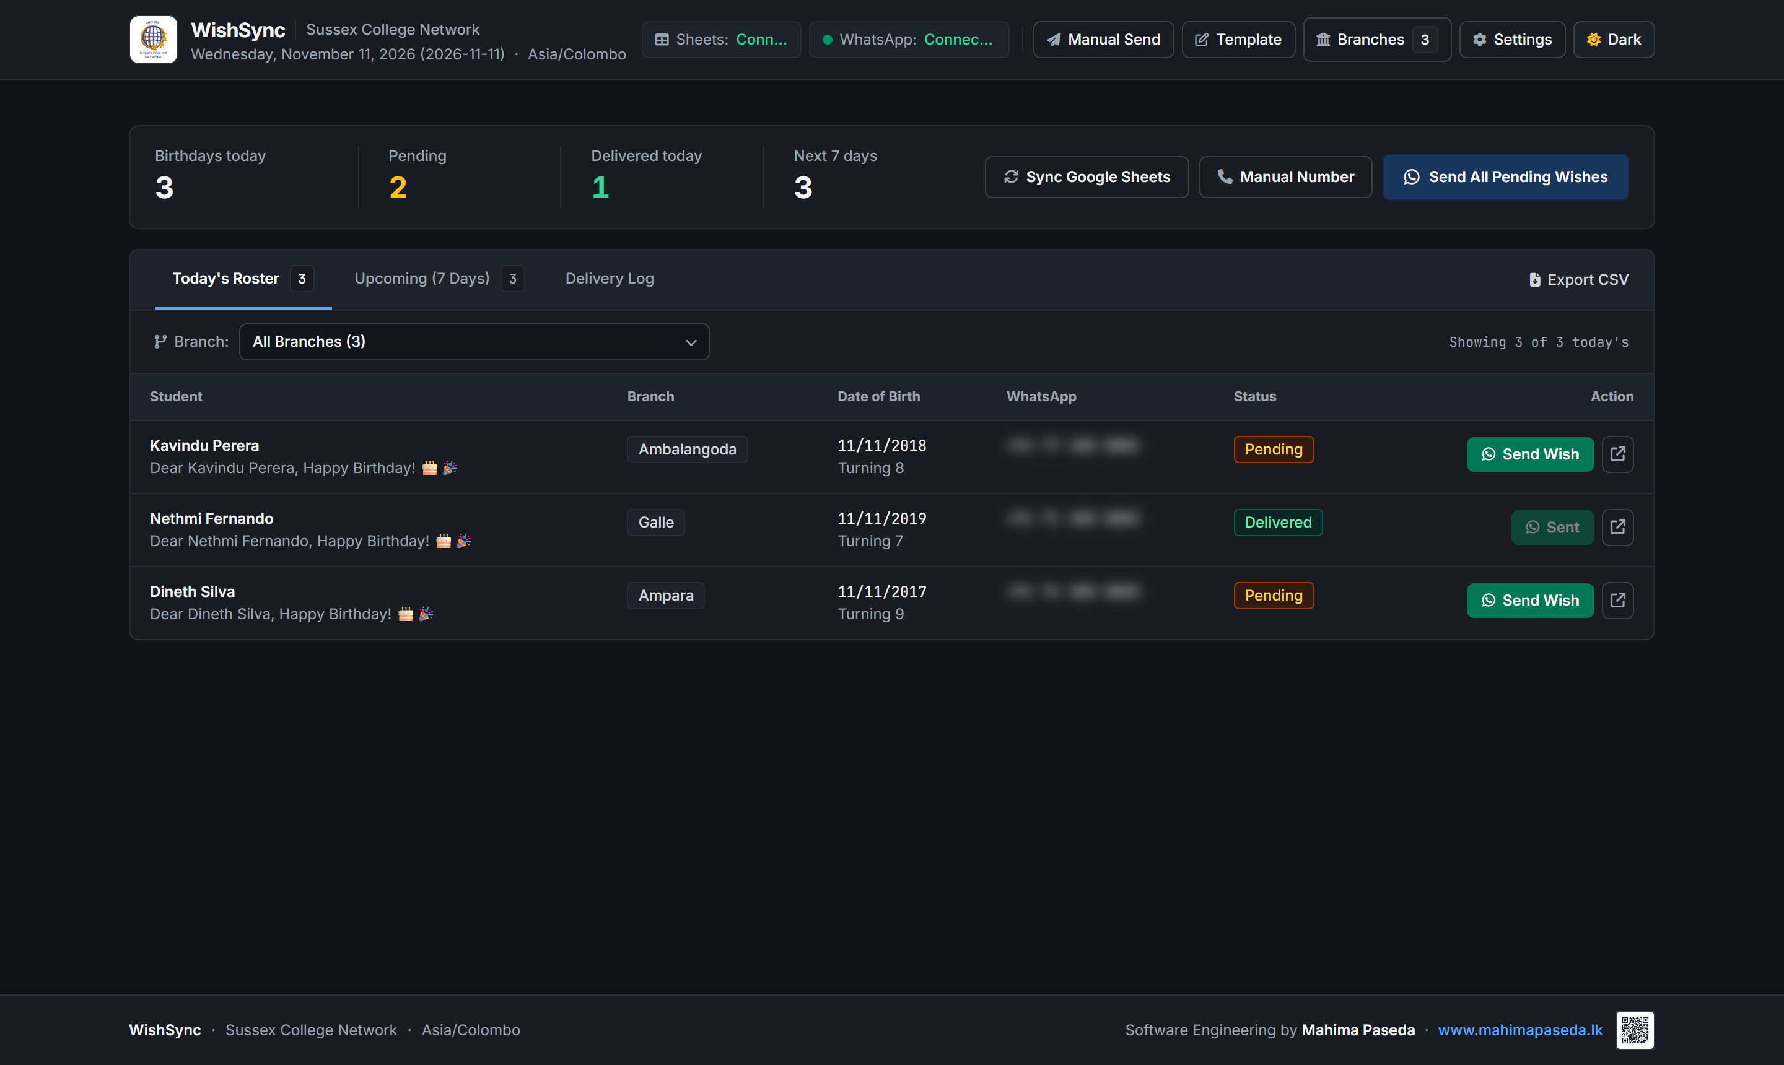
WishSync Automation Engine
🎯 WHAT IT IS USED FOR
• Automated Birthday Greetings: Daily background scheduler matches students/inquiries and delivers personalized WhatsApp wishes automatically.
• Multi-Campus Scalability: Powers centralized communication for 20+ Sussex College branches without manual intervention.
• Anti-Ban Protection: Randomized human-simulated dispatch delay (5s to 12s jitter) to safeguard official institutional phone numbers.
• Dynamic Personalization: Formats student names, branches, and custom templates with automated birthday flyer images attached.
• Delivery Intelligence: Real-time status logs, delivery confirmation, and delivered-today guardrails preventing duplicate sends.
⚙️ TECHNICAL SPECIFICATIONS
Runtime / Stack: Electron 39 Desktop Shell + Node.js 22 + Express REST API
WhatsApp Engine: whatsapp-web.js + Puppeteer Chromium (Local Session Persistence)
Cloud Sync: Google Sheets API v4 (OAuth 2.0 PKCE) + Offline CSV fallback
Auto-Updater: In-app Semver Auto-Updater via Private GitHub Releases API (v1.2.1)
Storage & Safety: %APPDATA%\WishSync (Zero data loss across version upgrades)
Internal Port: Express Daemon on http://localhost:3847 (100% Private Localhost)
Lead Engineer: Mahima Paseda

Slide 2
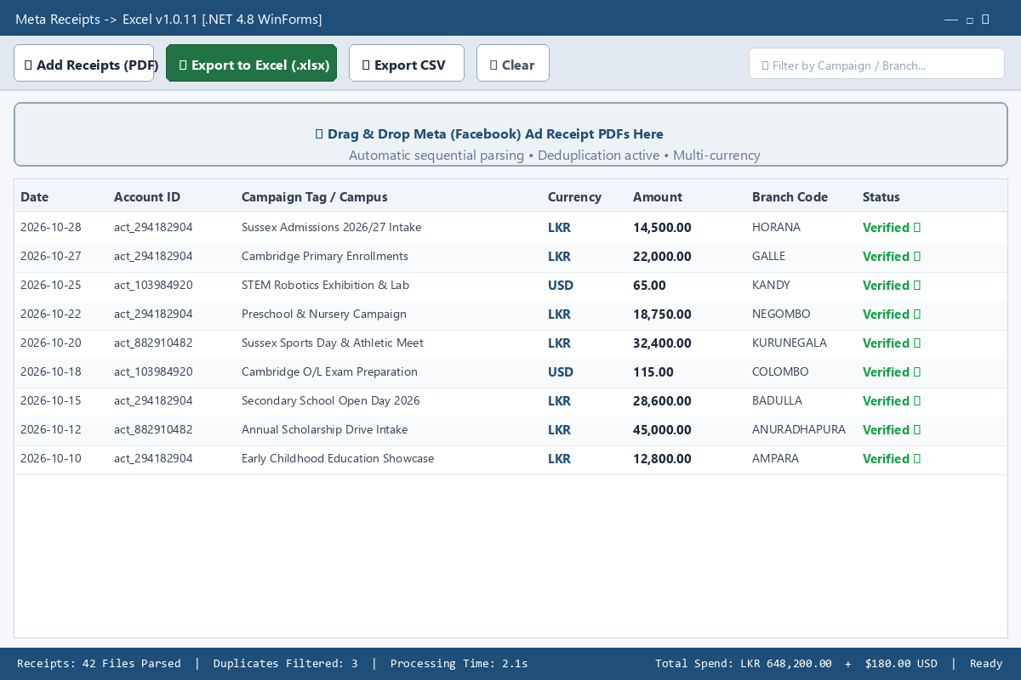
🎯 WHAT IT IS USED FOR
• Automated Invoicing & Audit: Converts high-volume Meta Ads receipt PDFs into structured, accounting-compliant Excel worksheets.
• Multi-Campus Campaign Attribution: Automatically detects branch names (Horana, Galle, Kandy, etc.) and tags from ad line items.
• Smart Currency Detection: Accurately parses and standardizes diverse billing currencies (LKR, USD, EUR) with precision decimal handling.
• Intelligent Deduplication: Detects transaction IDs and suppresses duplicate or overlapping invoice downloads automatically.
• 100% Offline & Private: Zero cloud uploads; confidential financial records remain completely inside the college accounts division.
⚙️ TECHNICAL SPECIFICATIONS
Architecture: C# WinForms Desktop Application on .NET Framework 4.8
PDF Parser Engine: PdfPig (UglyToad.PdfPig) sequential stream parser (Zero COM dependencies)
Export Formats: ClosedXML / OpenXML formatted .xlsx (multi-sheet) + RFC-4180 .csv
Footprint & Speed: < 15 MB standalone package / Inno Setup installer; 50+ PDFs in < 3.2s
Hardware Targets: Windows 10/11 & Windows 7 SP1; runs smoothly on low-spec admin PCs
Repository: C:\Users\User\Documents\GitHub\Meta2Excel

Slide 3
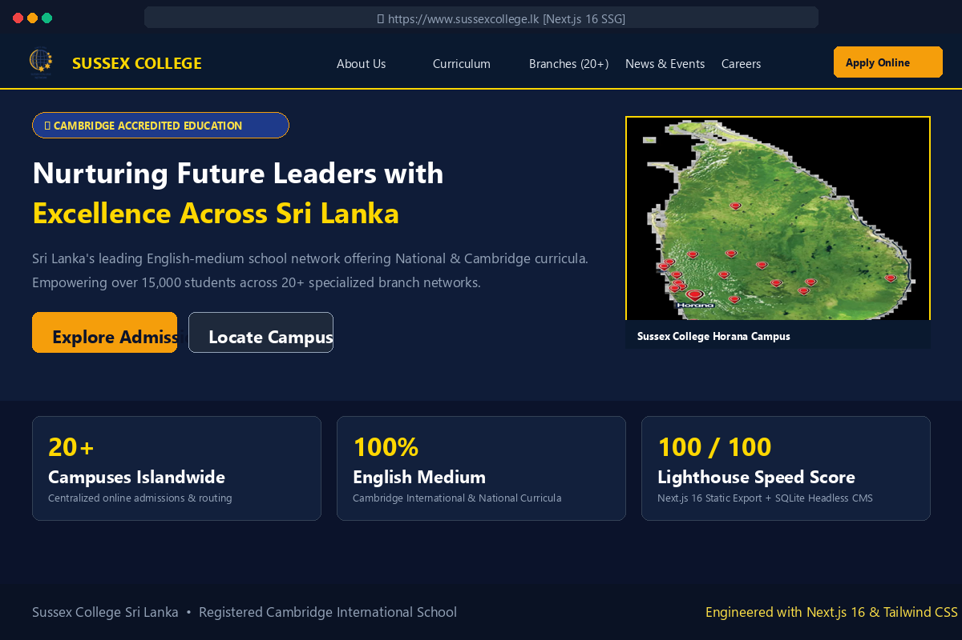
🎯 WHAT IT IS USED FOR
• Flagship Institutional Portal: Represents the nationwide Sussex College network (20+ branches) and Cambridge accreditation.
• Online Admissions Hub: Streamlined student enrollment inquiry registration and campus-specific lead routing.
• Headless Content Management: Enables non-technical staff to publish news, notices, and student achievements instantly.
• Search & AI Discoverability: Full GEO/SEO optimization, structured Schema.org JSON-LD, and AI agent readiness (llms.txt).
• Sub-Second Global Performance: Fully pre-rendered static site delivering instantaneous page loads on all mobile devices.
⚙️ TECHNICAL SPECIFICATIONS
Frontend Core: Next.js 16 (App Router) + React 19 + TypeScript + Tailwind CSS v4
Architecture: Static Site Generation (output: 'export') deployed on cPanel Apache
Backend & CMS: Embedded SQLite database + RESTful PHP overlay (public/cms-content/)
Performance & PWA: 100/100 Lighthouse Performance score, Service Worker offline caching
Multi-Campus Network: Dynamic branch profiles across 20+ cities throughout Sri Lanka
Repository: C:\Users\User\Documents\GitHub\Susex_College

