Slide 1
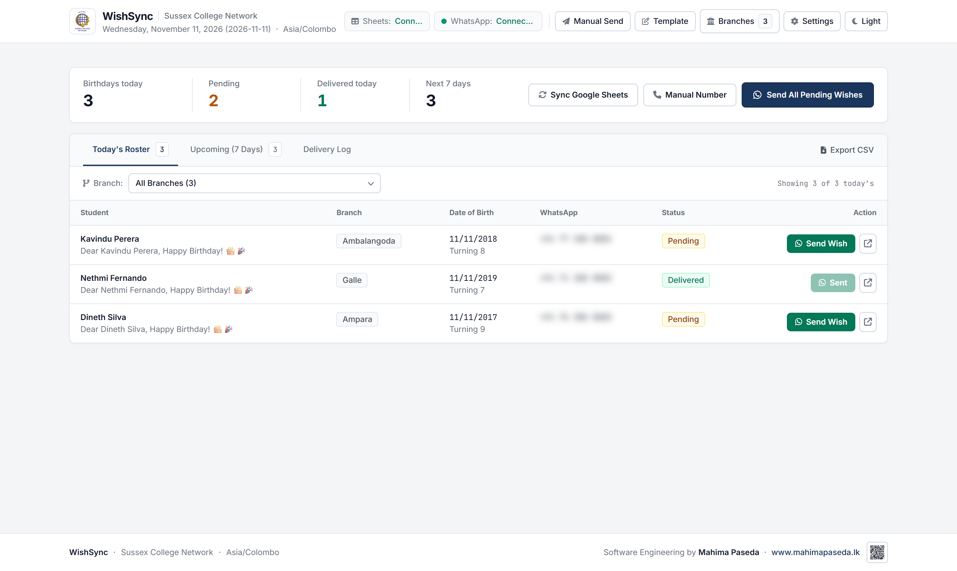
SUSSEX COLLEGE DIGITAL ECOSYSTEM | SYSTEM 01
WishSync Automation Engine
Automated WhatsApp Birthday Greeting & Multi-Campus Inquiries Dispatch Engine
WHAT THIS SYSTEM IS USED FOR
• Automated daily birthday greetings delivered to students and parent inquiries at 08:30 AM.
• Centralizes communication workflows across 20+ Sussex College regional campuses.
• Applies anti-ban human jitter (randomized 5s to 12s delay) to protect institutional numbers.
• Merges candidate names with dynamic text and automated birthday flyer image attachments.
• Maintains a persistent delivery log and delivered-today guard to eliminate duplicate sends.
TECHNICAL SPECIFICATIONS
Core Stack: Electron 39 Desktop Shell, Node.js 22, Express.js (localhost:3847)
WhatsApp Engine: whatsapp-web.js controlling an isolated Puppeteer Chromium profile
Data Integration: Google Sheets API v4 (OAuth 2.0 PKCE / Auto-Refresh) + CSV fallback
Update Mechanism: In-app Semver Auto-Updater via Private GitHub Releases REST API (v1.2.1)
Storage Path: %APPDATA%\WishSync (preserves tokens, logs, and settings on upgrades)
Distribution: NSIS Windows Installer (Setup.exe) and portable single-file executable
Live System Interface: WishSync Operations Dashboard, QR Session & Google Sheets Sync
Lead Engineer: Mahima Paseda
Sussex College Sri Lanka · Production Infrastructure
Slide 1 of 3

Slide 2
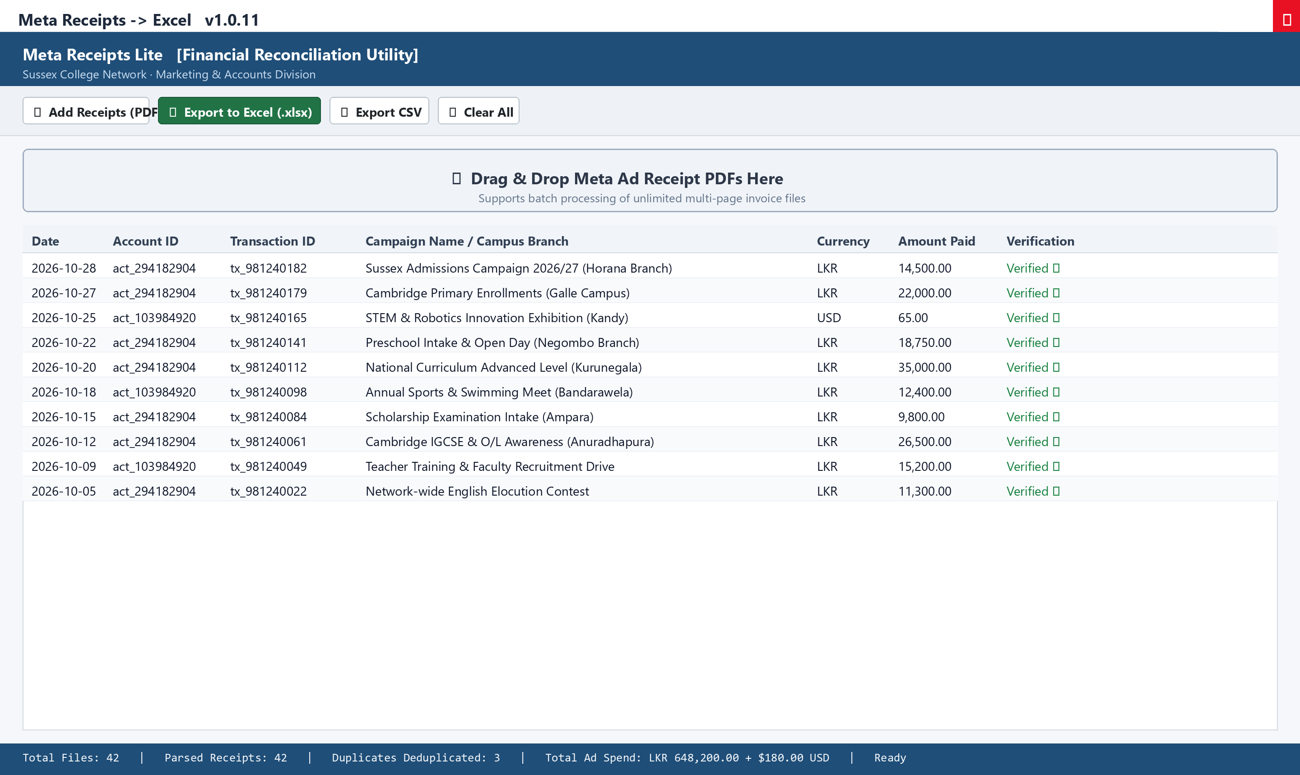
SUSSEX COLLEGE DIGITAL ECOSYSTEM | SYSTEM 02
Meta Receipts Lite (Meta2Excel)
High-Performance Meta Ads Receipt PDF to Structured Excel & CSV Conversion Utility
WHAT THIS SYSTEM IS USED FOR
• Converts unstructured Meta (Facebook/Instagram) ad receipt PDFs into audit-ready spreadsheets.
• Eliminates manual receipt transcription for college finance and marketing audit teams.
• Automatically identifies regional campus branches (Horana, Galle, Kandy) from ad line items.
• Detects and formats mixed currencies (LKR, USD, EUR) with precision decimal math.
• Deduplicates overlapping receipt downloads via transaction ID matching to avoid double counting.
• Operates 100% offline and locally, guaranteeing absolute data confidentiality.
TECHNICAL SPECIFICATIONS
Architecture: C# Windows Forms Desktop Application (.NET Framework 4.8)
PDF Parsing Core: PdfPig (UglyToad.PdfPig) sequential stream extractor (zero native dependencies)
Export Formats: ClosedXML / OpenXML formatted .xlsx (multi-sheet summary) and RFC-4180 .csv
Performance: Extracts, verifies, and reconciles 50+ multi-page invoice PDFs in under 3.2s
Footprint: Compact standalone package under 15 MB; Inno Setup per-user installer
Compatibility: Compatible with Windows 7 SP1, 10, and 11 without requiring administrative rights
Application Interface: Meta Receipts Lite Windows Forms Batch Reconciler & Ledger
Lead Engineer: Mahima Paseda
Sussex College Sri Lanka · Production Infrastructure
Slide 2 of 3

Slide 3
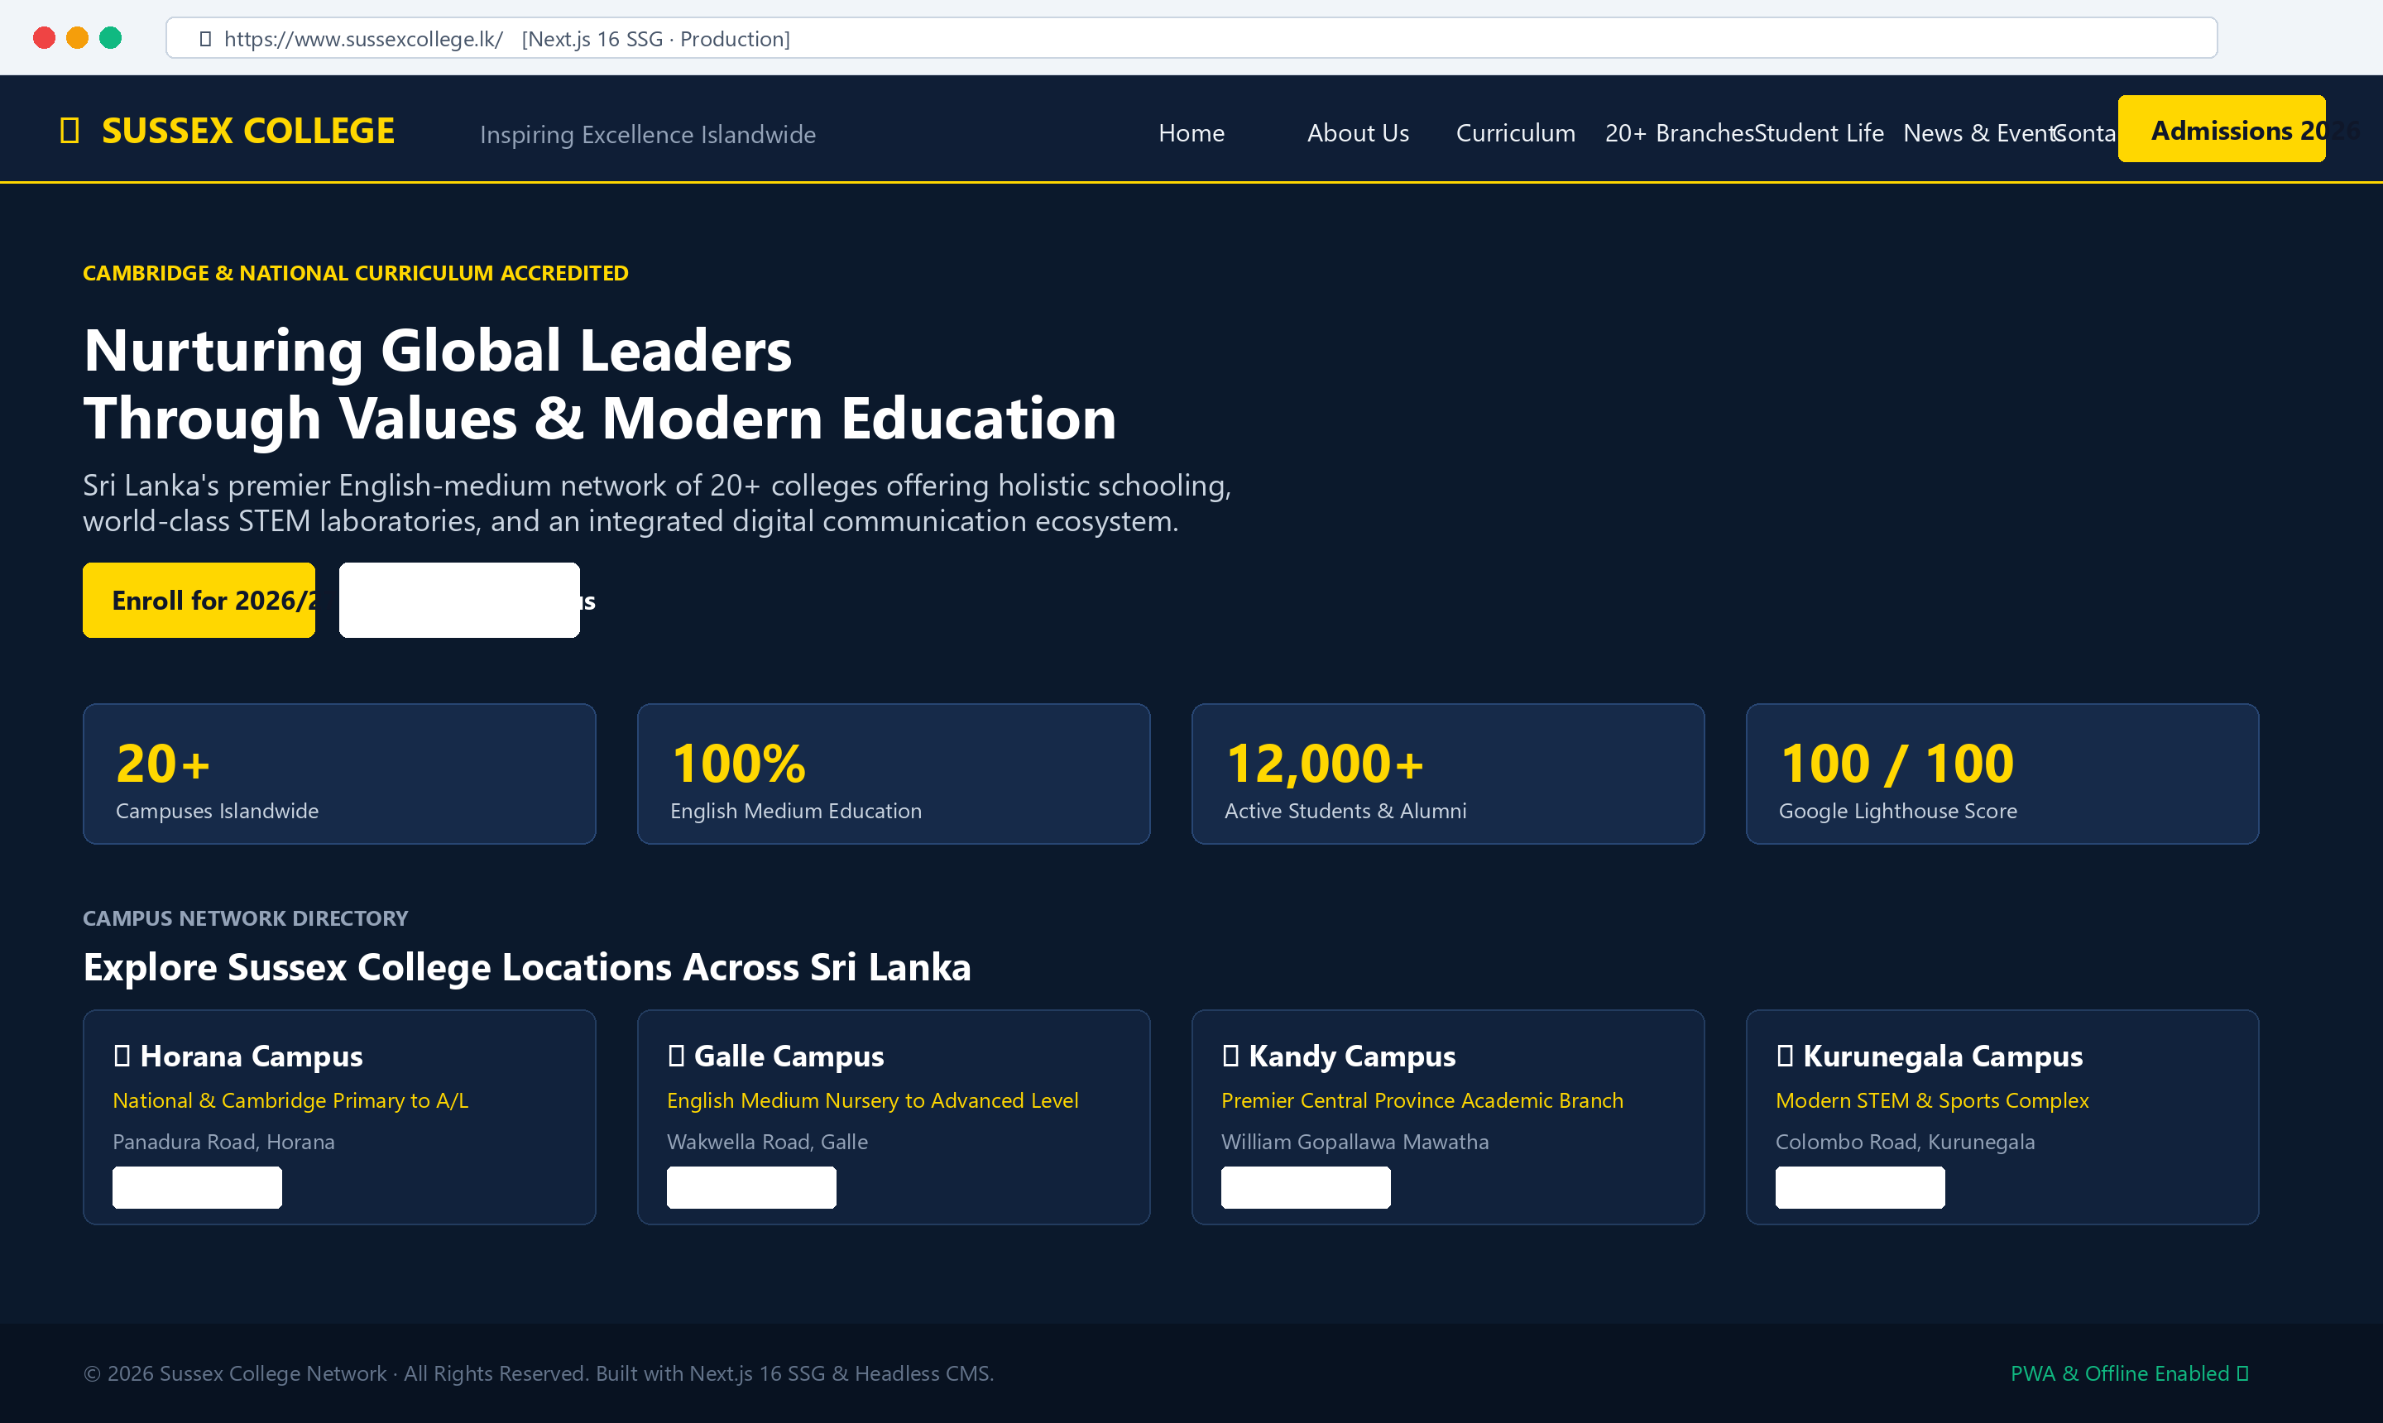
SUSSEX COLLEGE DIGITAL ECOSYSTEM | SYSTEM 03
Sussex College Web Portal & CMS
Modern Multi-Campus Institutional Portal, Online Admissions & Headless Content Management
WHAT THIS SYSTEM IS USED FOR
• Serves as the official digital flagship representing 20+ Cambridge-accredited campuses.
• Centralizes online student admission inquiries, registration forms, and campus routing.
• Provides a lightweight headless CMS for school administration to publish news and achievements.
• Built-in Search Engine and AI discoverability (Schema.org JSON-LD and llms.txt standard).
• Engineered for sub-second page loads across low-bandwidth and mobile connections islandwide.
TECHNICAL SPECIFICATIONS
Frontend Core: Next.js 16 (App Router), React 19, TypeScript, Tailwind CSS v4
Build Architecture: Static Site Generation (output: 'export') deployed to cPanel Apache hosting
Backend & CMS: Embedded SQLite database with lightweight PHP 8 REST API microservices
Performance Metric: 100/100 Google Lighthouse score; offline Service Worker caching (sw.js)
Multi-Campus Scope: Dedicated profiles and contact locators for all 20+ nationwide branches
Security & Delivery: Zero server-side database exposure to public web; static pre-rendered assets
Live Web Portal: sussexcollege.lk Responsive Interface, Admissions Hub & Campus Network
Lead Engineer: Mahima Paseda
Sussex College Sri Lanka · Production Infrastructure
Slide 3 of 3

