Slide 1
Advanced Scientific Calculator
A Python & Tkinter GUI Application
Mahima Thorecha
Data Science Intern
NextHikes IT Solutions

Slide 2
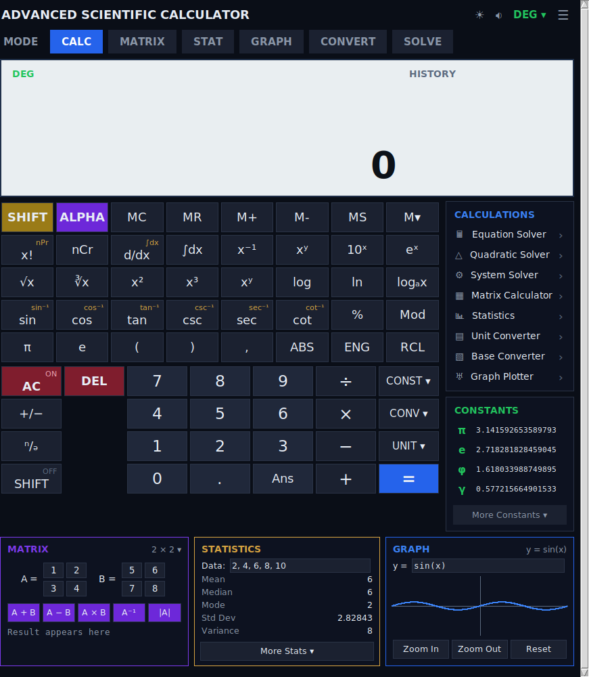
Features & Why It Stands Out
Core operations
Addition, subtraction, multiplication, division with a live expression display
Scientific functions
Trigonometry (DEG/RAD), logarithms, powers, roots, factorials, nCr / nPr
Matrix mode
Add, multiply, invert, transpose, determinant, rank, RREF — built from scratch
Statistics & graphing
1-variable/2-variable stats and a live plotted graph, right on the canvas
Why it's unique most everyday calculators stop at arithmetic. This one adds matrix math, statistics and graphing in a single lightweight, dependency-free desktop tool.
Actual application screenshot

Slide 3
Tools & Libraries Used
tkinter
math
Built the entire GUI — window, keypad, matrix/stat/graph panels — since it ships with Python and needs no install.
Powered every scientific function: trig, log, exponent, sqrt, factorial, combinatorics.
re (regex)
Custom matrix engine
Parsed and cleaned the typed expression — handled brackets, unary minus, and function names before evaluation.
Wrote determinant, inverse, adjoint and RREF logic in pure Python — no numpy dependency.
Alternatives considered NumPy for matrix math (skipped to keep the app dependency-free) and PyQt5 for the GUI (skipped — tkinter was lighter and sufficient). Built and version-controlled using VS Code and GitHub.

Slide 4
Challenges & How I Solved Them
01
Matrix math without NumPy
Solved using recursive cofactor expansion for determinants and the adjoint method for inverses.
02
Parsing nested expressions safely
Solved with regex-based preprocessing for brackets, unary minus, and factorials before evaluation.
03
Plotting a graph without matplotlib
Solved by mapping coordinates manually and drawing points directly onto a tkinter Canvas.
REFERENCES
Python official documentation (tkinter, math, re) · GeeksforGeeks and Real Python tutorials on Tkinter GUI patterns · Stack Overflow discussions on canvas-based graphing

Slide 5
Thank You
NextHikes IT Solutions

