Slide 1
TellCo Customer Analytics
Customer overview, engagement,
network experience and satisfaction
Acquisition assessment based on historical telecom records
Project 5 • Mahima Thorecha • October 2026
01
Notes:
Project 5 • Mahima Thorecha • October 2026
https://github.com/mahimathorecha/tellco-customer-analytics/blob/main/Project%205.ipynb

Slide 2
Decision summary
A large low-engagement group offers a testable opportunity to increase usage.
Positive growth potential,
subject to validation
Network profiles suggest areas for investigation, but mean replacement affects results.
The dataset supports operational hypotheses. It cannot establish revenue growth or company value.
Recommendation: defer purchase approval until financial and technical due diligence.
Source: Project 5 analysis notebook
02
Notes:
Source: Project 5 analysis notebook
https://github.com/mahimathorecha/tellco-customer-analytics/blob/main/Project%205.ipynb

Slide 3
Dataset and analytical scope
106,856
148,935
identified customers
session records with customer IDs
Input: 150,001 rows and 55 columns. Removed 1,066 rows with no customer ID.
Customer usage uses original totals. Network profiles use treated session measurements averaged by customer.
Historical sample: findings describe this dataset, not the current telecom market.
Source: Project 5 analysis notebook
03
Notes:
Source: Project 5 analysis notebook
https://github.com/mahimathorecha/tellco-customer-analytics/blob/main/Project%205.ipynb

Slide 4
Three manufacturers represent 88.97% of customers
Apple: 42,592 customers
Samsung: 30,780 customers
Huawei: 21,692 customers
Prioritize compatibility testing and support for these devices.
Source: Project 5 analysis notebook
04
Notes:
Source: Project 5 analysis notebook
https://github.com/mahimathorecha/tellco-customer-analytics/blob/main/Project%205.ipynb
Most frequent manufacturer per customer. Unknowns excluded from ranking but retained in share denominator.

Slide 5
Huawei B528S-23A is the most common device
10,615 customers use Huawei B528S-23A as their assigned device.
Apple contributes six models to the overall top ten.
Device-specific offers are hypotheses to test with campaign and revenue data.
Source: Project 5 analysis notebook
05
Notes:
Source: Project 5 analysis notebook
https://github.com/mahimathorecha/tellco-customer-analytics/blob/main/Project%205.ipynb
Labels shortened for readability. Exact models: Huawei B528S-23A, Apple iPhone 6S (A1688), iPhone 6 (A1586), iPhone 7 (A1778), iPhone Se (A1723).

Slide 6
Usage is concentrated in Gaming and Other
Total network traffic: 73,833.4 GB. Mean sessions per customer: 1.39.
Application totals do not reconcile with network download + upload. These bars are separate recorded volumes, not shares of total network traffic.
Source: Project 5 analysis notebook
06
Notes:
Source: Project 5 analysis notebook
https://github.com/mahimathorecha/tellco-customer-analytics/blob/main/Project%205.ipynb
Application totals also visible in deployed Usage dashboard. 1 GB = 1,000,000,000 bytes.

Slide 7
The longest-duration decile contributes 20.13% of data
The highest-duration half of customers contributes about 60.4% of network data.
Decile 10: 10,686 customers and 14,863.93 GB.
Usage does not rise at every decile. Duration alone is an incomplete targeting rule.
Source: Project 5 analysis notebook
07
Notes:
Source: Project 5 analysis notebook
https://github.com/mahimathorecha/tellco-customer-analytics/blob/main/Project%205.ipynb
Notebook text reports 60.36% but calculation output reports 60.37%. Rounded to 60.4% to avoid a false precision conflict. Deciles use original durations and customer-ID tie breaking.

Slide 8
Preprocessing changes the measured relationships
Replacing flagged values with means reduces variability and creates artificial peaks.
PCA on seven treated application variables needs six components to retain 92.02% of variance.
Correlations describe association and may reflect shared session counts.
Source: Project 5 analysis notebook
08
Notes:
Source: Project 5 analysis notebook
https://github.com/mahimathorecha/tellco-customer-analytics/blob/main/Project%205.ipynb

Slide 9
74.73% of customers fall in the low-engagement group
Low: 74.73% of customers
Medium: 21.95%
High: 3.32%
K-means uses standardized session count, duration and traffic with k = 3.
Source: Project 5 analysis notebook
09
Notes:
Source: Project 5 analysis notebook
https://github.com/mahimathorecha/tellco-customer-analytics/blob/main/Project%205.ipynb
Labels are relative engagement profiles. Original cluster IDs: Low 0, Medium 2, High 1. Elbow inspection also suggests k=4 as a candidate, with no unique sharp elbow.

Slide 10
High engagement means greater usage per customer
Mean traffic: 0.49 GB, 1.12 GB and 2.29 GB for Low, Medium and High.
Mean total duration: 28.64, 59.80 and 182.84 hours, respectively.
The Low group generates the largest combined traffic because it contains more customers.
Summed session duration does not necessarily measure active screen time.
Source: Project 5 analysis notebook
10
Notes:
Source: Project 5 analysis notebook
https://github.com/mahimathorecha/tellco-customer-analytics/blob/main/Project%205.ipynb

Slide 11
Network clusters show different trade-offs
Cluster 0: 45,687 customers. Lowest mean download RTT: 39.011 ms.
Cluster 1: 26,215 customers. Highest mean download RTT: 102.673 ms.
Cluster 2: 34,954 customers. Highest throughput, with RTT of 69.485 ms.
Cluster numbers identify groups. No group leads on every network metric.
Source: Project 5 analysis notebook
11
Notes:
Source: Project 5 analysis notebook
https://github.com/mahimathorecha/tellco-customer-analytics/blob/main/Project%205.ipynb

Slide 12
Heavy mean replacement limits network conclusions
Replacement includes missing values and IQR-flagged observations.
Cluster 1 depends strongly on substituted measurements.
Validate raw telemetry and alternative treatments before allocating network investment.
Source: Project 5 analysis notebook
12
Notes:
Source: Project 5 analysis notebook
https://github.com/mahimathorecha/tellco-customer-analytics/blob/main/Project%205.ipynb
Percentages are mean replacement percentages per customer in cluster 1, not the share of customers with any replacement.

Slide 13
Satisfaction is a calculated proxy
Satisfaction proxy =
(engagement score + experience score) / 2
Engagement score: distance from the least-engaged reference cluster in standardized feature space.
Experience score: distance from the selected poorest-experience reference cluster.
These scores have no survey scale. Distance can reflect unusual behavior as well as improvement.
Source: Project 5 analysis notebook
13
Notes:
Source: Project 5 analysis notebook
https://github.com/mahimathorecha/tellco-customer-analytics/blob/main/Project%205.ipynb
Reference clusters: engagement 0, experience 1. Euclidean distances. Extreme engagement score 102.277 leads to maximum satisfaction proxy 52.453.

Slide 14
Score clusters differ mainly in the experience component
Cluster 0: 32,682 customers (30.59%).
Cluster 1: 74,174 customers (69.41%).
Overall mean proxy: 1.919. Higher values do not establish higher reported satisfaction.
Source: Project 5 analysis notebook
14
Notes:
Source: Project 5 analysis notebook
https://github.com/mahimathorecha/tellco-customer-analytics/blob/main/Project%205.ipynb

Slide 15
Model delivery works, but predictive validity is unproven
Regression: 85,484 training customers and 21,372 test customers. R² = 1.000, with coefficients of 0.5 for both inputs.
This model reconstructs the formula used to create its target. A perfect fit provides no independent evidence about real satisfaction.
Delivery evidence: 106,856 scores exported to MySQL. MLflow logged training and model artifacts. Five local prediction checks passed with HTTP 200.
The five requests are a smoke test. Production monitoring and validation against surveys or churn remain future work.
Source: Project 5 analysis notebook
15
Notes:
Source: Project 5 analysis notebook
https://github.com/mahimathorecha/tellco-customer-analytics/blob/main/Project%205.ipynb

Slide 16
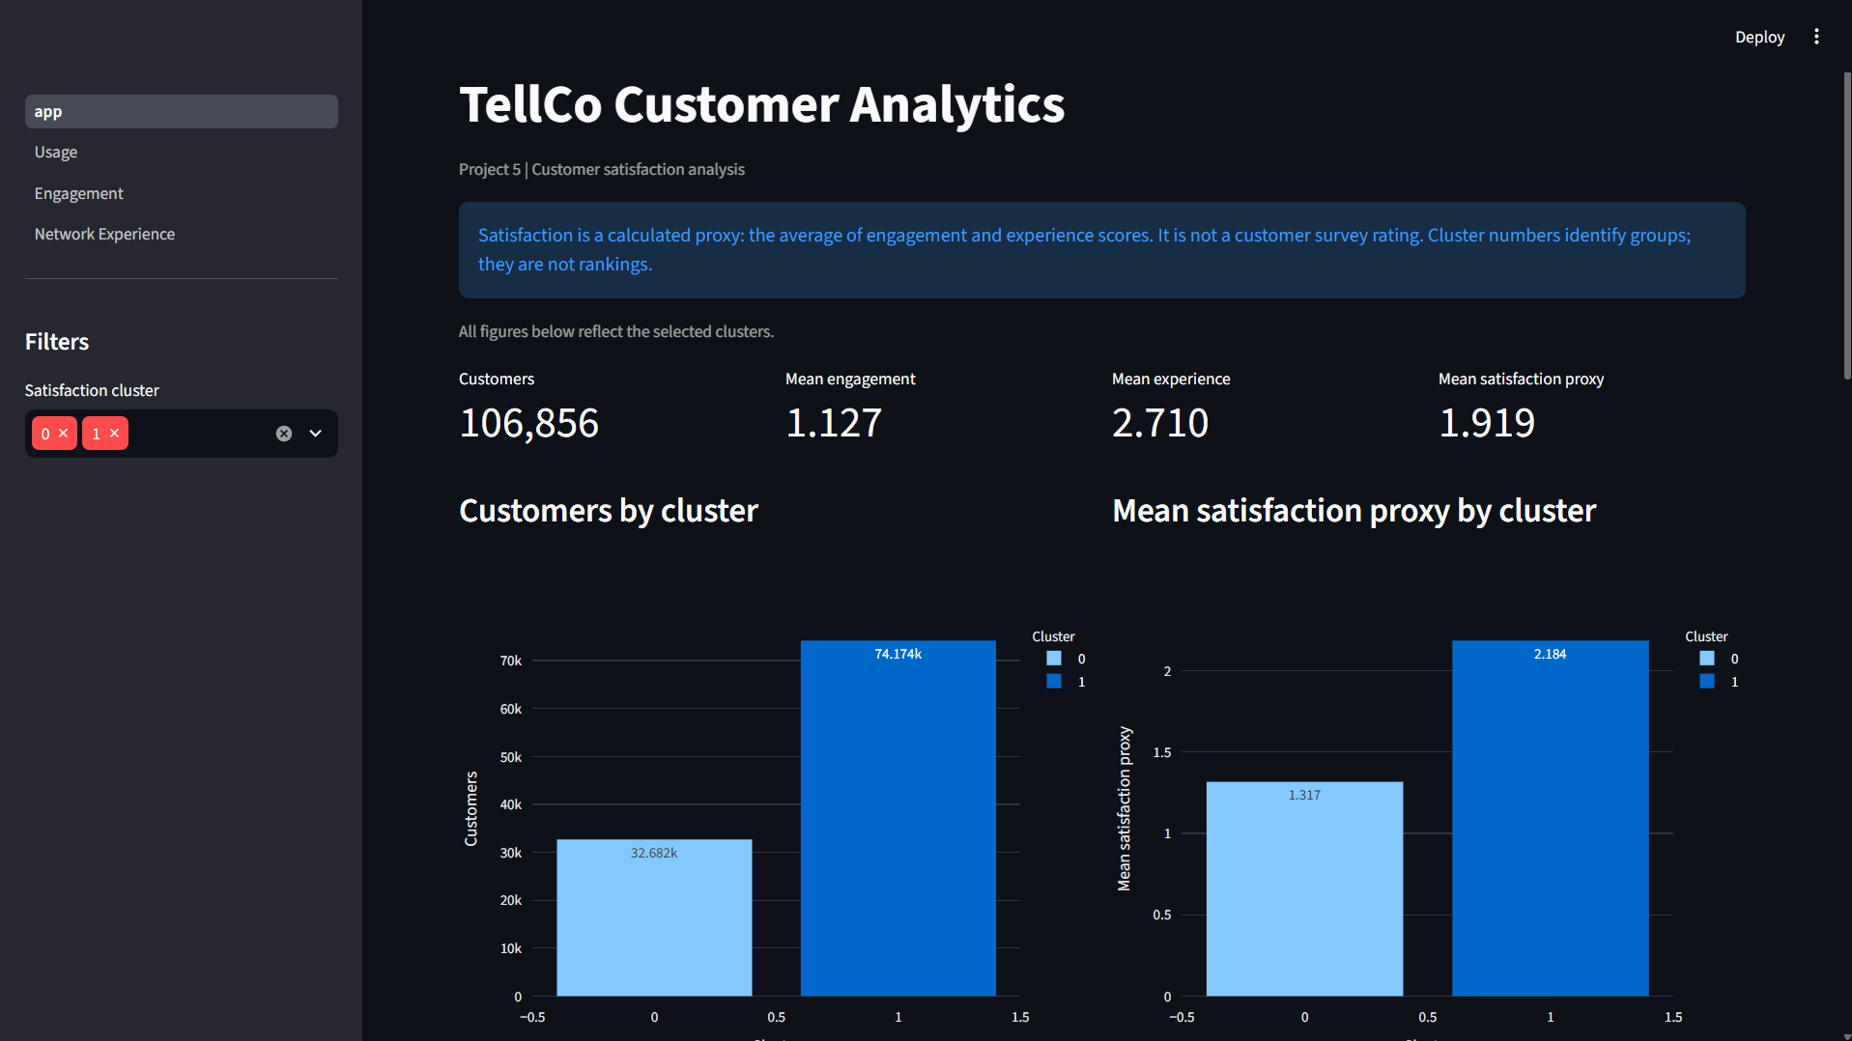
The dashboard makes all four analyses accessible
Pages: Satisfaction (app), Usage, Engagement and Network Experience.
Cluster filters support comparisons and CSV downloads.
Public dashboard and repository links appear on the reference slide.
Source: deployed dashboard and project screenshot
16
Notes:
https://tellco-customer-analytics-axvflyxas4ehnbqcuape8f.streamlit.app/
User confirmed dashboard opens in Incognito on 11 October 2026. Screenshot supplied in this conversation.

Slide 17
Growth potential is positive but conditional
Usage growth: test onboarding or relevant bundles with the 79,850 low-engagement customers. Measure incremental usage and margin against a control group.
Service improvement: investigate the low-throughput profiles using raw network telemetry before deciding where upgrades will help.
Device support: prioritize Apple, Samsung and Huawei compatibility because they represent 88.97% of identified customers.
Commercial validation: combine these profiles with revenue, retention and service-cost data. The current sample cannot quantify future growth.
Source: Project 5 analysis notebook
17
Notes:
Source: Project 5 analysis notebook
https://github.com/mahimathorecha/tellco-customer-analytics/blob/main/Project%205.ipynb
Recommendations are proposed experiments, not observed campaign results or forecasts.

Slide 18
Purchase recommendation: defer approval
Continue due diligence
The customer base and segmentation offer operational opportunities, but customer counts and traffic do not establish profitability.
Before acquisition: assess revenue and margins, churn, acquisition price, debt, network upgrade costs and regulatory obligations.
Proceed only if verified economics support the price and technical checks confirm manageable service risks. Otherwise, do not purchase.
Assessment based on project evidence
18
Notes:
Assessment based on project evidence
https://github.com/mahimathorecha/tellco-customer-analytics/blob/main/Project%205.ipynb
This is a case-study recommendation. No valuation, revenue growth or ROI estimate is claimed.

Slide 19
Limitations and next validation steps
Historical scope: the sample and excluded IDs limit generalization. Compare with recent periods and verify customer coverage.
Measurement quality: reconcile application volumes, investigate extreme durations and assess alternatives to mean replacement.
Model sensitivity: test robust scaling and alternative cluster counts. Cluster labels and distance scores are not direct quality rankings.
Missing outcomes: collect satisfaction surveys, churn and commercial data before treating the proxy as a business outcome.
Source: Project 5 analysis notebook
19
Notes:
Source: Project 5 analysis notebook
https://github.com/mahimathorecha/tellco-customer-analytics/blob/main/Project%205.ipynb

Slide 20
References and submission links
Analysis notebook: Project 5.ipynb
Repository: github.com/mahimathorecha/tellco-customer-analytics
Live dashboard:
tellco-customer-analytics-axvflyxas4ehnbqcuape8f.streamlit.app
Dashboard evidence: screenshots/ folder in the repository
Source data: project telecom dataset and field descriptions
Project brief: Project 5.pdf, Final Submission
Figures summarize saved notebook outputs and the deployed dashboard.
Source: Project 5 analysis notebook
20
Notes:
Primary sources:
https://github.com/mahimathorecha/tellco-customer-analytics/blob/main/Project%205.ipynb
https://github.com/mahimathorecha/tellco-customer-analytics
https://github.com/mahimathorecha/tellco-customer-analytics/tree/main/screenshots
https://tellco-customer-analytics-axvflyxas4ehnbqcuape8f.streamlit.app/
Project 5.pdf final submission brief provided by user. Project dataset telcom_data (2).xlsx. Source notebook fetched from GitHub on 11 October 2026. Charts use saved numerical results. Recommendations are analyst interpretations.

