Slide 1

SANJIVANI COLLEGE OF ENGINEERING
An Autonomous Institute Affiliated to Savitribai Phule Pune University
Accredited ‘A’ Grade by NAAC
Department of Computer Engineering
Subject: Fundamentals of IoT
Guided by: Dr. T. Bhaskar
Real-Time Temperature Monitoring System
Presented by:
Tipali Vaishnavi S. PRN: UCS23F1127
Tuwar Maharshi V. PRN: UCS23M1128
Vahadne Mahima M. PRN: UCS23F1129
Vellangara Ayush S. PRN: UCS23M1130
Waghmode Prasad B. PRN: UCS23M1131

Slide 2
Problem Definition
Manual environmental monitoring is inefficient and lacks real-time feedback.
There is no immediate alert system for temperature or gas anomalies in basic setups.
Data is not easily accessible remotely without IoT integration.
Traditional systems do not support dynamic response actions like fan or buzzer activation.
Users have no historical data logging or remote visualization capability.

Slide 3
Literature Review
Table 1:Lierature review
Author(s) | Year | Title/Focus | Technology Used | Key Contribution
A. Sharma et al. | 2021 | IoT-based Environment Monitoring | Arduino UNO, DHT11, ESP8266 | Real-time temp/humidity monitoring with mobile notifications
B. Ramesh & S. Nair | 2020 | Air Quality Monitoring and Alert System | MQ135, GSM Module | Alert system via SMS when gas exceeds threshold
S. Kaur & P. Mehta | 2019 | Smart Home Automation Using ESP8266 and Sensors | ESP8266, Blynk, Relay | IoT control for appliances based on environmental conditions
C. Rathi et al. | 2022 | Low-cost Temperature Control System | DHT11, Arduino, Fan Control | Automatic fan activation based on temperature sensor
This Project (Current) | 2024 | Real-Time Temp, Humidity, Air Quality Monitoring with Control | Arduino, ESP8266, LCD, Relay, Buzzer | Adds integrated fan/buzzer/LED control and ThingSpeak cloud sync

Slide 4




Methodology
Data Acquisition
DHT11 sensor collects ambient temperature data.
Data Processing
ESP8266 reads sensor data and compares it to predefined thresholds.
Alert Triggering
If thresholds are exceeded, Firebase Cloud Messaging triggers alerts to user devices.
Data Visualization
Real-time temperature data is displayed on a web/mobile dashboard for monitoring and analysis.

Slide 5
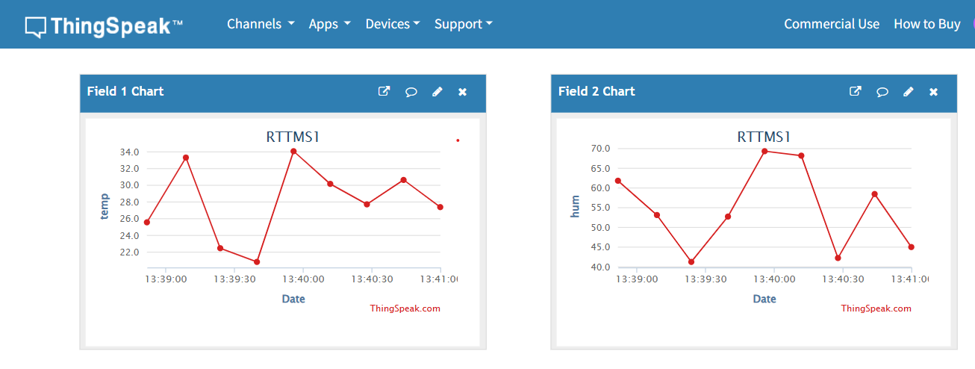
Technologies Used
Arduino UNO
ESP8266 Wi-Fi Module
DHT11 Sensor
MQ135 Gas Sensor
ThingSpeak Cloud Platform
Relay Module
SoftwareSerial Library
Fig 1: Thingspeak Dashboard

Slide 6
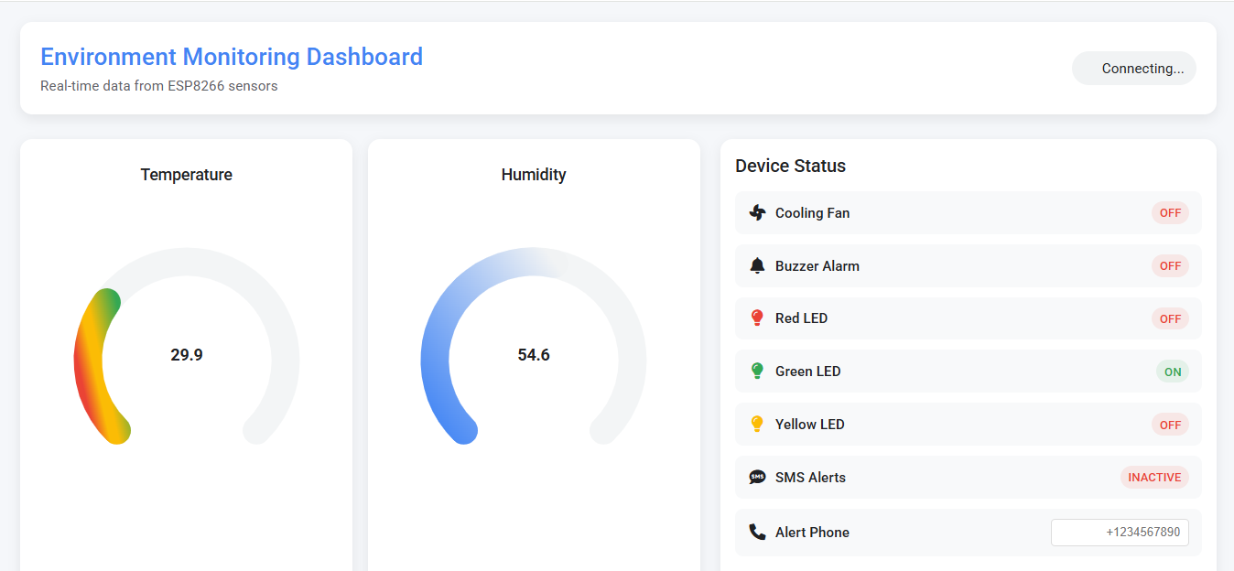
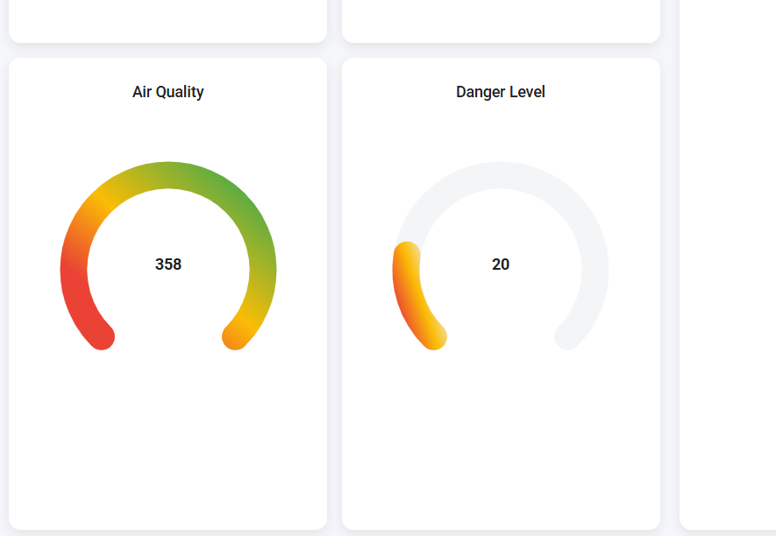
Dashboard

Slide 7
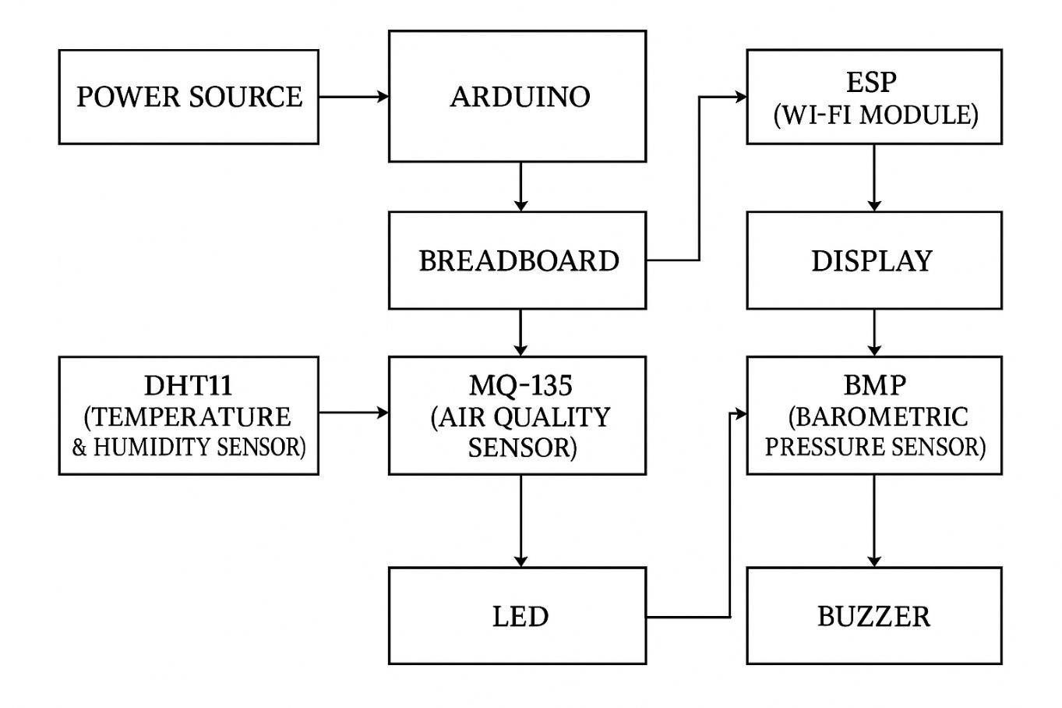
Block Diagram
Fig 2. block diagram of the system

Slide 8
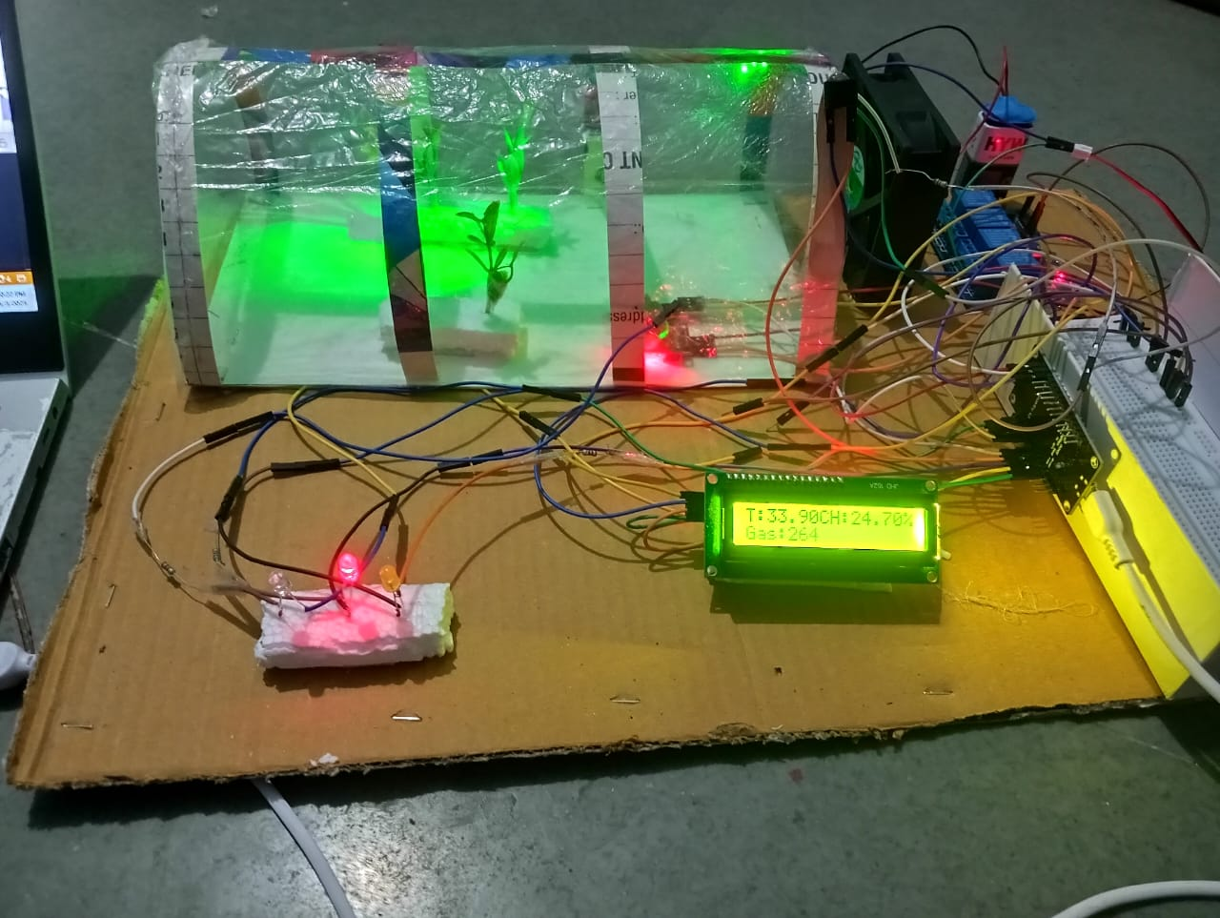
Experimental Setup
Sensor modules are placed in open-air zones.
LCD is positioned for user visibility.
Fan and relay are isolated for safety.
ESP8266 is placed near the Arduino and powered with regulated 3.3V.
Fig 3: Experimental setup

Slide 9



Results
Table 2: Experimental results
Temperature Readings
Time | Temp (°C) | Humidity (%) | MQ135 Value | Action
10:00 AM | 28.5 | 52 | 170 | Normal
10:30 AM | 32.1 | 45 | 185 | Fan ON
11:00 AM | 34.2 | 35 | 400 | Fan + Buzzer ON
Alert Triggering
Data Transmission

Slide 10





Applications
Home Automation
School and College Labs
Industrial Safety Monitoring
Healthcare Clinics
Smart Agriculture

Slide 11
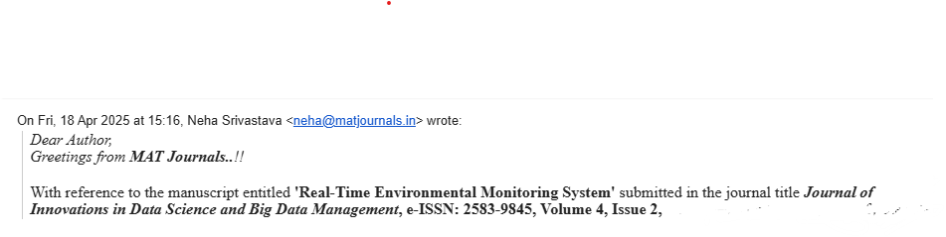
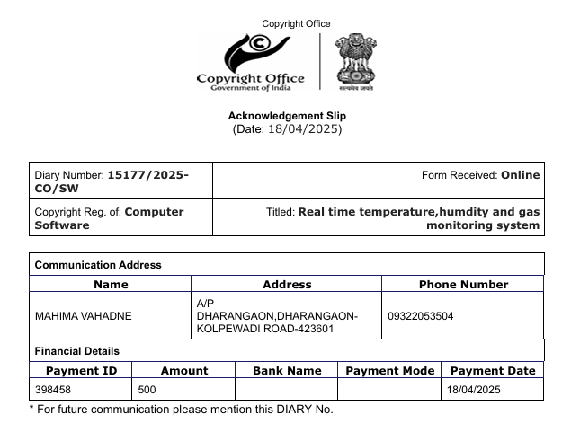
Outcomes
Research Paper Publication approved
2) Copyright registration

Slide 12
Conclusion
Effectively integrates sensing and control into one automated system.
Provides real-time monitoring with alerts via buzzer, fan, and LEDs.
Data is consistently uploaded to ThingSpeak for remote access and logging.
Low-cost and easy-to-build, ideal for educational and practical environments.
Offers modular expansion potential for additional sensors or mobile notifications.

Slide 13
References
ThingSpeak Documentation: https://thingspeak.com/docs
MQ135 Datasheet: https://www.electronicwings.com/sensors/mq135-gas-sensor
Sharma, A. & Gupta, R. (2021). "IoT Based Air Monitoring System Using Arduino and ESP8266". International Journal of Innovative Research in Science, Engineering and Technology, 10(3). https://www.ijirset.com/upload/2021/march/17_IOT.pdf
Nair, R. & Patil, A. (2020). "Design and Implementation of Smart Air Monitoring System". International Journal of Engineering Research & Technology (IJERT), 9(5). https://www.ijert.org/research/design-and-implementation-of-smart-air-monitoring-system-IJERTV9IS050112.pdf

