Slide 1
Object-Oriented Essentials
By Warren Mansur, edited by Eric Braude

Slide 2
Programs are mostly unrealiable
“I’ve assigned [binary search] in courses at Bell Labs and IBM. Professional programmers had a couple of hours to convert [its] description into a program in the language of their choice; a high-level pseudocode was fine. At the end of the specified time, almost all the programmers reported that they had correct code for the task. We would then take thirty minutes to examine their code, which the programmers did with test cases. In several classes and with over a hundred programmers, the results varied little: ninety percent of the programmers found bugs in their programs (and I wasn’t always convinced of the correctness of the code in which no bugs were found). I was amazed: given ample time, only about ten percent of professional programmers were able to get this small program right. But they aren’t the only ones to find this task difficult: in the history in Section 6.2.1 of his Sorting and Searching, Knuth points out that while the first binary search was published in 1946, the first published binary search without bugs did not appear until 1962.” —Jon Bentley, Programming Pearls (1st edition), pp.35–36
Notes:
This is not hypothetical or academic.

Slide 3
Learning Objectives
Understand motivations for object-oriented languages
Interpret relationships between classes
Use inheritance hierarchy
Use interface hierarchy
Apply polymorphism
Apply downcasting
Distinguish concrete classes from abstract classes
Contrast abstract classes vs interfaces
Use the Comparable interface

Slide 4
A Benefit of Strongly Typed Languages
Better able to practice safety:
Enforce what you intend

Slide 5

Agenda
Objects and classes
Inheritance
Constructors in Java
Polymorphism
Downcasting
Abstract classes
Interfaces

Slide 6
Motivations For Object-Orientation
Encapsulation
Every data item is owned by an object
Objects are decoupled and communicate with external interfaces
Internal data manipulation is hidden
Abstraction
Intent is separated from implementation
Problems are solved the way humans think
Modularity
The application is divided into loosely coupled, logical modules

Slide 7
Motivations For Object-Orientation
Inheritance
Objects extend other objects
Polymorphism
One name, many forms
Behavior has one name but behaves differently according to the relevant object
Code Reuse
Unnecessary rewriting is avoided
Rewriting of very similar code is avoided

Slide 8
Class
the blueprint from which individual objects are created
defines the attributes
the object’s data
defines methods
which represent an object’s behavior

Slide 9
Object
an instance or occurrence of a class
has its own values for the attributes
behavior same as all other objects for same class

Slide 10
Agenda
Objects and classes
Inheritance
Constructors in Java
Polymorphism
Downcasting
Abstract classes
Interfaces

Slide 11
Inheritance Example: from Car
class Car
{
private String model;
private int milesDriven;
public Car(String model, int miles)
{
this.model = model;
this.milesDriven = miles;
}
public int findPrice()
{
if (milesDriven < 50000)
return 20000;
else
return 10000;
}
}

Slide 12
Car Inheritance Ex.
class ElectricCar extends Car
{
private int energyEfficiency;
public ElectricCar(String model, int miles, int eff)
{
super(model, miles);
energyEfficiency = eff;
}
public int findPrice()
// POSTCONDITION:
// EITHER energyEfficiency < 3 AND super.findPrice() + $2,000 was returned
// OR energyEfficiency >= 3 AND super.findPrice() + $2,500 was returned
{
int temp = super.findPrice();
if (energyEfficiency < 3)
return temp + 20000;
else
return temp + 25000;
}
}
Notes:
Notice that ElectricCar redefines findPrice().

Slide 13
Car Inheritance Execution
public class Main
{
public static void main(String[] args)
/*
* POSTCONDITION 1: price of Camry with 48,000 miles is on the console
* POSTCONDITION 2: price of Camry electric with 4,000 miles is on the console
*/
{
Car c = new Car("Camry", 48000);
System.out.println(c.findPrice());
ElectricCar ec = new ElectricCar("Camryel", 4000, 5);
System.out.println(ec.findPrice());
}
}
Output
20000
45000111.

Slide 14
Agenda
Objects and classes
Inheritance
Constructors in Java
Polymorphism
Downcasting
Abstract classes
Interfaces

Slide 15
Constructor Rules for Java Inheritance*
Automatic Call to Parent Class Constructor: when a subclass (derived class) object is created, the constructor of the superclass (base class) is invoked first, automatically.
Default Constructor: If the superclass has a no-argument (default) constructor, it is called automatically when the subclass's constructor is invoked.
* Edited from chatGPT

Slide 16
Constructor Rules for Java Inheritance
Non-Default Constructor: If the superclass does not have a no-argument constructor, or if you want a specific constructor of the superclass to be called, you must manually call it from the subclass's constructor.
This is done by using the super() call in the first line of the subclass constructor. The arguments you pass to super() must match the arguments of one of the superclass's constructors.

Slide 17
Constructor Rules for Java Inheritance
No Inherited Constructors: In Java, constructors are not members of a class and hence, they are not inherited by subclasses. Each class (subclass or superclass) has its own constructors.
No Overriding of Constructors: A subclass cannot override constructors from its superclass.
Private Constructors: If a superclass has only private constructors, it cannot be subclassed. This is a common technique to prevent a class from being subclassed or to make a class effectively "final".

Slide 18
Constructor Rules for Java Inheritance
Calling Superclass Constructor: If you want to call a specific superclass constructor, you must use the super() call in the first line of your subclass's constructor. If you do not make a call to super(), the Java compiler will insert a no-argument super() call for you.
Constructor Overloading: Similar to methods, constructors can be overloaded in both superclass and subclass. Overloading provides different ways of initializing an object.

Slide 19
Superclass Constructor Example
class Base
{
public Base() {
System.out.println("Base's no-arg constructor invoked.");
}
public Base(int n) {
System.out.println("Base's constructor invoked with int param");
}
protected String getObjectDescription() {
return "Object of class Base";
}
}
public class Derived extends Base {
public int derivedAttribute;
public Derived(int aBAttributeValue) {
System.out.println("Derived's constructor invoked with int parameter.");
derivedAttribute = aBAttributeValue;
}
}
Notes:
In class Derived’s constructor Derived(int n), a programmer-written super() is NOT required because Base already has a no-arg constructor Base() which gets invoked automatically by Derived’s constructor.
If Base(int n) were the ONLY constructor in class Base, a super(int …) would be required in Derived’s constructor.

Slide 20
Superclass Constructor Example
public class Main {
public static void main(String[] args) {
Derived aDerivedInstance = new Derived(111);
System.out.println(aDerivedInstance.getObjectDescription() +
" with derivedAttribute = " + aDerivedInstance.derivedAttribute + ".");
}
}
Output
Base's no-arg constructor invoked.
Derived's constructor invoked with int parameter.
Object of class Base with derivedAttribute = 111. 111.

Slide 21
Agenda
Objects and classes
Inheritance
Constructors in Java
Polymorphism
Downcasting
Abstract classes
Interfaces

Slide 22
An Origin of Polymorphism
Using the same verb in different contexts is a key aspect of language
run a race
run a company

Slide 23
Student Classes
public class Student {
private int score;
public Student(int aScore)
{
score = aScore;
}
public int getScore()
{
return score;
}
public void setScore(int aScore)
{
score = aScore;
}
public String computeGrade()
// Returns "A"/B/C/D/F according to >= 90/80/70/60/otherwise
{
if (score >= 90) return "A";
else if (score >= 80) return "B";
else if (score >= 70) return "C";
else if (score >= 60) return "D";
else return "F";
}
}

Slide 24
GradStudent Class
public class GradStudent extends Student {
private String thesisTitle;
public GradStudent(int aScore, String aTitle)
{
super(aScore);
thesisTitle = aTitle;
}
public String getTitle()
{
return thesisTitle;
}
public void setTitle(String title)
{
thesisTitle = title;
}
public String computeGrade()
// Returns "First/Second Class" according to getScore() >= 95
{
if (getScore() >= 95)
return "First Class";
else
return "Second Class";
}
}

Slide 25
NonDegreeStudent Subclass
public class NonDegreeStudent extends Student {
public NonDegreeStudent(int aScore) {
super(aScore);
}
public String computeGrade()
{
if (getScore() >= 75) return "Pass";
else return "Fail";
}
}

Slide 26
Polymorphism
public class Main {
public static void main(String[] args)
{
ArrayList<Student> students = new ArrayList<>();
students.add(new Student(78));
students.add(new GradStudent(78, "Computer Science"));
students.add(new NonDegreeStudent(78));
for(Student s : students) { // demonstration of polymorphism
System.out.println("Student's score = " + s.getScore());
System.out.println("Student's grade = " + s.computeGrade());
}
}
}
Output
Student's score = 78
Student's grade = C
Student's score = 78
Student's grade = Second Class
Student's score = 78
Student's grade = Pass

Slide 27
Agenda
Objects and classes
Inheritance
Constructors in Java
Polymorphism
Downcasting
Abstract classes
Interfaces

Slide 28
Downcasting Example
Student g = new GradStudent();
g.setTitle("My Thesis"); // doesn't compile
System.out.println("Thesis title = " + g.getTitle()); // doesn’t compile
// Downcast (if known it’s a grad student)
((GradStudent)g).setTitle("My Thesis");
// Downcast using instanceof first
if (g instanceof GradStudent)
((GradStudent)g).setTitle("My Thesis");

Slide 29
Agenda
Objects and classes
Inheritance
Constructors in Java
Polymorphism
Downcasting
Abstract classes
Interfaces

Slide 30
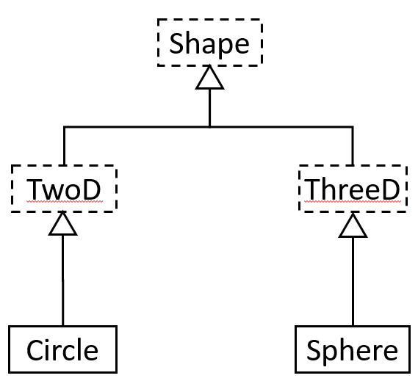
Abstract Class (No Instance)

Slide 31
Abstract Shape Classes
abstract class Shape
{
public abstract double getArea();
}
abstract class TwoD extends Shape
{
}
abstract class ThreeD extends Shape
{
public abstract double getVol();
}
class Circle extends TwoD
{
private double radius;
public Circle(double r)
{
radius = r;
}
public double getArea()
{
return Math.PI * radius * radius;
}
}
Notes:
Notice that in the two branches, ThreeD defines another method that must be implemented getVol(), while TwoD does not. All classes must implement getArea since all shapes have an area.

Slide 32
Concrete Shape Classes
class Sphere extends ThreeD
{
private double radius;
public Sphere(double r)
{
radius = r;
}
public double getArea()
{
return 4.0 * Math.PI * radius * radius;
}
public double getVol()
{
return (4.0/3.0) * Math.PI * radius * radius * radius;
}
}

Slide 33
Shape Output
public class Main
{
public static void main(String[] args)
{
Shape[] shArr = {new Circle(1.0), new Sphere(1.0), new Sphere(10.0)};
for (Shape elem : shArr)
{
if (elem != null)
{
System.out.println("Area = " + elem.getArea());
if (elem instanceof ThreeD)
System.out.println("Volume = " + ((ThreeD)elem).getVol());
}
}
}
}
Output
Area = 3.141592653589793
Area = 12.566370614359172
Volume = 4.1887902047863905
Area = 1256.6370614359173
Volume = 4188.790204786391

Slide 34
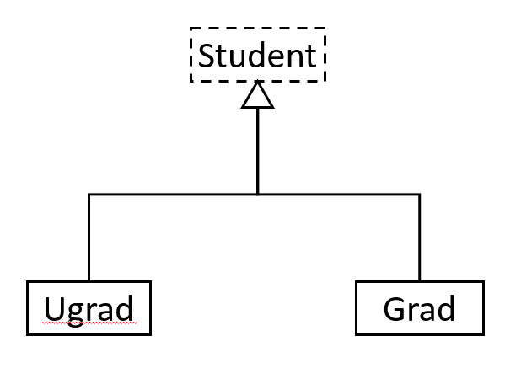
Student Diagram with Abstract

Slide 35
Student Classes
abstract class Student
{
public void computeGrade()
{
System.out.println("Student: pass");
}
}
class Ugrad extends Student
{
public void computeGrade()
{
super.computeGrade();
System.out.println("Ugrad: with honors");
}
}
class Grad extends Student
{
public void computeGrade()
{
System.out.println("Grad: with distinction");
}
}
Notes:
Notice that Ugrad calls the super method for its parent type.

Slide 36
Student Output
public class Main
{
public static void main(String[] args)
{
Student stuArr[] = {new Ugrad(), new Grad(), new Grad()};
for (Student elem : stuArr)
if (elem != null)
elem.computeGrade();
}
}
Output
Student: pass
Ugrad: with honors
Grad: with distinction
Grad: with distinction

Slide 37
Agenda
Objects and classes
Inheritance
Constructors in Java
Polymorphism
Downcasting
Abstract classes
Interfaces

Slide 38
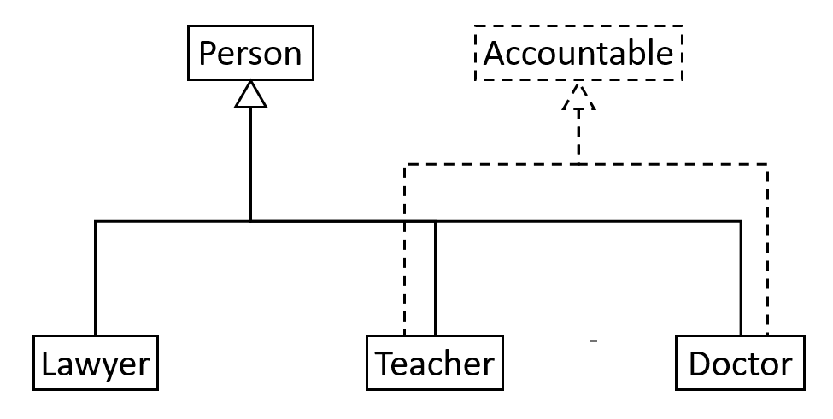
Interfaces Allow Multiple “Inheritance”

Slide 39
Accountable Classes
interface Accountable
{
public abstract void showAccountability();
}
class Person
{
public void print()
{
System.out.print("I am a Person. ");
}
}
class Teacher extends Person implements Accountable
{
public void showAccountability()
{
System.out.println("I am a Teacher; I am accountable to my students.");
}
}
class Doctor extends Person implements Accountable
{
public void showAccountability()
{
System.out.println("I am a Doctor; I am accountable to my patients.");
}
}
class Lawyer extends Person {}
Notes:
Notice that one object can “be” multiple types with interfaces. For example, a teacher is both a person and is accountable.

Slide 40
Accountable Output
public class Main
{
public static void main(String[] args)
{
Person[] persons = {new Teacher(), new Doctor(), new Lawyer()};
for (Person elem: persons)
elem.print();
if (elem instanceof Accountable)
{
Accountable accountable = (Accountable)elem;
accountable.showAccountability();
}
}
}
Output
I am a person. I am a Teacher; I am accountable to my students.
I am a person. I am a Doctor; I am accountable to my patients.
I am a Person.
Notes:
Notice that objects that are both a Person and also an Accountable have behavior for both.

Slide 41
Comparable Interface
public class DriversLicense implements Comparable<DriversLicense> {
private String firstName;
private String lastName;
private int licenseID;
public DriversLicense(String first, String last, int licenseID) {
this.firstName = first;
this.lastName = last;
this.licenseID = licenseID;
}
public int compareTo(DriversLicense otherLicense) {
int retVal;
if (licenseID == otherLicense.licenseID)
retVal = 0;
else if (licenseID < otherLicense.licenseID)
retVal = -1;
else
retVal = 1;
return retVal;
}
}
Notes:
Notice that one object can “be” multiple types with interfaces. For example, a teacher is both a person and is accountable.

Slide 42
DriversLicense Output
public class Main {
public static void main(String[] args) {
DriversLicense SallysLicense = new DriversLicense("Sally", "Small", 5);
DriversLicense BobsLicense = new DriversLicense("Bob", "Glass", 2);
DriversLicense ElainasLicense = new DriversLicense("Elaina", "Afilia", 5);
DriversLicense VishnusLicense = new DriversLicense("Vishnu", "Santhana", 10);
System.out.println("Sally's license compared to Bob's license: "
+ SallysLicense.compareTo(BobsLicense));
System.out.println("Sally's license compared to Elaina's license: "
+ SallysLicense.compareTo(ElainasLicense));
System.out.println("Sally's license compared to Vishnu's license: "
+ SallysLicense.compareTo(VishnusLicense));
}
}
Output
Sally's license compared to Bob's license: 1
Sally's license compared to Elaina's license: 0
Sally's license compared to Vishnu's license: -1
Notes:
Notice that the comparable interface returns a negative number, 0, or a positive number depending upon how it compares.
The Collections framework in Java relies on this interface for several operations.

Slide 43
Summary: use strongly typed language …
–in the struggle to manage complexity–
to enforce what you intend

