Slide 1
CS673 Software Engineering
BUMETCS
Yuting Zhang

Slide 2
Course Materials and Tools
Blackboard (live classroom links and recordings, syllabus, lecture notes, assignments, quizzes and final exam,)
Google drive (lecture slides, project documents)
Github (project documents and code)
Discord (communication)
Pivotal tracker or other Agile management tools (project management)
IDE/build tools: software development
UML tools: design
…

Slide 3
Course Features
SE concepts and practices used in the software development life cycle
Lectures, discussions, quizzes and the final exam
Semester-long group project
Labs
Project iteration 0-3
Student presentations
Code and documents
Requirements:
Active participation instead of passive listening and reading
Communication and collaboration
Self-learning and peer-learning from each other

Slide 4
Maximize Your Learning Outcomes
Three levels of Learning
Knowledge: SE concepts, practices, methodologies
Skills: problem solving, research, programming, tools, communication
Thinking model: system thinking, design thinking, algorithmic thinking, critical thinking
Your success is my success

Slide 5
CS673 Software Engineering
Module 1: Intro to SE
BUMETCS
Yuting Zhang

Slide 6
Question to Ask
Software Engineering =? Programming > <

Slide 7
Software Disasters
Ariane Project (1996) ($500 million)
Radiation Overdose (>5 death and >15 injured)
The year 2000 problem ($500 million)
The 2003 North America blackout ( 10 million people in Ontario and 45 million people in eight U.S. States.) ($6billion)
Bitcoin hack ($450 million)
The Equifax mega-breach (145 million people)
T-Mobile data breach
Exercise: find a software disaster(big failure) in recent 2-3 years.
What are possible causes of software failures?

Slide 8
Possible Causes of Software Failures
Unrealistic or unarticulated project goals
Poor project management
Inaccurate estimates of needed resources
Badly defined system requirements
Poor reporting of the project's status
Unmanaged risks
Poor communication among customers, developers, and users
Inability to handle the project's complexity
Poor software design methodology
Poor coding skills
Wrong or inefficient set of development tools
Inadequate test coverage
Inappropriate (or lack of) software process
No security control

Slide 9
Possible Causes of Software Failures
Unrealistic or unarticulated project goals
Poor project management
Inaccurate estimates of needed resources
Badly defined system requirements
Poor reporting of the project's status
Unmanaged risks
Poor communication among customers, developers, and users
Inability to handle the project's complexity
Poor software design methodology
Poor coding skills
Wrong or inefficient set of development tools
Inadequate test coverage
Inappropriate (or lack of) software process
No security control
How to avoid these mistakes?

Slide 10
Software Engineering Definition
IEEE definition: “the application of a systematic, disciplined, quantifiable approach to the development, operation and maintenance of software; that is, the application of engineering to software.”
Is SE more difficult than other engineering fields? Why? What are unique features in SE?

Slide 11

Software Engineering is Difficult!
“No silver bullet” by Frederick P. Brooks, Jr.
There is no single development, in either technology or management technique, which by itself promises even one order of magnitude [tenfold] improvement within a decade in productivity, in reliability, in simplicity."
Essential Difficulties:
Complexity, Changeability, conformity, Invisibility
Accidental Difficulties
Brooks’ argument: No silver bullet to solve essential difficulties. Promising solutions only tackle accidental difficulties.
Adding manpower to a late software project makes it later

Slide 12
4Ps
People
Project stakeholders (who are they?)
Product
Software, code, documents etc (what are they?)
Project
Activities (What are basic common activities?)
Process
Framework to carry out the activities (how to perform SE activities?)

Slide 13
SE Ethics
IEEE CS (Institution of Electrical and Electronic Engineers Computer Society ) and Association for Computing Machinery (ACM) produced Software Engineering Code of Ethics and Professional Practice in 1997 https://ethics.acm.org/code-of-ethics/software-engineering-code/
Eight principles: public, client and employer, product, judgement, profession, colleagues, self.
ACM Code of Ethics and Professional Conduct for computing professionals: https://ethics.acm.org/code-of-ethics/ (Adopted by ACM Council 6/22/18)
Public good is always the primary consideration.
Examples of possible violations?

Slide 14
Case Study
Rogue Services advertised its web hosting services as “cheap, guaranteed uptime, no matter what.” While some of Rogue’s clients were independent web-based retailers, the majority were focused on malware and spam. Several botnets used Rogue’s reliability guarantees to protect their command-and-control servers from take-down attempts. Spam and other fraudulent services leveraged Rogue for continuous delivery. Corrupted advertisements often linked to code hosted on Rogue to exploit browser vulnerabilities to infect machines with ransomware.

Slide 15
Case Study
Despite repeated requests from major ISPs and international organizations, Rogue refused to intervene with these services, citing their “no matter what” pledge to their customers. Furthermore, international pressure from other governments failed to induce national-level intervention, as Rogue was based in a country whose laws did not adequately proscribe such hosting activities.
Ultimately, Rogue was forcibly taken offline through a coordinated effort from multiple security vendors working with several government organizations. This effort consisted of a targeted worm that spread through Rogue’s network. This denial-of-service attack successfully took Rogue’s machines offline, destroying much of the data stored with the ISP in the process. All of Rogue’s clients were affected. No other ISPs reported any impact from the worm, as it included mechanisms to limit its spread. As a result of this action, spam and botnet traffic immediately dropped significantly. In addition, new infections of several forms of ransomware ceased.

Slide 16
Case Study
More case studies can be found at https://ethics.acm.org/code-of-ethics/using-the-code/

Slide 17
Test Yourself
What are essential difficulties described by Brooks?
What are accidental difficulties described by Brooks?
What are ethics principles should be adhered by the software engineers?

Slide 18
Software Activities
Inception
Planning
Requirements analysis
Software design
Implementation
Testing
Deployment
Maintenance
Operation and support
project management
configuration management
quality management
risk management

Slide 19
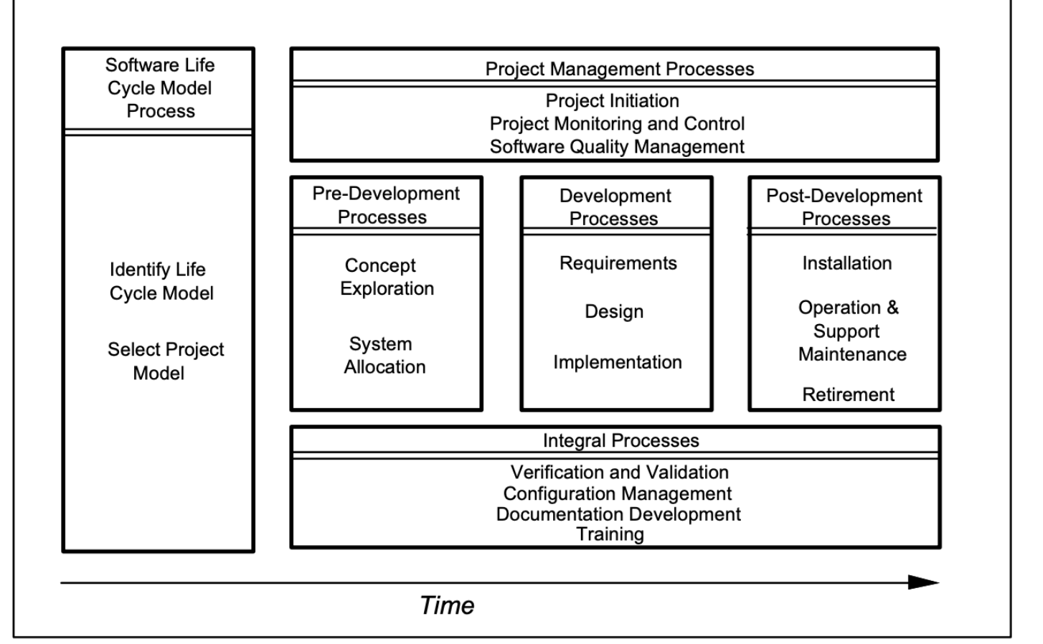
IEEE Guide for Developing Software Life Cycle Processes

Slide 20
Software Process
A software development process is a structure imposed on the development of a software product:
prescribes the order and frequency of phases
specifies criteria for moving from one phase to the next
defines the deliverables of the project
Software process has a positive effect if applied correctly
Meet schedules, Higher quality, More maintainable

Slide 21
Software Process Models (Life Cycle Models)
Sequential - Waterfall
Iterative
Spiral
UP (Unified Process)
Agile

Slide 22
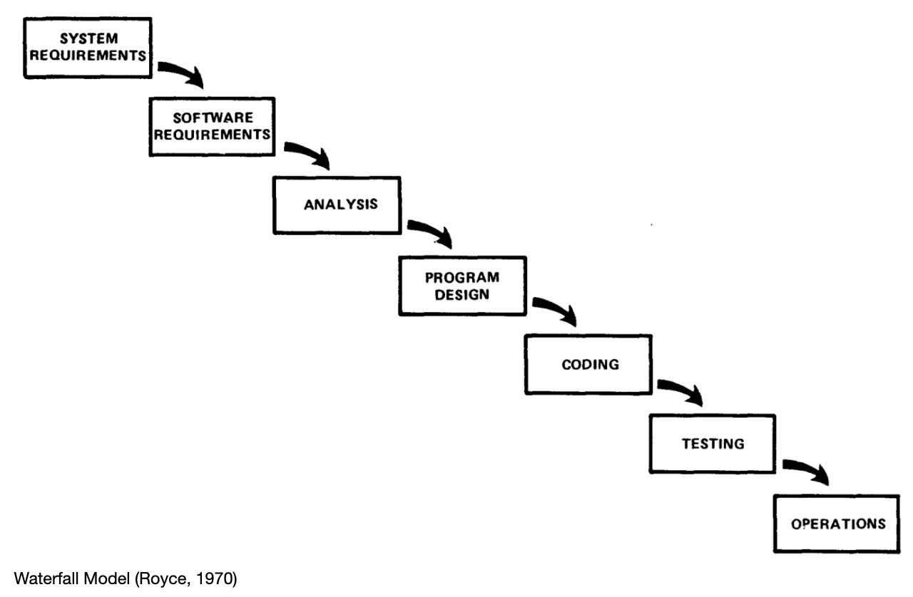
Waterfall

Slide 23
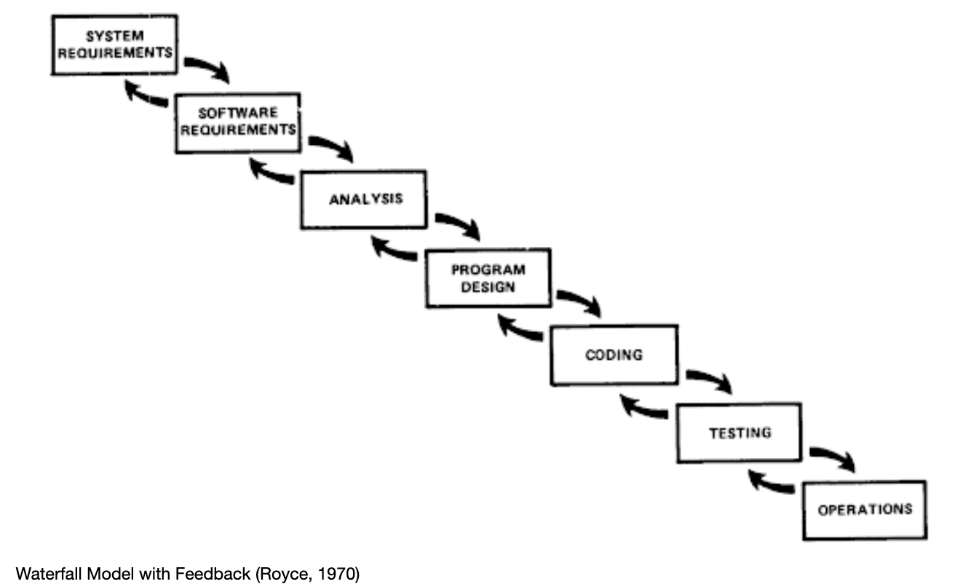
Waterfall
Pros and Cons?

Slide 24
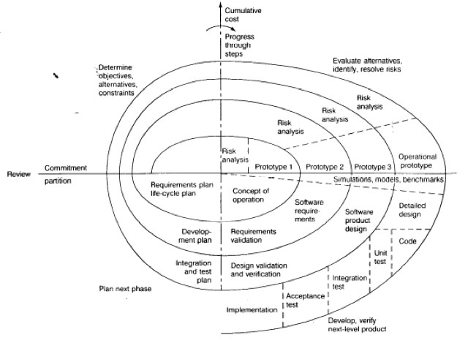
Spiral
Pros and Cons?
Barry Boehm, TRW Defense Systems,1986

Slide 25
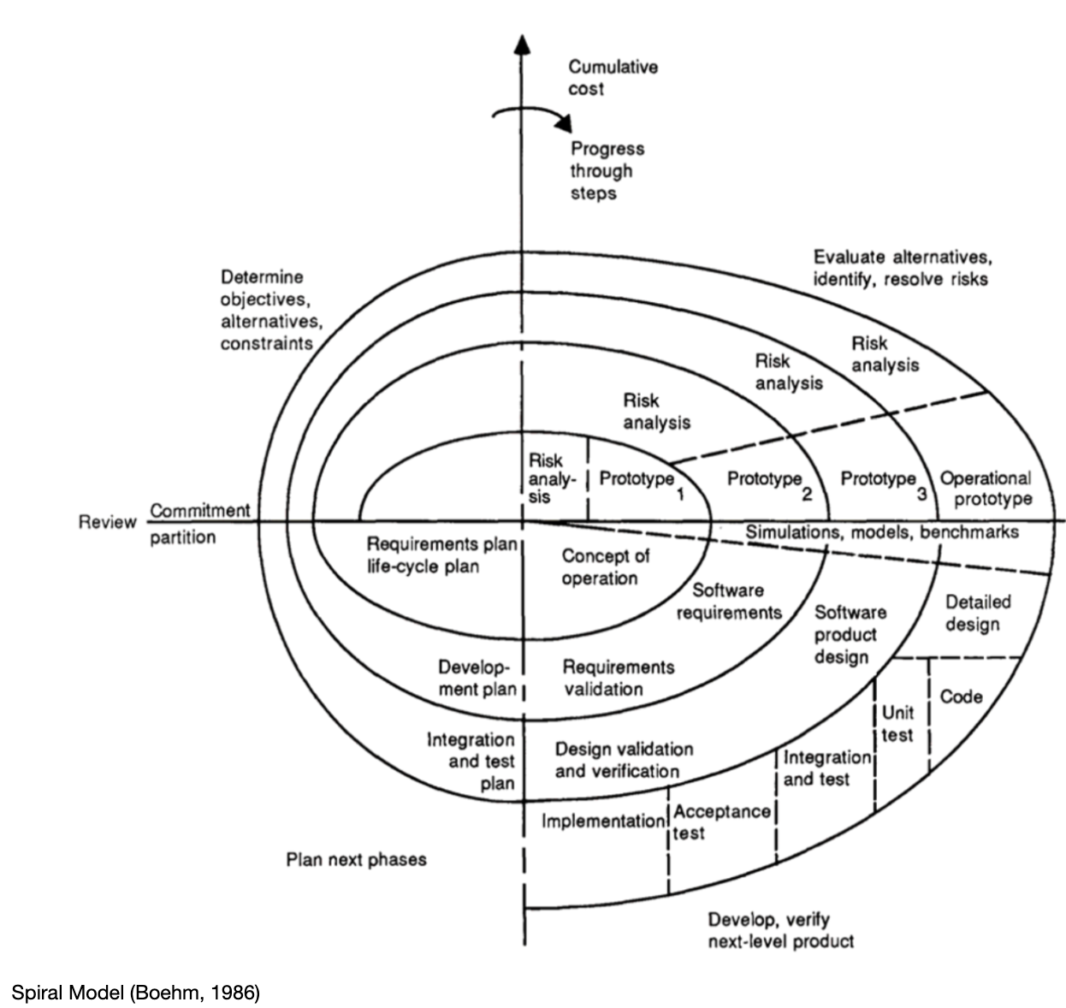
Spiral
Pros and Cons?
Risk Driven
Prototype
Barry Boehm, TRW Defense Systems,1986

Slide 26
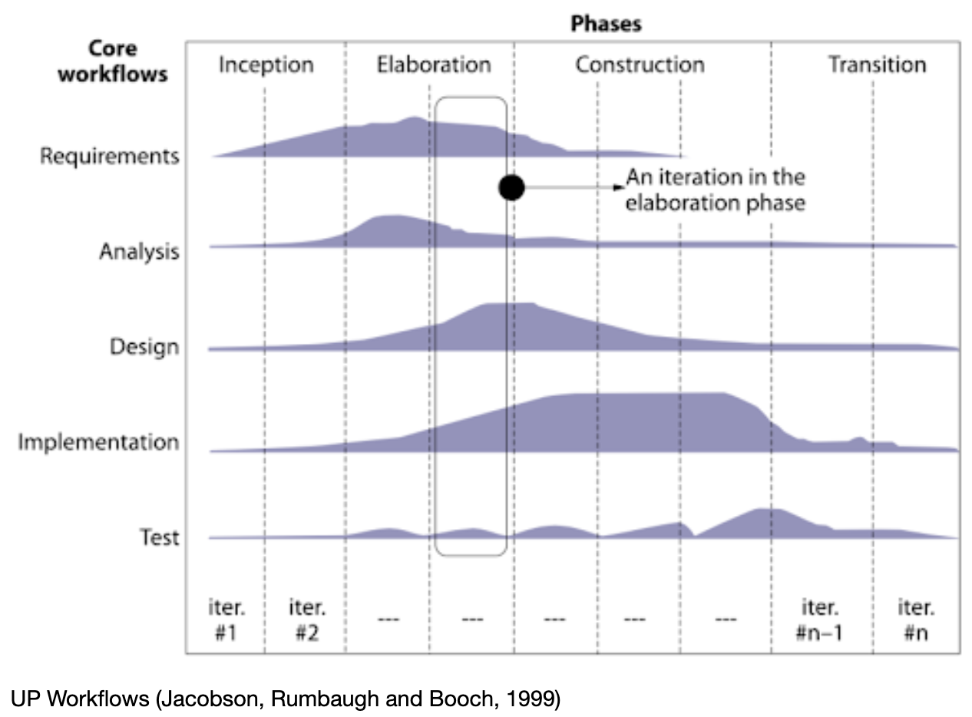
Unified Process
By Jacobson, Rumbaugh and Booch (Three Amigos) in 1999
Use-case driven
Architecture-centric
Iterative and incremental
Risk Focused
Pros and Cons?

Slide 27
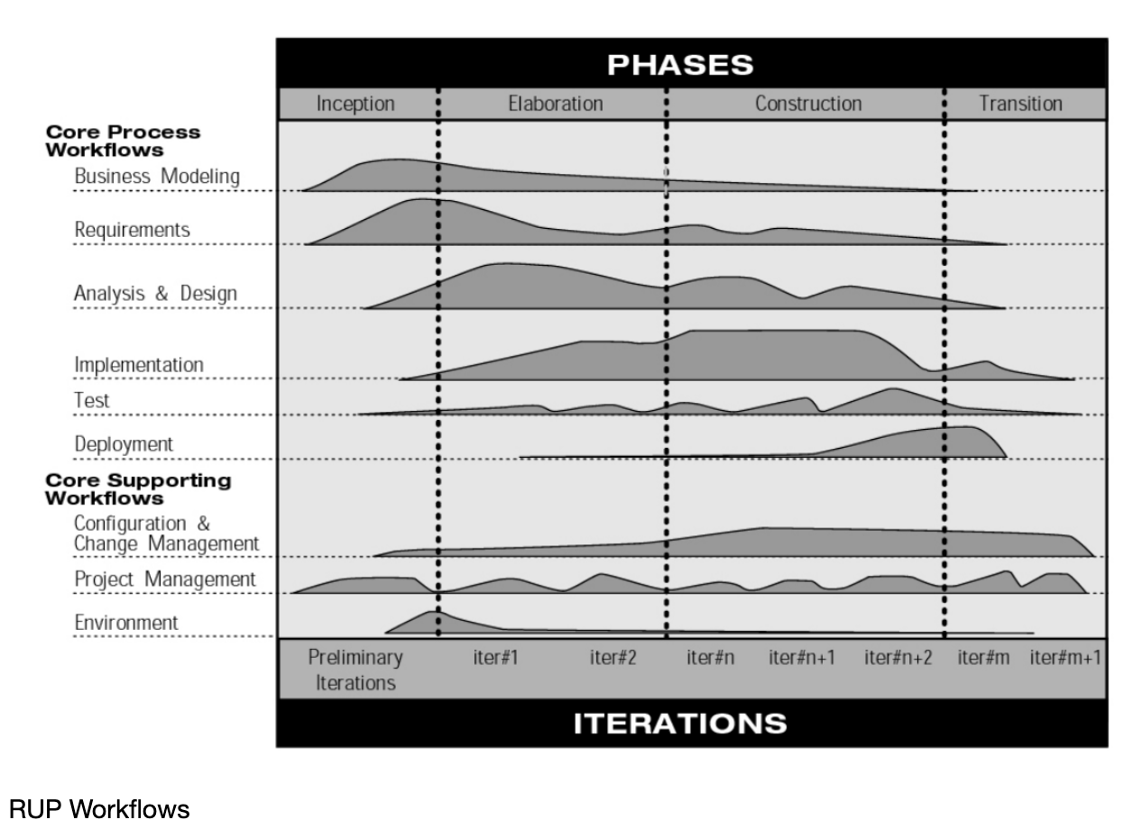
Rational Unified Process
Commercial product: IBM's Rational Unified Process (RUP)
Define all models using UML

Slide 28
Agile
Simple, light, quick and adaptive
Agile manifesto were created by 17 software developers in 2001
Focus on values and principles

Slide 29
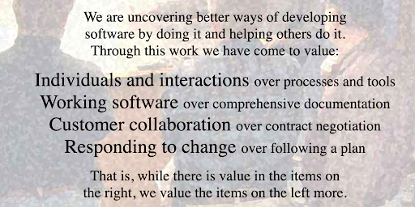
Agile Manifesto

Slide 30
Agile Principles
Our highest priority is to satisfy the customer through early and continuous delivery of valuable software.
Welcome changing requirements, even late in development. Agile processes harness change for the customer's competitive advantage.
Deliver working software frequently, from a couple of weeks to a couple of months, with a preference to the shorter timescale.
Business people and developers must work together daily throughout the project.
Build projects around motivated individuals. Give them the environment and support they need, and trust them to get the job done.
The most efficient and effective method of conveying information to and within a development team is face-to-face conversation.

Slide 31
Agile Principles
Working software is the primary measure of progress.
Agile processes promote sustainable development. The sponsors, developers, and users should be able to maintain a constant pace indefinitely.
Continuous attention to technical excellence and good design enhances agility.
Simplicity--the art of maximizing the amount of work not done--is essential.
The best architectures, requirements, and designs emerge from self-organizing teams.
At regular intervals, the team reflects on how to become more effective, then tunes and adjusts its behavior accordingly

Slide 32
eXtreme Programming
Invented by Ward Cunningham, articulated by Kent Beck and implemented by Ron Jeffries in 1996 for a project at Daimler Chrysler
Values: Communication, Simplicity, Feedback. Courage, Respect.
Practices: pair programming, test-driven development, refactoring, continuous integration, coding standard, etc.

Slide 33
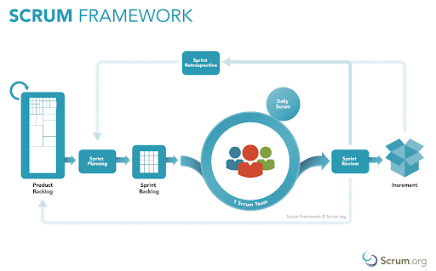
Scrum
Values:
Courage,
Focus,
Commitment
Respect
Openness
Developed in the early 1990s by Ken Schwaber and Jeff Sutherland

Slide 34
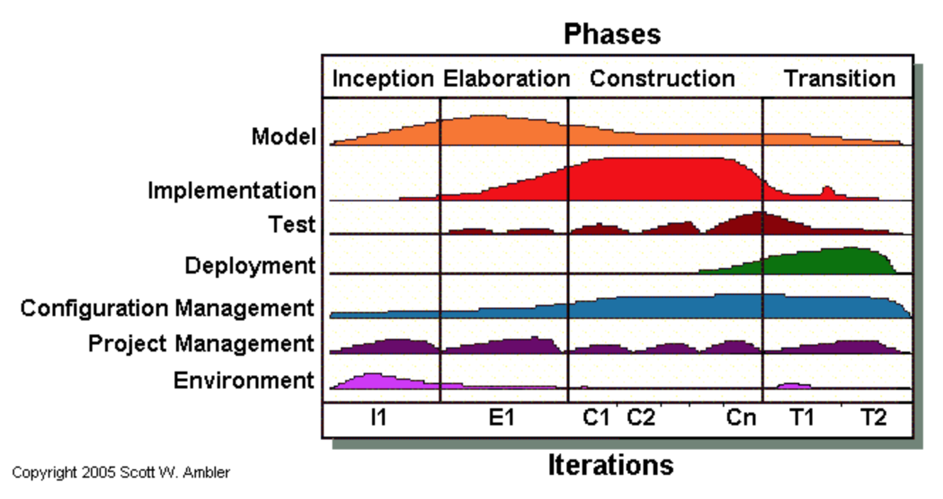
Agile UP

Slide 35
XP vs Scrum
Both are Agile frameworks with similar values
XP focuses on the technical side, and Scrum focuses on workflow and management practices.
Scrum can be applied beyond the software industry
Agile: pros and cons?

Slide 36
DevOps
A set of practices, roles, or processes to improve the communication between developers and IT operators in order to shorten the entire life cycle—including both development and deployment—when delivering new features, fixes, or updates.
Promotes the use of tools to automate infrastructure, automate workflow, and continuously monitor and measure application performance.

Slide 37
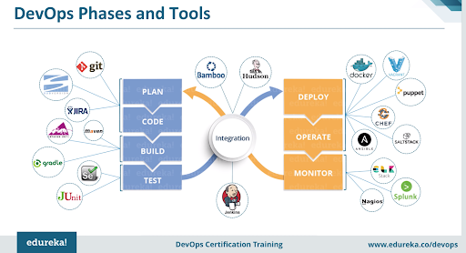
DevOps

Slide 38
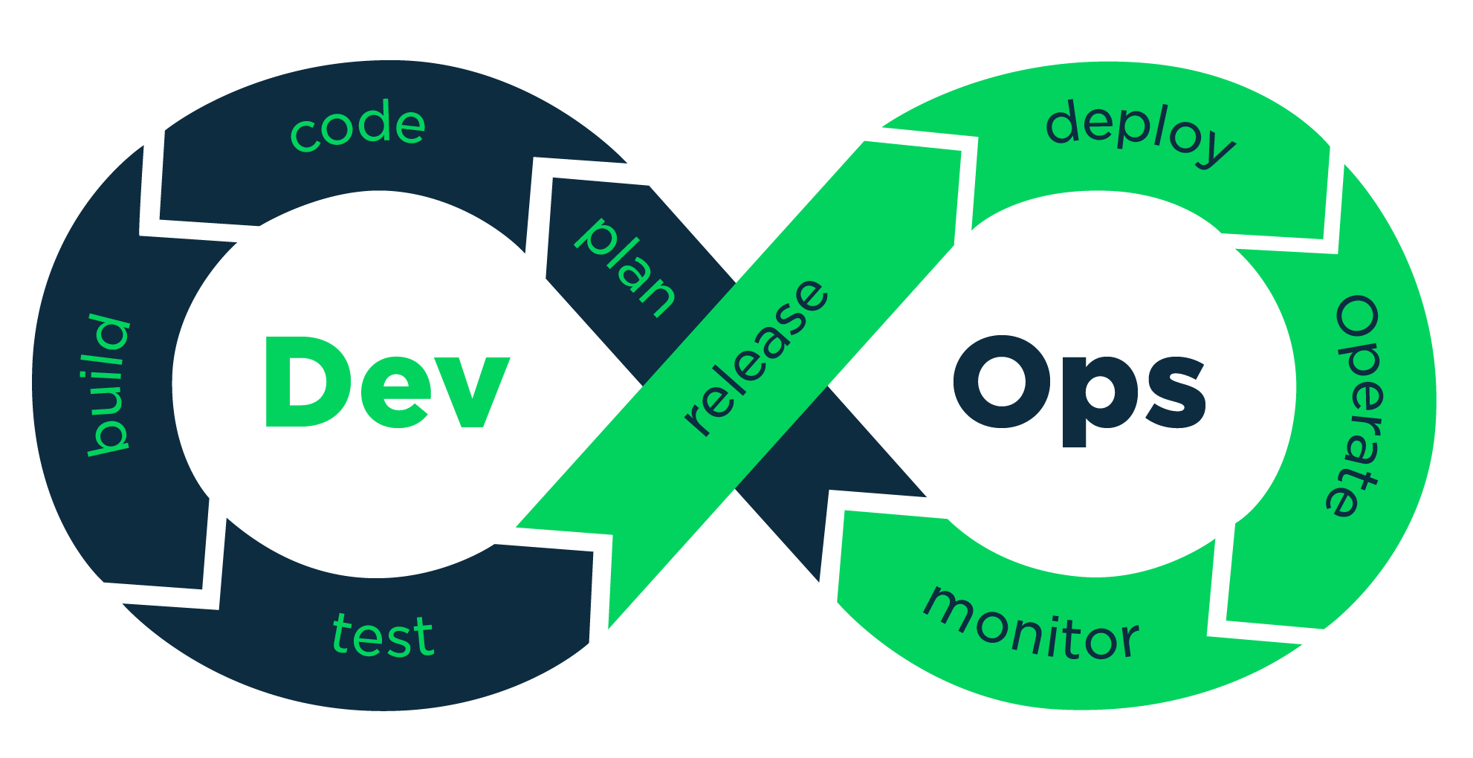
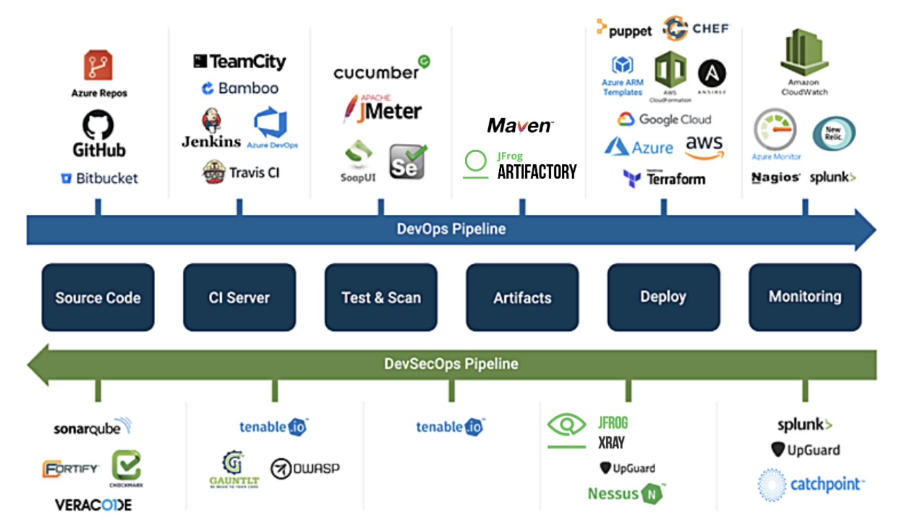
DevSecOps
Sec
https://www.catchpoint.com/blog/devops-india-summit-2020

Slide 39
Process Improvement and CMMI
Capability Maturity Model Integration
Initially developed by CMU in 1991, required by many DoD and government contracts
CMMI 2.0 was published in 2018
4 categories of capabilities areas , many practice areas and 5 levels (0 lowest - 5 highest) for each practice area
Pros and cons?

Slide 40
Test Yourself
Compare waterfall model, spiral model, unified process model and agile model. How can these models apply in contemporary development? (sequential, iterative, feedback, use-case driven, risk driven, prototype, architecture centric, simple, working code, documentation, collaboration, individuals … )

Slide 41
Test Yourself
Compare XP (eXtreme Programming) and Scrum?
(user stories, sprint, continuous integration, pair programming, product owner, product backlog, workflow, test driven development, whole team, workflow, management, refactoring …)

Slide 42
Test Yourself
What are the relationship and differences between Agile and DevOps?
Is DevOps the same as using tools for automation?
How does DevSecOps differ from DevOps?

Slide 43
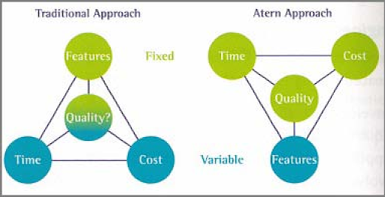
Software Project Factors TradeOff

Slide 44
Software Quality Characteristics
External Quality Characteristics: Correctness, Usability, Efficiency, Reliability, Integrity, Adaptability, Accuracy, Robustness and Security.
Internal Quality Characteristics: Maintainability, Flexibility, Portability, Re-usability, Readability, Testability, and Understandability.
How to measure quality?

Slide 45
Defect Management
The more closely a software product meets its specified requirements, and those requirements meet the wants and needs of its customers, the higher its quality.
A software defect is any deviation from requirements (both explicit and implicit).
Defect categories :
Severity: major, medium, trivial
Priority: high, medium, low
Type: omission, unnecessary, inconsistency, unclassified
Source: which phase was it injected?

Slide 46
Defect Management
Goals:
Remove as many defects as is reasonably possible before project is completed
Remove as many of these defects as early in the development process as possible. (Cost to repair defects increases the later they are discovered)

Slide 47
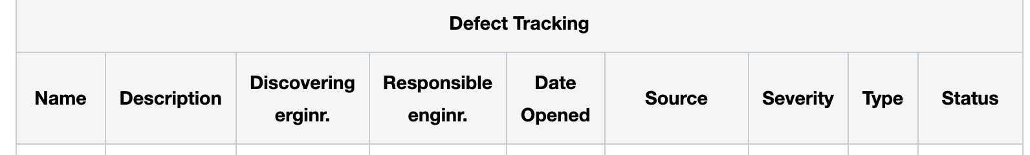
Defect Management
Need to be tracked and managed.
Many tools support defect management: Github, pivotaltracker

Slide 48
Quality Metrics
Product metrics
Defect density, defect counts
Testing coverage,
Size, complexity
MTTF
Customer satisfaction
Project Specific metrics
...
Process metrics
Defect repair rate
Effort (in person hours), velocity, burn down
...

Slide 49
Quality Assurance: V&V
Verification: Ensuring that each artifact is built in accordance with its specifications
“Are we building the product right?”
Focus on process
Mostly inspections and reviews (both code and documents)
Validation: Checking that each completed artifact satisfies its specifications
“Are we building the right product?”
Focus on products
Mostly testing
Focus on discover defects

Slide 50
SQAP (Software Quality Assurance Planning)
Who are responsible?
What documentation to generate?
What standards to use?
What metrics to use?
What procedures to use?
What testing to perform?
What techniques to use?
How to handle defects?
Our SPPP includes the SQAP section

Slide 51
Test Yourself
What are quality metrics? What are differences between product metrics and process metrics?
Limitations and interpretation of each quality metric.
How to find defects and how to manage them?
What are differences between inspection/review and testing?

Slide 52
Software Configuration Management
Manage changes in software and ensure what was designed is the same as what is built and deployed.
Configuration items include source code, property files, configuration file, documentation, binaries, and other entities in the software life cycle.
SCM helps in identifying, tracking, managing, controlling changes of these configuration items.
Version Control System (VCS) is an important component.
DevOps:
Container: Docker
CI & CD
Infrastructure as Code (IaC) and Configuration as Code (CaC)

Slide 53
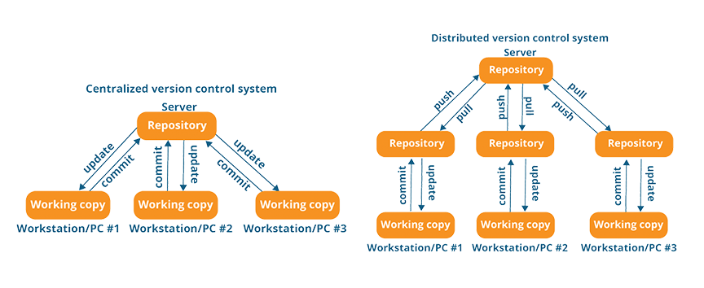
VCS
Distributed vs Centralized
Git, Mercurial
CVS, SVN
Git Branching: https://www.flagship.io/git-branching-strategies/

Slide 54
Docker
Containerization technology: portable, lightweight, self-contained environment for applications and dependencies.
Image (static files) vs Container (running instance)
Docker Daemon (background service manages container) vs Docker client
Dockerfile: configuration file of the docker image
Docker repo and Docker hub
Container orchestration

Slide 55
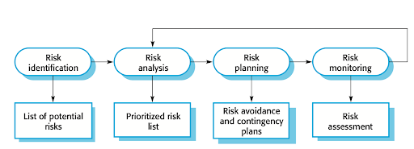
Risk Management
Risk: uncertain factors that have negative impact
Classification:
Project risks, technical risks, Business risks threaten.
Generic risks and specific risks
Risk Management
Identify, analyze, mitigate, monitor …
Should include in SPPP
Risk factors survey:
https://forms.gle/MSDHsvrZkN

Slide 56
Test Yourself
What are the differences between centralized and distributed version control systems?
Explain basic terminology about VCS and basic commands about git.
Explain basic elements of the docker system.
Define the term “risk” and identify common risks.
How to manage risks?

Slide 57
Questions?

