Slide 1
CS673 Software Engineering
Module 2: Requirement Analysis
BUMETCS
Yuting Zhang

Slide 2
Requirement Analysis
It is the process of gaining the necessary understanding of requirements (what the customer wants)
Gathering requirements
Represent requirements
Analyze requirements
The challenge is that the customers usually do not know exactly what they want at the beginning

Slide 3
Gathering Requirements
Stakeholders:
Clients (customers), users, domain experts, market researchers, lawyer, software engineers, HCI specialists, managers, etc.
Techniques:
List of questions
Bluesky (Brainstorm, think big)
Role playing
Observing real world application domain examples
Review available documents
Observe current system
Research similar systems

Slide 4
Feature Set Design
Knowledge
Users, products, domain and technology
Factors
Simplicity vs functionality
Familiarity vs Novelty
Control vs automation
(Sommerville, 2018)

Slide 5
Representing Requirements
List features in plain language.
User stories
Use cases
Mockup UIs
...

Slide 6
User Stories
Used in Agile software development.
Describe one thing (specific)
Short (couple of sentences), fits on 3” x 5” index card
Flexible and easy to manage
Customer driven
Written with/by and for customers
Understandable by customers (everyday non-technique language)
Involve all stakeholders (particularly non-tech people).

Slide 7
Using A Template
Title (Feature name)
As a [role], I can/want to [feature/functionality] so that [reason]
Example
Add a Project
As a project owner, I want to add my project to the application so that other users can view it.

Slide 8
End User Roles (Personas)
Understand potential end users and list all types of possible users.
Elicit features for each type of user.
Using personas (imaged users) to describe scenarios can help develop user stories.

Slide 9
Good or Bad?
As a user, I want to be able to edit the projects, so that I can update the project information.
As a Product Owner, I want the system to have the possibility of deleting projects, so that users have the possibility of deleting projects.
As a developer, I need to design the database schema so that I can implement it.

Slide 10
INVEST
Independent
Negotiable
Valuable
Estimable
Sized appropriately or small
Testable

Slide 11
Conversation to Add Details
Add a Project
Should have an “add project” button.
The user should already login.
Project information includes the project title, project description, keywords, authors, and possible various links.
Project title, description, authors and keywords are mandatory fields and should only contain valid characters such as letters, numbers, space, hyphen, etc.
Project links should be in the valid format.

Slide 12
Acceptance Tests (Confirmation)
User already logged in.
Click on the “add project” button.
Check that title, description, authors and keywords are not empty.
Check that the title, description, keywords and authors contain only valid characters.
Check that the project is added into the “My Projects” list.

Slide 13
Acceptance Test Template
Given … (setup/preconditions),
When … (input/ actions)
Then … (expected outputs)
This template can help map the acceptance tests to executable code nicely through some BDD framework. (e.g. pytest-bdd: https://pypi.org/project/pytest-bdd/ )

Slide 14
Acceptance Test Examples
Given I already logged in,
When I want to add a project,
Then the project is added.

Slide 15
Acceptance Test Examples
Given I already logged in, (Good precondition, any additional precondition or setup needed?)
When I want to add a project, (How to add a project is not clear at all)
Then the project is added. (How to know the project is added successfully)

Slide 16
Acceptance Test Examples
Given I already logged in, (Good precondition, any additional precondition or setup needed?)
When I want to add a project, (How to add a project is not clear at all)
Then the project is added. (How to know the project is added successfully)
Not Good

Slide 17
Acceptance Test Examples
Given I already logged in, and the “add project” button is available,
When I click on the “add project” button,
Then the “add project” screen is displayed with the following fields available: title, description, keywords, authors, and links.

Slide 18
Acceptance Test Examples
Given the “add project” screen is displayed,
When I input a valid project title (e.g. “ProjectPortal”), description (e.g. “ProjectPortal is a web-based application where students and faculty members can publish their completed and ongoing project information to share with others. ), authors (e.g. “Yuting Zhang”), Keywords (“software engineering”, “project based learning”, “web application”) and click the “submit” button,
Then the new project is added into the “My projects” list displayed on the screen.

Slide 19
Acceptance Test Examples
Given the “add project” screen is displayed,
When I click the “submit” button without providing any valid project title and description,
Then an error message should be displayed: “Please input a valid project title and description.”

Slide 20
Break Down Tasks and Estimation
For the develop team
Help estimate user story complexity
May vary based on different assumptions
Can use a range instead of a specific number in the estimation

Slide 21
Example
Add a Project
Add a project title text field
Add a project description text field
Add an author text field
Add the “submit” and “cancel” buttons.

Slide 22
Example
Add a Project
Add a project title text field
Add a project description text field
Add an author text field
Add the “submit” and “cancel” buttons.
Only about GUI components
NOT Good!

Slide 23
An Example of Break Down Tasks and Estimation
Add a Project
Create a project class (YZ) -- 0.5 person hour
Create a UI mockups for manage project creation, deletion, editing (JD) -- 0.5 person hour
Implement UI to add(create) a project (JD) -- 2 - 5 person hours
Implement the database to perform CUID on projects (YZ) -- 2 - 5 person hours
Integrate all components and testing (YZ) -- 2 - 5 person hours

Slide 24

When a Story is Ready (Rubin, 2012)
Business value is clearly articulated
Details are sufficiently understood by the development team Dependencies are identified and no external dependencies would block it from being completed.
Team is staffed appropriately to complete it
It is estimated and small enough to comfortably be completed in one sprint.
Acceptance criteria are clear and testable.
Performance criteria, if any, are defined and testable
The team understands how to demonstrate it at the review.

Slide 25
When a Story is Done (Rubin, 2012)
Design reviewed
Code completed
Refactored, in standard format, commented, checked in, inspected/reviewed
Unit/integration/regression/platform/language tested
Zero known defects
Acceptance tested
End-user documentation updated
Live on production servers

Slide 26
User Story Management
Product backlog and user story prioritization
User stories with the highest priority move to the current iteration.
User stories can be added, deleted, modified before they are ready.
Velocity
User story points are used to measure the relative complexity
Velocity is the number of story points completed in one iteration.
Epics and themes
Epics are larger user stories that need to be further divided.
A theme is collection of related user stories

Slide 27
Adaptive Planning
Initial Planning
Coarse granularity
Scope, rough estimation
Product backlog
Iteration Planning
Iteration goals
Iteration backlog
Prepare resources
Assign tasks

Slide 28
Scope Creep
Scope expands without being properly managed.
Mitigation:
Have a clear vision of the project
Have a realistic estimation
Manage the change
Communicate clearly and often

Slide 29
Technical Debt
Coined by Ward Cunningham.
Refer to the shortcuts that are purposely taken, or problems such as bad design, defects, insufficient test coverage, excessive manual testing.
Need to pay interest usually.
May be unavoidable.
Need to be managed to avoid the cumulative negative effect.

Slide 30
Technical Debt
Managing accrual of technical debt
Make it visible
Repay the debts

Slide 31
Non-functional Requirements
Quality attributes (-abilities): usability, reliability, availability, maintainability, portability, performance, security, etc.
Constraints: platforms, development media, Platform, development media,operation, package, license, regulation, etc.
External interfaces: Hardware, other software, communication with external agents
Error handling: Ignore, warn, log, substitute default values, shut down, etc

Slide 32
External Quality Characteristics
Efficiency, often evaluated using the response time and throughput.
Reliability: often measured in terms of mean time failure.
Robustness: how well a system can cope with errors.
Usability: how easily used by the users
Security: how the software system is protected from possible malicious attacks
Cost: the cost of developing, maintaining and operating the software system. Often measured based on person-hour or person-day spent.

Slide 33
Internal Quality Characteristics
Maintainability: the degree to which an application is understood, repaired, or enhanced.
Re-usability: expected reuse potential of software design or code.
Readability: how easily the design can be understood
Portability: the ability of software to be transferred from one platform to another.

Slide 34
Examples
The system shall support “five-nines” availability
The system shall support 10000 simultaneous requests.
AES-256 is used to encrypt all personal data.
The application must execute on any 1GH Linux computer
The application must interface with a model of 1234 bar code reader.
The system shall be user friendly.
The system shall be secure.

Slide 35
Examples
The system shall support “five-nines” availability
The system shall support 10000 simultaneous requests.
AES-256 is used to encrypt all personal data.
The application must execute on any 1GH Linux computer
The application must interface with a model of 1234 bar code reader.
The system shall be user friendly.
The system shall be secure.
X
NOT Good!

Slide 36
Nonfunctional Requirements
Not individual features, not PBIs (Product Backlog Items).
Qualities and constraints across PBIs.
Can be described in the acceptance tests.
Need to be tested at the system level

Slide 37
Security Requirements
Registration/Login - Authentication
As a user, I want to register an account on the project portal system so that I can manage my projects in my own account.
As a user, I want to log into the project portal system with my login name and password so that I can access my projects.
As a user, I want to log into the project portal system with my github account so that I don’t need to create additional username and passwords.
Authentication related security issues:
Password constraints: > 8 chars, letters + numbers + special chars
Secure password storage
Forgot Password features

Slide 38
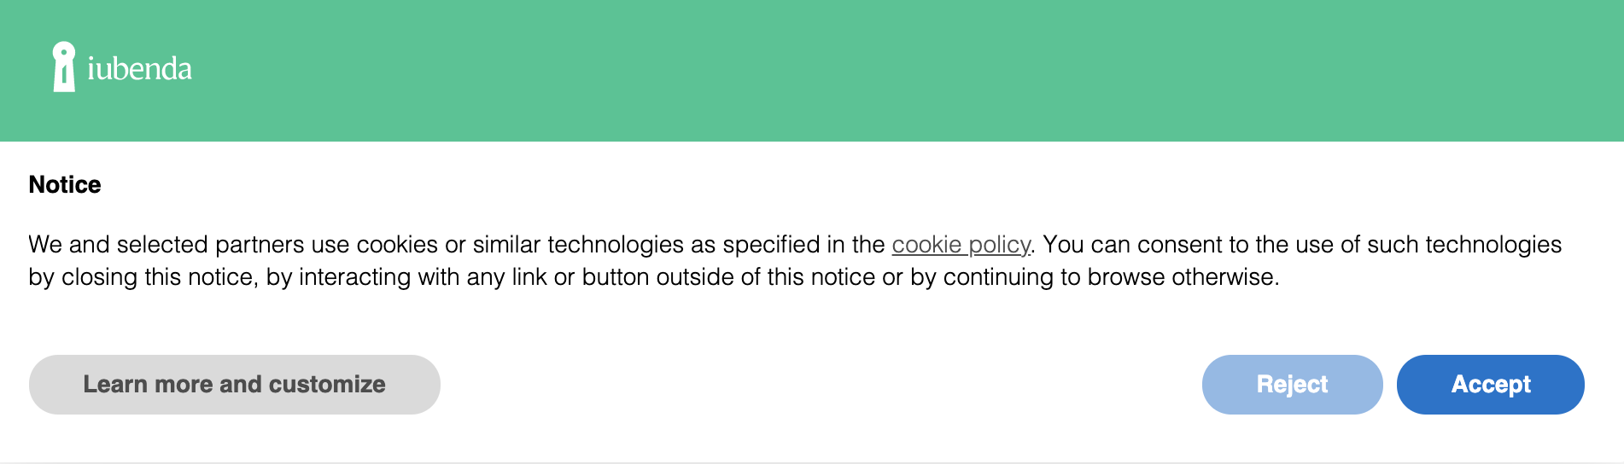
Security Requirements
Session Management
Session ID/Token, Cookies, JWT (Json web token)
Access Control
As a student, I can view my assignment grades on blackboard, but I cannot view other’s grades.
Data security:
All sensitive data need to be encrypted securely.
Disclaimers and Privacy Policies
Privacy policy statement, cookie clauses, etc https://www.iubenda.com/en/help/5525-cookies-gdpr-requirements
Abuser stories
As an attacker, I can view and modify any students’ grades.

Slide 39
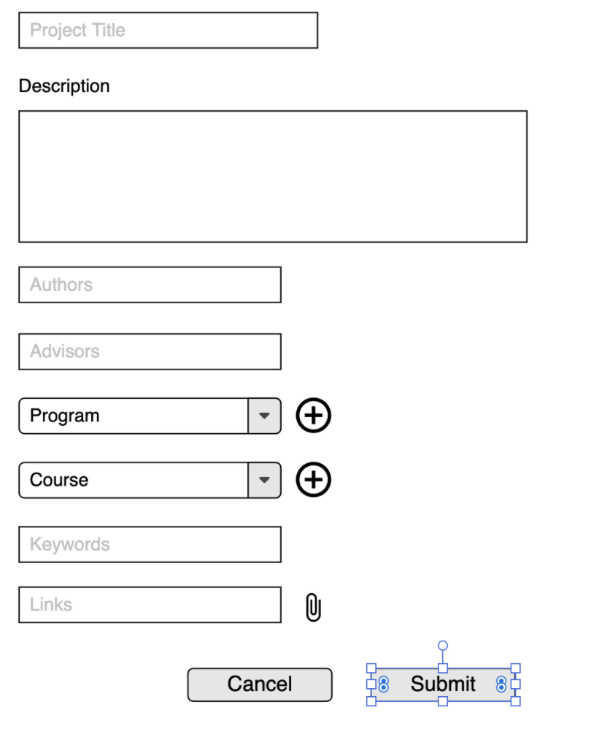
UI Mockups
Lo-Fi
Easy, fast
Convey the basic ideas.

Slide 40
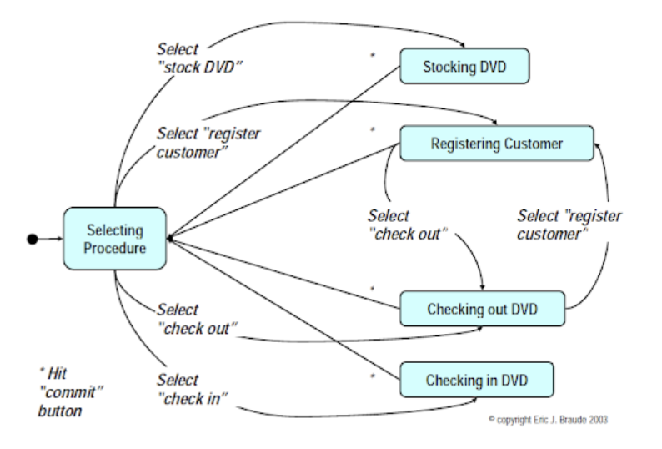
UI Flow
UI screens navigation
UI flow diagrams
State transition diagrams

Slide 41
Domain Objects
Use OOD
Identify domain classes/objects
Real world objects or concepts in the application
Bridge the gap between high-level requirements and design
The EBC Pattern
Entity: the persistent data and logic
Boundary: the interfaces
Control: the control tasks (actions)

Slide 42
Example
Entity: project, user, the ProjectPortal system,
Boundary: the addProject screen (including various text fields, dropboxes, and buttons)
Control: the addProject action

Slide 43
Example
On the CS673 blackboard course site, students can submit their completed assignment by clicking on the corresponding assignment. A new page will be displayed. Students can upload their files, write the comments, and click the Submit button to submit their assignments. Each assignment has a deadline. After the deadline, the instructor will grade each student’s submission by clicking on the corresponding submission and assigning a score. The instructor can also add comments or attach additional files as feedback for students.

Slide 44
Related User Stories
As a student, I want to submit my assignment so that the instructor can access my learning.
Acceptance tests:
Given I am logged into the blackboard as a student, and presented an assignment submission page of one of my courses, When I attach my assignment file, input some comments and click the submission button, Then a page is displayed to show my submission is completed and my assignment is done.

Slide 45
Related User Stories
As a student, I want to submit my assignment so that the instructor can access my learning.
As an instructor, I want to grade my students’ assignment submission, so that I can know how well they learn.

Slide 46
Identify ECB
Entity: CS673CourseSite, Student, Instructor, Assignment, AssignmentSubmission, Grade, File(Attachment)
Boundary: SubmissionPage, GradingPage,
Control: StudentSubmitAssignment, InstructorGradeAssignment

Slide 47
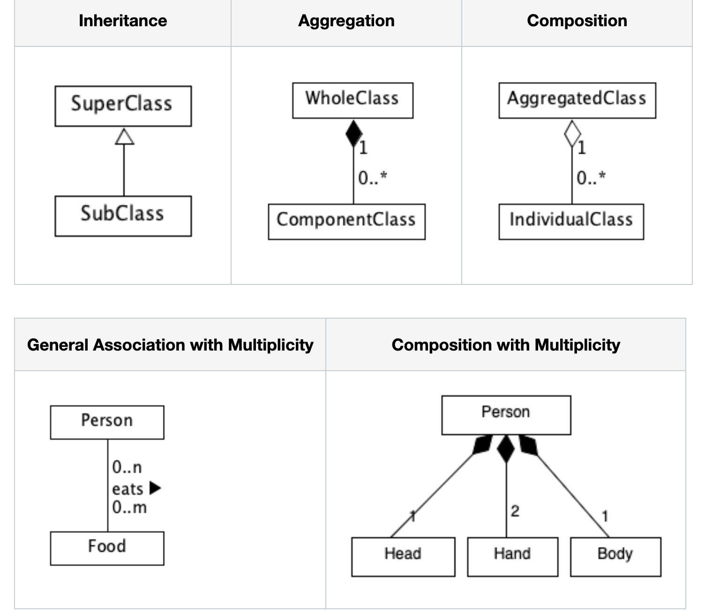
Class Diagrams
composition
Aggregation
A type of UML structure diagrams
Classes and their relationship
Class Relationships:
Inheritance
Composition
Aggregation
Association
Self association
Dependency

Slide 48
UML Tool
A simple tool recommended to use in this class is UMLet:
https://www.umlet.com/
The web-based UMLet can be accessed at
http://www.umletino.com/umletino.html
(It is quite easy to use. You can drag and drop and change the properties of a diagram in the properties panel. Be aware, a double click of a component in UMlet is to copy it, instead of select it)

Slide 49
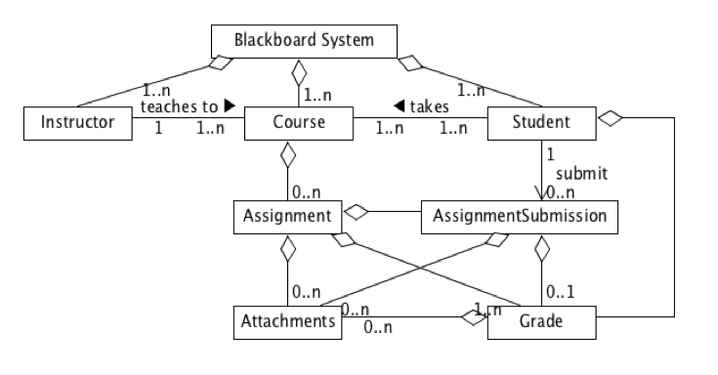
http://www.umlet.com/umletino/umletino.html

Slide 50
Questions?

