Slide 1
CS673 Software Engineering
Module 3: Software Design
BUMETCS
Yuting Zhang

Slide 2
Software Design
Application domain - > Solution domain
It is a representation/model of the software to be built.
It is usually in the form of a set of documents/diagrams, and should be easily translated to code by programmers
It includes
High-level design: software architecture
Upfront design + architecture refinement in Agile
Detailed design: a collection of classes/methods, algorithms, the database schema, design patterns, etc
May be blended with the implementation and testing in Agile

Slide 3
Design Goals
Sufficient to satisfy the requirements
Reduce the complexity
Flexible to handle changes
Strive for high quality:
Efficiency, reliability, security, maintainability, scalability, agility, etc
Trade-off among different quality characteristics
Check non-functional requirements

Slide 4
Trade-offs
Functionality vs. Usability
Security vs Usability
Cost vs. Robustness
Maintainability vs performance
Efficiency vs. Portability
Rapid development vs. Functionality
Cost vs. Reusability
Backward Compatibility vs. Readability
…

Slide 5
Software Architecture
Basic structure/organization
Use decomposition to reduce system complexity while allowing change
Decompose the system into subsystems (or components) with each implementing a set of functionalities and providing one or more services to other components.
Define components, environment, relationships, constraints, principles, etc.

Slide 6
Cohesion vs Coupling
Cohesion measures dependency among classes within the subsystem
High cohesion: The classes in the subsystem perform similar tasks and are related to each other via many associations
Low cohesion: Lots of miscellaneous and auxiliary classes, almost no associations
Coupling measures dependency among subsystems
High coupling: Changes to one subsystem will have high impact on the other subsystem
Low coupling: A change in one subsystem does not affect any other subsystem.

Slide 7
Cohesion vs Coupling
Cohesion measures dependency among classes within the subsystem
High cohesion: The classes in the subsystem perform similar tasks and are related to each other via many associations
Low cohesion: Lots of miscellaneous and auxiliary classes, almost no associations
Coupling measures dependency among subsystems
High coupling: Changes to one subsystem will have high impact on the other subsystem
Low coupling: A change in one subsystem does not affect any other subsystem.

Slide 8
Cohesion vs Coupling
Trade-offs
High cohesion within a subsystem: decompose a system into smaller subsystems,
Low coupling between subsystems: keep the total number of subsystems small.
Can use the hierarchical structure, with 3-5 top-level subsystems
Principle: separation of concern, single responsibility

Slide 9
Architecture Styles
Client server
P2P
MVC
Multi-layer and Multi-tier
SOA
Microservice
REST
Server-less
Components
Relationships
Interfaces
Constraints
Principles

Slide 10
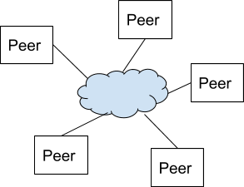

Client-Server vs P2P
Centralized vs distributed
Performance, scalability, reliability, security?

Slide 11
MVC
Separate the business logic and application data from the presentation data to the user.
Model: business logic and application data
View: presentation of model, UI.
Controller:
Intercept the request from view (UI) and pass to the model for proper actions.
Notify the views of the changes in the model.
Reusable and expressive.

Slide 12
MVC
Separate the business logic and application data from the presentation data to the user.
Model: business logic and application data (entity)
View: presentation of model, UI. (boundary)
Controller: (control)
Intercept the request from view (UI) and pass to the model for proper actions.
Notify the views of the changes in the model.
Reusable and expressive.

Slide 13
MVC
First implemented by Trygve Reenskaug at 1979 on Smalltalk at Xerox labs.
Used widely in both GUI and web applications now
Used in a lot of frameworks.
In GUI apps, the views and the controllers often work very closely together.

Slide 14
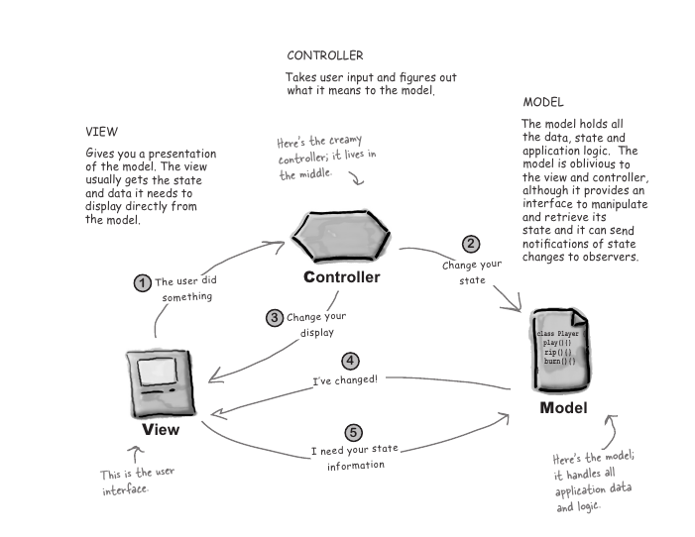
MVC
Original MVC.
The Model and the View can communicate with each other directly.
From “Head First Design Pattern”

Slide 15
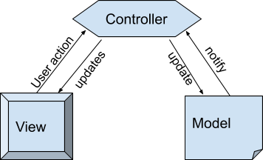
MVC
Modified MVC.
The controller is the mediator between the model and the view. Every communication between the model and the view needs to go through controller.
MVC song: https://www.youtube.com/watch?v=YYvOGPMLVDo

Slide 16
MVC vs MVP vs MVVM
View
View
View
*
Controller
Presenter
ViewModel
Model
Model
Model
MVC
MVP
MVVM

Slide 17
MVC in Web Applications
Model (Application domain data or business logic).
Often related to DB, knowing nothing about html or web server
View (UI)
Usually can query model to display, but not supposed to change model. Can be implemented using a template to render an html page
Control: (handle user actions)
Receives user requests and translate them into actions that model should take. It can also select appropriate view to handle the response. E.g. it can handle the incoming http requests. (e.g. common actions like authentication, session management)

Slide 18
MVC in Web Applications
Decouple model and view, so that the presentation is always independent of application data.
Decouple view and control so that the request made by the user can be independent of the resulting page.

Slide 19
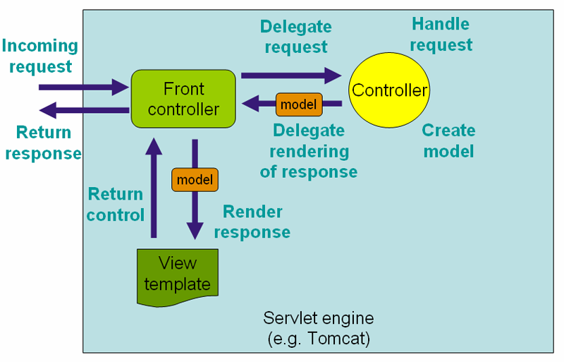
Spring Web MVC
http://docs.spring.io/spring/docs/current/spring-framework-reference/html/mvc.html

Slide 20
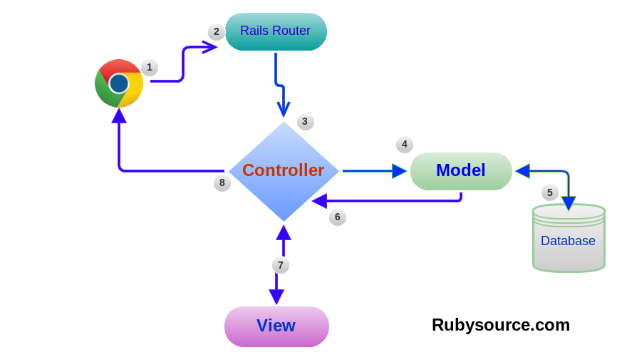
Ruby on Rail

Slide 21
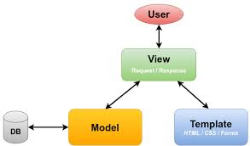
Django

Slide 22
Layered Architecture
Pros?
Cons?
Layer 4
Layer 4
Layer 3
Layer 3
Layer 2
Layer 2
Layer 1
Layer 1
Closed Layered Architecture
Open Layered Architecture

Slide 23
Layered Architecture
View
Client
Controller
Server
Model

Slide 24
Tiered Architecture
Client Presentation
A Layered architecture
Layers can be distributed on physically separated nodes.
Presentation
Server Presentation
Application
Application
Data
Data
A 3-tiered Architecture
A 4-tiered Architecture

Slide 25
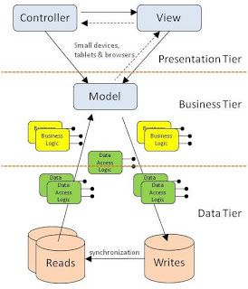
MVC + Layered/Tiered Architecture
http://criticaltechnology.blogspot.com/2011/10/mvc-in-three-tier-architecture.html

Slide 26
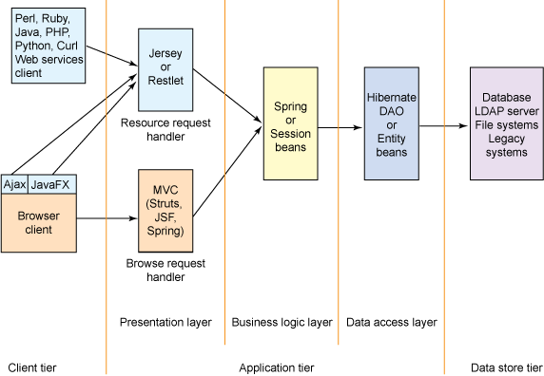
MVC + Layered/Tiered Architecture
http://www.ibm.com/developerworks/library/wa-aj-multitier/

Slide 27
SOA
Business logic or individual functions are modularized and presented as services for consumer/client applications.
Each service is a self contained, reusable, independent of implementation stack.
The services are exposed usually using standard interface
Reusability is an important design goal.
Target large applications at the enterprise level
Provides business automation and organizational agility

Slide 28
SoA (Thomas Erl)
Standardized service contract
Service loose coupling
Service abstraction
Service reusability
Service autonomy
Service statelessness
Service discoverability
Service composability

Slide 29
Microservices
Divide and Conquer at the all phases (design, implementation, deployment, operation)
Each service is single purpose and small can be independently developed and deployed in different environments and individually scaled.
An important design goal is the separation to achieve deployment flexibility, technology flexibility, and scalability.
https://www.youtube.com/watch?v=kq_0goMjKOs&list=PLqq-6Pq4lTTZSKAFG6aCDVDP86Qx4lNas&index=3
A good article about microservice: https://martinfowler.com/articles/microservices.html

Slide 30
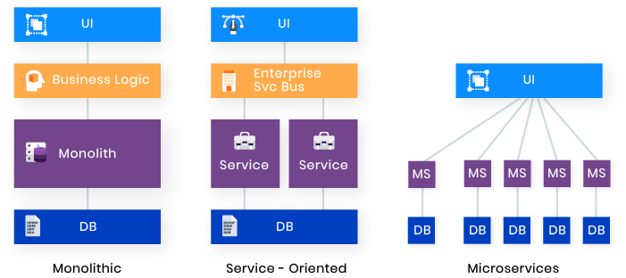
SOA vs Microservices
https://www.edureka.co/blog/microservices-vs-soa/
Best Architecture for an MVP: Monolith, SOA, Microservices, or Serverless?

Slide 31
REST
REST stands for Representational State Transfer
A software architecture style for Network based application
Defined by Roy Fielding
A system conform to REST constraints is RESTful system
It is typically used with HTTP and web services. Restful application uses HTTP to perform all CRUD operations.

Slide 32
REST
It is defined as a set of constraints
Client-server
Stateless (Server does not maintain state)
Uniform interface
Cacheable
Layered
Code on demand (optional)
https://restfulapi.net/rest-architectural-constraints/

Slide 33
REST
Give every resource a URI
/projects
/projects/11
Link them together through hyperlinks
Use standard HTTP operations (GET, POST, PUT, DELETE
All states should be either turned into resource states, or kept on the client.

Slide 34
Serverless Architecture
“No server side?”
Use third-party “Backend as a Service” (BaaS) services
Custom code run in managed, ephemeral containers on a “Functions as a Service” (FaaS) platform.

Slide 35
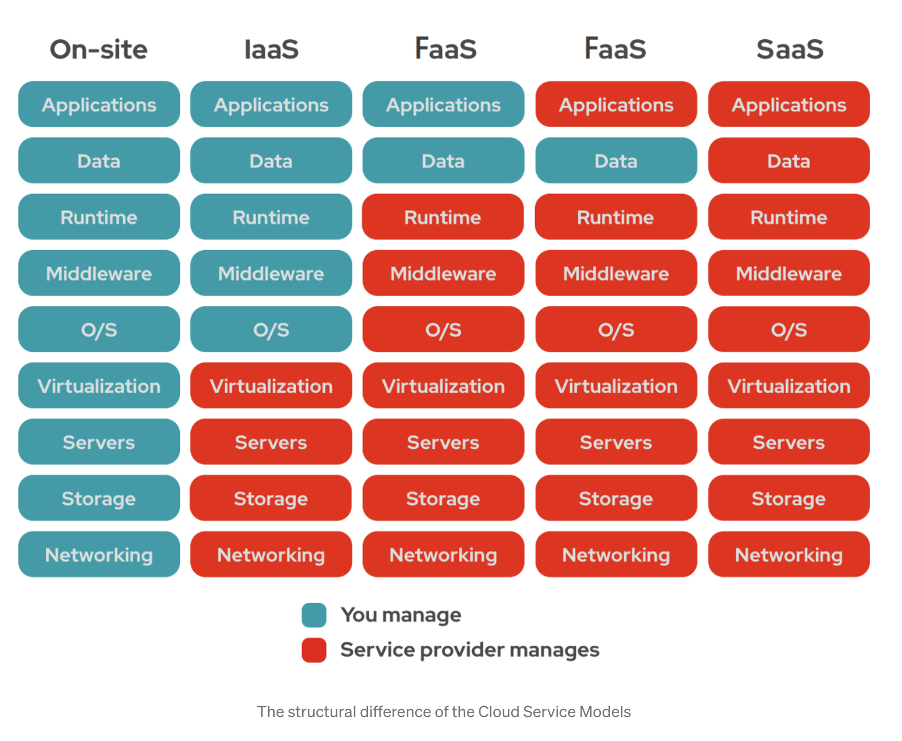
IaaS, PaaS, FaaS, SaaS
PaaS
https://pub.towardsai.net/what-are-cloud-iaas-paas-saas-faas-and-why-we-use-them-8af979dad141 (by Michelangiolo Mazzeschi)

Slide 36
Detailed Design
Focus on the internals in each subsystem.
Object Oriented design is usually used nowadays
Identify classes/objects and their relationships (UML tools)
Data/Database Design
Local or remote, centralized or distributed,
relational (ORMs) or non relational DB
Design Patterns
Improve reusability, flexibility, and maintainability
Algorithms
Focus on performance (efficiency, scalability, etc)
Security

Slide 37
OO Ways of Reuse
Inheritance
Access to the development products must be available
New functionality is obtained by inheritance
Composition
Access to models and designs is not available
New functionality is obtained by aggregation
The new object with more functionality is an aggregation of existing objects

Slide 38
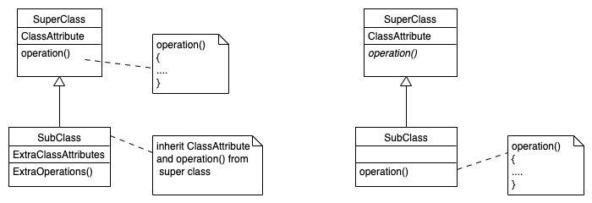
Inheritance

Slide 39
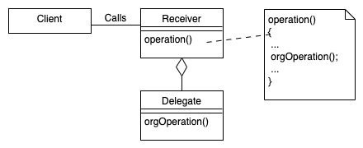
Composition

Slide 40
Inheritance
Implementation inheritance (class inheritance)
Both interface and implementation of methods in super class are inherited by subclass.
Goal: reuse functionalities already implemented in the existing class.
Specification inheritance (subtype)
Only interface is inherited
Goal: reuse specification, which is usually an abstract class with all operations specified, but not yet implemented.
Polymorphism

Slide 41
Example
I need a List class that can add or remove an element from the list. It may be implemented as an arraylist or a linked list.

Slide 42
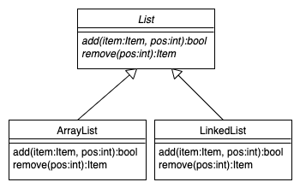
Example
I need a List class that can add or remove an element from the list. It may be implemented as an arraylist or a linked list.

Slide 43
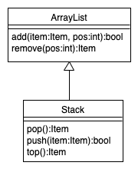
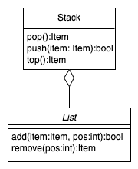
Example
I also want a Stack class which should have operations such as push(), pop(), top()). Should we use inheritance or composition to reuse the List class?
?

Slide 44
Example
I also want a Stack class which should have operations such as push(), pop(), top()). Should we use inheritance or composition to reuse the List class?

Slide 45
Example
I also want a Stack class which should have operations such as push(), pop(), top()). Should we use inheritance or composition to reuse the List class?
class Stack
{
List myList = new ArrayList();
Item pop(){
myList.remove(0);
}
void push(Item item) {
myList.add(item, 0);
}
}

Slide 46
Inheritance | Composition (Delegation)
Supported by many programming languages Support implementation reuse
More coupled. Exposes a subclass to details of its superclass Change in the parent class requires recompilation of the subclass. More efficient. Specification inheritance is more used to reuse interfaces. | Less coupled No need to access the details of the delegated class. It is easy to replace the delegated class to a different one Less efficient. Implementation reuse

Slide 47
Inheritance vs Composition
Specification inheritance provides better flexibility and extensibility.
New subclasses with different implementations can be easily added without changing existing code.
Implementation reuse through composition can provide better flexibility and extensibility than implementation inheritance.
The new code is less coupled with existing reused code.

Slide 48
Design Principles
Program to Interface, not Implementation.
Dependency inversion Principle: Depend on abstractions.
High level modules should not depend upon low level modules.
Favor composition over inheritance for implementation reuse.
Liskov Substitution Principle: subclasses should be substitutable for their base classes. If an object of type S can be substituted in all the places where an object of type T is expected, then S is a subtype of T.

Slide 49
Design Principles
Open-closed principle: Classes should be open for extension but closed for modification.
Limit the number of classes to interact: the effect of changes can be limited.
Interface segregation principle: Split a general purpose interface into multiple independent ones. This can reduce the side effects and frequency of required changes.
Inversion of Control - Hollywood Principle
Don't call us, we'll call you

Slide 50
SOLID
Single responsibility principle
Open–closed principle
Liskov substitution principle
Interface segregation principle
Dependency inversion principle

Slide 51
Design Patterns
High level ideas on how to structure classes and objects to solve certain problem. We need write our own code to adopt those patterns.
Provide a shared vocabulary
Framework and libraries are not design patterns, but are specific implementations that can be used in our code. However, they may make use of design patterns in their implementations.

Slide 52
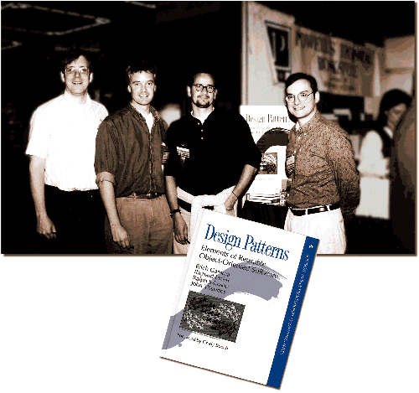
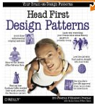
Design Patterns
From left to right: Ralph Johnson, Richard Helm, Erich Gamma, and John Vlissides. (Gang of Four)

Slide 53
MVC Related Patterns
Compound design pattern
Observer Pattern
Strategy Pattern
Composite Pattern

Slide 54
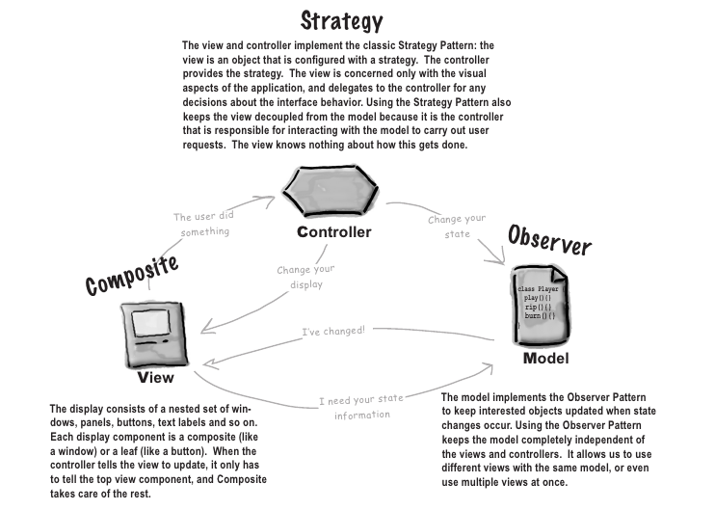

Slide 55
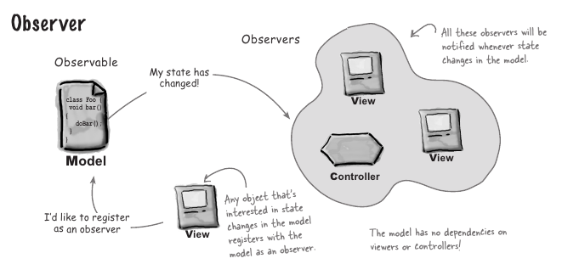

Slide 56
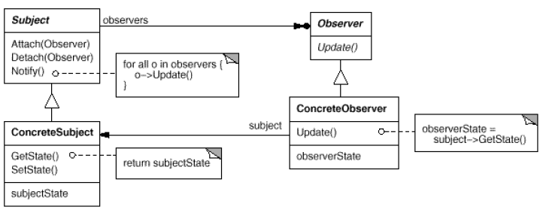
Observer

Slide 57
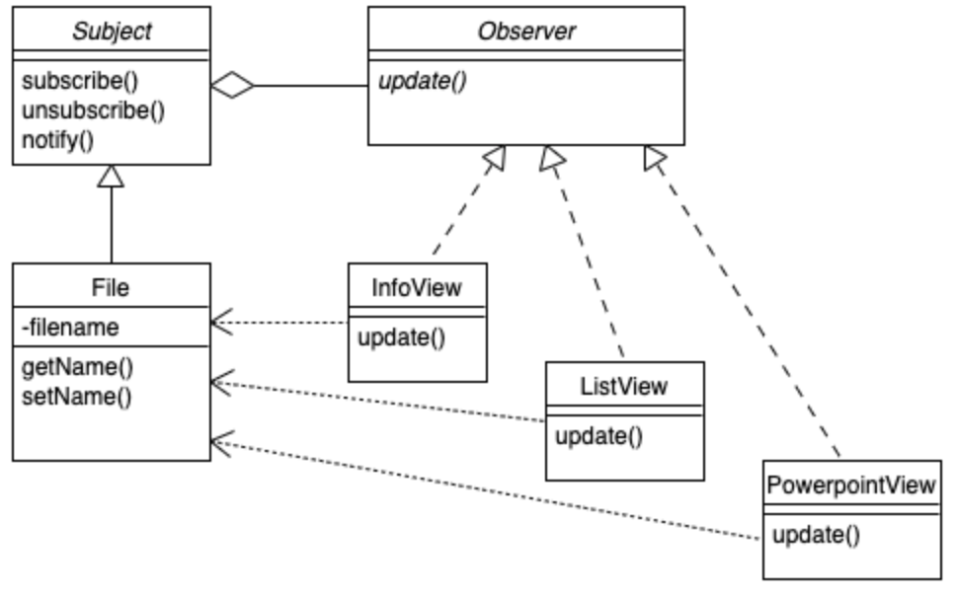
Observer

Slide 58
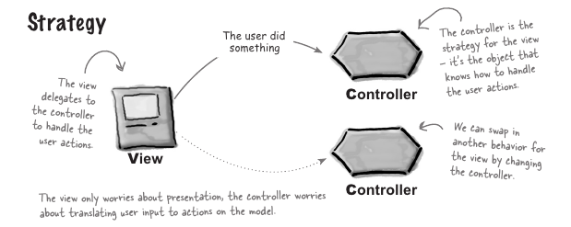

Slide 59
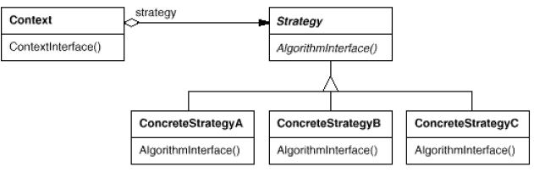
Strategy

Slide 60
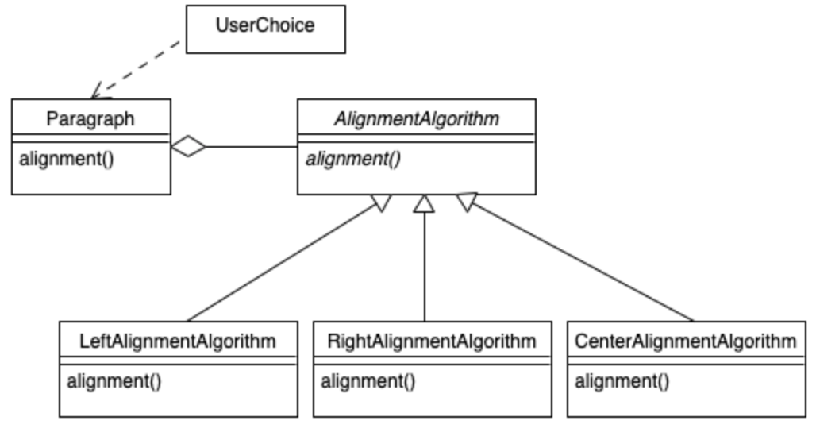
Strategy

Slide 61
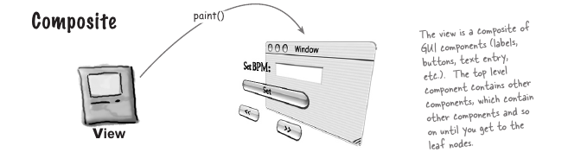

Slide 62
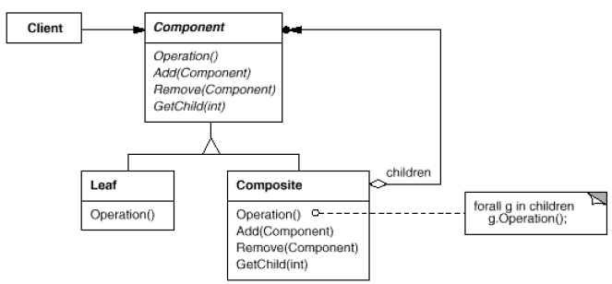
Composite

Slide 63
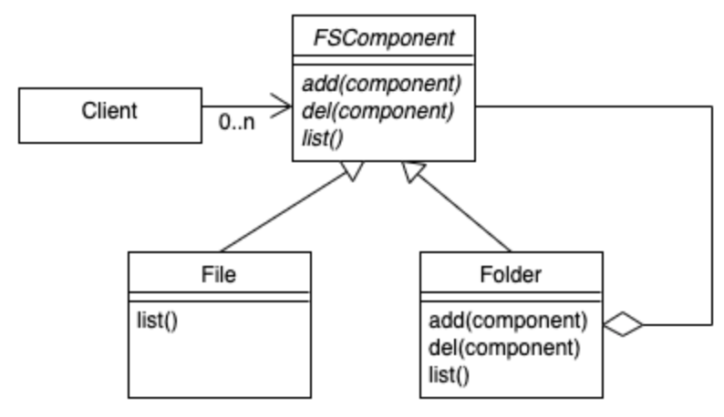
Composite
changeOwner()

Slide 64
Design Patterns
Creational: related to class instantiation or object creation.
Structural: Related to the class organization and structure
Composite
Behavioral: related to the object behavior and interaction
Observer
Strategy

Slide 65
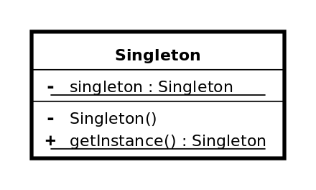
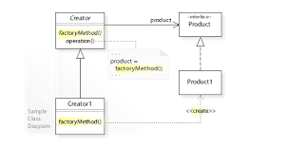
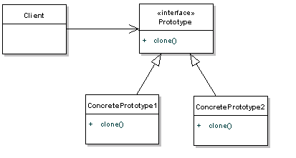
Other Design Patterns
Creational patterns:
Factory method: create objects without specifying the exact class to create.
Prototype: create objects by cloning an existing object.
Singleton: only create one instance for a class

Slide 66
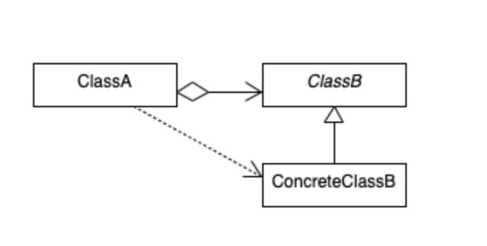
Dependency Injection
Dependency is injected by the external object.
Suppose A is dependent on B (A uses some method of B), instead of creating B object(the dependent object), A simply receives the B object from outsides through a parameterized constructor, or setter or other interface, and then directly use it.
https://www.youtube.com/watch?v=IKD2-MAkXyQ
class A {
B b;
A (ConcreteB b) {
This.b = b;
}
foo () {
...
b.hi();
...
}
}

Slide 67
Design Patterns
Pros?
Cons?

Slide 68
An Example
Suppose we need to create a file system and a file browser application. Which design pattern can be used in each of the following scenarios:
A folder can consist of files or folders. When you change the owner of a folder, it also changes the owner of all files or folders in that folder.
We want to encrypt the file using different encryption algorithms dynamically based on the user’s choice in the run time.
A user may open multiple file browser windows. If the user changes the file name in one window, its name will be automatically changed in another window.

Slide 69
Security Design
Security principles applied in design
Architecture risk analysis:
All components and their communication, dependencies, technology, frameworks, environment, ...
Attack pattern, attack surface, threat modeling (e.g. STRIDE)

Slide 70
Security Principles - Restrictiveness
CSEC 2017 (Cybersecurity Curricular Guideline) proposes 14 design principles in three categories.
Least Privilege: just enough privileges to complete the task
Fail-safe defaults/fail securely: deny access by default unless explicitly grant
Complete mediation: validate every access
Separation (of domains/duties): should not grant access to a resource or take a security relevant action, based on a single condition.
Minimize trust (Reluctance to trust): check all inputs and all security relevant actions.

Slide 71
Security Principles - Simplicity
Economy of Mechanism
Security features should be as simple as possible
Least Common Mechanism
The sharing of resources should be reduced as much as possible
Least Astonishment
security features of software, and security mechanisms it implements, should be designed so that their operation is as logical and simple as possible.

Slide 72
Security Principles - Methodology
Open Design
security of software, and of what that software provides, should not depend on the secrecy of its design or implementation.
Layering
modules at a given layer interact only with modules in the layers immediately above and below it. reduce access points, enforcing the principle of separation
Abstraction
hide the internals of each layer, making only the interfaces available, this enables you to change how a layer carries out its tasks without affecting components at other layers.
Modularity
software as a collection of cooperating components(modules), each module interface is an abstraction.
Complete linkage
security design and implementation link to the security specification
Design for iteration
plan the design in such a way that it can be changed, if needed.

Slide 73
Security Principles - Others
Defense in depth
Find the weakest link
Audit sensitive events
Fix security issues correctly

Slide 74
Questions?

