Slide 1
CS673 Software Engineering
Module 4: Refactoring and Testing
BUMETCS
Yuting Zhang
Yuting Zhang

Slide 2
Questions
Why need testing?
What does the 100% test pass rate indicate?
How to evaluate the testing process?

Slide 3
Why Need Testing
To validate if the requirements are met
To detect fault/error/defects
Provoke failures in a planned way.
It is impossible to completely test any nontrivial module or system
Practical limitations: Complete testing is prohibitive in time and cost
Theoretical limitations: e.g. Halting problem
“Testing can only show the presence of bugs, not their absence” (Dijkstra).
Testing is not for free. Need to decide the scope of testing
Cost vs Benefit (efficiency and effectiveness)
Automatic and manual testing

Slide 4
Software Testing Definition
Software testing is an empirical technical investigation conducted to provide stakeholders with information about the quality of the product or service under test.(By Cem Kaner, FIT, wikipedia)
(http://www.testingeducation.org/BBST/ )

Slide 5
Test Plan
What to test? (scope, types)
To what extent to test?
Who should test?
When to test?
How to test? (input, oracle)
Resources, Metrics, Documents
Risk management

Slide 6
Test Early, Test Often
Test Driven Development:
Test – design – test – implementation - test
Red– Green – refactor
Regression Test: retest when changes are made
To assure that the code added/altered since the last test has not comprised the functionality that was present before the changes were made.
Retest dependent components
Always remember there are trade-offs.
Retest risky use cases
Retest frequent use cases
Need automated testing infrastructure

Slide 7
When to Finish?
When tester has not been able to find another defect in 5 (10? 30? 100?) minutes of testing
When all nominal, boundary and out-of-bounds test examples show no defect
When a given checklist of test types has been completed
After completing a series of targeted coverage (e.g., branch coverage for unit testing)
When testing runs out of its scheduled time

Slide 8
Types of Testing
Unit Testing
Individual components ( a class or subsystem)
Goal: Confirm that the component or subsystem is correctly coded and carries out the intended functionality
Integration Testing
Groups of subsystems (collection of subsystems) and eventually the entire system
Goal: Test the interfaces among the subsystems and interactions of the subsystems.
Feature testing

Slide 9
Types of Testing
System Testing
The entire system (on test bed)
Goal: Determine if the system meets the requirements (functional and nonfunctional)
Acceptance Testing
The entire system delivered (on the final platform)
Carried out by the client. May involve executing typical transactions on site on a trial basis
Goal: Demonstrate that the system meets the requirements and is ready to use.

Slide 10
Types of Testing
Functional Testing
The entire system (on test bed)
Goal: Determine if the system meets the functional requirements
Nonfunctional Testing
Usability testing
Scalability testing
Security testing
Stress testing
Timing testing
...

Slide 11
Types of Testing
Regression Testing
Performed after changes. Can be applied at the different levels.
Goal: Determine if changes introduces new bugs.
Automatic Testing vs Manual Testing
Manual testing is usually at the system level
Automatic Testing is usually at the unit level. It can also be performed the system level.
Pros and Cons?

Slide 12
Types of Testing
API testing
Installation testing
Smoke testing
Release testing
...

Slide 13
Test Cases
A Test case includes
Setup (Given), Input (When), Expected output (or Oracle) (Then), and log
Driver:
A component, that calls the UnitToTest
Controls test cases
Stub:
A component, the UnitToTest depends on
Partial implementation
Returns fake values.
Use the driver and the stub to separate the UnitToTest from the system
driver
UnitToTest
stub

Slide 14
Test Cases
class TestMyCalculator (unittest.TestCase):
def setUp(self):
self.myCal = MyCalculator()
def test_add(self):
assert self.myCal.cal(2,"+", 3) == 5, “test add”
def test_sub(self):
assert self.myCal.cal(3, "-", 2) == 1, “test sub”

Slide 15
Test Case Report
Test case ID, name
Test items: (what do you test )
Test priority (high/medium/low)
Dependencies (to other test cases/requirements if any):
Preconditions:
The input data:
Test steps:
Postconditions:
Expected output:
Actual output:
Pass or Fail:
Bug id/link: (this may link to your github issue id)
Additional notes:

Slide 16
Testing Tools
Junit: a Java unit testing framework
Unittest,PyUnit: a Python unit testing framework
Jest: a Javascript testing framework
Abbot: a Java GUI testing Framework.
Selenium: a portable software testing framework for web applications.
Visual studio: build-in automated testing feature

Slide 17
TDD
Test driven development
Started in XP, evolve over time. (Kent Beck)
Test first before implementation
Test drives design
design
implementation
test
design
test
implementation

Slide 18
TDD
Test often
design
test
implementation
test
design
test
test
implementation

Slide 19
TDD
Test often
design
test
implementation
test
Write test Code and necessary production code stubs to Fail the Test
test
test
Complete the production code to just make the test pass.

Slide 20
TDD Workflow
RED: understand the requirements and create an automated test that defines input and the expected output. The new test will fail because the requirement haven't been implemented.
GREEN: write code (experiment/prototype/build) to pass the test. The code is only designed to pass the test.
Refactor: clean up the code, remove duplicates (DRY: do not repeat yourself), change code structure without affecting the existing functionality. Make code more readable, maintainable etc. Rerun all tests and shall pass all.
After refactoring, always perform regression testing.
Repeat for each new test.

Slide 21
3 Rules
Described by Uncle Bob.
You are not allowed to write any production code unless it is to make a failing unit test pass.
You are not allowed to write any more of a unit test than is sufficient to fail, and compilation failures are failures.
You are not allowed to write any more production code than is sufficient to pass the one failing unit test
Refactored by Javier Saldana
Write only enough of a unit test to fail.
Write only enough production code to make the failing unit test pass.

Slide 22
Benefits
Improved quality
Less time debugging - lower cost
Cleaner code
Better design - initially and continually
Documented by example
Automated test: write once - run many times
Junit, unit, TestNG
Unit test: isolate code

Slide 23
Problems
“TDD is dead” by David Heinemeier Hansson: http://david.heinemeierhansson.com/2014/tdd-is-dead-long-live-testing.html
“Is TDD dead?” Discussion by David, Kent Beck and Martin Fowler. http://martinfowler.com/articles/is-tdd-dead/
When should and when shouldn’t?

Slide 24
Example
http://www.jamesshore.com/Blog/Lets-Play/Lets-Play-Test-Driven-Development.html
The Triangle Problem: the classical software testing problem since 1969.
The program reads three numbers as the sides of a triangle, and states whether the triangle is scalene, equilateral , or isosceles.

Slide 25
BDD
Behavior Driven Development
Test first
Testing actual behavior from the end user perspective
Cucumber: a BDD framework
https://cucumber.io/
Use the Given, When and Then format
Use ubiquitous language
Can map to acceptance tests well.

Slide 26
Example
We will practice TDD to implement a file system.
Since a folder can have subfolders or normal files inside it. When we change the owner of a folder, the owner of all folders and files inside it will also be changed (composite)
Suppose we have two different views: infoview and detailed view. When a filename is changed, both views should be updated. (Observer)
Suppose we can encrypt a file with different encryption methods based on the user choice or current context. (Strategy)

Slide 27
Implementation
Programming Languages: Java, Python, Ruby, Javascript, C#, C++/C, Objective C, Kotlin, Swift, Go,...
Frameworks: spring (boot), flask, django, ruby on rail, node.js, jquery, angular, react, …
Coding standards
Naming conversion
Indentation, space, curly brackets
comments
File/package organization
...

Slide 28
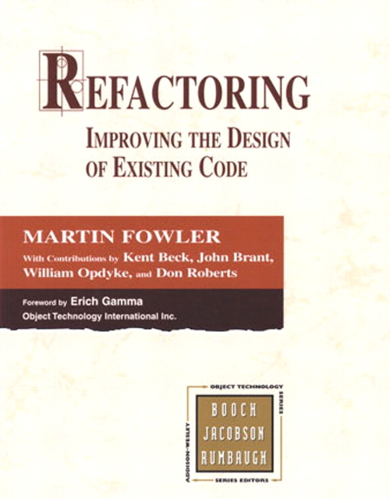
Code Smells and Refactoring
http://martinfowler.com/books/refactoring.html
http://sourcemaking.com/refactoring/

Slide 29
Refactoring
Refactoring: a change made to the internal structure of software to make it easier to understand and cheaper to modify without changing its observable behavior
Refactor: to restructure software by applying a series of refactorings without changing its observable behavior.
Refactor constantly, particularly when add new a function, fix a bug, or do a code review.
Challenging: may introduce new bugs
To minimize new bugs, (regression) testing is the key

Slide 30
Why?
Improve design
Eliminate duplicate code – easier to modify
Easier to understand
Help find bugs
Help program faster
Make code more beautiful! Get rid of code smells!

Slide 31
Problems
Databases change/data migration
Add a separate layer of software between object model and database model
Interfaces change
Leave both old and new interfaces first, let old call new.
Have superclass
Poor design
Trade-offs between refactorings and the upfront design

Slide 32
When Not?
When it is easier to rewrite from scratch.
e.g. code full of bugs
Make decision on single components.
Too close to a deadline.

Slide 33
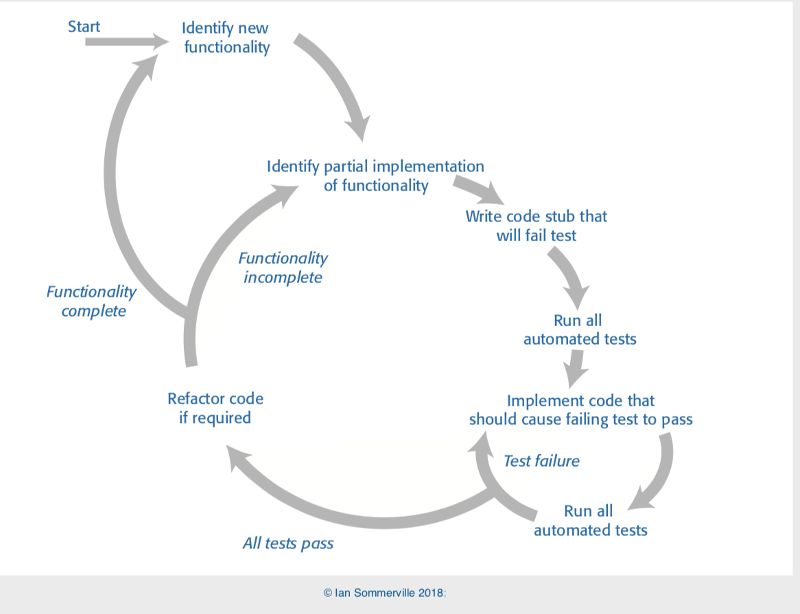
Agile Workflow

Slide 34
Principles
KISS: Keep It Stupid Simple
DRY: Don’t Repeat Yourself
SOLID:
Single responsibility principle
Open–closed principle
Liskov substitution principle
Interface segregation principle
Dependency inversion principle

Slide 35
Code Smells
Bloaters (increased complexity)
Long Method
Large Class
Primitive Obsession
Long Parameter List
Data Clumps
OO Abusers
Switch Statements
Temporary Field
Refused Bequest
Alternative Classes with Different Interfaces
https://sourcemaking.com/refactoring/smells

Slide 36
Code Smells
Change Preventers
Divergent Change
Shotgun Surgery
Parallel Inheritance Hierarchies
Dispensables (unnecessary)
Comments
Duplicate Code
Lazy Class
Data Class
Dead Code
Speculative Generality

Slide 37
Code Smells
Couplers (excessive coupling or delegation)
Feature Envy
Inappropriate Intimacy
Message Chains
Middle Man

Slide 38
Code Smells
Couplers (excessive coupling or delegation)
Feature Envy
Inappropriate Intimacy
Message Chains
Middle Man
Avoid code smells when writing new code
Constantly refactor existing code to get rid of code smells

Slide 39
Fowler's Refactoring Taxonomy
Composing Methods
Moving Features Between Objects
Organizing Data
Simplifying Conditional Expressions
Making Method Calls Simpler
Dealing with Generalization
Big Refactoring

Slide 40
Composing Methods
Extract/Inline Method
Inline temp (remove a temporary variable)
Replace temp with query/function
Introduce explaining variable (to replace complicated expression)
Split temporary variable (that is used for multiple purposes)
Remove assignments to parameters (introduce temp var)
Replace method with method object
Substitute algorithm

Slide 41
Move Features Between Objects
Move method/field
Extract class/Inline class
Hide delegate/Remove middleman
Introduce foreign method / Introduce local extension (for library class)

Slide 42
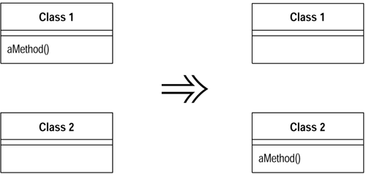
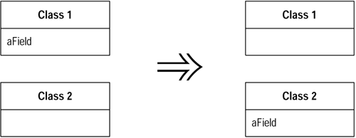
Move Method/Field

Slide 43
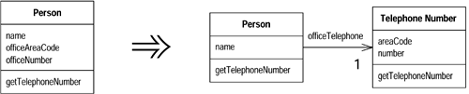
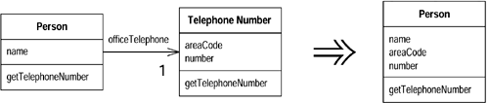
Extract/Inline Class

Slide 44
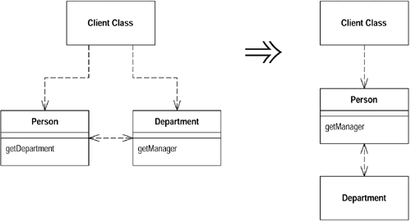
Hide Delegates/Remove Middleman

Slide 45
Organizing Data
Self Encapsulate Field
Replace Data Value with Object (for when basic types aren't enough)
Change Value To/From Reference
Replace Array with Object
Duplicate Observed Data
Change Bidirectional Association to/from Unidirectional
Replace "magic numbers" with Symbolic Constants
Encapsulate Field/collection (accessor methods for private variables)
Replace Record with Data Class (hide database implementation)
Replace Type Code with Class/Subclass
Replace Type Code with State/Strategy
Replace subclass with fields

Slide 46
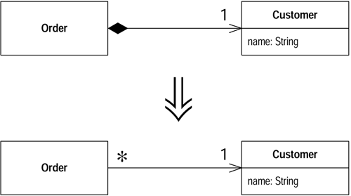
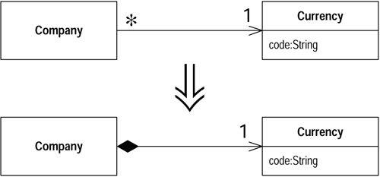
Change Value to/from Reference

Slide 47
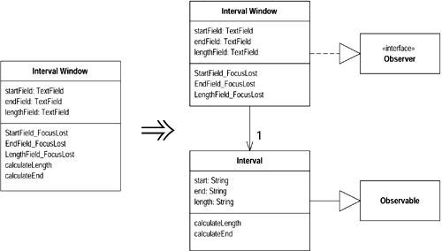
Duplicate Observed Data

Slide 48
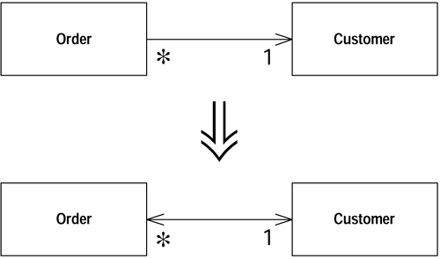
Change Unidirectional Association to/from Bidirectional

Slide 49
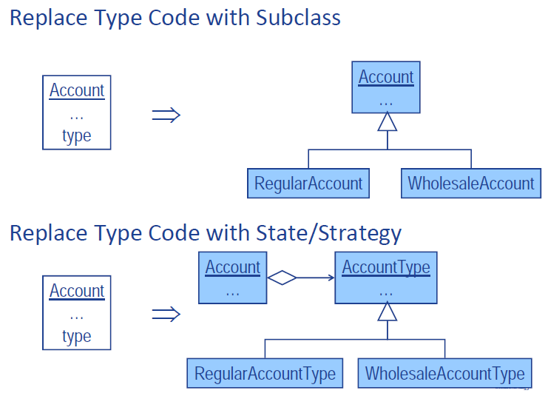
Replace Type Code

Slide 50
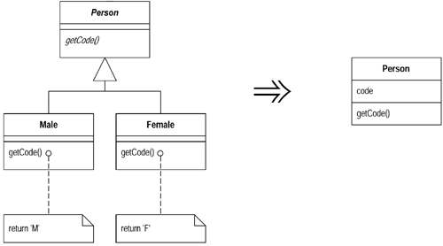
Replace Subclass with Fields

Slide 51
Organizing Data
Data vs Objects: when data is associated with certain operations, use object instead.
Array vs Object: an array contains save type of data and an object can contain different types of data
Value vs Reference: use value objects for infrequently changed data, while reference objects are easier to change.
Unidirectional vs bidirectional: when both classes need to be aware of each other, use bidirectional association. Otherwise, use unidirectional.
Single value vs collection: when dealing with collections, use add() or remove() methods instead of simple getter or setter methods.

Slide 52
Simplifying Conditional Expression
Decompose/consolidate conditional expression
Consolidate duplicate conditional fragments
Remove control flag (use break/return)
Replace nested conditional with guard clauses (which either returns or throws an exception)
Replace conditional with polymorphism
Introduce null object
Introduce assertion

Slide 53
Replace Conditional with Polymorphism
double getSpeed() {
switch (_type) {
case EUROPEAN:
return getBaseSpeed();
case AFRICAN:
return getBaseSpeed() - getLoadFactor() * _numberOfCoconuts;
case NORWEGIAN_BLUE:
return (_isNailed) ? 0 : getBaseSpeed(_voltage);
}
throw new RuntimeException ("Should be unreachable");
}

Slide 54
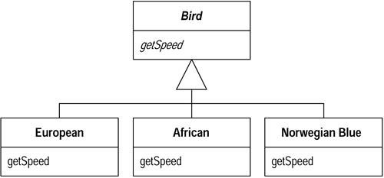
Replace Conditional with Polymorphism

Slide 55
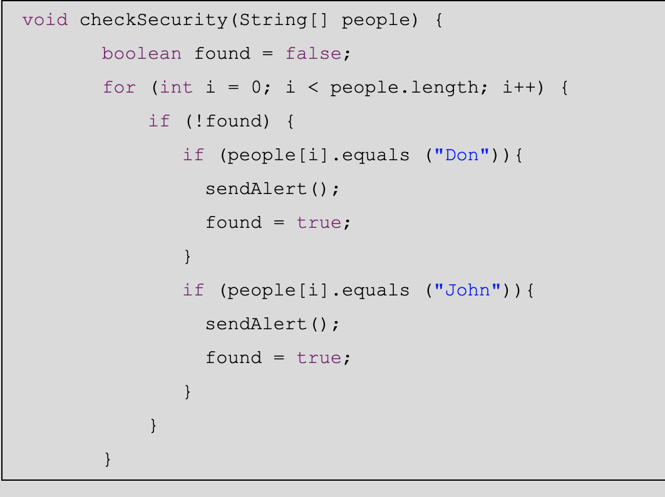
Refactor Conditional Statements

Slide 56
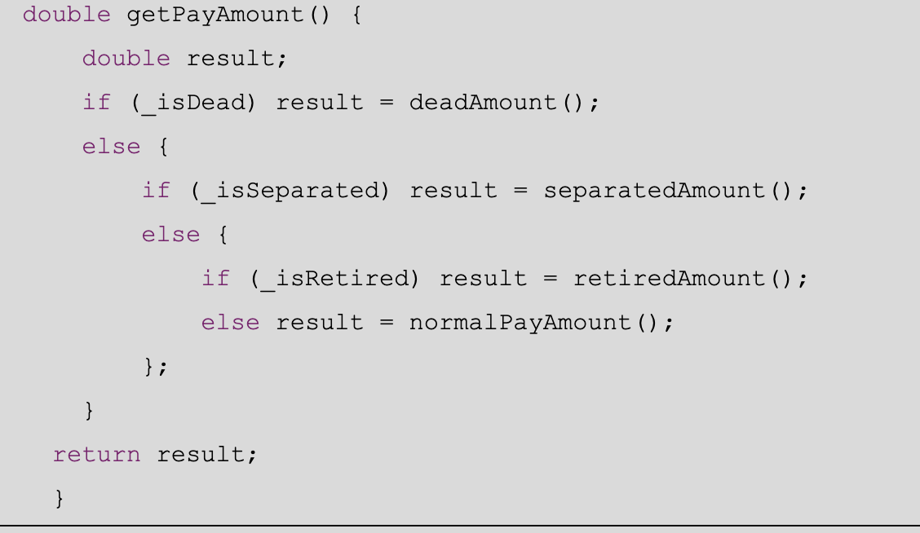
Refactor Conditional Statements

Slide 57
Making Method Calls Simpler
Rename method
Add/remove parameter
Parameterize method / Replace parameter with explicit methods
Preserve whole object / Introduce parameter object
Replace parameter with method (receiver invoke the method)
Remove setting method
Separate query from modifier
Hide method
Replace constructor with factory method
Encapsulate downcast
Replace error code with exception / Replace exception with test

Slide 58
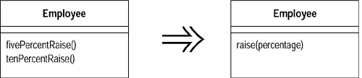
Parameterize Method

Slide 59
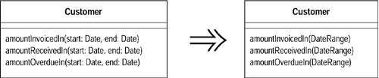
Introduce Parameter Object

Slide 60
Dealing with Generalization
Pull Up/push down Field
Pull Up/push down Method
Pull up constructor body and replace with super()
Extract Subclass/Superclass
Extract Interface
Collapse Hierarchy
Form Template Method
Replace Inheritance with Delegation and vice versa

Slide 61
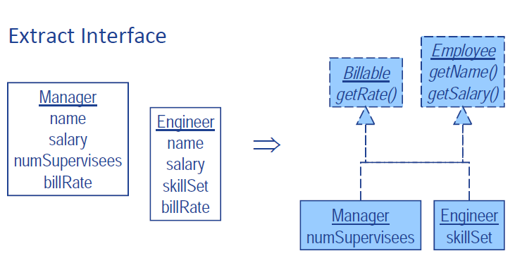

Slide 62
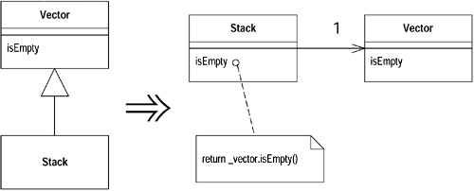
Replace Inheritance with Delegation

Slide 63
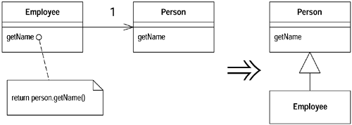
Replace Delegation with Inheritance

Slide 64
Big Refactorings
Tease Apart Inheritance
Clean up class inheritance to have a simpler inheritance model
Convert Procedural Design to Objects
Introduce classes to a procedural function
Separate Domain from Presentation
Separate presentation layer from data/function layer
MVC/Observer pattern
Extract Hierarchy
When a new extended hierarchy is needed.

Slide 65
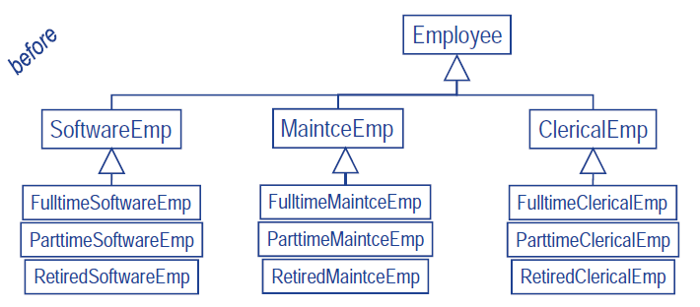
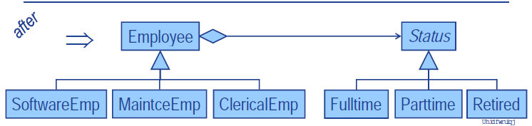
Tease Apart Inheritance

Slide 66
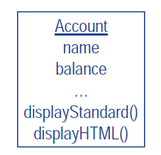
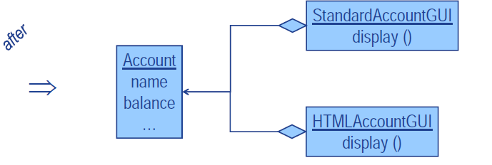
Separate Domain from Presentation

Slide 67
Fowler's Refactoring Taxonomy
Composing Methods
Moving Features Between Objects
Organizing Data
Simplifying Conditional Expressions
Making Method Calls Simpler
Dealing with Generalization
Big Refactorings

Slide 68
Regression Testing & Refactoring
Refactoring should be performed together with regression testing
Regression testing should be performed when there is any change to the existing code
Regression testing is one type of testing.
Automated testing is very important
Testing tools and frameworks need to used.

Slide 69
Questions?

Slide 70


Junit
An open source Java framework for writing and running unit tests written by Kent Beck and Erich Gamma
Written with “test first” and pattern-based development in mind
Tests written before code
Allows for regression testing
Facilitates refactoring
Junit test: www.junit.org.
Particular FAQ section
Javadoc for Junit
Two classic books on Junit:
Junit Recipes (J.B. Rainsberger, Scott Stirling, Manning publications)
Junit in Action (Vincent Massol and Ted Husted, Manning publications)
Notes:
Kent Beck is the creator of Extreme programming and Erich Gamma is a coauthor of the “design patterns” book.

