Slide 1
CS673 Software Engineering
Module 5: More on Analysis and Testing
BUMETCS
Yuting Zhang
Yuting Zhang

Slide 2
UML Tools
UML: Unified Modeling Language
Developed by three amigos (Grady Booch, James Rumbaugh, and Ivar Jacobson) for the Unified Process framework.
Use to model the software in both requirement analysis and design phases.
UML diagrams attempt to visualize the software.

Slide 3
UML Diagrams
Structure Diagrams: Class Diagram, Object Diagram, Component Diagram, Composite Structure Diagram, Package Diagram, Deployment Diagram.
Behavior Diagrams: Use Case Diagram (used by some methodologies during requirements gathering); Activity Diagram, and State Machine Diagram.
Interaction Diagrams: Sequence Diagram, Communication Diagram, Timing Diagram, and Interaction Overview Diagram.
Reference: https://www.uml-diagrams.org/uml-25-diagrams.html

Slide 4
Use Case Model
A set of all use cases that completely describe the functionality of the system.
Functional Model: represent external behavior (“visible from the outside of the system”)
A use case diagram
actors: external entities (users or other systems)
Use cases
Their relationships
The system boundary
Use case text descriptions

Slide 5
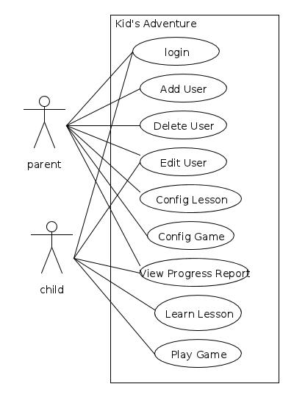
An Example
Name: Add User
Participator Actor: Parent
Entry Condition: Parent is successfully logged in
Exit Condition:
New user added or Error Message
Flow of Events:
Parent clicks the “Add User ” button
System displays an “add user” form
Parent fills in the username, age and chooses a picture for the user
Parent clicks the submit button
System displays a message to show that the user is successfully added or an error message.

Slide 6
Another Example
Name: Withdraw Money Using ATM
Initiating actor: Bank Customer
Entry condition:
Bank Customer has opened a Bank Account with the Bank and
Bank Customer has received an ATM Card and PIN
Exit condition:
Bank Customer has the requested cash or
Bank Customer receives an explanation from the ATM about why the cash could not be dispensed

Slide 7
Flow of Events
Actor steps | System Steps
1. Bank Customer inputs the card into the ATM. 3. Bank Customer types in PIN. 5. Bank Customer selects an account. 7. Bank Customer inputs an amount. | 2.ATM requests the input of a four-digit PIN. 4. If several accounts are recorded on the card, the ATM offers a choice of the account numbers for selection by the Bank Customer 6.If only one account is recorded on the card or after the selection, the ATM requests the amount to be withdrawn. 8. ATM outputs the money and a receipt and stops the interaction.

Slide 8
Invalid Cases
Actor steps | System Steps
1. Bank Customer inputs the card into the ATM. 3. Bank Customer types in PIN. 5. Bank Customer selects an account. 7. Bank Customer inputs an amount. | [Invalid card] The ATM outputs the card and stops the interaction. [Invalid PIN] The ATM announces the failure and offers a 2nd try as well as canceling the whole use case. After 3 failures, it announces the possible retention of the card. After the 4th failure it keeps the card and stops the interaction. [Amount over limit] The ATM announces the failure and the available limit and offers a second try as well as canceling the whole use case.

Slide 9
Alternative Flow
1a. Customer inserts an invalid card. The ATM outputs the card and stops the interaction.
3a. Customer inputs an invalid pin. The ATM announces the failure and offers a 2nd try as well as canceling the whole use case. After 3 failures, it announces the possible retention of the card. After the 4th failure it keeps the card and stops the interaction.
7a. Customer inputs the amount that exceeds the limit. The ATM announces the failure and the available limit and offers a second try as well as canceling the whole use case.

Slide 10
Relationships
Communication Relationship
To represent the information exchange between actors and use cases.
Includes Relationship
To represent functional behavior common to more than one use case.
Extends Relationship
To represent seldom invoked use cases or exceptional functionality
Inheritance Relationship
One use case/actor can specialize another more general one.
Help to reduce the complexity
include
(A includes B)
A
B
included case
extend
(B extends A)
A
B
extending case
(B inherits from A)
A
B

Slide 11
Relationship
Includes:
Decompose a complex use case into several smaller use cases
The reusable functionalities can also be factored out
The Includes relationship is specified in the including use case.
Extends:
The exceptional event flows are factored out of the main event flow for clarity.
Use cases representing exceptional flows can extend more than one use case.
The Extends relationship is specified in the extending use case.

Slide 12
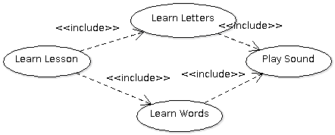
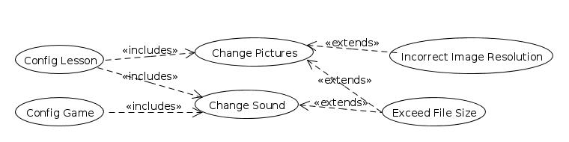
Examples

Slide 13
Inheritance
Problem: We want to factor out some common (but not identical) behavior.
Solution: The child use cases inherit the behavior and meaning of the parent use case and add or override some behaviors.
Example: “ValidateUser” is responsible for verifying the identity of the user. The customer might require two realizations: “CheckPassword” and “CheckFingerprint”
Child
Use Case
CheckPassword
ValidateUser
Parent
Case
CheckFingerprint

Slide 14
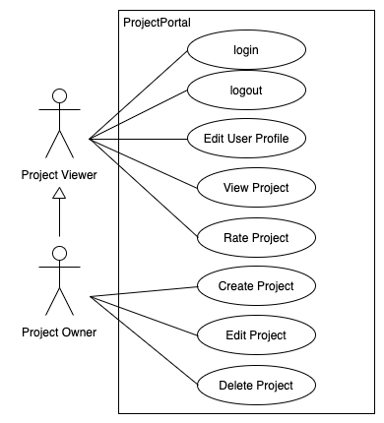
Inheritance
Between actors

Slide 15
Use Cases vs User Stories
Use case (formulated by Ivar Jackson, Unified process): formal, complex, detailed ...
User story (coined by Kent Beck, agile): flexible, easier to understand,
Both are used to model the behavior of the system from an outside perspective, and they are used throughout the life of the system (by Kent Beck).
Functional model for high-level requirements.
http://c2.com/cgi/wiki?UserStoryAndUseCaseComparison

Slide 16
Another Example: the Blackboard System
Identify use cases and draw a use case diagram of the blackboard system described as below:
A new BU student, Bob registered the software engineering course CS673 taught by Prof. Zhang.
System admin created an account on the blackboard for Bob and enrolled him into CS673 class.
Bob can log into the blackboard and view the CS673 course site.
Prof. Zhang logged into the blackboard. She posted the syllabus on blackboard, as well as an announcement to welcome students before the first class. The announcement was automatically sent to all students through email.
Bob received the email and logged into the blackboard to check the syllabus.
Prof. Zhang posted the lecture slides and related course materials on the blackboard before the class.
Bob previewed the lecture content before the class.

Slide 17
Another Example: the Blackboard System
Prof Zhang updated some materials after the class, and also posted an assignment on the blackboard.
Prof. Zhang created a discussion forum on blackboard to facilitate students' communication.
Bob reviewed the course material. He also posted a question on a discussion forum about the use case model. His classmate Ann posted her answer to that question. Some other students also joined the discussion.
The discussion helped Bob understand the use case model. He completed the assignment and submitted it just before the deadline.
Prof. Zhang graded the students' submissions.
Bob reviewed his grade of the assignment and feedback from Prof. Zhang.
Unfortunately, he had some work schedules changed and had to drop the class.
The system admin deleted his name from the course list.
Bob cannot view the CS673 course website anymore.

Slide 18
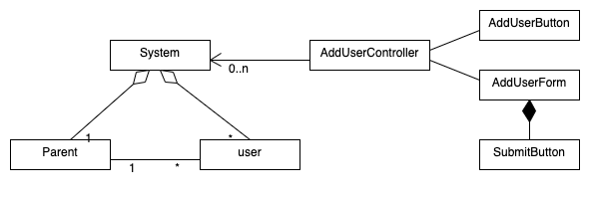
Class Diagram
Flow of Events:
Parent clicks the “Add User ” button
System displays an “Add User” form
Parent fills in the username, age and chooses a picture for the child user
Parent clicks the submit button
System displays a success or failure message.

Slide 19
Dynamic Model
State Machine Diagram:
Model GUI screen transition
Model dynamic behavior of a single object
Sequence Diagram:
Model dynamic interactions among objects (also show temporal relations)

Slide 20
State Machine Diagram
Event with parameters attr
Name of State
Action
State1
Event(attr) [condition]/action
State2
do/Activity
entry /action
Actions and Activities in State
Guard
condition
exit/action
Note:
Events are italics
Conditions are enclosed with brackets: []
Actions and activities are prefixed with a slash /

Slide 21
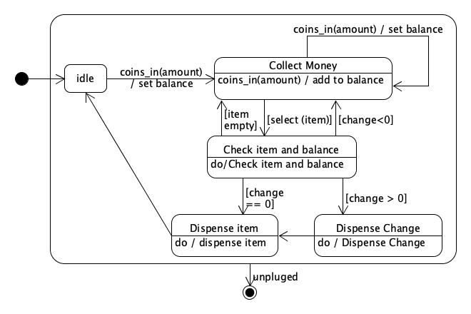
A Vender Machine Example
Initial State
Final State

Slide 22
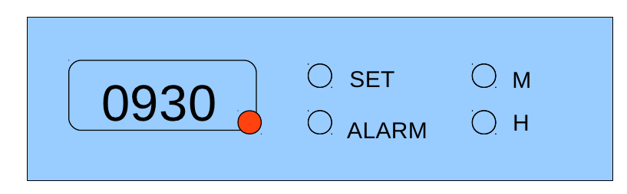
An Alarm Clock Example
Suppose we have an alarm clock as shown below. The alarm clock has a time display screen, and several buttons. To set the time, press the “set” button and then press “M” or “H” to increase the minute or hour in current display time. After done, press the “set” button again. To enable the alarm, press the “alarm” button. To disable the alarm, press the “alarm” button again. The red light on the display will blink and there will be an alarming sound when the alarm is up. It will last for one minute or press the “alarm” button to disable it. To set the alarm time, when the alarm is enabled, press the “set” button, then press “M” or “H” to increase the minute or hour. After done, press the “set” button.

Slide 23
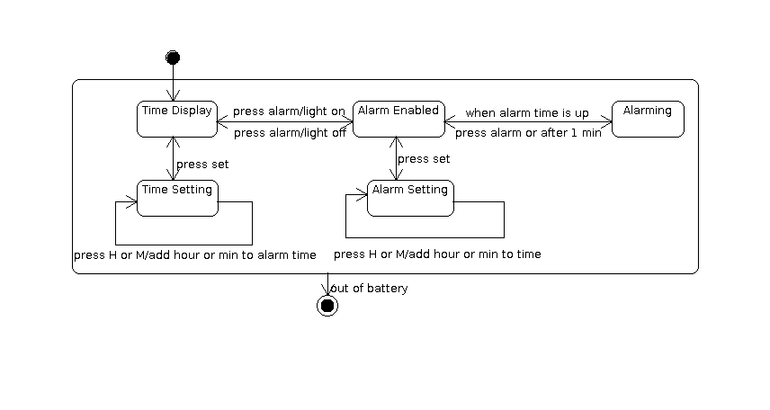
An Alarm Clock Example

Slide 24
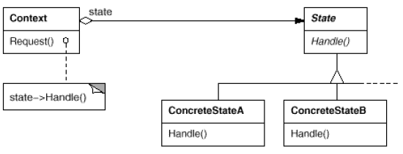
State Pattern
When you need to change the behavior of an object by changing its internal state.

Slide 25
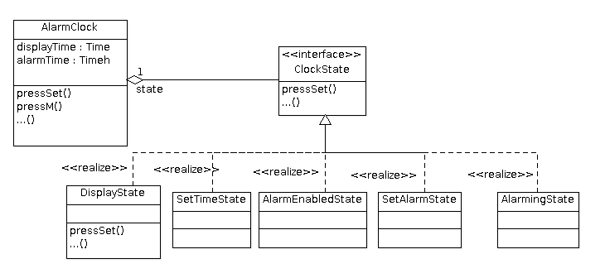
The Alarm Clock Example using State Pattern

Slide 26
Sequence Diagrams
UML sequence diagrams represent dynamic behavior in terms of the interactions between classes/objects
It may be time consuming to build, but is good to represent the complex interactions.
It complements the class diagrams (which represent static structure).
It can be used during requirement analysis
To refine use case descriptions
To find additional objects (“participating objects”)
It can also be used during software design to refine subsystem interfaces

Slide 27
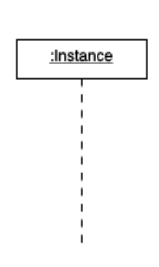
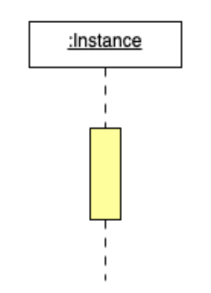
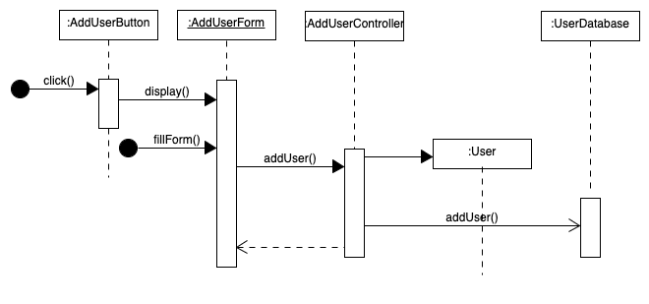

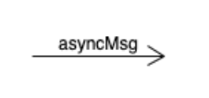


A Sequence Diagram Example

Slide 28
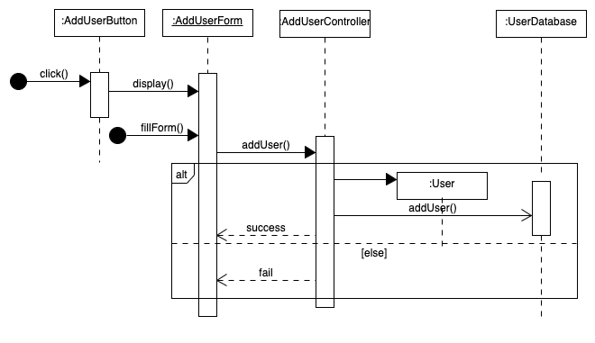
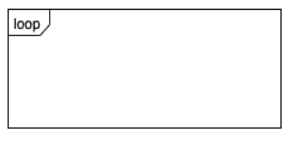
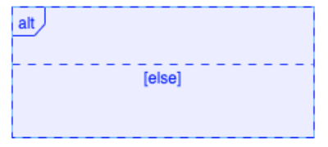
A Sequence Diagram Example

Slide 29
Questions?

Slide 30
Testing
Input determined by
Actual output compared With required output
White Box Testing
Black Box Testing
Gray Box Testing
White box
…design elements
Real Output
…requirement
Black box
Real Output

Slide 31
White Box Testing
Test all code statements
Check the use of all called objects
Verify the handling of all data structures
Verify the handling of all files
Check all paths, including both sides of all branches
Check normal termination of all loops
Check abnormal termination of all loops
Check normal termination of all recursions
Check abnormal termination of all recursions
Verify the handling of all error conditions
Check timing and synchronization
Verify all hardware/platform dependencies

Slide 32
Code Coverage
Structural Coverage
Statement coverage
Method coverage
Class coverage
Branch coverage
Condition coverage
Path coverage
...

Slide 33
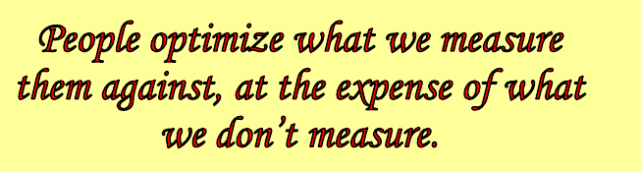
Other Testing Measurements
Feature Coverage (Functional testing)
Defect counts
Test case counts
(Cam Kaner)

Slide 34
100% Coverage != Complete Testing
Test every possible input, as well as output and intermediate variable.
Test every possible combination of inputs to every combination of variables
Test every possible path of the program
Test every possible timing of inputs
Test every possible interferences with the other programs
Test every possible configuration
…

Slide 35
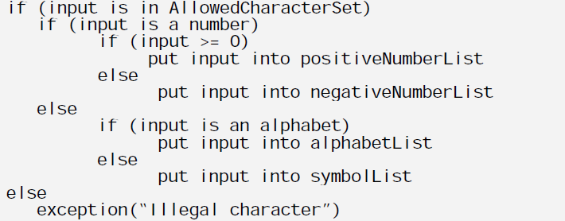
Example

Slide 36
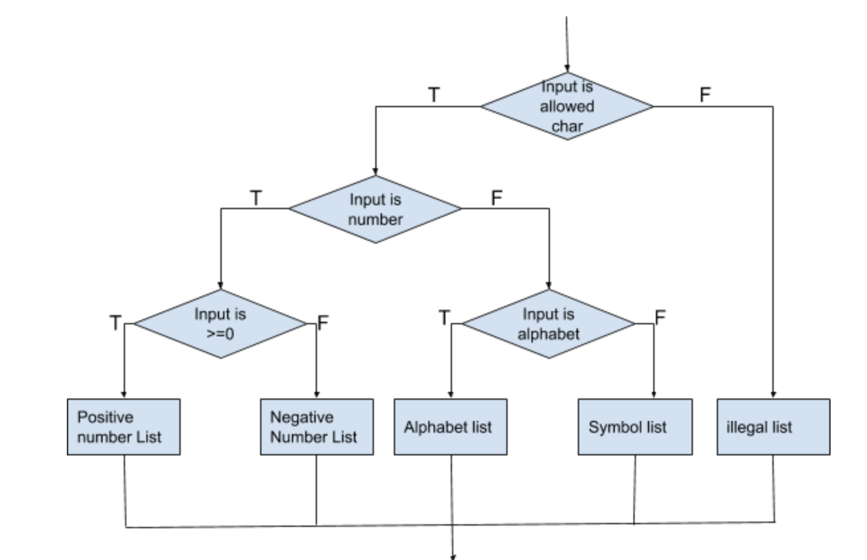
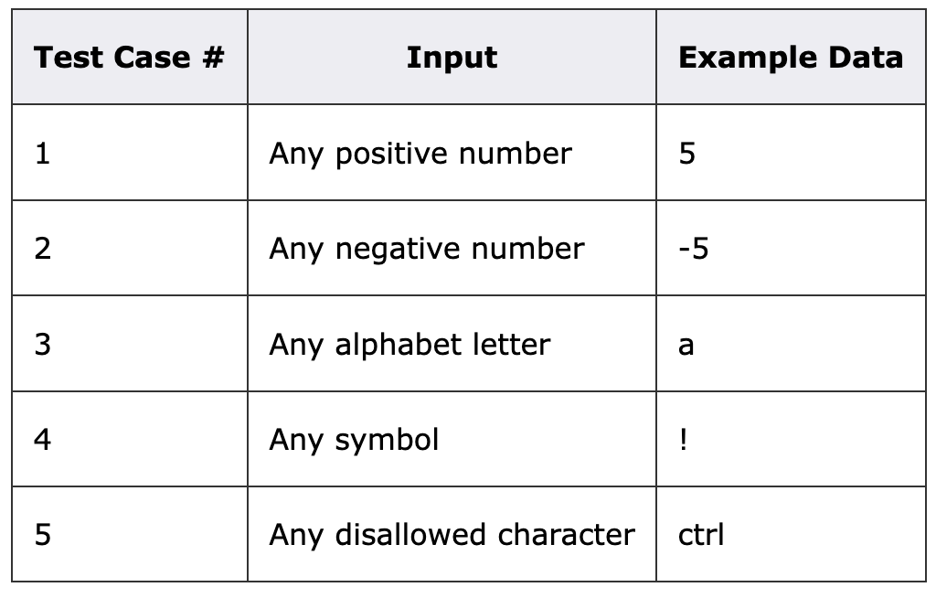
Flow Chart Diagram

Slide 37
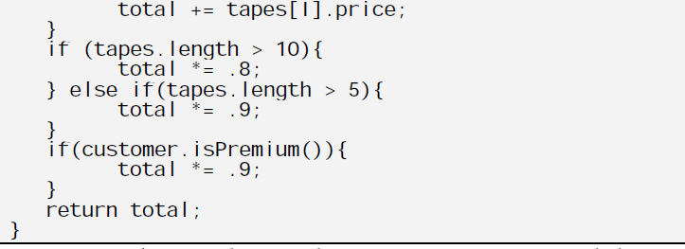
Example

Slide 38
Domain Testing
Selecting a small number of test cases from a nearly infinite group of candidate test cases using domain knowledge.
Domain: a set of values associated to a function. Includes input domain and output domain.
Reduce number of test cases using equivalence partition and representative selection
Dividing test case space into equivalence classes based on domain information
Only choose a few test cases (most representative) in each equivalence class.
Boundary case should be considered.

Slide 39
Domain Testing Steps
Identify all variables that can be analyzed. Usually we focus on the input variables, sometimes, output variables are also used sometimes.
Understand the requirements and functionality with respect to identified variables.
Identify characteristics, values, and dimensions of each variable.
A dimension of a variable is one aspect of the variable that changes.
A string variable: string length and allowed characters.

Slide 40
Example
Example: # of days in each month
Input: month, year
Output: number of days in each month.

Slide 41
Domain Testing Steps
Use equivalence partition and boundary (or best representative) case techniques to choose a small number of input values for each variable.
Divide based on the linear range or discrete sets
Invalid and valid
Based on possible risks
Boundary cases or the one that can most likely trigger the risk
Tests usually involve multiple variables. Finally, we will need to combine multiple variables.
All-pairs combination
Reference: http://testingeducation.org/a/DTD&C.pdf http://testingeducation.org/BBST/

Slide 42
Possible Risks
Invalid input value
Invalid input type (e.g. input arbitrary characters instead of numbers for integer input)
Incorrect number of inputs
Input overflow (e.g. use a too large number to overflow the integer )
Try different timing for input events to triggle possible synchronization issues.
Repeatedly executing test cases many times may cause memory leaks

Slide 43
Example
In a web-based mail system, a user has to enter his/her username and password and then click on the “Sign up” button to register an account. The user name can have five to fifteen characters. Only digits and lowercase letters are allowed for the user name. [Padmanabhan, 2003]
What variables could be involved in analysis of this group of facts? What variable do we know enough about to perform equivalence class analysis and then a boundary value analysis? Identify the relevant dimensions for this variable. Develop a series of tests by performing equivalence class analysis and boundary value analysis on each of the identified dimensions of this variable.

Slide 44
The Triangle Problem
The triangle problem is a classical problem used in software testing since 1969. The program reads three numbers as the sides of a triangle, and states whether the triangle is scalene, equilateral , or isosceles.

Slide 45
Myers' Categories
Test case for a valid scalene triangle. (e.g. 3. 4, 5)
Test case for a valid equilateral triangle (e.g. 3, 3, 3)
Three test cases for valid isosceles triangles (e.g. (3, 3, 5), (3, 4, 4), (5, 4, 5))
One, two, or three sides has zero value (5 cases)
One side has a negative
Sum of two numbers equal the third (e.g. 1, 2, 3) (a+b = c, a+c +b, b+c = a)
Sum of two numbers is less than the third (e.g. 1, 2, 4) (a+b < c, a+c < b, b+c < a)
Non-integer
Too many or too few sides

Slide 46
Types of Testing
Unit testing vs. Integration testing vs. System testing vs. Acceptance testing
Functional testing vs. nonfunctional testing
Alpha testing (internal acceptance testing) vs. Beta testing (external user acceptance testing)
Regression testing
...

Slide 47
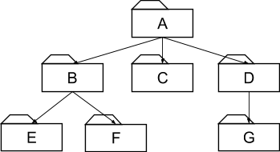
Integration Testing
Test a group of subsystems. Focus on the interactions between subsystems.
The Integration testing strategy determines the order in which the subsystems are selected for testing and integration.

Slide 48
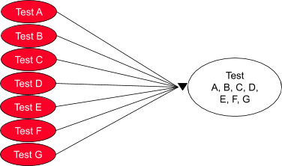
Big-Bang

Slide 49
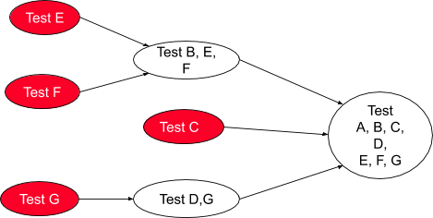
Bottom-up

Slide 50
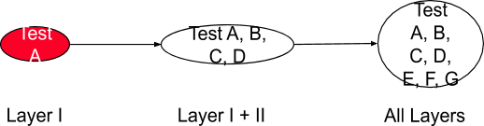
Top-down

Slide 51
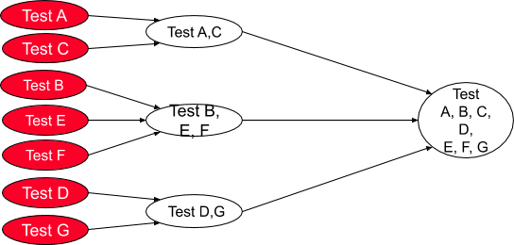
Modified Sandwich

Slide 52
Continuous Integration
Continuous build:
Build from day one
Test from day one
Integrate from day one
System is always runnable
Requires integrated tool support:
Continuous build server
Automated tests with high coverage
Tool supported refactoring
Software configuration management
Issue tracking.

Slide 53
Questions?

