Slide 1
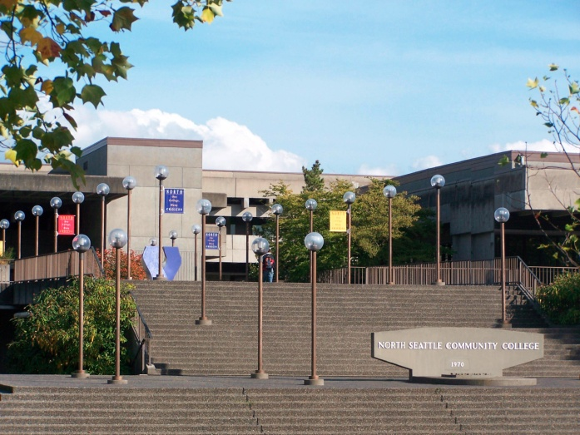
All College Meeting
North Seattle
Community College
October 6, 2010

Slide 2

North Seattle
Community College
Agenda
Opening Remarks - President Mitsui
Enrollment Update - Mary Ellen O’Keeffe & Marci Myer
Budget - Alan Ward
Roles of the Budget Planning Team, College Council and E-Team
Communication Plan - How to submit budget ideas

Slide 3
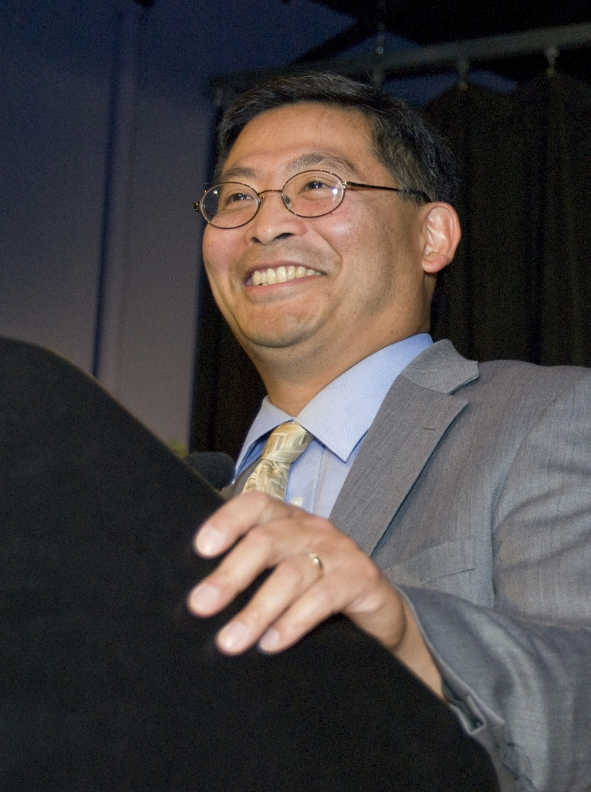
Opening Remarks
President Mitsui

Slide 4
Fall 2008 61% enrolled on 9/10 Fall 2010 86% enrolled by 9/10 Oct 5th Numbers Total headcount- 8846 Running Start-280 International - 631 Self Support- 1087 State - 6771
Enrollment Update Mary Ellen O’Keeffe
New patterns of enrollment

Slide 5
Enrollment Update … cont.
Marci Myer
 | 2010 | 2009
Admissions Applications | 6,506 | 5,949
Waiting List Transactions | 5,222 | 3,244
Advising Contacts | 8,058 | 5,983
Financial Aid Applications | 6,614 | 5,297
There were still 1,409 students on waitlists when they were shut off last week.

Slide 6
Enrollment Update … cont.
Marci Myer
Financial Aid awards for 2010-2011
Over $3.5M in Pell Grants
Over $1.2M in State Need Grants
$166,000 in State Work Study (down 31%)
$184,000 in Federal Work Study
$111,000 in Federal Supplemental Grants

Slide 7
Enrollment Update … cont.
Marci Myer
 | 2010 | 2009
Veteran Students | 208 | 162
Running Start Students | 281 | 238
International Students | 632 | 596
Self Support | 1,113 | 1,100
Our Greeter’s Program attracted 1,583 students this Fall compared to 1,090 same time last year. Thank you!

Slide 8
The Numbers Alan Ward, VP Administrative Services
Budget Presentation Fiscal Year 2010-2011

Slide 9
North Seattle Community College FY2010-2011
State Budget Reductions
Fiscal Year Began July 1, 2010
Budget Reduction of $46M or 6.5% in the community college system. (incl. 1% one-time compensation reduction)
Approximately $4.7M reductions for Seattle Community College District.
Reductions include $4M in general budget and $720K in compensation/salaries for SCCD.

Slide 10
North Seattle Community College FY2010-2011
North’s Numbers
6.5% reduction for North
General reduction of $1,015,608
Compensation reduction of $182,490
Total reduction of $1,198,098

Slide 11
North Seattle Community College FY2010-2011
North’s Numbers
Tuition Increase 7% added $1,150,105 to budget (more aggressive allocation approach)
College received additional $645,548 to cover higher cost of health benefits –Now $850 per month per person

Slide 12
Source of Funds
Operating Budget
Operating Budget Funding by Source
Permanent State funding w/o WRT, HEET |  | $ 15,725,985 |  | 54.10% | State
Tuition Funds |  | $ 8,320,104 |  | 28.62% | Tuition
Carry-forward from 09-10 |  | $ 522,141 |  | 1.80% | Tuition
Remaining Tuition Distribution 09-10 |  | $ 172,602 |  | 0.59% | Tuition
Hospital Employee Education & Training |  | $ 359,865 |  | 1.24% | State
Worker Retraining |  | $ 1,000,391 |  | 3.44% | State
International Student Revenue |  | $ 1,850,000 |  | 6.36% | Local
Running Start |  | $ 425,000 |  | 1.46% | Local
Indirect Charges |  | $ 325,000 |  | 1.12% | Local
Rolex |  | $ 200,000 |  | 0.69% | Local
ABE |  | $ 105,455 |  | 0.36% | State
El Civics |  | $ 64,249 |  | 0.22% | State
Totals |  | $ 29,070,792 |  | 100.00%

Slide 13
North Seattle Community College
FY2010-2011
How Funds Were Allocated by Unit
President’s Office $1,027,025 3.5%
Instruction $19,872,081 68.4%
Student Services $2,324,781 8.0%
Administrative Svcs. $5,049,166 17.4%
Contingency Reserve $797,739 2.7%
Totals $29,070,792 100%

Slide 14
North Seattle Community College
FY2010-2011
Budget Deficits Need Fixing
Food Services $208,000
Homewaters $179,586
Watch Technology $56,500
Cisco AATC $28,412
Cisco Instruction $14,664
Motor Pool $10,936

Slide 15
North Seattle Community College
FY2010-2011
NEW Worker Retraining Funding
Increase funding of $687,539 for Worker Retraining for North Seattle Community College.
157 additional WRT FTES for NSCC.
WRT funding may provide some flexibility in offsetting budget reductions.
WRT funding increase is currently only for 2010-11.

Slide 16
Budget Strategies
FY2010-2011
The Colleges and the District Office utilized a flat budget development model, as net reductions are projected to be minimal.
No reductions or very minimal reductions to the department budgets in FY2011.

Slide 17
Proposed District Operating Budget
2010-11
General Operations – Allocation
FY2010-11 FY2009-10*
General State: $ 60,117,258 $ 66,152,033
Worker Retraining: $ 7,287,684 $ 4,438,167
Health Insurance: $ 2,456,988 $
Tuition: $ 30,609,142 $ 26,248,560
Offset & Indirect Recoveries: $ 11,740,721 $ 13,063,321
TOTAL $112,211,793 $109,902,081
*as of 8th District Allocation – May 14, 2010

Slide 18
District Allocation 2010-2011
 | FY2010-11 | As % of Total
Central | $40,713,745 | 36.3%
North | $27,876,489 | 24.8%
South | $30,688,101 | 27.3%
SVI | $5,368,254 | 4.8%
District Office | $5,702,471 | 5.1%
DW Accounts | $1,862,734 | 1.7%
TOTAL | $112,211,793 | 100.0%

Slide 19
District Allocation 2010-2011

Slide 20
Seattle Central Community College
FY2010-2011
Central Campus Budget Process Summary
Significant budget changes for FY2011
$800K to $1.05M increase in part-time faculty budget. Some additional funding will come from new Worker Retraining money
$106K one-time STATway initiative

Slide 21
North Seattle Community College
FY2010-2011
North Campus Budget Process Summary
Significant budget changes for FY2011
Convert/fund 5 new full-time faculty positions
$100K increase contribution from International Programs to General Operating
Temporarily increase part-time faculty funding using new Worker Retraining money

Slide 22
South Seattle Community College
FY2010-2011
South Campus Budget Process Summary
Significant budget changes for FY2011
Convert/fund 3 new full-time faculty positions
Fund one new security officer position
$78K increase in part-time faculty pool
$200K reductions in apprenticeship programs

Slide 23
Seattle Vocational Institute
FY2010-2011
SVI Campus Budget Process Summary
Significant budget changes for FY2011
Conversion from clock hours to credit hours beginning Summer Quarter 2010
Conversion to slightly affect SVI student tuition

Slide 24
District Office
FY2010-2011
District Office Budget Process Summary
Significant budget changes for FY2011
$90K annual increase in Unemployment Compensation
Tentative funding approval for Human Resources’ recruiting and evaluation software

Slide 25
Budget Was Balanced- Then!!
Revenue Forecasts Didn’t Hold!
Governor Required to Order Across-the Board Budget Cuts Triggered by Budget and Accounting Act
First Trigger Since 1991 Additional 6.3% Cut ordered for Current Fiscal Year for All Agencies
Maintenance of Effort (2006) Didn’t Save Higher Education

Slide 26
Budget Information
Additional Cuts Expected for Next Biennium, Which Begins July 1, 2011
What is the NSCC Plan?
Planning for a total reduction of 10% for Current year and Next Biennium
Total Reduction of $1,740,286

Slide 27
Budget Reductions by Unit
President’s Area $61,482
Instruction $1,189,617
Student Services $139,870
Admin. Services $302,262
Contingency Reserve $47,756

Slide 28
What Is the NSCC Plan?
Formula is Simple! Need to Either Cut Costs or Increase Revenue
College Could Use Reserves This Year to Cover Cut; not a Sound Fiscal Strategy!
NSCC will do Less with Less!
The College/District is Planning for a 10% Cut

Slide 29
Ways to Balance Budget
Additional Revenue
Use of Reserves
Savings (reduce expenses)
Efficiencies (consolidate departments)
Cost Shifts (move expenses to fee budgets)
Reductions (primarily positions)

Slide 30
Fiscal Outlook
FY2011-2013
Biennium 2011-13 Outlook
Projected $3.3 billion deficit for Washington
Expected enrollment changes- may have peaked
Tuition & fee impacts on students
Pent-up demand for COLA’s

Slide 31
Fiscal Outlook
Governor’s plan to transform Washington’s budget
State budget process to be based on:
Fiscal responsibility
Is the activity an essential service?
Can the activity be eliminated or delayed?
Are there other fund sources available?
Efficiency
Are there more cost-effective and/or efficient ways?
Performance
Can the activity be the subject of a performance contract?
Can the activity be the subject of a performance incentive?

Slide 32
DW Budget Presentation
FY 2010-2011
End of Presentation
You may wake up!

