Slide 1
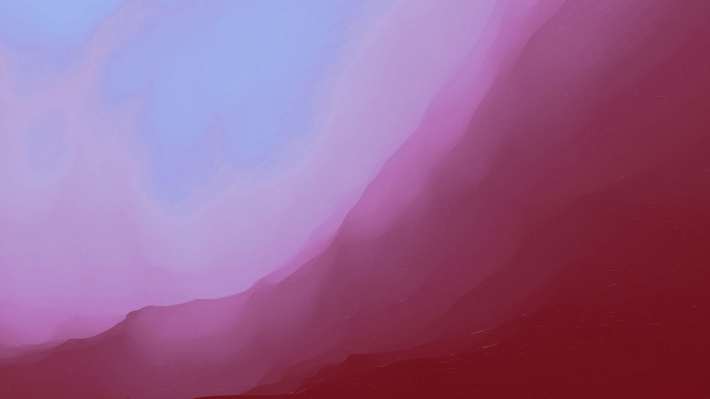
Enabling Data Diversity: Efficient Automatic Augmentation via Regularized Adversarial Training - Yunhe Gao et al.
Presented By
Mokshagna Sai Teja Karanam
Gao, Yunhe, Zhiqiang Tang, Mu Zhou, and Dimitris Metaxas. "Enabling data diversity: efficient automatic augmentation via regularized adversarial training." In International Conference on Information Processing in Medical Imaging, pp. 85-97. Cham: Springer International Publishing, 2021.

Slide 2
Motivation
In medical image analysis, a well-designed augmentation policy requires much expert knowledge and is difficult to generalize to multiple tasks due to the vast discrepancies among pixel intensities, image appearances, and object shapes in different tasks.
Data augmentation is a crucial technique for deep neural network training and model optimization
Data augmentation has proved extremely useful by increasing training data variance to alleviate overfitting and improve deep neural networks’ generalization performance.

Slide 3

How to effectively augment medical data with more diversity and less human effort?

Slide 4
Proposed Model
A regularized adversarial training framework via two min-max objectives and three differentiable augmentation models covering affine transformation, deformation, and appearance changes.

Slide 5
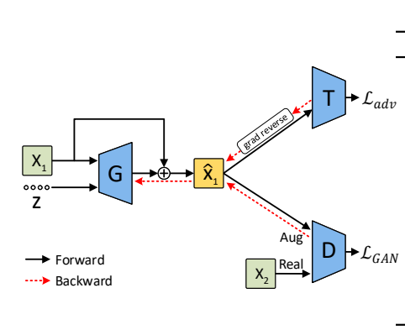
Regularized Adversarial Data Augmentation Framework

Slide 6
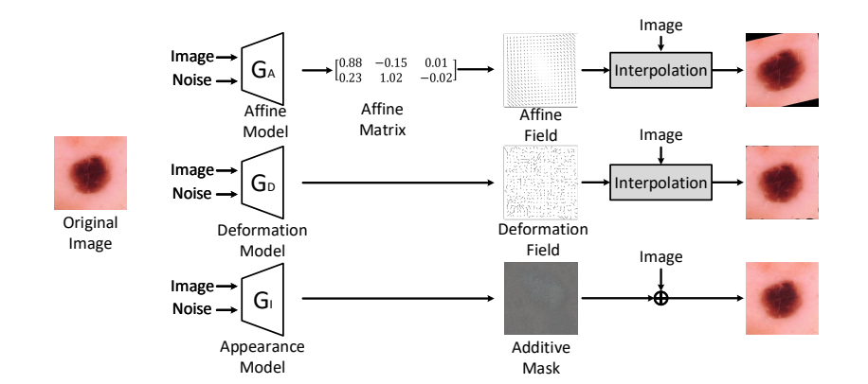
Augmentation Models

Slide 7


Affine transformation
Affine transformation is used to approximate global transformation of an image.

Slide 8


Deformation model
Deformation can characterize local geometric transformations
Obtain Deformation smoothness by adding the following regularization:

Slide 9


Appearance model
w.r.t geometric transformation appearance transformation perturbs the pixel intensity.
Appearance mask + pixel wise addition:
Regularization for constraining the magnitude is

Slide 10



Method
Vanilla supervised training with data augmentation -
As the proposed method is to use adversarial training to automate data augmentation
Not to produce excessive images so that it won't impact the model generalization on clean data

Slide 11


Method
The second adversarial objective
Using Discriminator is beneficial because small transformations may still make augmented data look fake.
Overall objective is

Slide 12
Generator Implementation
Three augmentation generators share similar architectures, which take an image and a 128-dimension Gaussian noise vector as inputs.
The image branch also outputs a feature map with the same size through 4 convolutional layers.
Gaussian noise vector is reshaped to a feature map and processed by six convolutional layers and is finally upsampled to the same size as the image.
The three generator shares a discriminator, which consists of a series of convolutional layers, BN, and LeakyReLU with slope 0.2, output with sigmoid function.
λ = 1 and γ = 0.1.

Slide 13
Datasets
Skin lesion diagnosis: 2D image classification task Used the public ISIC 2018 challenge dataset to make automated predictions of 7 categories of skin lesion within 2D dermoscopic images. The training dataset consists of 10,015 skin lesion images with a fix size of 450 × 600 pixels.
Organ-at-risk (OAR) segmentation: 3D image segmentation Task Used OARs dataset in MICCAI 2015 challenge to segment 9 OARs in head-and-neck region from 3D CT images. It consists of 38 CT scans for training and 10 scans for testing.

Slide 14
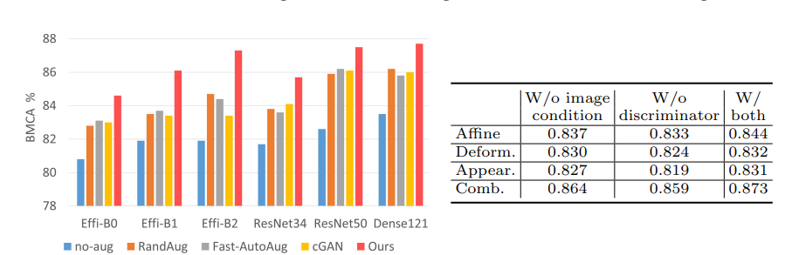
Result – Skin Lesion Diagnosis

Slide 15
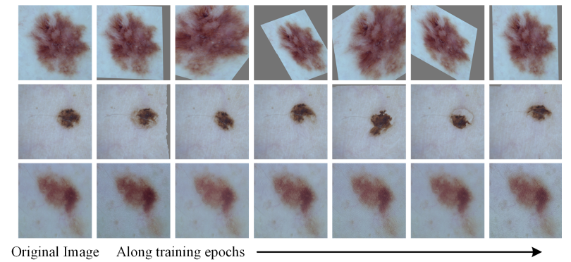
Augmented skin lesion images

Slide 16
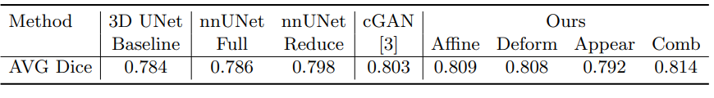
Result – OAR Segmentation

Slide 17
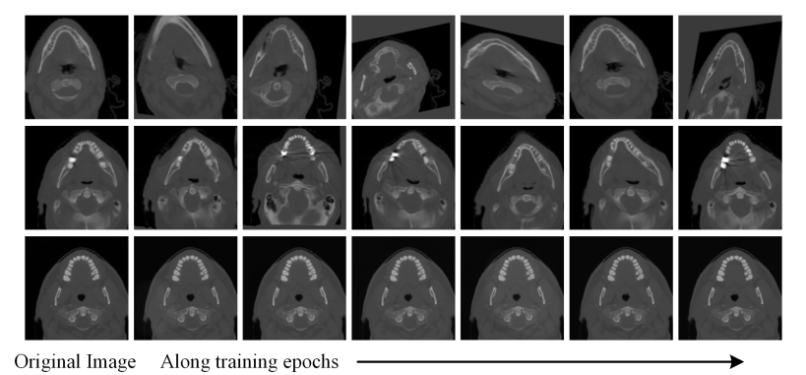
Augmented Images - OAR

Slide 18

Thank you

