Slide 1

HYBRID SUMMARIZER FOR BANGLA DOCUMENT
Ahsanullah University of Science and Technology
Department of Computer Science and Engineering
HYBRID SUMMARIZER FOR BANGLA DOCUMENTS
Course No. : CSE 4100
Course Title : Project and Thesis - I

Slide 2
HYBRID SUMMARIZER FOR BANGLA DOCUMENT
Supervisor
Mohammad Moinul Hoque
Associate Professor, Department of CSE, AUST
Presented By
Asadullahhil Galib 15.02.04.022
Mahimul Islam 15.02.04.047
Fariha Nuzhat Majumdar 15.02.04.054
Najmul Huda Auvy 13.02.04.081

Slide 3
HYBRID BANGLA TEXT SUMMARIZATION
Extracting important sentences from Bengali document(s)
Maximum coverage of information(s)
Must include all crucial points
Lack of summarizer for Bangla language
Huge amount of useless and redundant data
Saving reading time for big documents
Machine generated summary free from bias
What is text summarization?
Necessity

Slide 4
CATEGORIES OF TEXT SUMMARIZATION
Text Summarization
Extractive Summarization
Abstractive Summarization

Slide 5
METHODS OF AUTOMETIC TEXT SUMMARIAZATION
Automatic
Text Summarization
Generic Summarization:
Generic summary gives users the overall sense of document. It typically contains core information of the document.
Topic Centric Summarization:
The topic centric summaries are generally restricted to one topic. Topic is typically based on the key words supplied by human.

Slide 6
LITERATURE REVIEW
“Bengali Text Summarization by Sentence Extraction”
Significance on:
has discussed text summarization for single document of Bengali language signifying the impact of thematic term feature and position feature of sentences.
Document Resource
Evaluation
“Ananda Bazar Patrika”
Unigram based Recall score 0.4122
The score for LEAD baseline 0.3991

Slide 7
LITERATURE REVIEW
“A study on text summarization techniques and implement few of them for Bangla language”
Significance on:
They have put significance on sentence location, cue phrase presence, title word presence, term frequency and numerical data.
Document Resource
Evaluation
“Daily Prothom Alo”
Average accuracy 71.3%

Slide 8
LITERATURE REVIEW
“Topic-Based Bangla Opinion Summarization”
Significance on:
They have summarized Bengali documents using sentiment information.
They have tried to identify the sentiment information in a document and they aggregate that for generating summary.
Document Resource
Evaluation
“Ananda Bazar Patrika”
Precision:72.15%
Recall: 67.32%
F-score: 69.65%

Slide 9
LITERATURE REVIEW
“Automated Bangla Text Summarization by Sentence Scoring and Ranking”
Significance on:
have discussed Bengali summarization taking into consideration of several attributes. They have calculated sentences’ scores based on aspects such as frequency, sentence position, cue phrases’ presence and skeleton of document.
Document Resource
Evaluation
“The Daily Prothom Alo”
“The Daily Ittefaq”
“The Daily Jugantor”
83.57% percent of summary sentences match

Slide 10
LITERATURE REVIEW
"Automatic Bengali news documents summarization by introducing sentence frequency and clustering"
Significance on:
They have done text summarization with Bengali documents using sentence ranking and clustering.
Document Resource
Evaluation
“The Daily Prothom Alo”
“The Daily Jugantor”
Precision: 0.608
Recall: 0.664
F-score: 0.632

Slide 11
RESEARCH PROBLEM
Author | Document Resource | Evaluation | Areas we can improve
“Bengali Text Summarization by Sentence Extraction” | “Ananda Bazar Patrika” | Unigram based Recall score 0.4122 The score for LEAD baseline 0.3991 | We have a chance to increase the score of unigram based Recall and LEAD baseline.
“A study on text summarization techniques and implement few of them for Bangla language” | “Daily Prothom Alo” | Average accuracy 71.3%. | Sometime it generate some sentences in summaries which is totally different from human generated summaries. We can improve here.
Amitava Das and Sivaji Bandyopadhyay | “Ananda Bazar Patrika” | Precision:72.15%, Recall: 67.32%, F-score: 69.65% | Main problem is “subjectivity” and we have a chance to improve this area.
Md. Iftekharul Alam Efat, Mohammad Ibrahim, Humayun Kayesh | “The Daily Prothom Alo”, “The Daily Ittefaq”, “The Daily Jugantor” | 83.57% percent of summary sentences match
Md. Majharul Haque, Suraiya Pervin and Zerina Begum | “The Daily Prothom Alo” and “The Daily Jugantor” | Precision: 0.608 Recall: 0.664 F-score: 0.632

Slide 12
PROPOSED MODEL
Why hybrid?
Keyword Ranking
Sentiment Scoring
Text Ranking
Weight1
Weight2
Weight3
Processing
Generated Output

Slide 13
PROPOSED MODEL
We will add weight to each of them and the final ranking will be based on the combination of the three.
SS*W1+KR*W2+TR*W3 = Final Score of a sentence
W1 = A percentage of the total sentiment score
W2 = A percentage of the total keyword score
W3 = A percentage of the total text ranked score

Slide 14
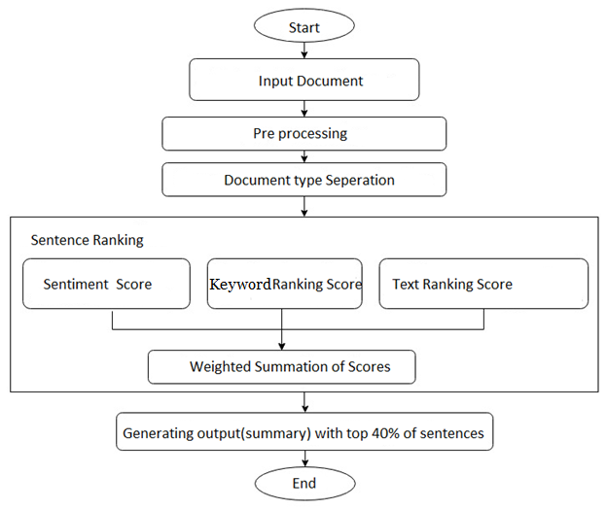
DEATAILED ANALYSIS OF PROPOSED MODEL
1
Input Document
2
Preprocessing
3
Document type separation
4
Sentence Ranking
5
General Output Summary

Slide 15
DATASET
All the datasets on different categories are collected from renowned Bengali newspaper “Daily Prothom Alo”
News Category | Number of documents
Politics | 100
Economic | 100
Entertainment | 100
Accidents | 100
The summaries we are considering as the gold summaries are created by random people.

Slide 16
EVALUATION MEASURE
Evaluation Measures
Intrinsic Measures
Extrinsic Measures

Slide 17
EVALUATION MEASURE
Intrinsic Measures
Text Quality Evaluation
1
Content Evaluation
2

Slide 18
EVALUATION MEASURE
Content Evaluation
Co-selection
Content Based
1
Precision
Recall
F-score
1
Cosine similarity
Rouge
2
2
3

Slide 19
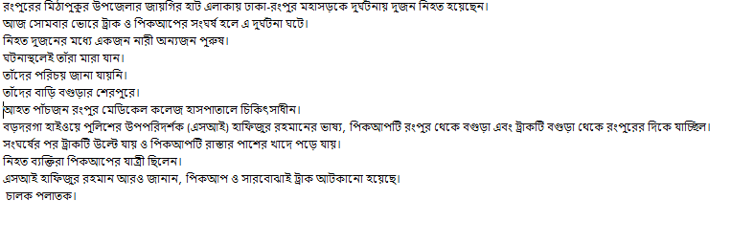
Scoring Of Sentence
Here we are calculating the total value of the sentence based on the Keyword.
Actual news:
নিহত দুজনের মধ্যে একজন নারী অন্যজন পুরুষ।

Slide 20


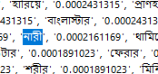
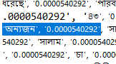

HOW TO MEASURE
নিহত দুজনের মধ্যে একজন নারী অন্যজন পুরুষ।
Score Calculation:
Value of নিহত : 0.0026474323
Value of দুজনের : 0.0001080585
Value of একজন : 0.0007293946
Value of নারী : 0.0002161169
Value of অন্যজন : 0.0000540292
Value of মধ্যে , and পুরুষ : 0 (as these are included stop words)
Calculate the total value of the sentence
= 0.0026474323 + 0.0001080585 + 0 + 0.0007293946 + 0.0002161169 + 0.0000540292 + 0
= 0.0037550315

Slide 21
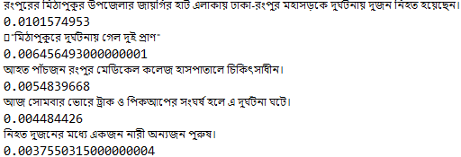
HOW TO MEASURE
Value we have measured by our proposed model: 0.003755031500000004

Slide 22
EVALUATION MEASURE
Precision
ROUGE precision = No. of overlapping words / No. of words in the gold summary
ROUGE recall = No. of overlapping words / No. of words in the generated summary
F-measure = 2 ・ Precision ・ Recall / (Precision + Recall)
Recall
F-measure

Slide 23
EXPERIMENTAL RESULT
We have evaluated our generated summaries based on ROUGE score.
ROUGE –Recall-Oriented Understudy for Gisting.
ROUGE-N: Overlap of N-grams between the system and reference summaries.
ROUGE-1
refers to the overlap of 1-gram (each word)
between the system and reference summaries.
ROUGE-2
refers to the overlap of bigrams between the system and reference summaries.

Slide 24
EXPERIMENTAL RESULT
We calculated ROUGE 1 and 2 precision, recall and f-measures for both experiments.
We have evaluated our generated summaries taking 50%, 30% of the total documents respectively for training purpose and 50%, 70% of the total documents for testing.

Slide 25
EXPERIMENTAL RESULT
Categories and number of documents for training and testing:
Document Category | Number of Document | Doc number for testing (1st setup) | Doc no. for training (1st setup) | Doc number for testing (2nd setup) | Doc no. for training (2nd setup)
Politics | 100 | 50 | 50 | 70 | 30
Economics | 100 | 50 | 50 | 70 | 30
Entertainment | 100 | 50 | 50 | 70 | 30
Accidents | 100 | 50 | 50 | 70 | 30
Table: Categories and number of documents for training and testing

Slide 26
EXPERIMENTAL RESULT
Average ROUGE 1 Score of the system for Category Accidents (1st Setup)
Average ROUGE 2 Score of the system for Category Accidents (1st Setup))
Scoring Criteria | Keyword Ranking | Sentiment Scoring | Hybrid Ranking
Precision | 0.66159324619780 | 0.5308688586081 | 0.6636432048409692
Recall | 0.5948583384576289 | 0.6969638888744052 | 0.6434343344940061
F- measure | 0.6188428328433 | 0.584093770072639 | 0.6455896227468243
Scoring Criteria | Keyword Ranking | Sentiment Scoring | Hybrid Ranking
Precision | 0.5722231742540784 | 0.44884034405454015 | 0.5881596980722679
Recall | 0.5240815915987505 | 0.6073102487858675 | 0.5782780150787632
F- measure | 0.5402111910222734 | 0.49609559147204263 | 0.5762013172304195
Average ROUGE 2 Score of the system for Category Accidents(2nd Setup)
Average ROUGE 1 Score of the system for Category Accidents(2nd Setup)
Scoring Criteria | Keyword Ranking | Hybrid Ranking
Precision | 0.5926772685466905 | 0.6000051543820866
Recall | 0.619459786304816 | 0.6551265832435337
F- measure | 0.5874770847809804 | 0.6094923582941807
Scoring Criteria | Keyword Ranking | Hybrid Ranking
Precision | 0.4974993361743983 | 0.5125122083496548
Recall | 0.538167823757799 | 0.5803801036788611
F- measure | 0.49857911975063585 | 0.5266610148001319

Slide 27
EXPERIMENTAL RESULT
Average ROUGE 1 Score of the system for Category Economics(1st Setup)
Average ROUGE 2 Score of the system for Category Economics(1st Setup)
Scoring Criteria | Keyword Ranking | Sentiment Scoring | Hybrid Ranking
Precision | 0.5158958850227193 | 0.46593916096094096 | 0.5080010604310806
Recall | 0.6333498618446669 | 0.6922099313227926 | 0.6511425896109441
F- measure | 0.5602144415027602 | 0.5505767996362746 | 0.5618778814685278
Scoring Criteria | Keyword Ranking | Sentiment Scoring | Hybrid Ranking
Precision | 0.43299307568916917 | 0.38064581802651803 | 0.4273061072932202
Recall | 0.5219582552686898 | 0.5568482460112641 | 0.536138659787984
F- measure | 0.4679867074582635 | 0.4473002870073573 | 0.47021385056112863
Average ROUGE 1 Score of the system for Category Economics(2nd Setup)
Average ROUGE 2 Score of the system for Category Economics(2nd Setup)
Scoring Criteria | Keyword Ranking | Hybrid Ranking
Precision | 0.5336298585788968 | 0.5326751267251951
Recall | 0.649739245675017 | 0.6661688740279508
F- Measure | 0.5787740362399783 | 0.5845232784324765
Scoring Criteria | Keyword Ranking | Hybrid Ranking
Precision | 0.4479242754683059 | 0.4492098536986767
Recall | 0.5402425956470084 | 0.5542940249600111
F- measure | 0.4850060272261207 | 0.4914846098581935

Slide 28
EXPERIMENTAL RESULT
Average ROUGE 1 Score of the system for Category Entertainment (1st Setup)
Average ROUGE 2 Score of the system for Category Entertainment(1st Setup)
Scoring Criteria | Keyword Ranking | Sentiment Scoring | Hybrid Ranking
Precision | 0.37254143591997907 | 0.42547782812667073 | 0.3881587549377135
Recall | 0.510721548840136 | 0.6347493988014965 | 0.5706118903153072
F- measure | 0.40988733141452566 | 0.4892778297312287 | 0.440273638474502
Scoring Criteria | Keyword Ranking | Sentiment Scoring | Hybrid Ranking
Precision | 0.2793706029950417 | 0.3467880510121859 | 0.30157884786903816
Recall | 0.39435941570356675 | 0.5173377672293704 | 0.4557770122576866
F- measure | 0.307743728372305 | 0.39806230371315493 | 0.34174194659747026
Average ROUGE 1 Score of the system for Category Entertainment (2nd Setup)
Average ROUGE 2 Score of the system for Category Entertainment (2nd Setup)
Scoring Criteria | Keyword Ranking | Hybrid Ranking
Precision | 0.40496363271073577 | 0.40227487147781094
Recall | 0.5302462054270292 | 0.5635128045633565
F- Measure | 0.43867803386905513 | 0.4486596627434662
Scoring Criteria | Keyword Ranking | Hybrid Ranking
Precision | 0.31361260131597263 | 0.3142145978148542
Recall | 0.4149276881097124 | 0.4451791087181594
F- measure | 0.34008329547630617 | 0.3500534007188291

Slide 29
EXPERIMENTAL RESULT
Average ROUGE 1 Score of the system for Category Politics (1st Setup)
Average ROUGE 2 Score of the system for Category Politics (1st Setup)
Scoring Criteria | Keyword Ranking | Sentiment Scoring | Hybrid Ranking
Precision | 0.6204961747307296 | 0.6123666805895343 | 0.6233005082319047
Recall | 0.6885024870149205 | 0.7502913217533412 | 0.7057532142607639
F- measure | 0.6500296248309857 | 0.670752448049582 | 0.6594222568157321
Scoring Criteria | Keyword Ranking | Sentiment Scoring | Hybrid Ranking
Precision | 0.5051028237741886 | 0.5088111654713952 | 0.5097635213096195
Recall | 0.5835665585259223 | 0.6434587210672598 | 0.6035165613339387
F- measure | 0.5384626942089759 | 0.5644897083535387 | 0.5497510995927283
Average ROUGE 1 Score of the system for Category Politics (2nd Setup)
Average ROUGE 2 Score of the system for Category Politics (2nd Setup)
Scoring Criteria | Keyword Ranking | Hybrid Ranking
Precision | 0.6145295660812783 | 0.6122365473277448
Recall | 0.6880940358989862 | 0.6996304076323496
F- Measure | 0.6461359402556486 | 0.5397443079183754
Scoring Criteria | Keyword Ranking | Hybrid Ranking
Precision | 0.5006536340512605 | 0.49954434535851644
Recall | 0.5838206284890538 | 0.5949540125026279
F- measure | 0.535740811709038 | 0.5397443079183754

Slide 30
EXPERIMENTAL RESULT
Fig: Average ROUGE 1 Scores of the system for different methods (1st Setup)

Slide 31
EXPERIMENTAL RESULT
Fig: Average ROUGE 1 Scores of the system for different methods (2nd Setup)

Slide 32
EXPERIMENTAL RESULT
Fig: Average ROUGE-2 Scores of the system for different methods (1st Setup)

Slide 33
EXPERIMENTAL RESULT
Fig: Average ROUGE-2 Scores of the system for different methods (2nd Setup)

Slide 34
OUR PROGRESS TILL NOW
Prepared Datasets for training and Testing
Split Sentences
Keyword Extraction
Classification of Documents
Score Calculation of words
Individual Scoring for Each Sentence
Sentiment Based Ranking
Hybrid Scoring

Slide 35
DIFFICULTIES ENCOUNTERED
The gold summaries are not 100 percent accurate.
Lack of resources for Bengali documents.
“PolyGlot” library is not well trained for Bengali language.
Problem in splitting sentence in “PolyGlot” library.

Slide 36
FUTURE WORKS and CONCLUTION
1
Text Ranking
2
Improving Stop Words List
3
Sentences based on headline and numerical values
4
Calculation of the accuracy of document classification

Slide 37
THANKS FOR YOUR ATTENTION
Any Suggestion?

