Slide 1
Online Job Portal
Academic Project
Tools: Servlet,JSP,HTML,CSS

Slide 2
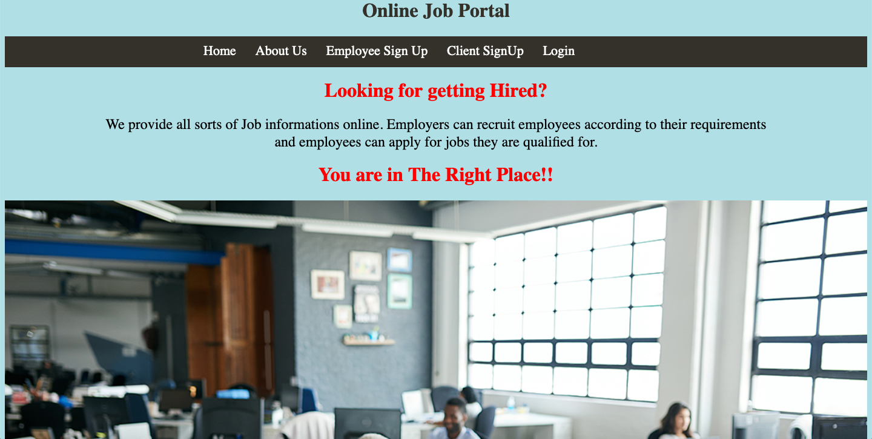
Index Page

Slide 3
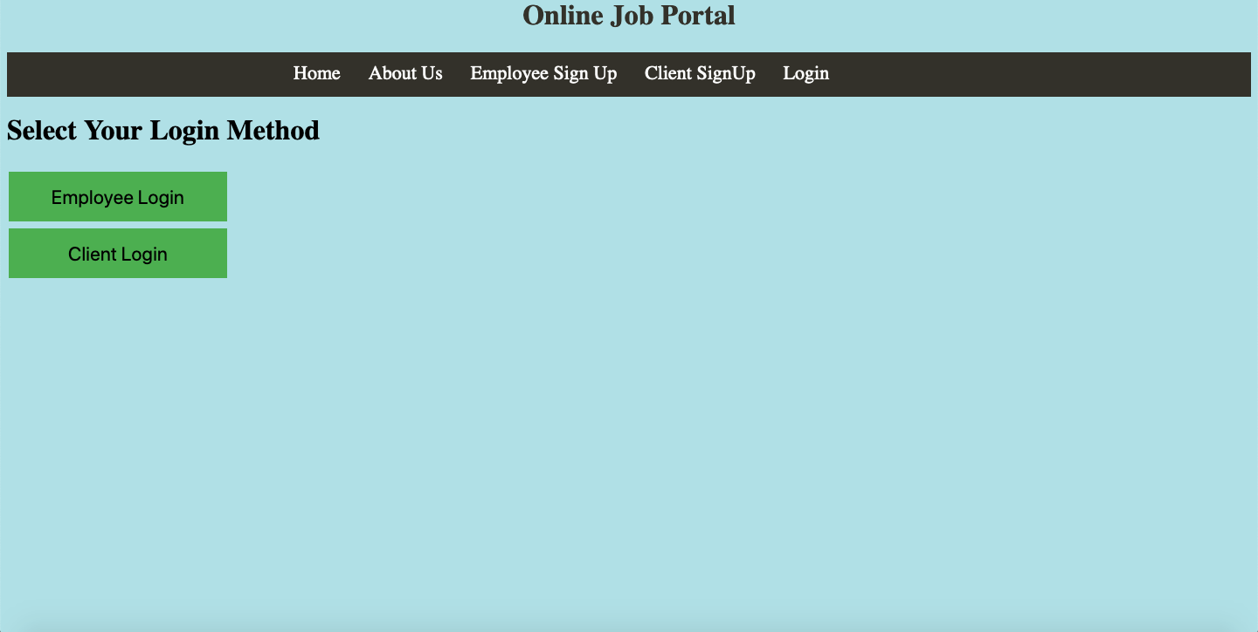
Login Screen

Slide 4
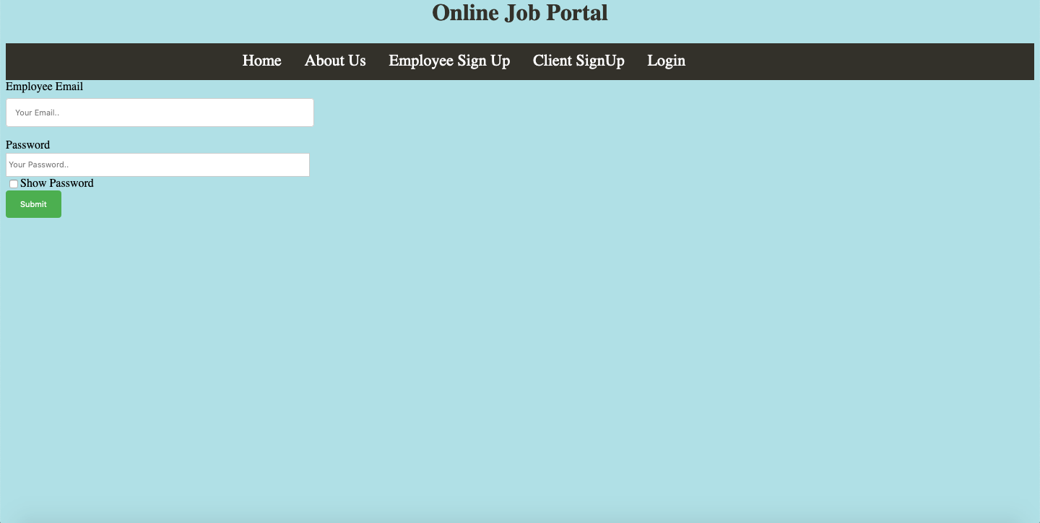
Employee Login

Slide 5
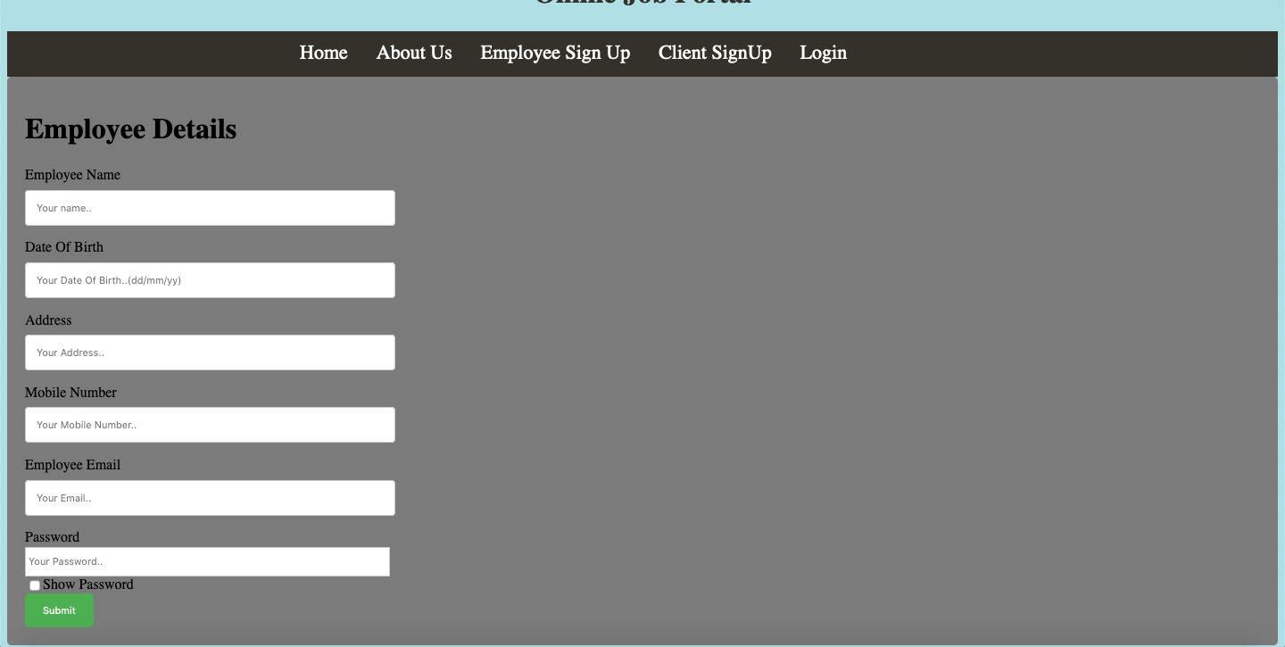
Employee Signup

Slide 6
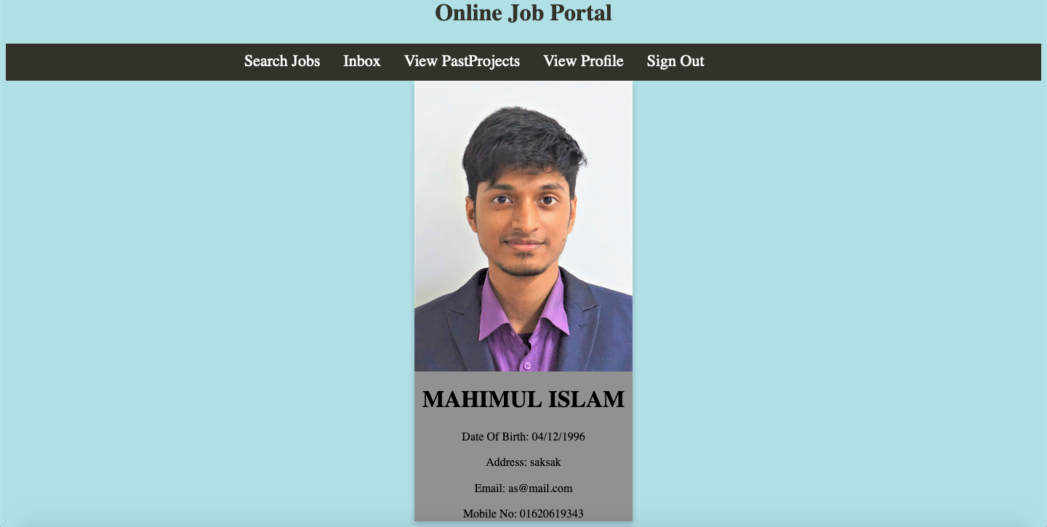
Employee Profile

Slide 7
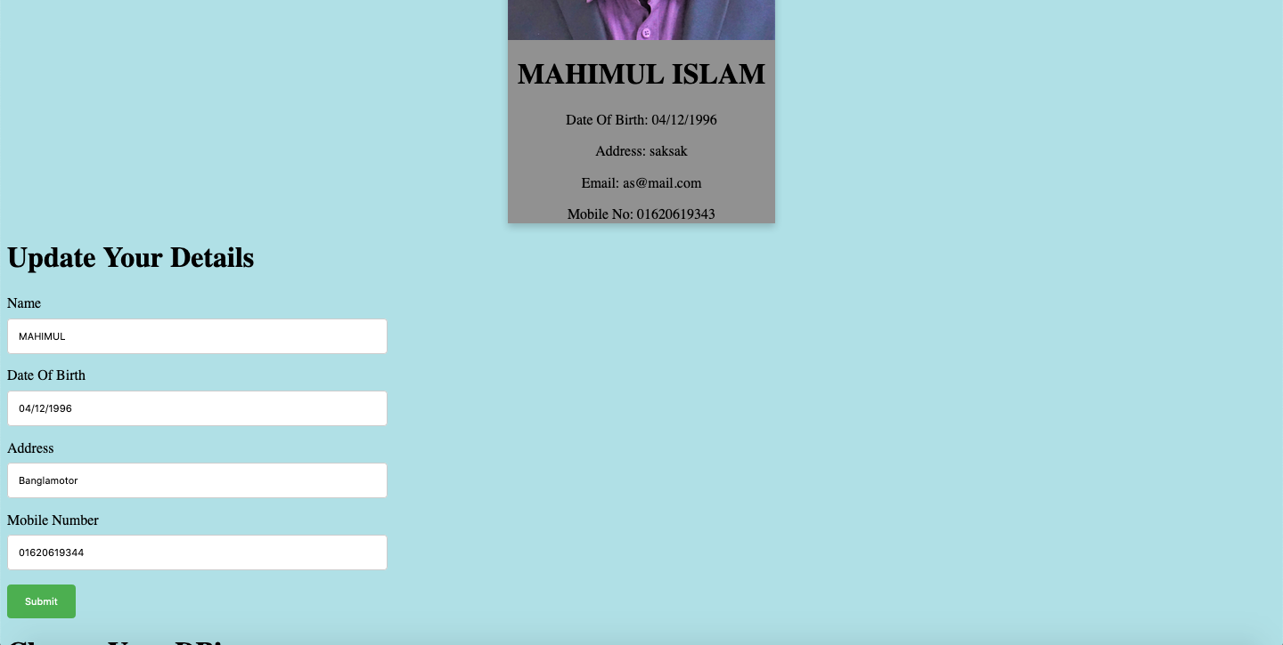
Profile Update

Slide 8
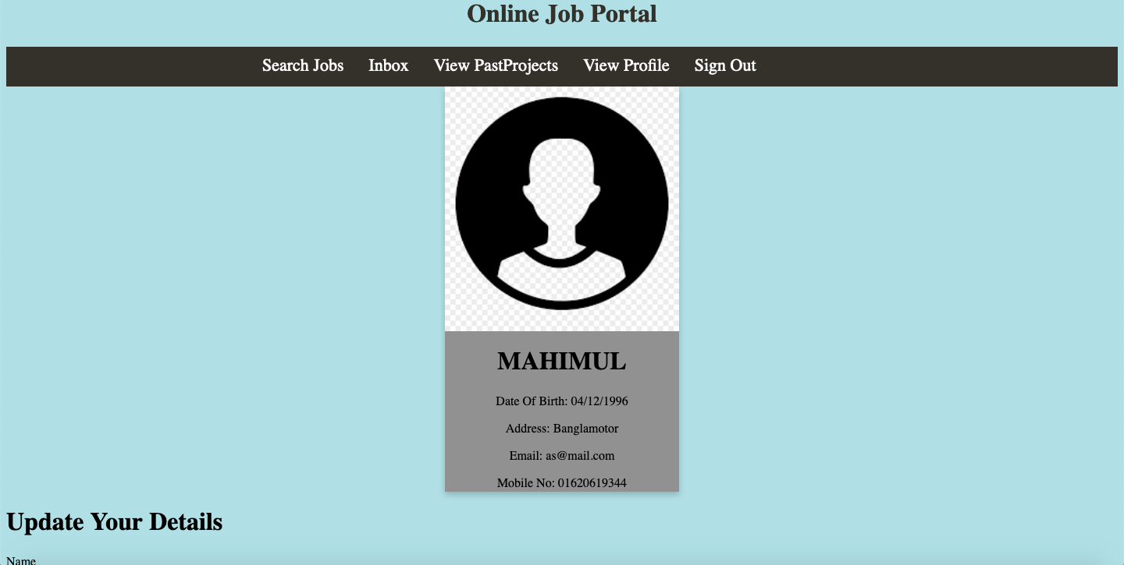
Updated Profile

Slide 9
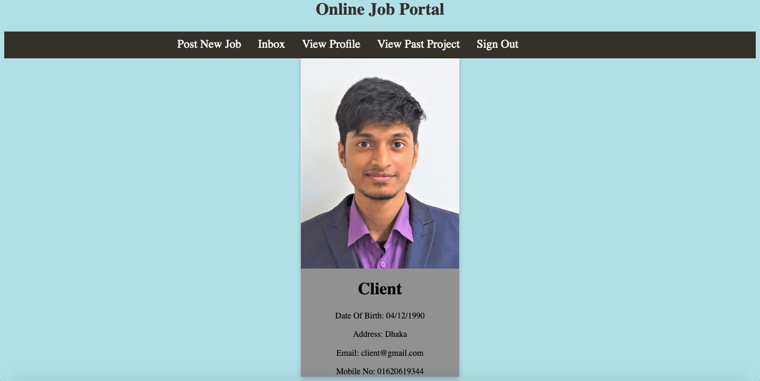
Client Profile

Slide 10
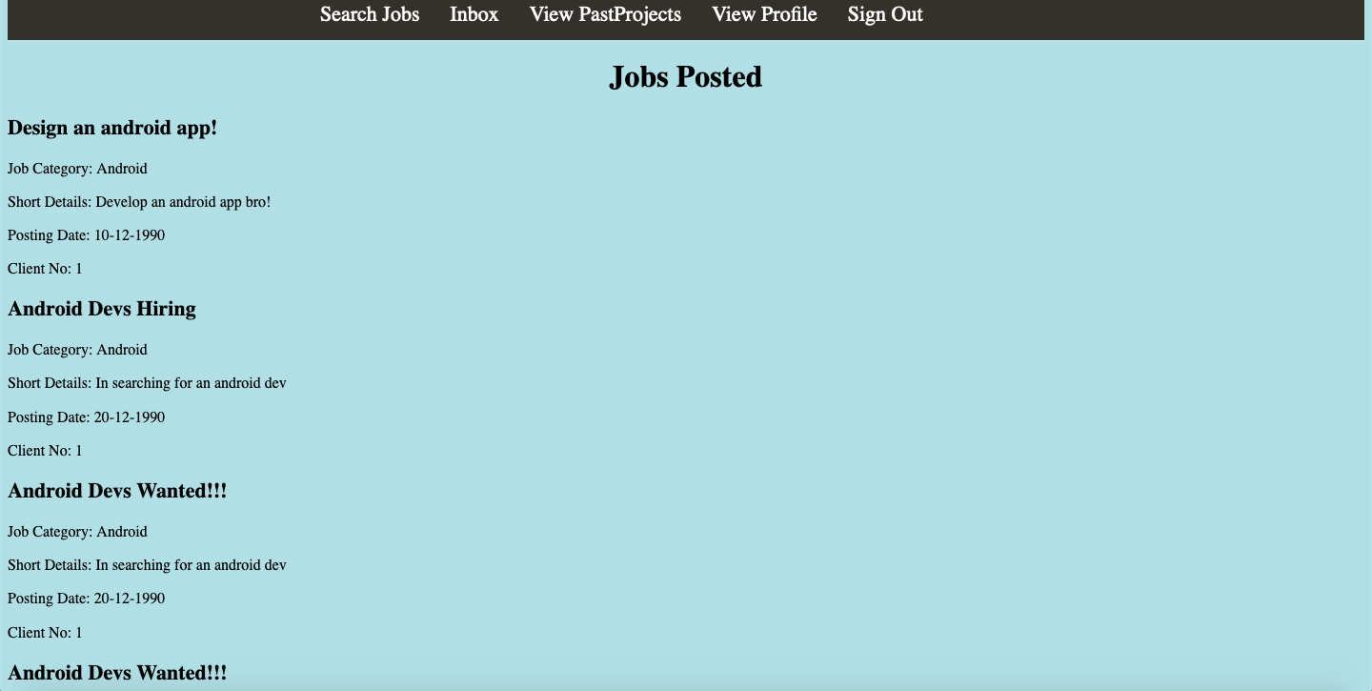
Find Jobs

Slide 11
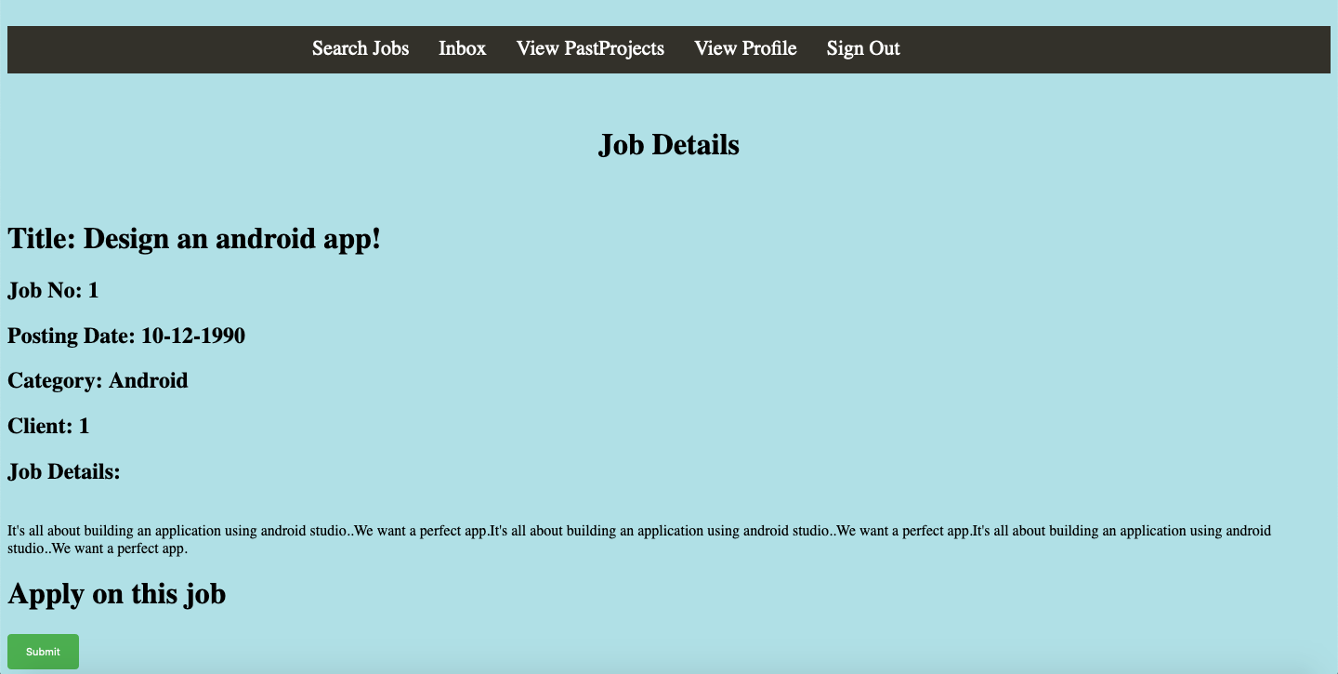
Apply Job

Slide 12
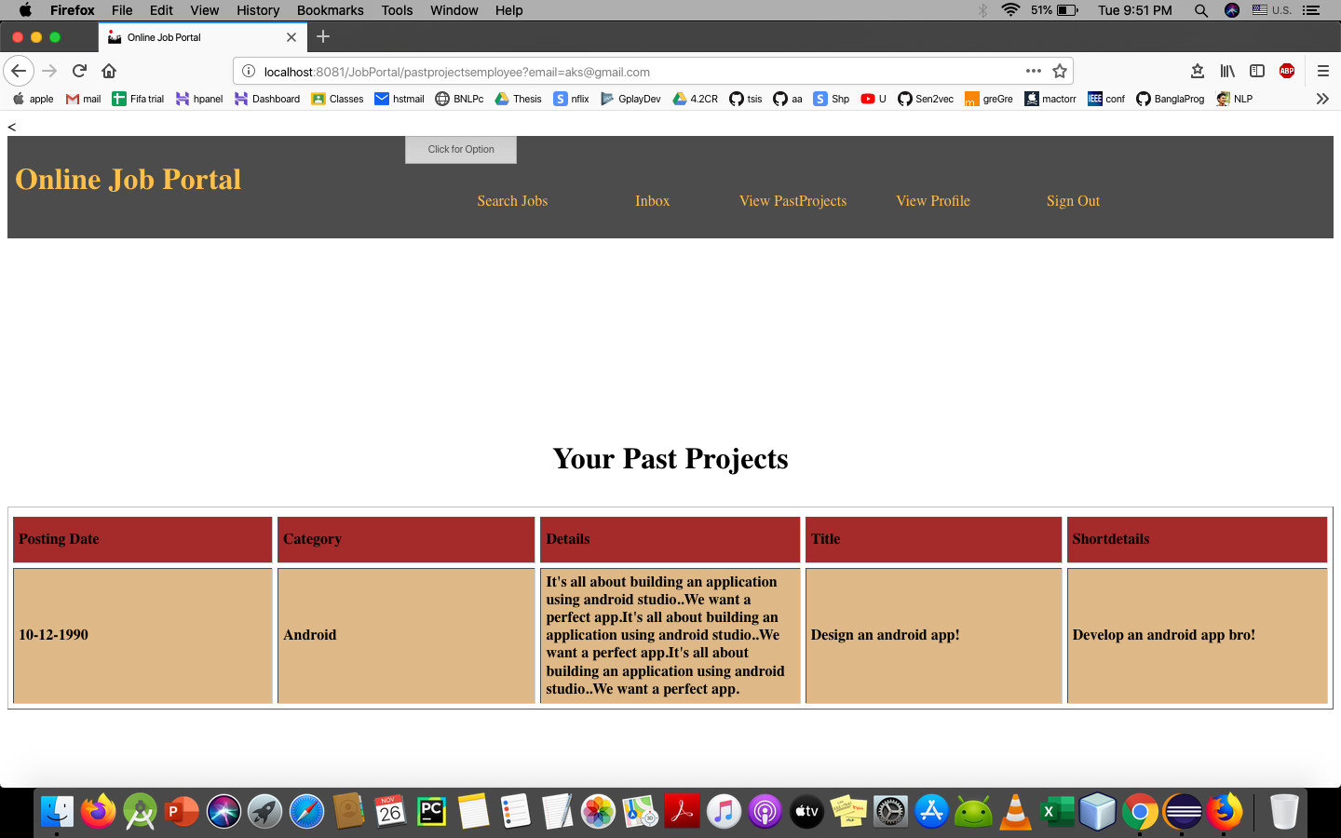
View Past Projects

Slide 13

Client Homepage

Slide 14
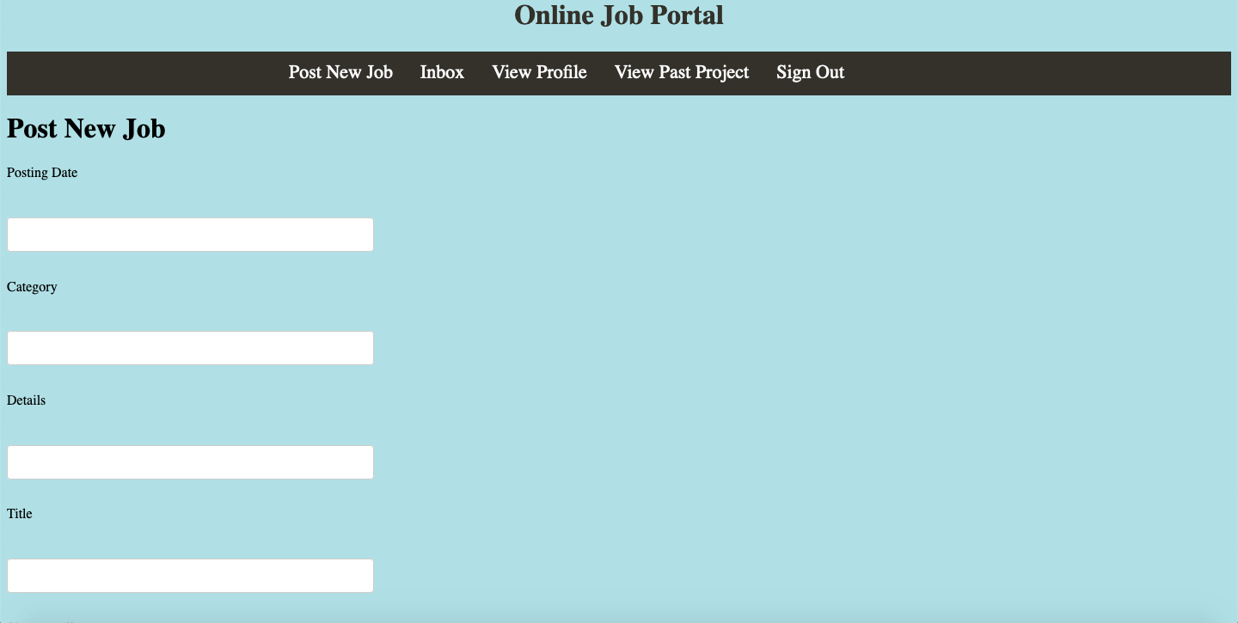
Client Post Job

