Slide 1
K – Means clustering
Implementation of the k-means clustering algorithm

Slide 2
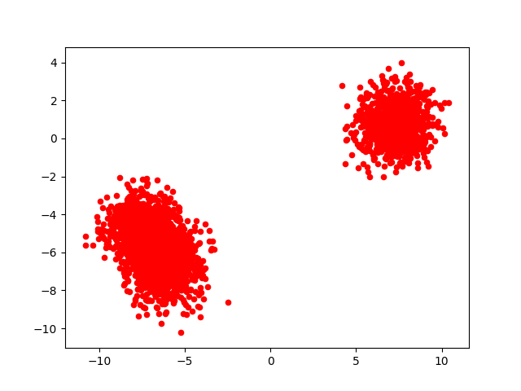
Output before clustering

Slide 3
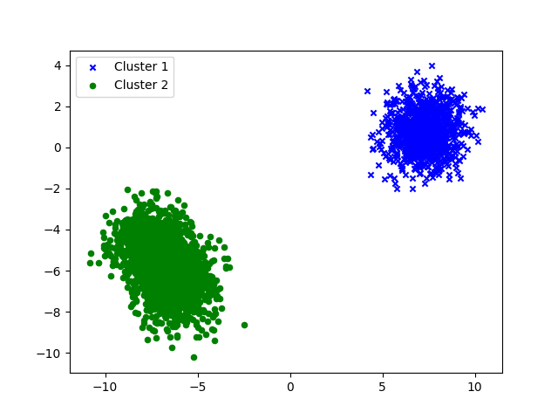
Output After Clustering

