Slide 1

Minimum Error Rate Classifier
Implementing a minimum error rate classifier for a two class problem with given data

Slide 2
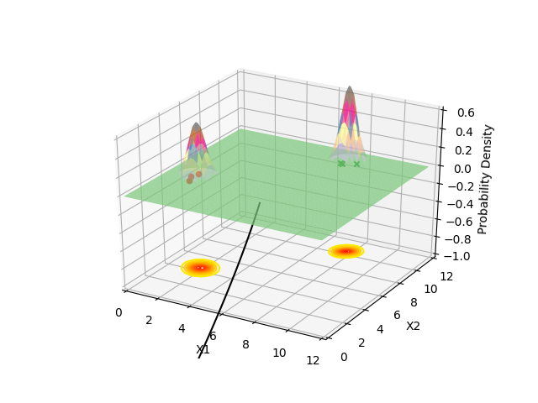
Output 1

Slide 3
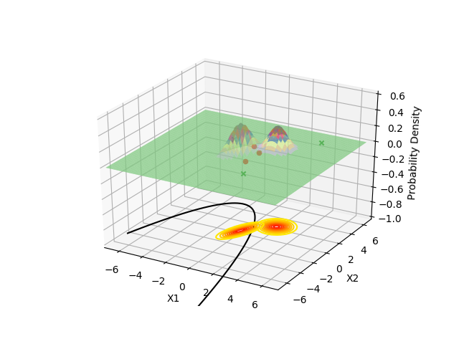
Output 2

