Slide 1
Perceptron Algorithm
“Implementing the Perceptron algorithm for finding the weights of a Linear Discriminant function.”

Slide 2
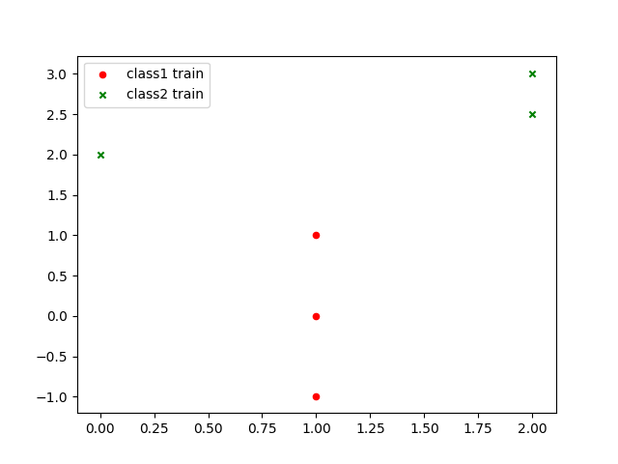
Output of Original File

Slide 3
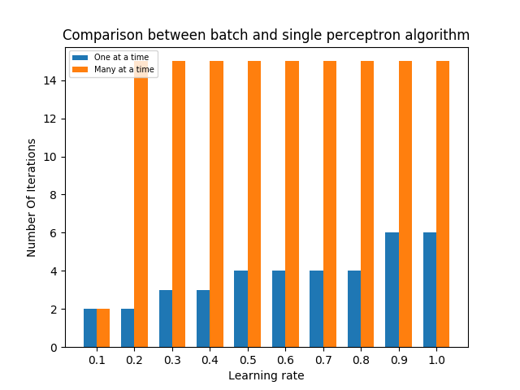
Output of Original File

Slide 4
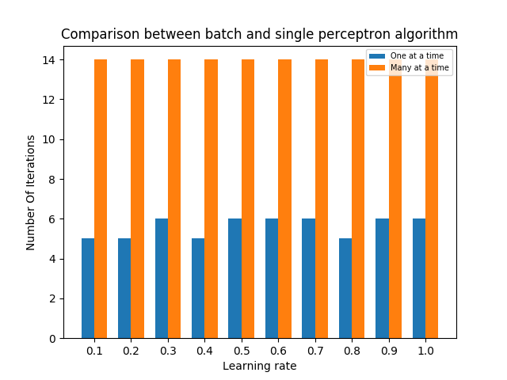
Output of Original File

Slide 5
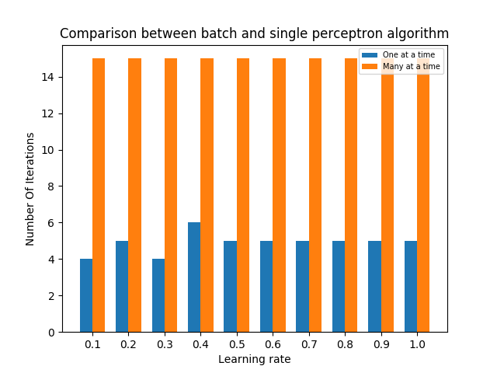
Output of Original File

Slide 6
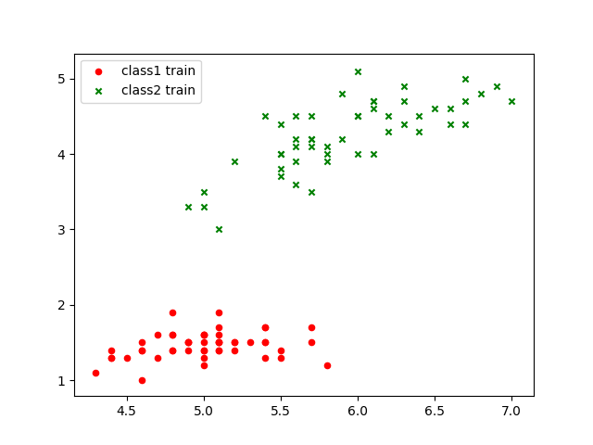
Output of Modified File

Slide 7
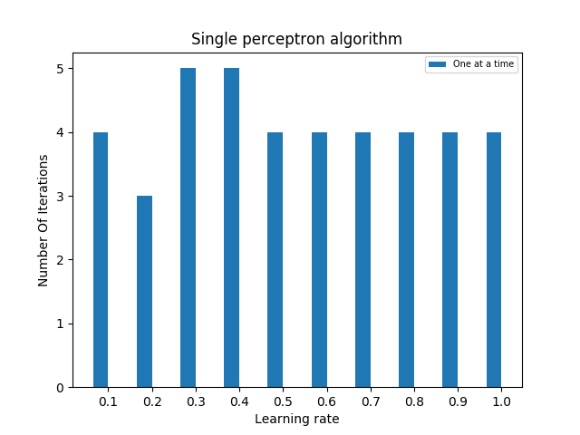
Output of Modified File

