Slide 1
Raven
A Clothing Store

Slide 2
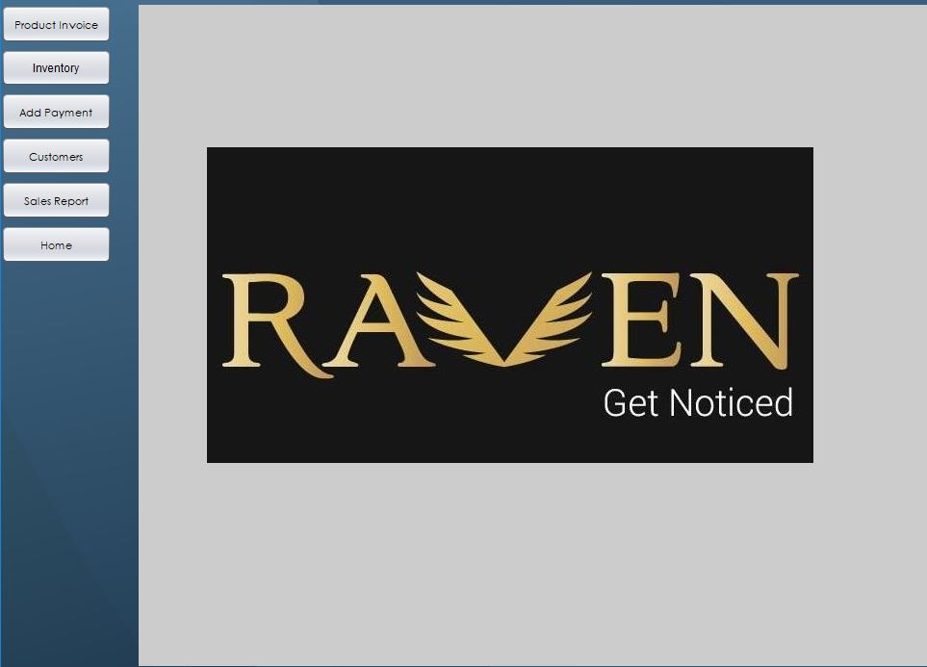
Home Page

Slide 3
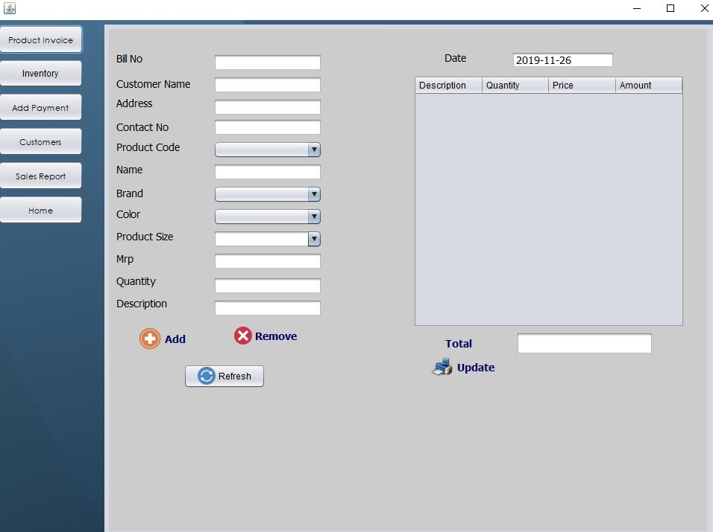
Invoice Creation

Slide 4
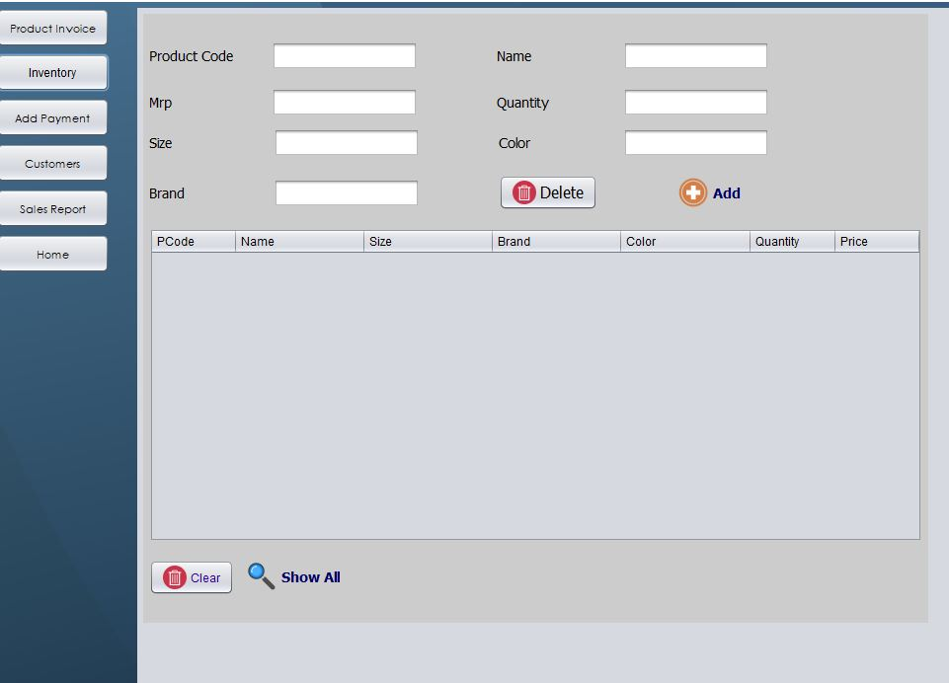
Inventory

Slide 5
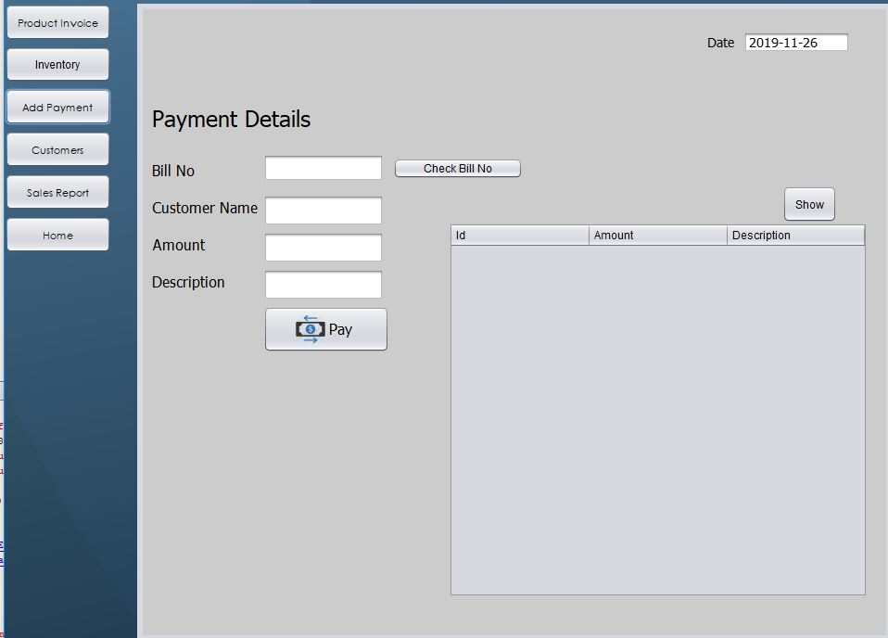
Payment Collection

Slide 6
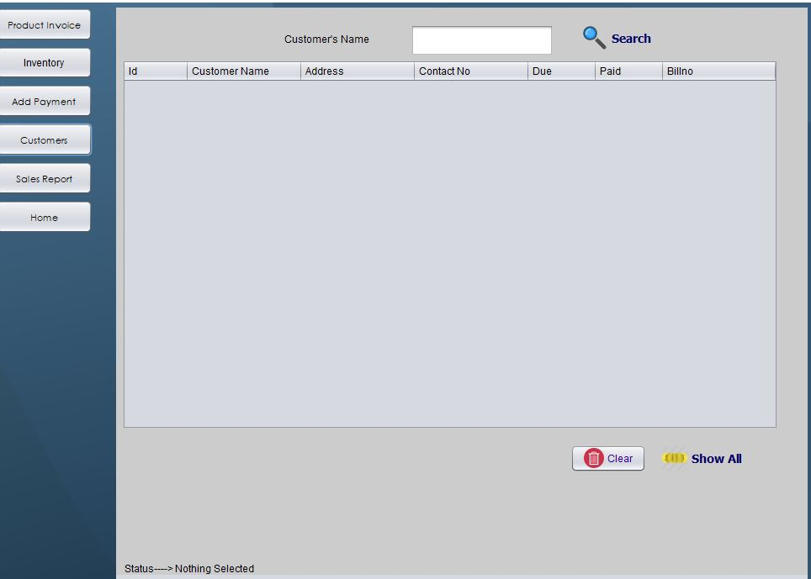
Customer Tab

Slide 7
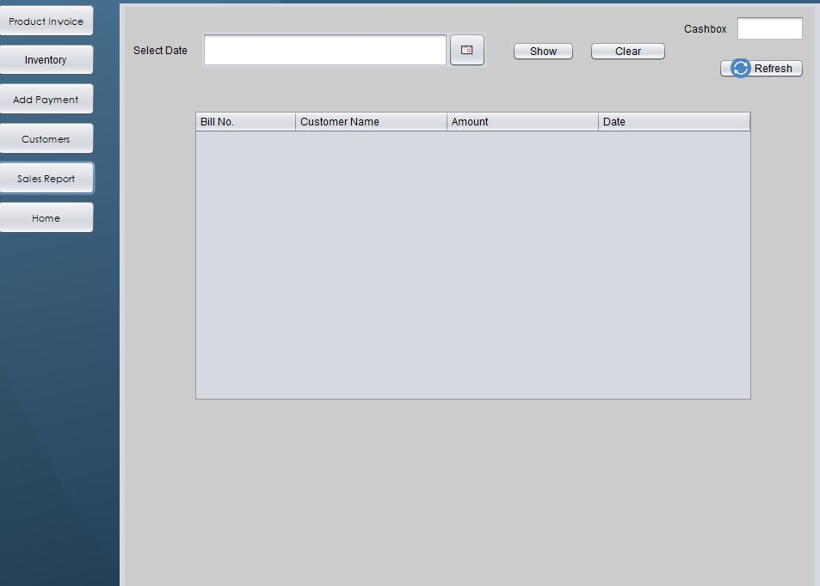
Sales Report

