Slide 1

1
Ahsanullah University Of Science And Technology
Course no: CSE 3216
Project Name : Automatic Car Parking System
Submitted By :
Shahnawaz Md Tanzib (15-02-04-035)
Mahimul Islam Akash (15-02-04-047)
Fariha Nuzhat Majumdar(15-02-04-054)

Slide 2
Overview
2
Automatic Car Parking System is a mechanical system designed to minimize the area and volume required for parking cars.
It will provide parking for cars on multiple levels stacked vertically.
We will utilize a mechanical system to transport cars to and from parking spaces.

Slide 3
Objectives
3
Automate the car parking to allow the cars into the park.
Reduce human effort and time for parking.
Creating a cost effective parking system.
Achieving multi level car parking system.

Slide 4
Requirements
4
Software Requirement
Proteus
Arduino
Arduino Uno
Servo motor
LCD
IR Sensor (TCRT5000)
Resistors
Wire
Bread board

Slide 5
Features
5
Identifying the entry or exit of the cars into/out of park.
Detecting car by disturbing IR signal.
To rotate the gate using servo motor by the microcontroller.
Closing the gate only after the car leaves.
Not opening the gate if there is no space.
Displaying number of cars and showing message if the park is completely filled.

Slide 6
Future Scopes
6
We will try to modify our project and make it 2 - floor or 3 – floor parking system.
We will use swing gates/ slide gates in our parking system.
We will try to make the opening/ closing of the gate voice controlled.
We will add the feature of surveillance in our parking system in future.

Slide 7
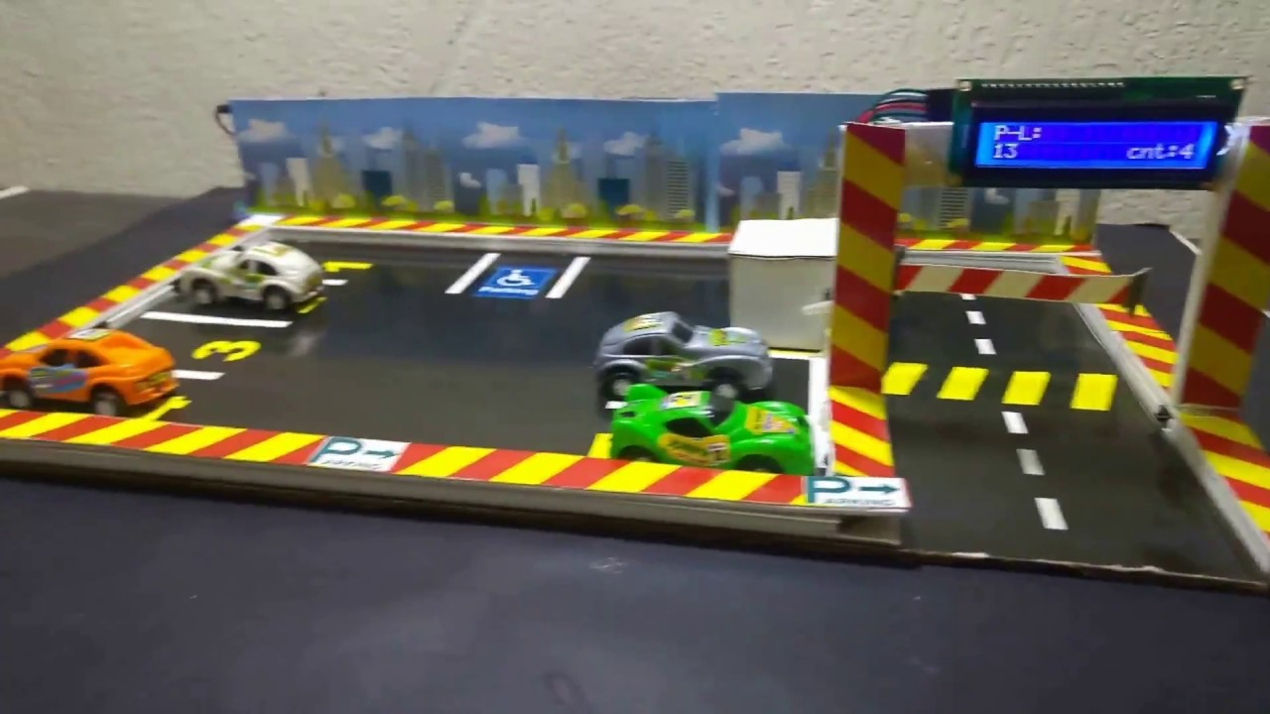
Sample Model
7

Slide 8
Conclusion
8
The whole world is facing a serious problem in managing the parking system.
People actually roam around to find a suitable place to park in.
Our project is to produce a real life solution to the car parking problem.
By creating a car parking system which is fully automated, we think we can solve this problem.

