Slide 1
Study Planner
Personal Project

Slide 2
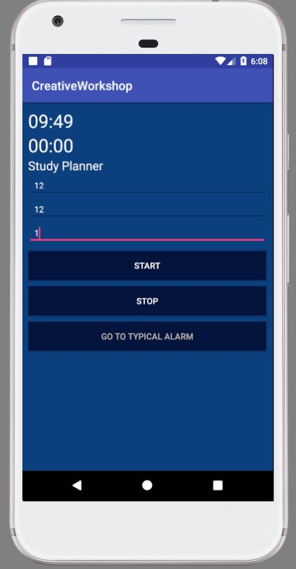
Custom Timer for Study

Slide 3
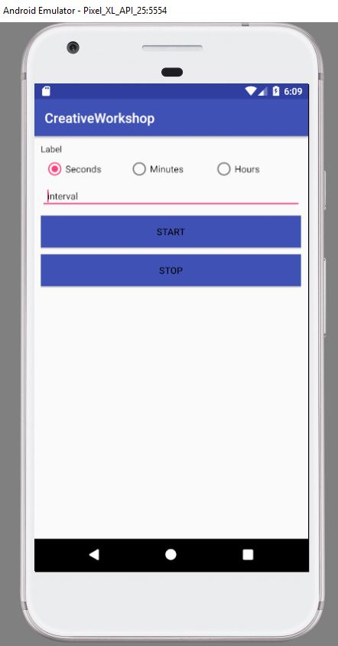
Customized Alarm

